Slide 1
Safe Water Provision in India

Slide 2
As usual…
Which of the following is a water-washed disease?
Trachoma
Leptospirosis
Acute Hepatitis A
Legionnaire’s Disease

Slide 3
As usual…
Which of the following is a water-washed disease?
Trachoma
Leptospirosis
Acute Hepatitis A
Legionnaire’s Disease

Slide 4
Sources of Water
Surface water
Rain
Rivers & streams
Impound-ing reservoirs
Tanks & ponds
Ground water
Shallow wells
Deep wells
Springs
None in India, Used in Gibralter
Mumbai, Chennai, Nagpur
Delhi, Kolkata, Allahabad, Bhopal
Some villages
Lakes
Bhopal
Sea water
Costly to desalinate
Chandi-garh
In most villages
Hilly areas

Slide 5
Quiz
Purest water in nature is from
Rains
Lakes
Ponds
Springs

Slide 6
Quiz
Purest water in nature is from
Rains
Lakes
Ponds
Springs

Slide 7
Quiz 2
While collecting water for biological testing, which of the following should NOT be done?
Using sterile container
Sealing the top with paper
Discarding the initial water from source
Cleaning the container before sample collection

Slide 8
Quiz 2
While collecting water for biological testing, which of the following should NOT be done?
Using sterile container
Sealing the top with paper
Discarding the initial water from source
Cleaning the container before sample collection

Slide 9
Concept of Safe Water
Free from pathogens
Free from harmful chemical substances
Pleasant to taste (free from bad odour or taste)
Usable for domestic purposes

Slide 10
Safe Drinking Water can have..
Improved Sources
Unimproved Sources
Piped household
Public standpipe
Borehole
Protected dugwell
Protected spring
Rainwater collection
Unprotected dug-well
Unprotected spring
Surface water (river, dam, lake, pond, stream, canal, irrigation channel)
Vendor-provided water (carts, tanker truck etc)
Bottled water*
Bottled water is not considered improved due to limitations in the potential quantity, not quality, of the water

Slide 11
Legal Commitment!
The provision of clean drinking water has been given priority in the Constitution
Article 47 conferring the duty of providing clean drinking water and improving public health standards to the State (i.e. Indian Union)

Slide 12
Indian Government norms for Water
Availability of 40 litres of safe drinking water per capita per day for rural areas, AND
At least one hand-pump / spot-source for every 250 persons

Slide 13
Quiz
Vital layer is present in
Slow sand filter
Rapid sand filter
Reverse osmosis filter
Solar distillation apparatus

Slide 14
Quiz
Vital layer is present in
Slow sand filter
Rapid sand filter
Reverse osmosis filter
Solar distillation apparatus

Slide 15
Availability of Drinking Water Resources (Census 2011)..
S No | Availability | India | Madhya Pradesh
1 | Within the Premises | 46.6% | 23.9%
2 | Near the Premises | 35.8% | 45.6%
3 | Away from the Premises | 17.6% | 30.5%
94 % of the rural population and 91 % of the people living in urban areas have access to safe drinking water
More information available at http://indiawater.gov.in/IMISReports/

Slide 16
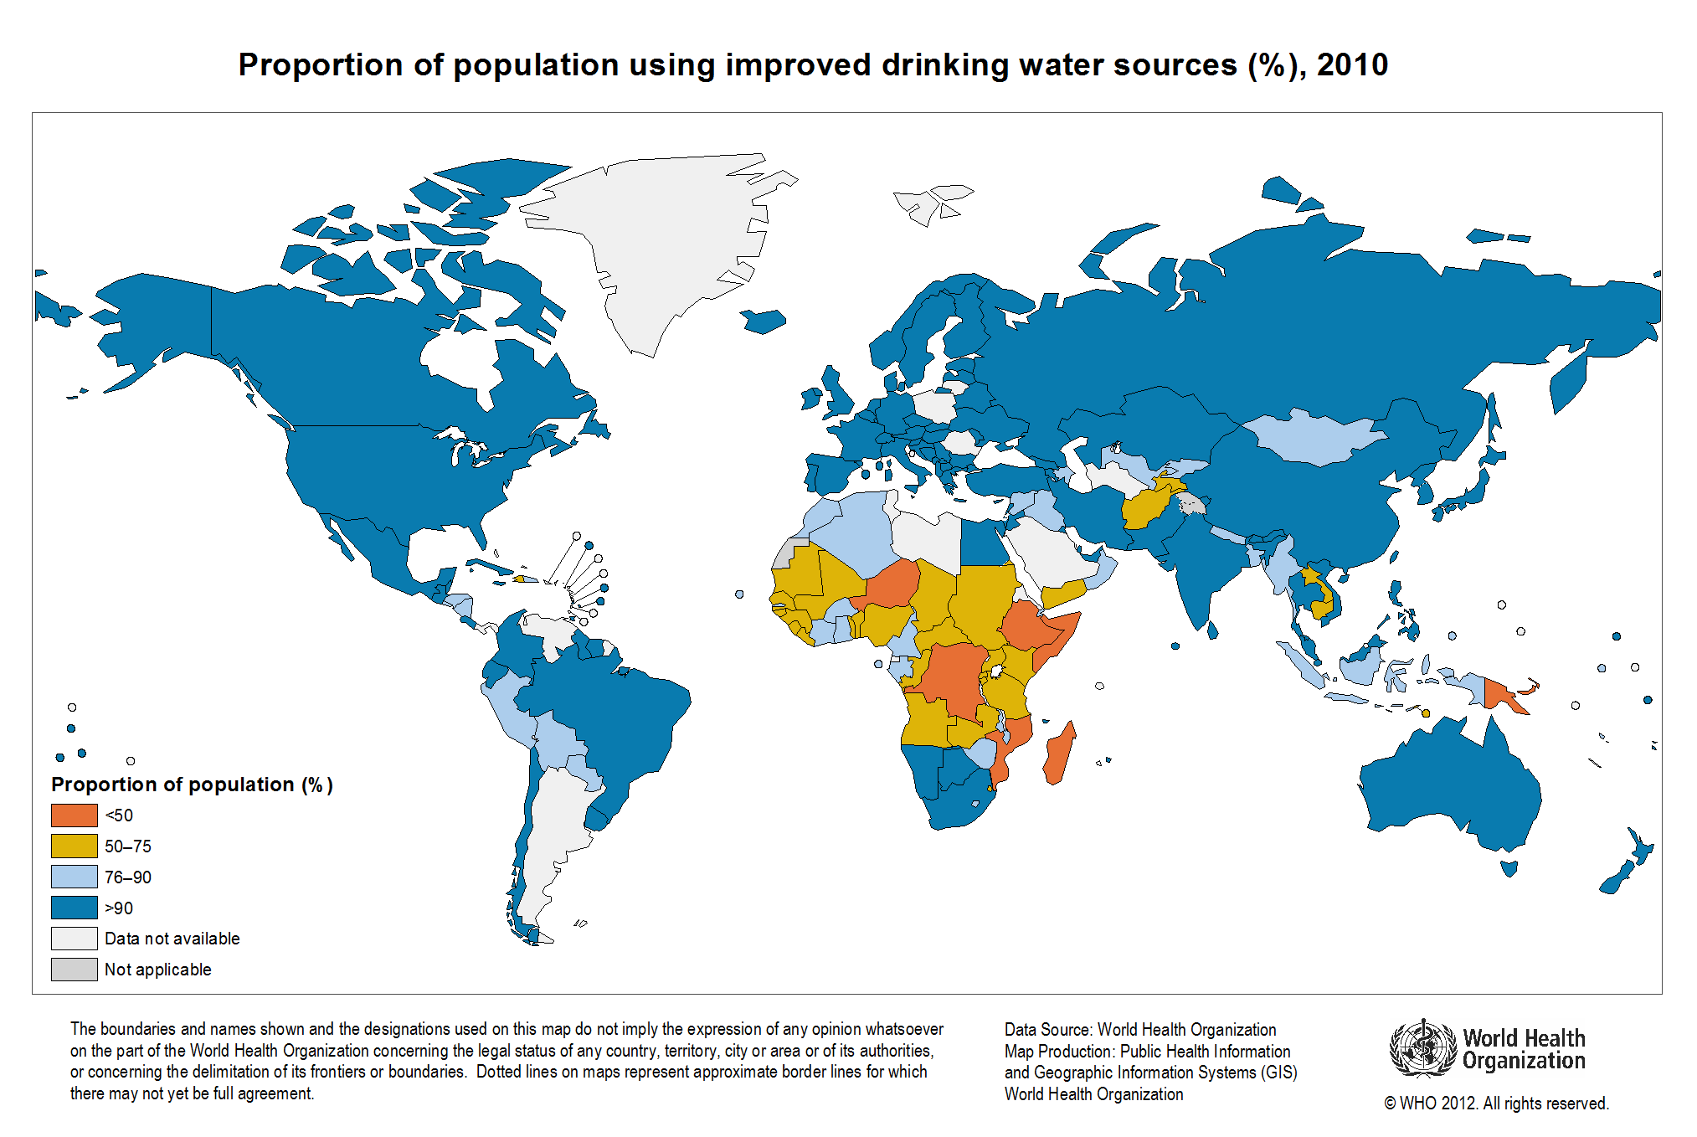

Slide 17
Miles to go before we sleep..
Fine, should we focus on problems rather than “achievements”?
Problems
Unsafe water
Unimproved water
Unpalatable water

Slide 18
Burden of Unsafe water
1.5 million children die of diarrhoea per year
37.7 million cases of waterborne diseases annually
73 million working days are lost annually
$600 million a year is economic loss annually

Slide 19
Vulnerable Populations..
The rural population
>700 million people
residing in about 1.42 million habitations
spread over 15 diverse ecological regions
Urban slums
Nomadic populations groups

Slide 20
“Problem Village”
No source of safe water available within a distance of 1.6 kilometers, OR
Water available at depth of more than 15 metres, OR
Water source has excess salinity, iron, fluorides, and other toxic elements, OR
Water exposed to risks of cholera

Slide 21
Challenges..
The major chemical parameters of concern are fluoride and arsenic
66 million Indians at risk due to excess fluoride
10 million due to excess arsenic
Iron and Nitrates are also emerging as major problems

Slide 22
Quiz
Chlorination does not affect in normal doses
HIV
Polio
Shigella
Salmonella

Slide 23
Quiz
Chlorination does not affect in normal doses
HIV
Polio
Shigella
Salmonella

Slide 24
Recall what is Safe Water?
Free from pathogens
Free from harmful chemical substances
Pleasant to taste (free from bad odour or taste)
Usable for domestic purposes

Slide 25
Safe water provision also means that….
Supply
Water is treated to make it safe
Storage
Water is stored to prevent contamination
Retrieval
Water is retrieved to keep it safe
Treatment
Availability
Accessibility
Affordability
Adequate
Improved
Community-level or at level of house
Household level
Covered/ uncovered

Slide 26
Water Treatment (Purification)
One or more of following measures
Storage leading to sedimentation
Filtration
Disinfection

Slide 27
Community-level Water Treatment

Slide 28
Storage & Sedimentation
Impounding in natural/ artificial reservoirs
To prevent further pollution
Removes larger particles
~90% of suspended impurities settle in 24 hours
Clear water allows penetration of light
UV disinfection

Slide 29
Storage & Sedimentation
Organic matter is oxidized
Free ammonia to nitrates
Reduction of pathogens
~90% of total bacterial count reduces by 5-7 days
Longer period of storage increases growth of algae
Bad odour & colour
Optimal period for river water is 10-14 days

Slide 30
Filtration
Sand-filters
Rapid (Mechanical)
Slow (Biological)

Slide 31
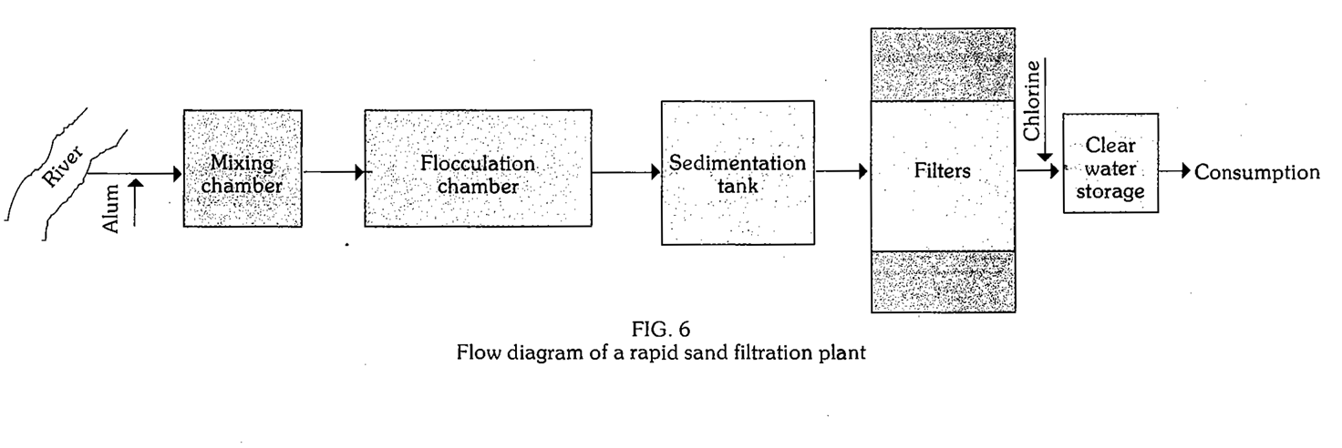
Rapid Sand Filter

Slide 32
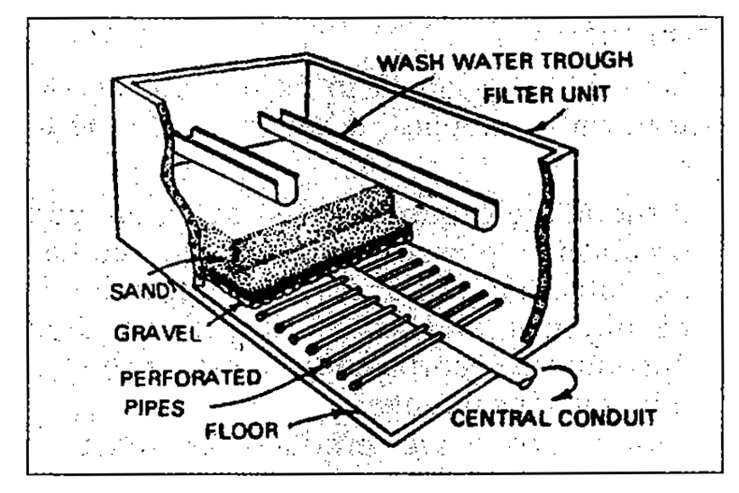
Rapid Sand Filter

Slide 33
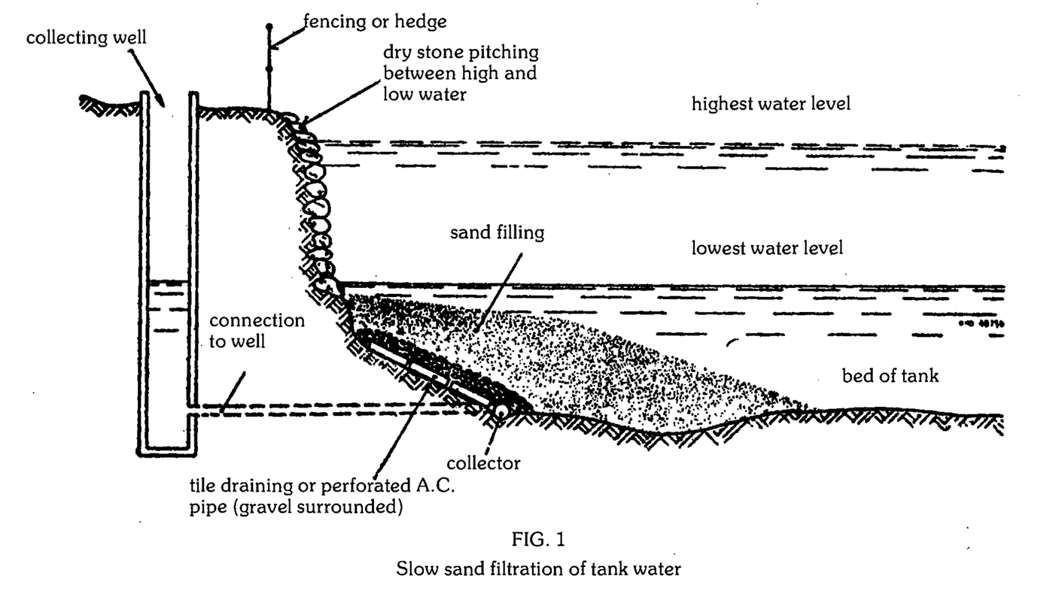
Slow Sand Filtration of Tank Water

Slide 34
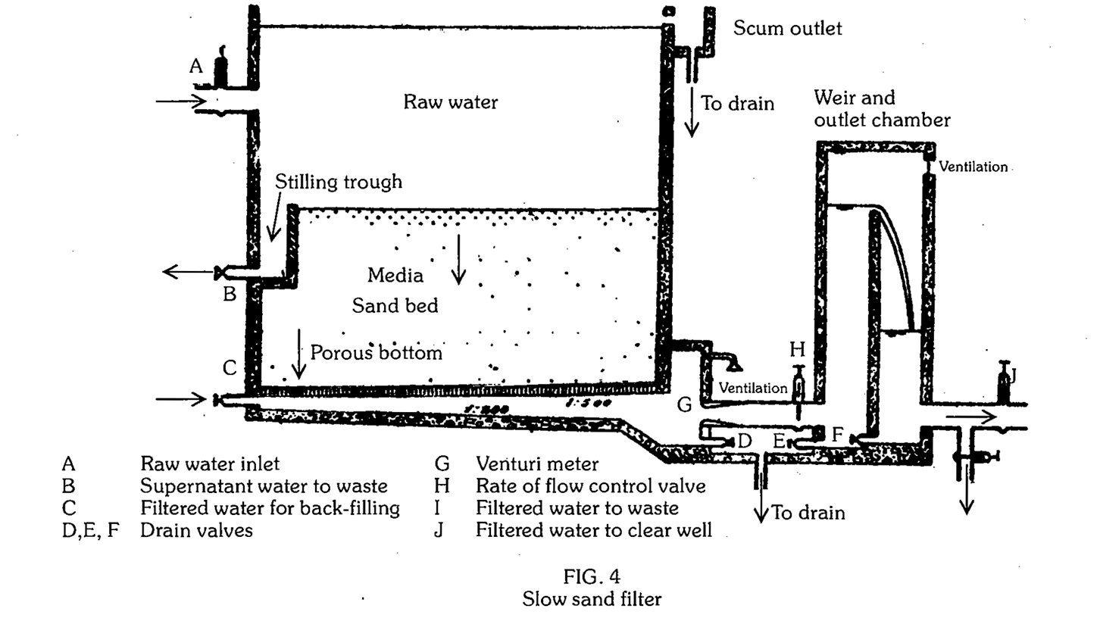
Slow Sand Filter Schematics

Slide 35
Now try to answer..
In a city grappling with reconstruction phase after torrential rain, which method would be better to provide water to its people?
Slow sand-filter
Rapid sand-filter

Slide 36
Disinfection
Doesn’t remove turbidity
Various methods
Chlorination
Solar disinfection
Ozonation
Reverse osmosis

Slide 37
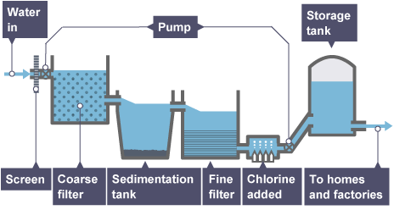
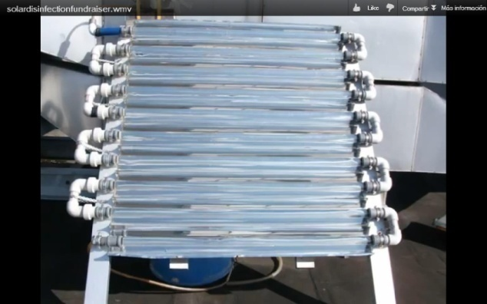
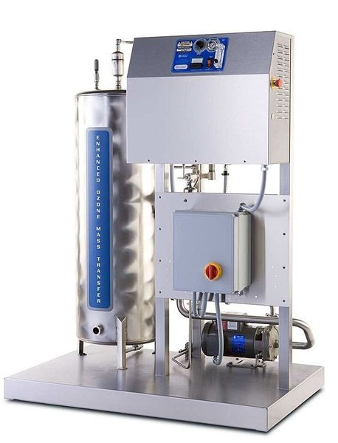
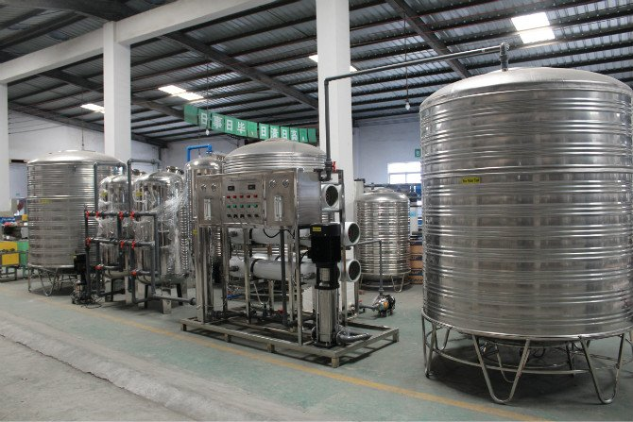
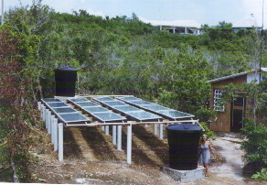
Disinfection Methods

Slide 38
Household level water treatment

Slide 39
Household level water storage
Rooftop/Ground-level Tanks
Household Containers/ Pots
No storage
Handpumps
Covered or uncovered

Slide 40
Storage & Sedimentation
Rural
Urban
Wells (open/ covered)
Household containers
Overhead / grounded tanks
Bricked
Plastic
None
Overhead / grounded tanks
Bricked
plastic
Household containers
None

Slide 41
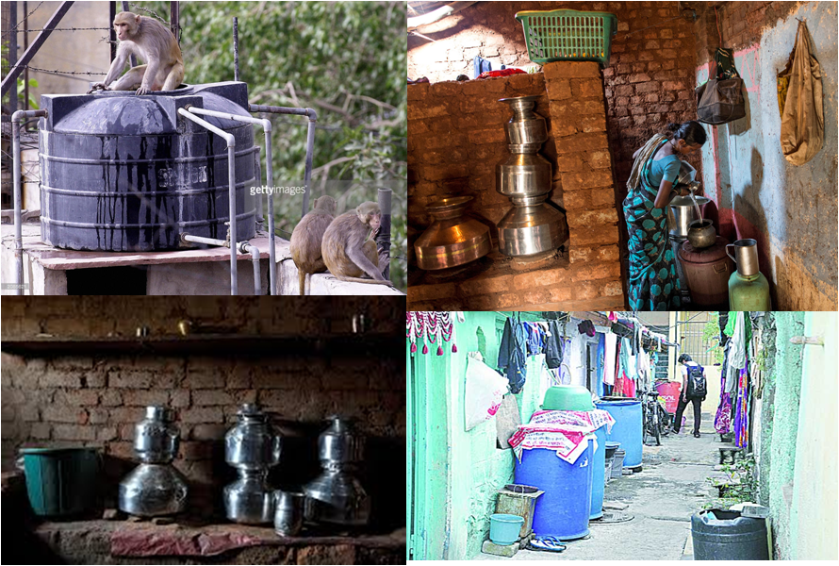

Slide 42
Storage & Sedimentation
Settling
24-72 hours (eg. Three Pot Method for 2 days)
Cheap, easy
Coagulation
2+ hours
Cheap, difficult to use
Poor awareness & acceptability
Natural (eg. Moringa seeds, Strychnos or nirmali etc)
Chemical (eg. Alum, alum potash)

Slide 43
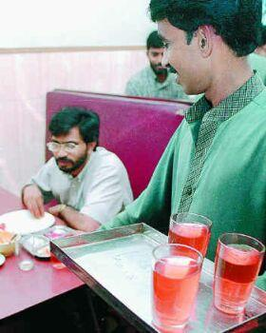
Now debate
Which method of sedimentation have you come across in day-to-day life?
The drinking water available in usual restaurants / households in Kerala coloured.

Slide 44
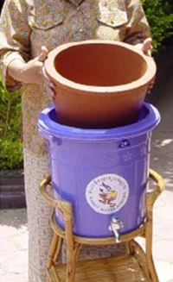
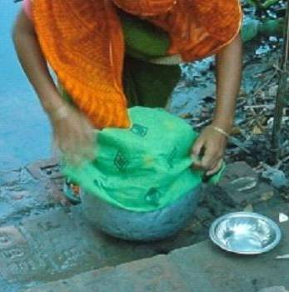
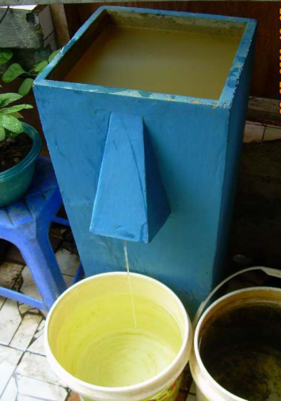
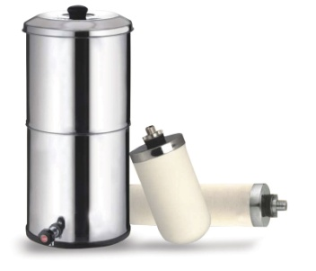
Filtration
Straining through Clothes
Biosand filters
Ceramic Filters
Pot
Candle
Membrane filters

Slide 45
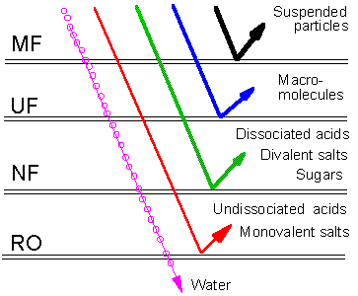
Membrane Filter
Filtration Type | Pore Size (µm / nm)
Microfiltration (MF) | 0.1-10 µm (1‑1000 nm)
Ultrafiltration (UF) | 0.01-0.1 µm (1‑100 nm)
Nanofiltration (NF) | <0.001 µm (<1 nm)
Reverse osmosis (RO) | <0.001 µm (<1 nm)
(Contaminant Removal Capabilities)

Slide 46
Disinfection
Boiling
Chlorination
Solar disinfection (SODIS)
Solar distillation
UV disinfection
RO disinfection

Slide 47
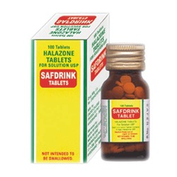
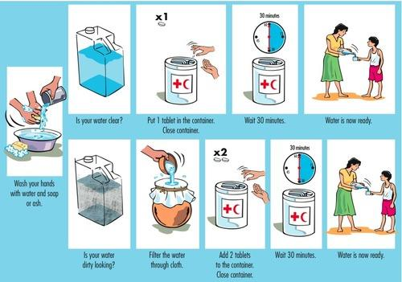
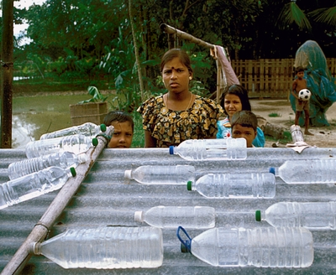
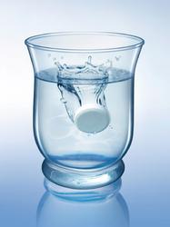
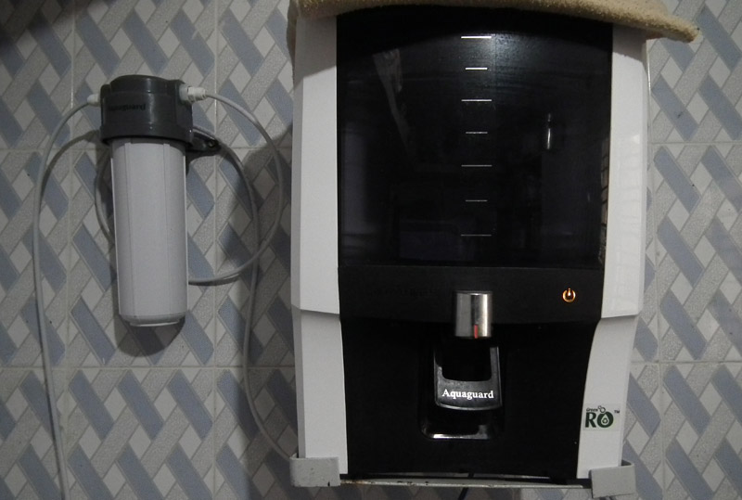
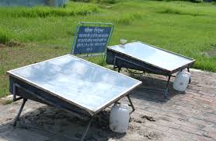
Household level disinfection

Slide 48
Boiling
Rolling boil for 10-20 minutes
All pathogens are killed at 100⁰ C*
Except sporulating organisms (eg Clostridium)
No residual protection
Bland in taste, Smell or colour not changed
Easy, medium cost

Slide 49
Chlorination*
Most widely used
Contact of 30 minutes
Residual effect
Not effective on some protozoa & helminths
Cryptosporidium parvum, Ascaris, Schistosoma
Bleaching Powder, Chlorine Tablets, Chlorine Solution, High Test Hypochlorite
*Iodine & PPM are less commonly used methods of chemical disinfection

Slide 50
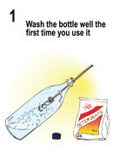
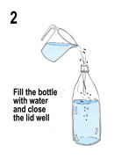
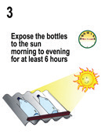
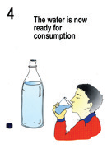
Solar Disinfection
Use transparent PET bottle
More effective on bacteria, less on virus & protozoa
Easy & low cost

Slide 51
Retrieving safe water
Taps and glass
Taps and bottles
Glass dipped
Ladle
????

Slide 52
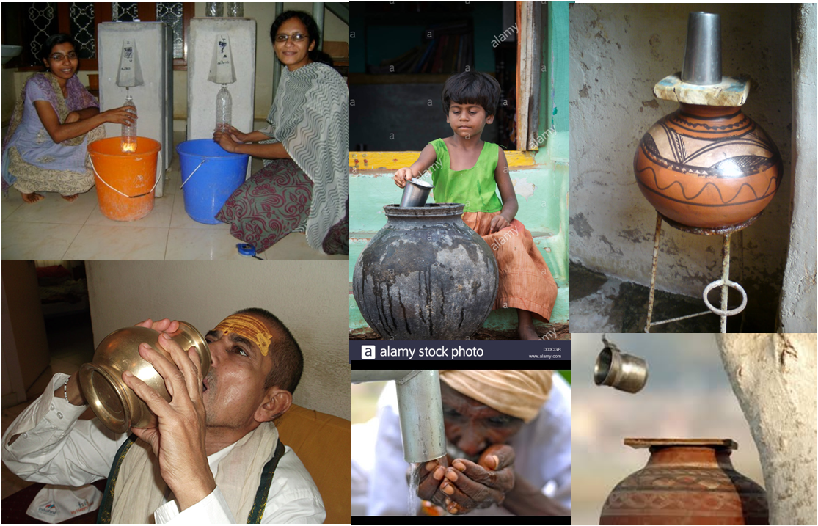
Water Retrieval Methods

Slide 53
Water conservation!!!
Activity | Frequency | Circumstances | Water Used
Toilet | Four flushes per day | Conventional toilet | 3.5–7 gallons per flush
 |  | Ultra-low flush toilet | 1.6 gallons per flush
Shower | Once a day for 5 minutes | Conventional showerhead | 3–8 gallons per minute
 |  | Low-flow showerhead | 2.5 gallons per minute
Bath | Once a day | Full bathtub | 36 gallons
 |  | Tub 1/4 to 1/3 full | 9–12 gallons
Shaving | Once a day | Open tap | 5–10 gallons
 |  | 1 full basin | 1 gallon
Brushing teeth | Twice a day | Open watertap | 2–5 gallons
 |  | Brush and rinse | 1/4–1/2 gallon
1 gallon of water is equal to 3.8 liters

Slide 54
Water conservation!!!
Activity | Frequency | Circumstances | Water Used
Washing hands | Twice a day | Open watertap | 2 gallons
 |  | 1 full basin | 1 gallon
Cooking‡ | Washing produce | Open watertap | 5–10 gallons
 |  | 1 full kitchen basin | 1–2 gallons
Automatic dishwasher | Once per day-full load | Standard cycle | 10–15 gallons
 |  | Short cycle | 8–13 gallons
Manual dishwashing | Once a day | Open watertap | 30 gallons
 |  | Full basin/wash and rinse | 5 gallons
Laundry§ | 1/3 load a day | Portion of full load | 35–50 gallons per full load
 |  | Full load | 10–15 gallons for a full load
Car washing | Twice a month | Hose with shut-off nozzle | 100 gallons per month
 |  | 5 full, 2-gallon buckets | 20 gallons per month
1 gallon of water is equal to 3.8 liters

Slide 55
Parting quiz..
Which of the following is NOT a criteria for a PROBLEM VILLAGE?
Water source has excess iron
Water exposed to risks of cholera
Water available at depth of >15 metres
No source of safe water available within a distance of 5 km

Slide 56
Parting quiz..
Which of the following is NOT a criteria for a PROBLEM VILLAGE?
Water source has excess iron
Water exposed to risks of cholera
Water available at depth of >15 metres
No source of safe water available within a distance of 5 km

Slide 57
any Queries?

