Slide 1
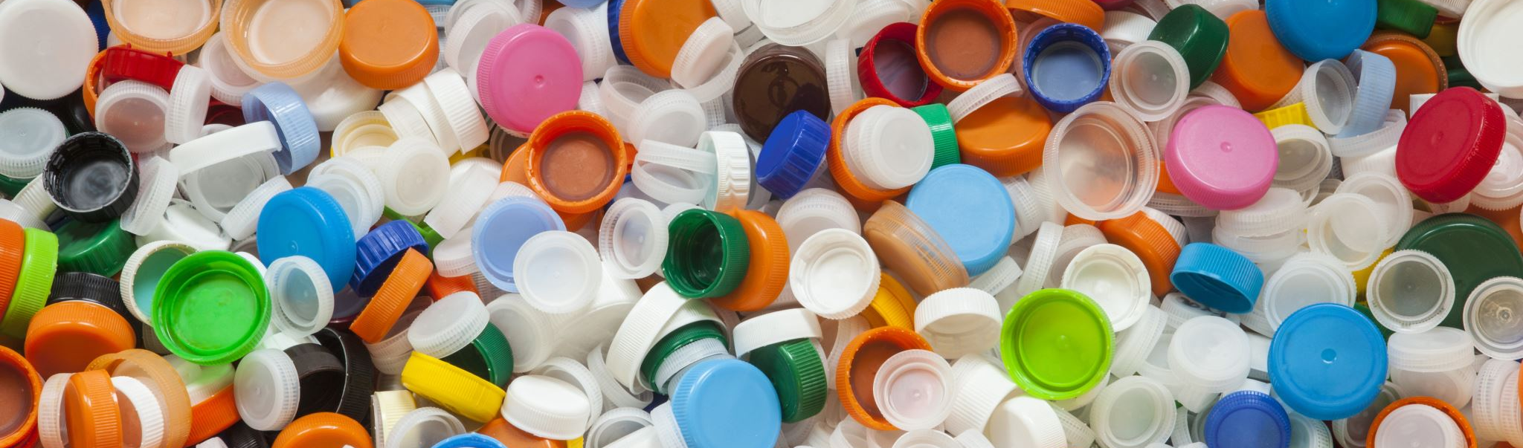
Solid waste disposal

Slide 2
Methods of disposal
The principal methods of refuse disposal are
(a) Dumping
(b) Controlled tipping or sanitary land-fill
(c) Incineration
(d) Composting
(e) Manure pits
(f) Burial.

Slide 3
Dumping
Refuse is dumped in low lying areas partly as a method of reclamation of land but mainly as an easy method of disposal of dry refuse.
As a result of bacterial action, refuse decreases considerably in volume and is converted gradually into humus.
Kolkata disposes of its refuse by dumping and the reclaimed land is leased out for cultivation.
The drawbacks of open dumping are :
(1) the refuse is exposed to flies and rodents,
(2) it is a source of nuisance from the smell and unsightly appearance,
(3) the loose refuse is dispersed by the action of the wind, and
(4) drainage from dumps contributes to the pollution of surface and ground water.
A WHO Expert Committee (1967) condemned dumping as “a most insanitary method that creates public health hazards, a nuisance, and severe pollution of the environment”. Dumping should be outlawed and replaced by sound procedures

Slide 4
Controlled tipping
Most satisfactory method of refuse disposal where suitable land is available.
It differs from ordinary dumping in that the material is placed in a trench or other prepared area, adequately compacted, and covered with earth at the end of the working day.
The term "modified sanitary landfill” has been applied to those operations where compaction and covering are accomplished once or twice a week

Slide 5
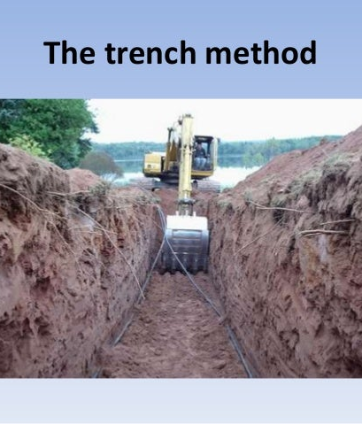
Where level ground is available,
A long trench is dug out - 2 to 3 m (6-10 ft.) deep and 4 to 12 m, (12-36 ft.) wide, depending upon local conditions.
The refuse is compacted and covered with excavated earth. Where compacted refuse is placed in the fill to a depth of 2 m (6 ft.), it is estimated that one acre of land per year will be required for 10,000 population.

Slide 6
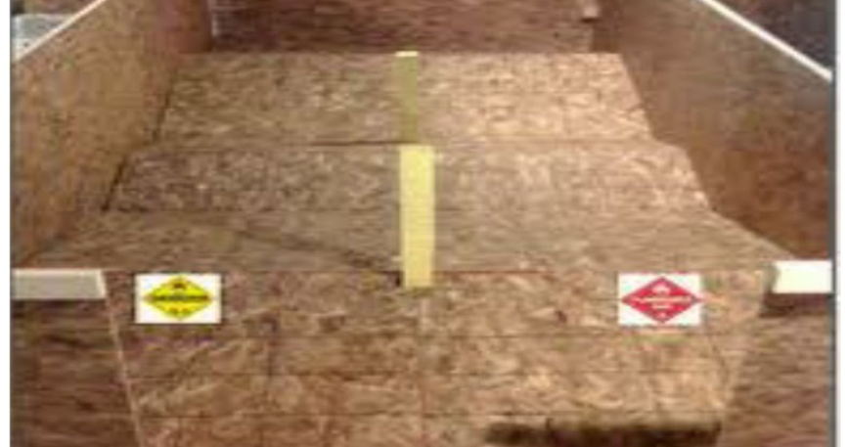
The Ramp Method
This method is well suited where the terrain is moderately sloping.
Some excavation is done to secure the covering material

Slide 7
Area Method
This method is used for filling land depressions, disused quarries and clay pits.
The refuse is deposited, packed and consolidated in uniform layers up to 2 to 2.5 m (6-8 ft.) deep.
Each layer is sealed on its exposed surface with a mud cover at least 30 cm (12 inches) thick.
Such sealing prevents infestation by flies and rodents and suppresses the nuisance of smell and dust.
This method often has the disadvantage of requiring supplemental earth from outside sources.

Slide 8
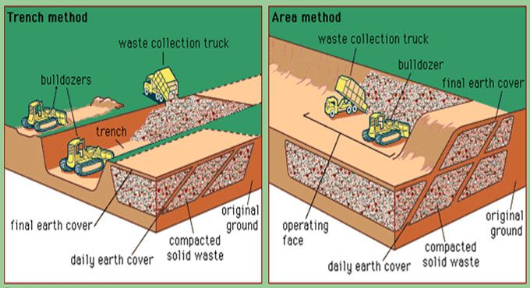

Slide 9
Control tipping
Chemical, bacteriological and physical changes occur in buried refuse.
The temperature rises to over 60 deg. C within 7 days and kills all the pathogens and hastens the decomposition process.
Then it takes 2 to 3 weeks to cool down.
Normally it takes 4 to 6 months for complete decomposition of organic matter into an innocuous mass.
The tipping of refuse in water should not be done as it creates a nuisance from odours given off by the decomposition of organic matter.
The bulldozer achieves the tasks of spreading trimming and spreading top soil.

Slide 10
Incineration
Refuse can be disposed of hygienically by burning or incineration. It is the method of choice where suitable land is not available.
Hospital refuse which is particularly dangerous is best disposed of by incineration.
Incineration is practised in several of the industrialized countries, particularly in large cities due to lack of suitable land
Incineration is not a popular method in India because the refuse contains a fair proportion of fine ash which makes the burning difficult.
A preliminary separation of dust or ash is needed. All this involves heavy outlay and expenditure besides manipulative difficulties in the incinerator
Disposal of refuse by burning is a loss to the community in terms of the much needed manure.
Burning, therefore, has a limited application in refuse disposal in India.

Slide 11
Composting
Combined disposal of refuse and nightsoil or sludge.
It is a process of nature whereby organic matter breaks down under bacterial action resulting in the formation of relatively stable humus-like material, called the compost which has considerable manurial value for the soil.
The principal by-products are carbon dioxide, water and heat.
The heat produced during composting, about 60 deg C or higher, over a period of several days, destroys eggs and larvae of flies, weed seeds and pathogenic agents.
The end-product — compost — contains few or no disease producing organisms, and is a good soil builder containing small amounts of the major plant nutrients such as nitrates and phosphates

Slide 12
Bangalore method (anaerobic)
Indian Council of Agricultural Research at the Indian Institute of Science, Bangalore, a system of anaerobic composting, known as Bangalore method (hot fermentation process) has been developed.
Trenches are dug 90 cm (3 ft.) deep, 1.5 to 2.5 m (5-8 ft.) broad and 4.5 to 10 m (15-30 ft.) long, depending upon the amount of refuse and nightsoil to be disposed of.
Depths greater than 90 cm (3 ft.) are not recommended because of slow decomposition.
The pits should be located not less than 800 m (1/2 mile) from city limits.
First a layer of refuse about 15 cm (6 in) thick is spread at the bottom of the trench. Over this, nightsoil is added corresponding to a thickness of 5 cm (2 in). Then alternate layers of refuse and nightsoil are added in the proportion of 15 cm (6 in) and 5 cm (2 in) respectively, till the heap rises to 30 cm (1 ft.) above the ground level.
The top layer should be of refuse, at least 25 cm (9 in) thickness.
Then the heap is covered with excavated earth. If properly laid, a man’s legs will not sink when walking over the compost mass

Slide 13
Bangalore method (anaerobic)
Within 7 days as a result of bacterial action considerable heat (over 60 deg C) is generated in the compost mass.
This intense heat which persists over 2 or 3 weeks, serves to decompose the refuse and nightsoil and to destroy all pathogenic and parasitic organisms.
At the end of 4 to 6 Months, decomposition is complete and the resulting Manure is a well decomposed, odourless, innocuous material of high manurial value ready for application to the land.
The Environmental Hygiene Committee (1949) did not recommend composting by municipalities with a population of over 100,000.
Bigger municipalities should install underground sewers to transport human excreta.

Slide 14
Mechanical Composting (aerobic)
Compost is literally manufactured on a large scale by processing raw materials and turning out a finished product.
The refuse is first cleared of salvageable materials such as rags, bones, metal, glass and items which are likely to interfere with the grinding operation.
It is then pulverised in a pulverising equipment in order to reduce the size of articles to less than 2 inches.
The pulverised refuse is then mixed with sewage, sludge or nightsoil in a rotating machine and incubated.
The factors which are controlled in the operation are a certain carbon-nitrogen ratio, temperature, moisture, pH and aeration. The entire process of composting is complete in 4 to 6 weeks.
This method of composting is in vogue in some of the developed countries, e.g., Holland, Germany, Switzerland, Israel.
The Government of India is considering the installation of mechanical composting plants in selected cities. Cities such as Delhi, Nagpur, Mumbai, Chennai. Pune, Allahabad, Hyderabad, Lucknow and Kanpur have offered to join the Government for setting up pilot plants for mechanical composting.

Slide 15
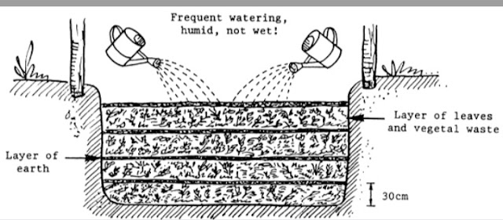
Manure pits
In rural areas in India, there is no system for collection and disposal of refuse. Refuse is thrown around the houses indiscriminately resulting in gross pollution of the soil.
The problem of refuse disposal in rural areas can be solved by digging ‘manure pits’ by the individual householders. The garbage, cattle dung, straw, and leaves should be dumped into the manure pits and covered with earth after each day’s dumping.
Two such pits will be needed, when one is closed, the other will be in use.
In 5 to 6 month’s time, the refuse is converted into manure which can be returned to the field.
This method of refuse disposal is effective and relativel y simple in rural communities.

Slide 16
Burial
This method is suitable for small camps.
A trench 1.5 m wide and 2 m deep is excavated, and at the end of each day the refuse is covered with 20 to 30 cm of earth.
When the level in the trench is 40 cm from ground level, the trench is filled with earth and compacted, and a new trench is dug out.
The contents may be taken out after 4 to 6 months and used on the fields.
If the trench is 1 m in length for every 200 persons, it will be filled in about one week.

Slide 17
Public education
Refuse disposal cannot be solved without public education.
People have very little interest in cleanliness outside their homes.
Many municipalities and corporations usually look for the cheapest solution, especially in regard to refuse disposal.
What is needed is public education on these matters, by all known methods of health education, viz., pamphlets, newspapers, broadcasting, films etc.
Police enforcement of the laws may also be needed at times.

Slide 18
Economics and finance
If refuse disposal is to be carried out efficiently, hygienically and economically, heavy capital outlay will be needed whatever system of disposal is adopted.
In the highly industrialized countries up to 20 percent of municipal budgets are spent on the collection and disposal of solid wastes, and even more will be required if the job is to be done adequately

Slide 19
International oraganization
The International Solid Wastes and Public Cleansing Association (ISWA) in 1970, to assist countries in the general endeavour to improve sanitary services.
A WHO International Reference Centre has also been set up in Switzerland to collect, evaluate and disseminate information on wastes-disposal practices and to foster research.

Slide 20
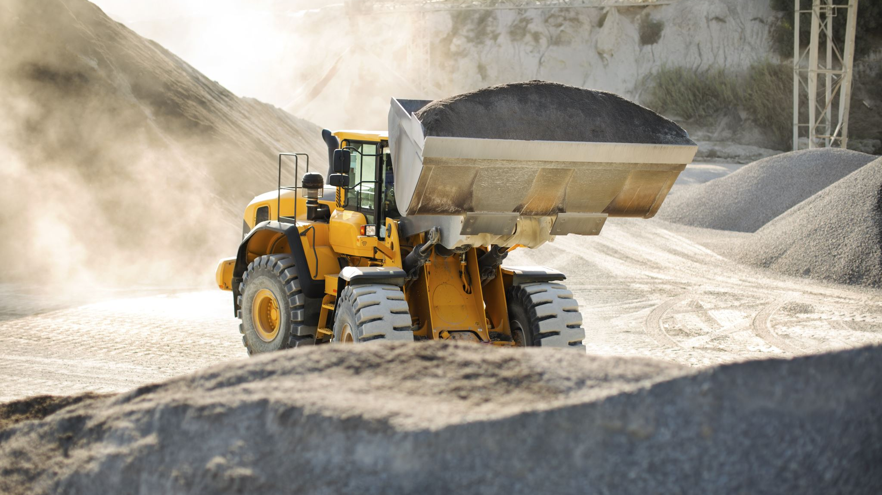
Excreta disposal

Slide 21
Public health importance
Human excreta is a source of infection.
It is an important cause of environmental pollution. Every society has a responsibility for its safe removal and disposal so that it does not constitute a threat to public health.
The HEALTH HAZARDS of improper excreta disposal are : (1) soil pollution, (2) water pollution, (3) contamination of foods, and (4) propagation of flies.
The resulting diseases are typhoid and paratyphoid fever, dysenteries, diarrhoeas, cholera, hookworm disease, ascariasis, viral hepatitis and similar other intestinal infections and parasitic infestations.
These diseases are not only a burden on the community in terms of sickness, mortality and a low expectation of life, but a basic deterrent to social and economic progress.
Proper disposal of human excreta, therefore, is a fundamental environmental health service without which there cannot be any improvement in the state of community health.

Slide 22
Extent of problem in India
Nearly 70 per cent of India’s population live in rural areas and the majority of them “go to the fields” for defecation and thereby pollute the environment with human excrement.
Statistics indicate that the intestinal group of diseases claim about 5 million lives every year while another 50 million people suffer from these infections.
Surveys carried out in the community development block areas in Andhra Pradesh, Assam, Bihar, Madhya Pradesh, Manipur, Orissa, Rajasthan and West Bengal show that the enteric group of fevers is very common in rural areas.
Hookworm disease is also known to be highly prevalent. About 45 million people are estimated to be infested with hookworms.
The solution to the problem is only through hygienic disposal of human excreta which is the corner stone of all public health services.

Slide 23
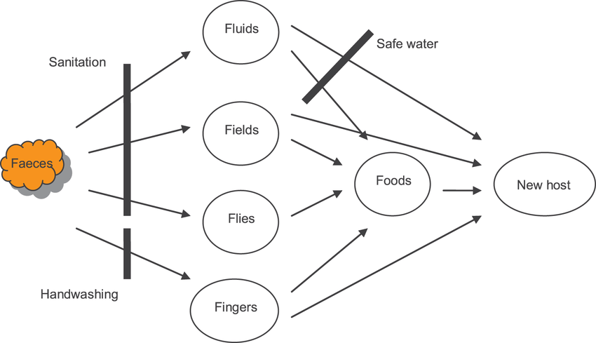
Faecal borne disease transmission

Slide 24
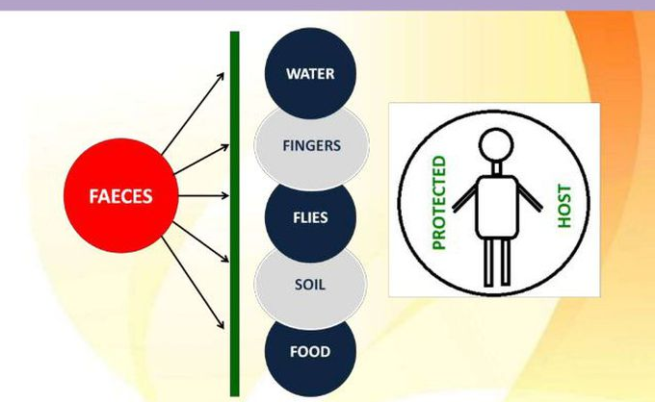
Sanitation barrier
The disease cycle may be broken at various levels :
Segregation of faeces,
Protection of water supplies,
Protection of foods,
Personal hygiene
Control of flies.
The most effective step would be to segregate the faeces and arrange for its proper disposal so that the disease agent cannot reach the new host, directly or indirectly.
Segregation of the excreta by imposing a barrier called the “sanitation barrier”.
In simple terms, this barrier can be provided by a ‘sanitary latrine’ and a disposal pit.
The more elaborate schemes envisage installation of a sewerage system and sewage treatment plants.

Slide 25
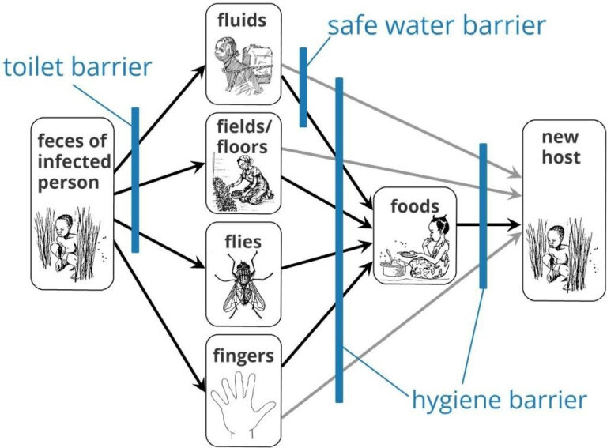

Slide 26
Methods of excreta disposal (unsewered areas)
SERVICE TYPE LATRINES (CONSERVANCY SYSTEM)
Nightsoil is collected from pail or bucket type of latrines by human agency, and later disposed of by buryinq or composting
NON-SERVICE TYPE (SANITARY LATRINES)
(a) Bore hole latrine
(b) Dug well or pit latrine
(c) Water-seal type of latrines
(i) RR.A.I. type
(ii) R.C.A. type
(iii) Sulabh Shauchalaya.
(d) Septic tank
(e) Aqua privy.
LATRINES SUITABLE FOR CAMPS AND TEMPORARY USE
(a) Shallow trench latrine
(b) Deep trench latrine
(c) Pit latrine
(d) Bore hole latrine

Slide 27
Methods of excreta disposal (sewered areas)
WATER-CARRIAGE SYSTEM AND SEWAGE TREATMENT
Primary treatment
Screening
Removal of grit
Plain sedimentation
Secondary treatment
Trickling filters
Activated sludge process
Other methods
Sea outfall
River outfall
Sewage farming
Oxidation ponds.

Slide 28

Thank you

