Slide 1

Introduction to R
Gateway to statistical Computing

Slide 2
R - language
Developed in the early 1990s by Ross Ihaka and Robert Gentleman at the University of Auckland, New Zealand
A powerful language for statistical computing and graphics
Widely used by statisticians, data scientists, and researchers
Rstudio
User Interface

Slide 3
Why Use R
Extensive libraries for data analysis and visualization
Active community support
Cross-platform compatibility (Windows, MacOS, Linux)
Integration with other languages like Python and C++
Free and open-source

Slide 4
Key Features of R
Comprehensive statistical analysis tools
Advanced graphics capabilities with ggplot2
Rich ecosystem of packages (e.g., dplyr, tidyr)
Interactive and reproducible research with RMarkdown

Slide 5
R vs Python
R
Python
Designed primarily for statistical analysis and data visualization.
Rich ecosystem of packages for data analysis, like dplyr, ggplot2, and caret.
Preferred in academia and research for its extensive statistical libraries.
A general-purpose programming language with a wide range of applications.
Strong in data science and machine learning with libraries like pandas, scikit-learn, and TensorFlow.
Extensive community support and versatile for web development, automation, and more.

Slide 6
Installation of R and RStudio
R - The Comprehensive R Archive Network
Windows - https://cran.rstudio.com/bin/windows/base/R-4.4.1-win.exe
MacOS - https://cran.rstudio.com/bin/macosx/big-sur-arm64/base/R-4.4.1-arm64.pkg
Rstudio - RStudio Desktop - Posit

Slide 7
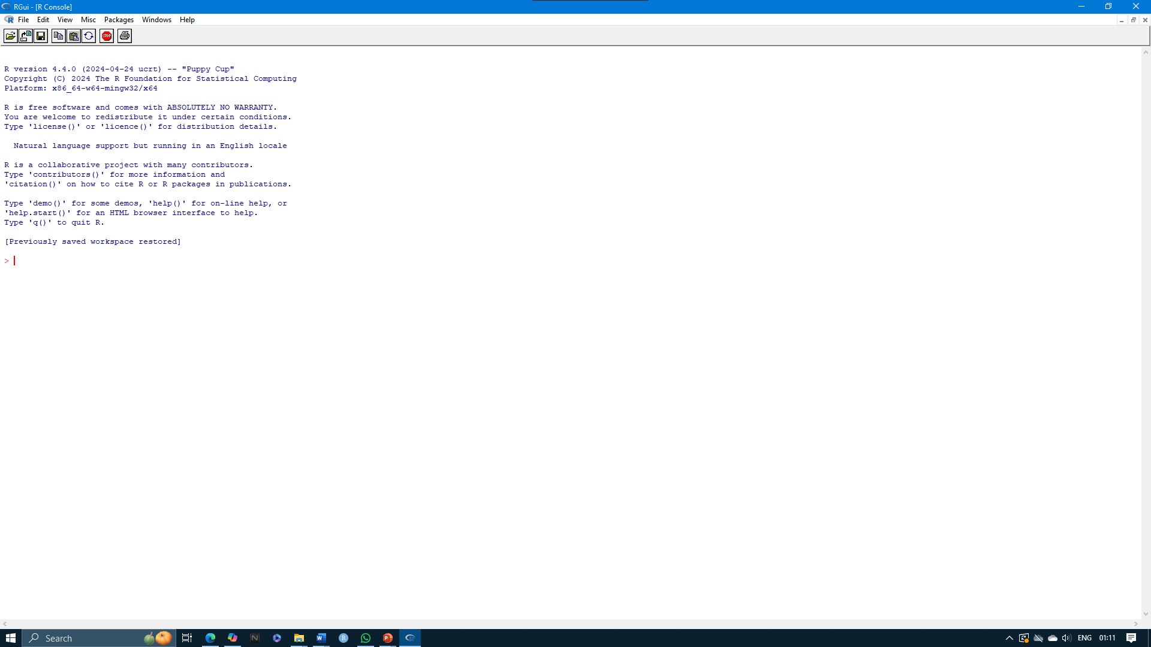
R 4.4.1

Slide 8
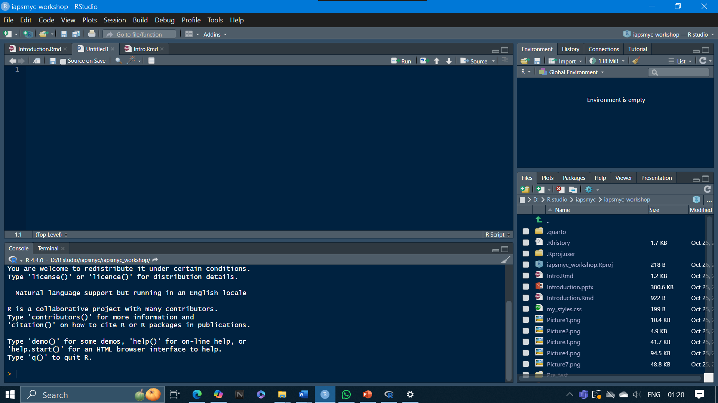
Project
Source Pane
Environment / History
Viewer Pane
Console Pane

Slide 9
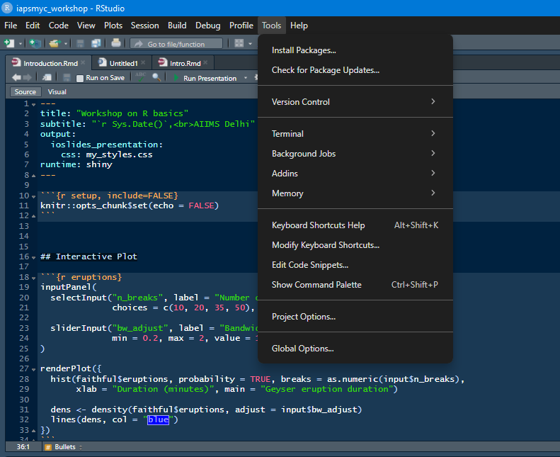
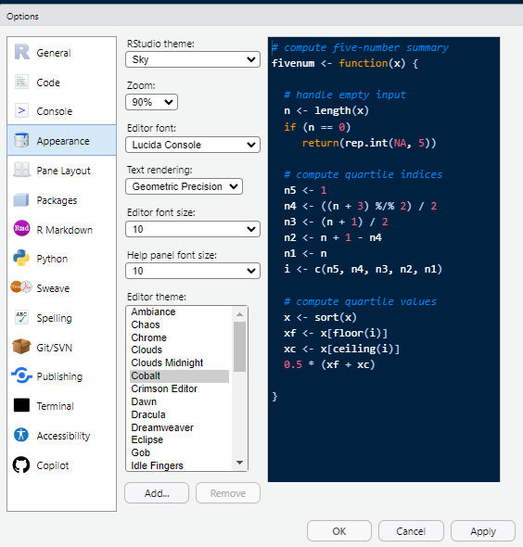

Slide 10
Project
Centralized Management
Consistent Environment
Version Control Integration
Quicker Setup

Slide 11
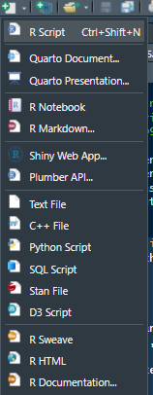
New file

Slide 12
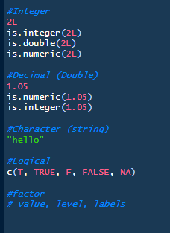
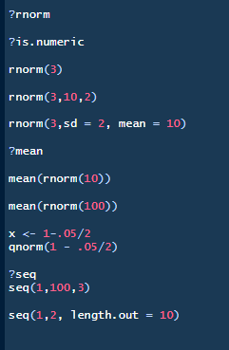
Variables and functions

Slide 13
List and matrices
Lists
A list is a flexible data structure that can hold elements of different types.
Use Cases:
Heterogeneous Data Storage (e.g., strings, numbers, vectors)
Nested Data Structures (e.g., lists within lists)
Storing Results of Statistical Models
Matrices
A matrix is a two-dimensional array that holds elements of the same type, typically numeric or character.
Use Cases:
Mathematical Computations (e.g., matrix multiplication)
Representing Tabular Data
Image Processing

Slide 14
Packages
Packages are collections of R functions, data, and compiled code bundled together.
Installation – install.packages()
install.packages(c(“tidyverse”, ”ggplot2”, “readxl”, “gtsummary”, “ggstatsplot”, “flextable”, “pacman”))
Loading packages – library() or p_load()
library(“tidyverse”) or p_load(“tidyverse”, ”ggplot2”, “readxl”, “gtsummary”, “ggstatsplot”, “flextable”, “pacman”)

Slide 15
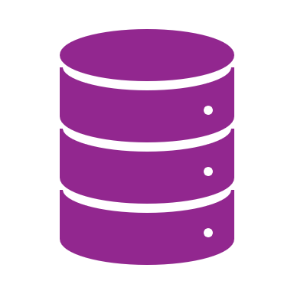
Further on:
Data wrangling
Importing dataset
Transforming and creating new variables
Filtering rows or columns
Longer and wider data

