Slide 1



Harnessing the power of AI to fuel scientific discoveries
Mentee: Alex Umeasalugo (Grambling State University)
Mentor: Mr Marco Mambelli (Fermilab)
Co-mentors: Namratha Urs and Bruno Coimbra (Fermilab)

Slide 2
Abstract
This project contributes to the optimization of large-scale scientific computing systems used in high-energy physics experiments such as CMS at CERN and DUNE at Fermilab. Focusing on GlideinWMS and HEPCloud, the work involves designing and implementing a modern, container-based Continuous Integration/Continuous Deployment (CI/CD) pipeline to streamline and automate software workflows. Key components include the integration of AI-powered tools to enhance code coverage, automation of software release processes, and the development of real-time test feedback systems through collaboration platforms such as Slack and Microsoft Teams. The project leverages DevOps technologies including Docker and GitHub Actions, and emphasizes best practices in collaborative software engineering. By intersecting distributed computing and experimental physics, this work equips participants with practical expertise in CI/CD, container orchestration, and open-source development—skills that are increasingly vital in the modern STEM workforce.

Slide 3
Overview
Introduction
CMS Data Scale
Features and Architecture of GlideinWMS
Working Analogy and Description
Project Objectives
Project Results
Acknowledgements

Slide 4
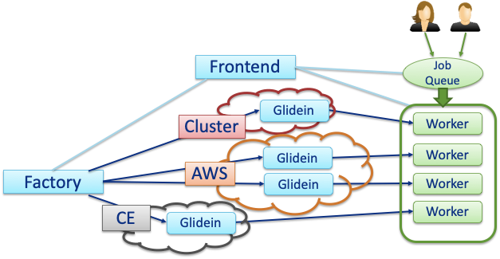

What is GlideinWMS?
GlideinWMS is a pilot-based resource provisioning tool for distributed High Throughput Computing
Provides reliable and uniform virtual clusters
Submits Glideins to heterogeneous resources
Leverages HTCondor
Provides HTCondor pools
Uses HTCondor capabilities

Slide 5
CMS Data Scale
The CMS experiment generates petabytes of data annually, requiring the coordinated use of globally distributed computing resources. Thousands of scientists queue jobs to analyze this data, making efficient resource scheduling and software delivery essential to scientific productivity.
How does GlideinWMS Helps?
Dynamic Provisioning: GlideinWMS enables CMS to dynamically allocate computing resources from hundreds of distributed sites worldwide, based on demand.
Scalability: As CMS generates petabytes of data, GlideinWMS ensures millions of analysis jobs can be scheduled and executed efficiently without overloading local systems.
Global Pooling: By creating a global HTCondor pool, it treats geographically distributed compute resources as a single virtual cluster, making it easier to schedule jobs close to the data.

Slide 6

Features and Architecture in GlideinWMS
Glide job for node testing and customization and for running user jobs
Frontend: A pressure-driven mechanism that submits Glidein requests to the factory, prompting it to allocate computing resources.
Factory: Interfaces with computing resources to launch Glideins based on incoming resources.
Distributed system, multiple instances of any component.

Slide 7
Working Analogy and Description

Slide 8
Project Objectives
Create a Virtual Machine on Fermicloud to run container applications
Familiarize myself with Podman container
Learn how to use containers to run GlideinWMS
Write docstrings to GlideinWMS Python files
Learned Shell scripting
Boost code coverage with AI: Use AI-powered tools and my coding skills to
generate Python unit tests and improve software quality.
Get instant feedback: Generate reports and summaries of tests and integrate them
into collaboration platforms such as Slack, Teams, etc.

Slide 9
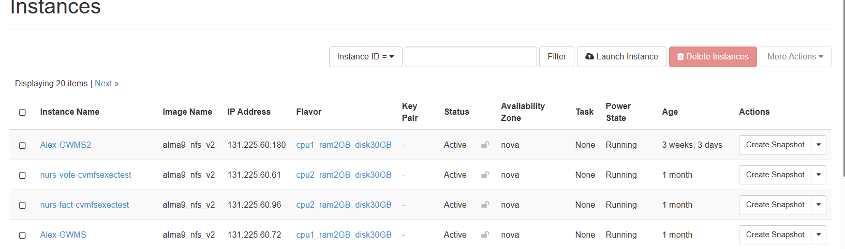
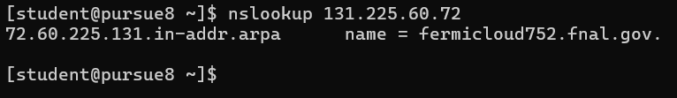
Project Results

Slide 10


Minimal Glidein deployment
Frontend
Job Queue
Central Manager
Factory
CE
Glidein
Worker

Slide 11
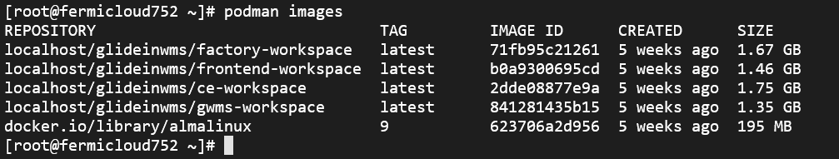
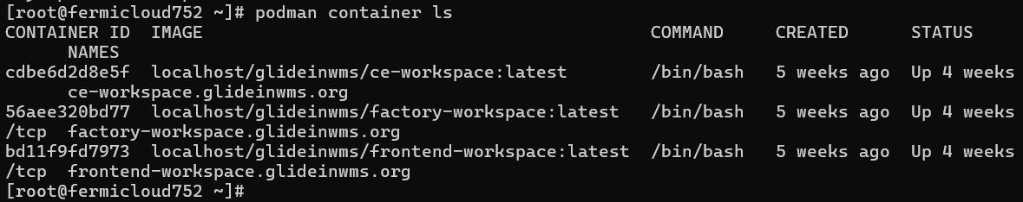
GlideinWMS Setup
(1)

Slide 12
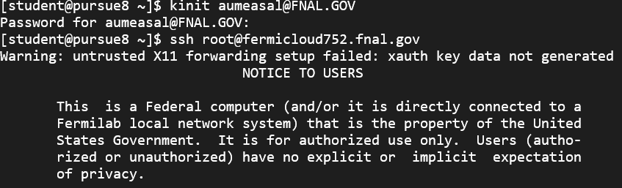
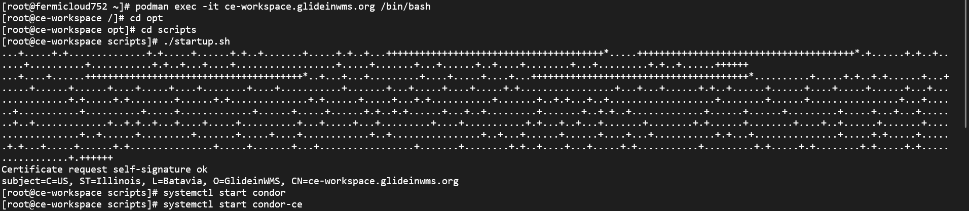
CE-Workspace Setup

Slide 13
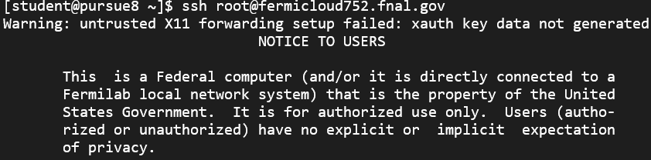
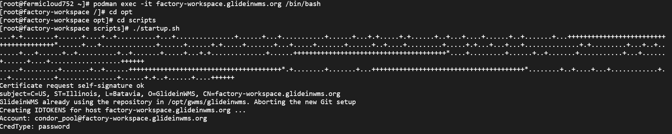
Factory-Workspace Setup

Slide 14
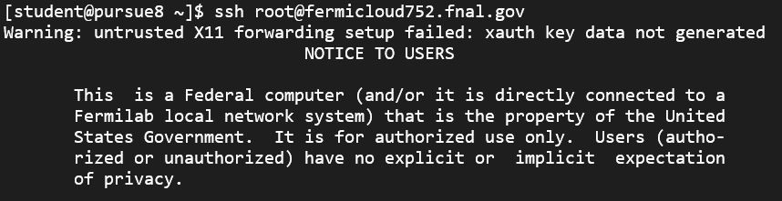
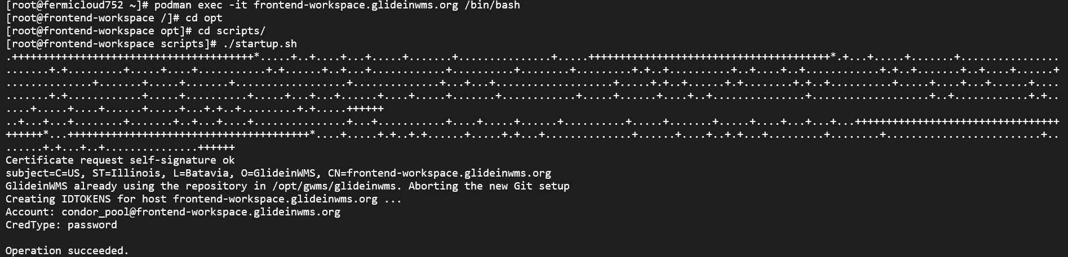
Frontend-Workspace Setup

Slide 15
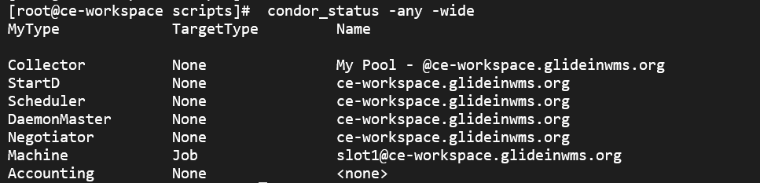
Condor on CE-workspace

Slide 16
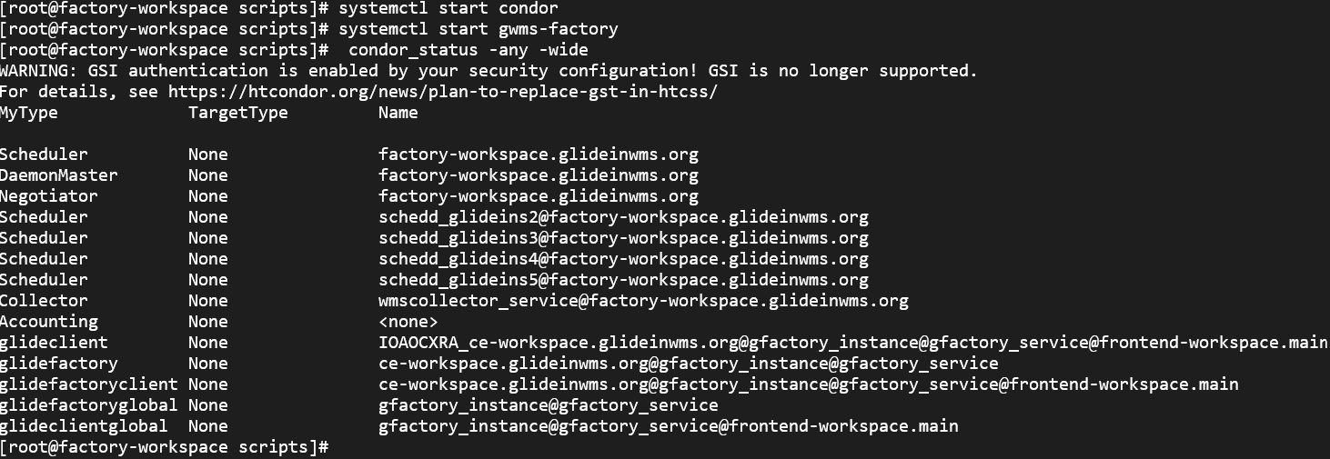
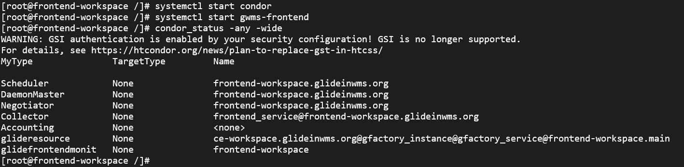
Condor on Factory and Frontend Workspaces

Slide 17
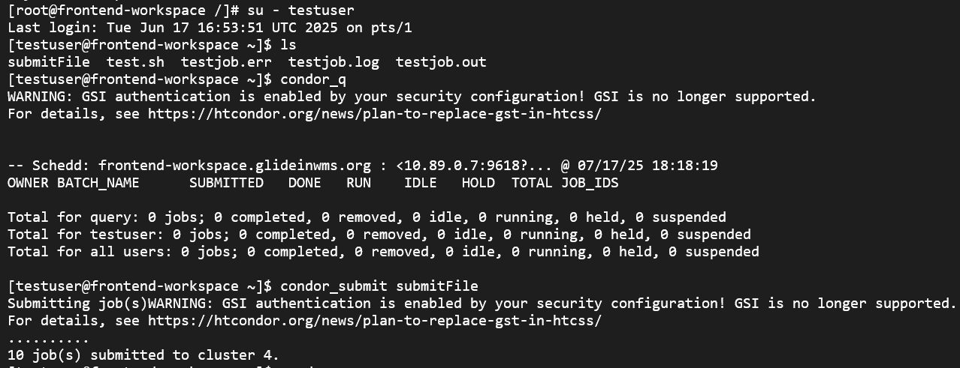
Job Submission

Slide 18
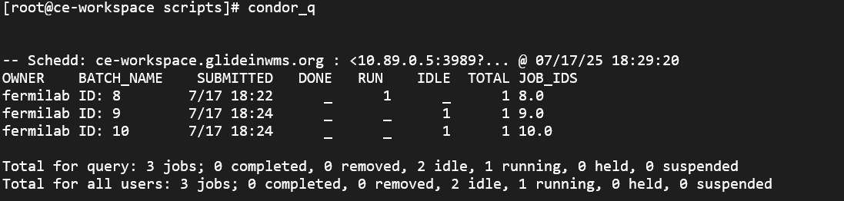
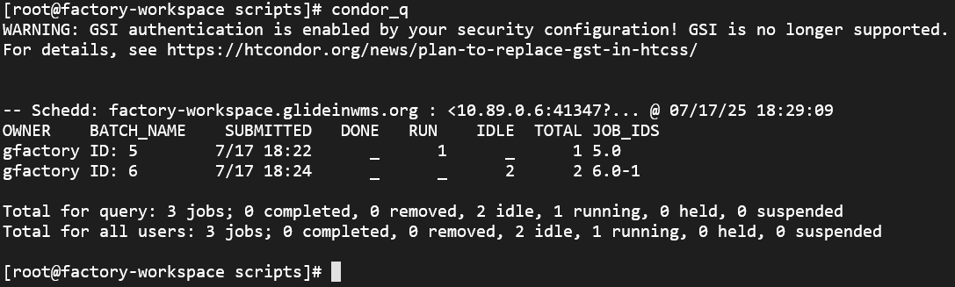
Job Submission-CE and Factory

Slide 19
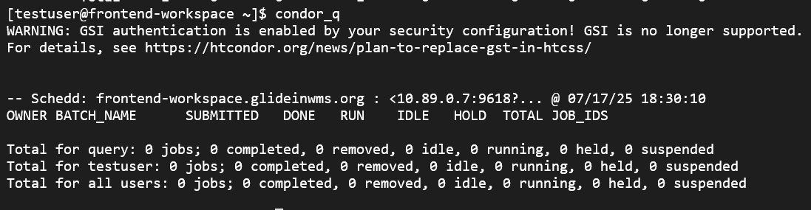
Job Submission
Notes:
a

Slide 20
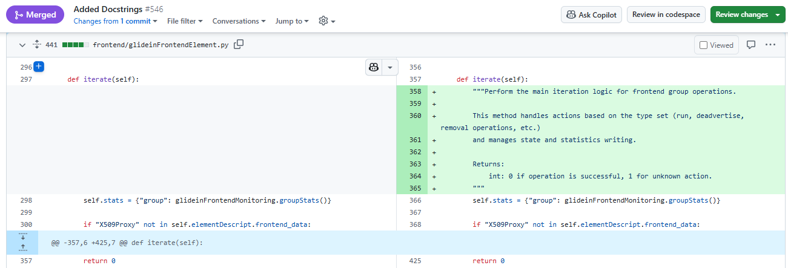
Google Docstrings

Slide 21
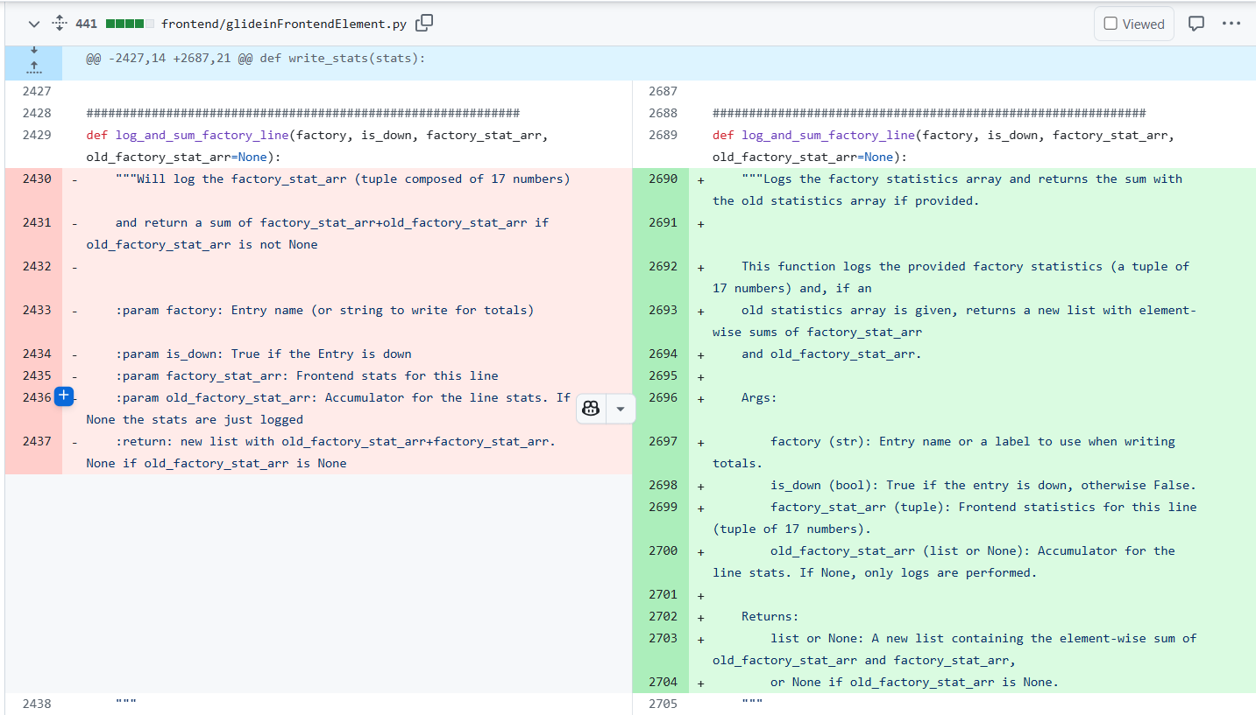
Google Docstrings

Slide 22
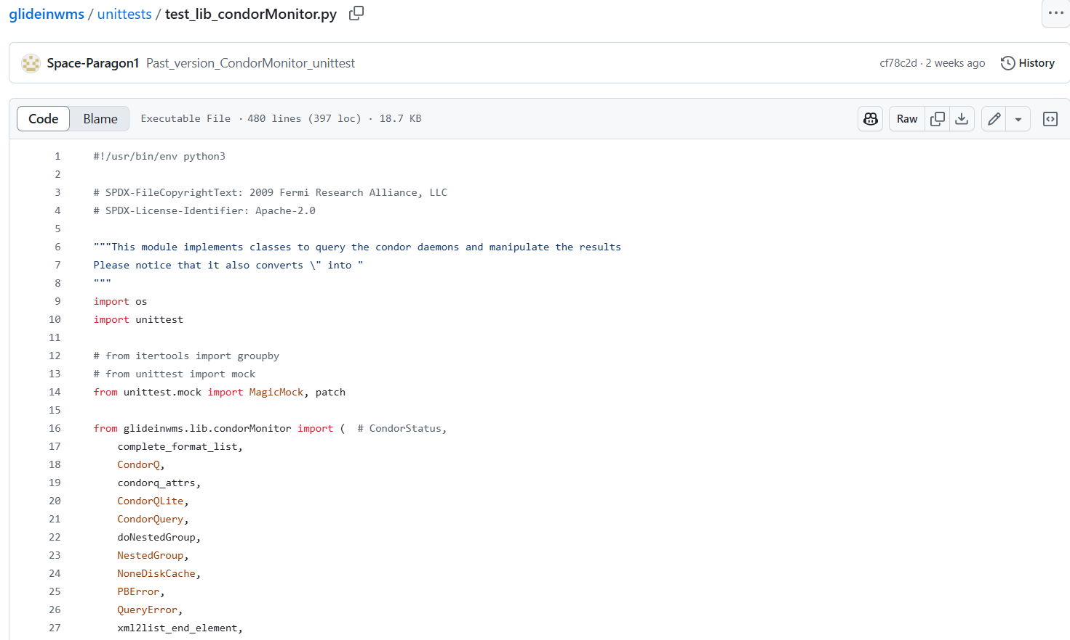
Unittest

Slide 23
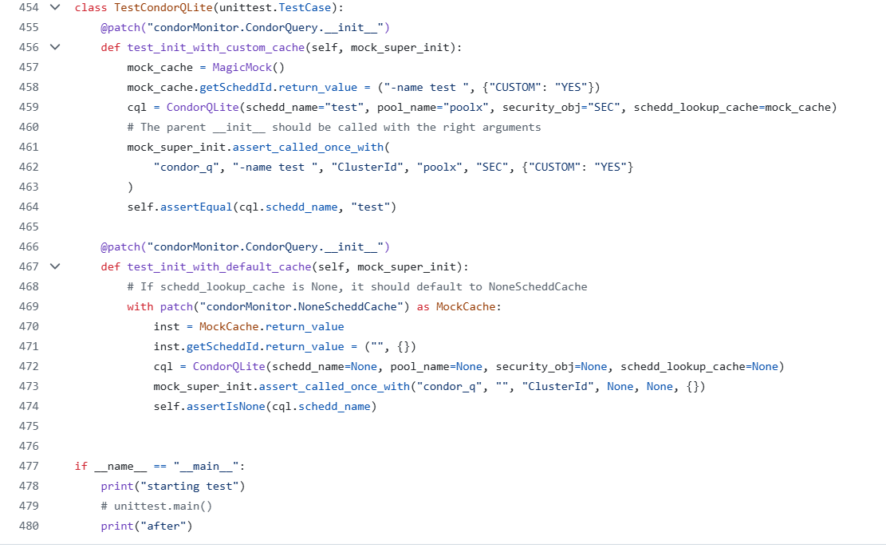
Unittest

Slide 24
Future Works
Write a shell script to automate CI/CD
A script to start Integration test bed containers and run a test job
Expand a test to work on multiple configurations and versions of Glideinwms
Write the missing Google Docstrings for all the python file in the GlideinWMS repository
Write the missing Unit Test for all the code on the repository

Slide 25
Acknowledgements
This work was supported by the DOE grant RENEW-HEP: U.S. CMS SPRINT - "A Scholars Program for Research INTernship" at Tougaloo College, MS (DE-SC0023681), Brown University (DE-SC0023651), RI, University of Puerto Rico-Mayaguez, PR (DE-SC0023680), and University of Wisconsin – Madison, WI (DE-SC0023643) and U.S. CMS Operations at the Large Hadron Collider (NSF-2121686)

Slide 26

Thank you for listening

