Slide 1
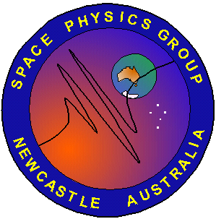
Propagation of Electromagnetic Ion Cyclotron (EMIC) waves in the Earth’s Magnetosphere
T.M. Loto’aniu, B.J. Fraser, and C.L. Waters
CRC for satellite Systems
University of Newcastle
NSW 2308 Australia

