Slide 1
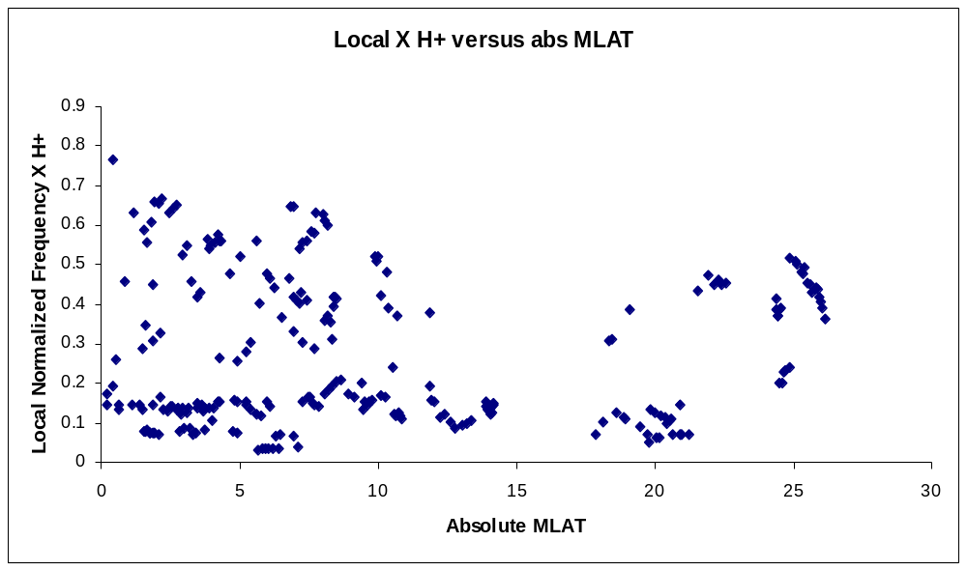
Figure 5.1 Scatter Plot of X versus absolute MLAT

Slide 2
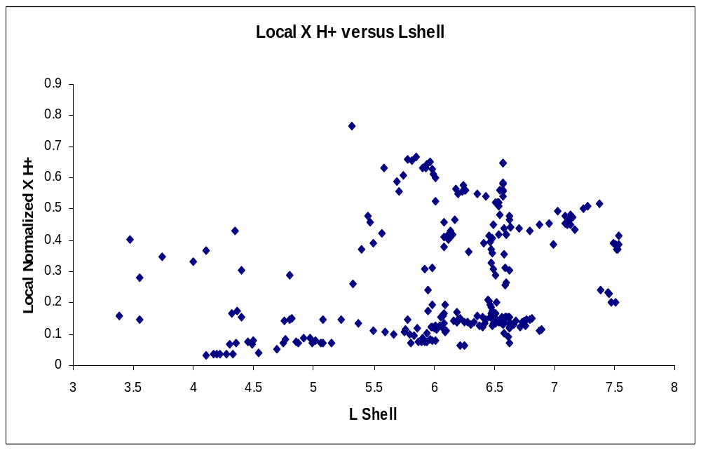
Figure 5.2 Scatter Plot X versus L Shell

