Slide 1


Comparison of Eye-Tracking Representations for Engagement Inference in Knowledge Workers
Department of Intelligent Systems (E9)
Jožef Stefan Institute
Tomi Božak, Zoja Anžur and Gašper Slapničar
SKUI 2026,
October 2026, Ljubljana
Notes:
- Thank the chair; I'm Tomi Božak from the Department of Intelligent Systems, JSI.
- Joint work with Zoja Anžur and Gašper Slapničar.
- Topic: which way of representing eye-tracking data works best for predicting engagement at work.

Slide 2
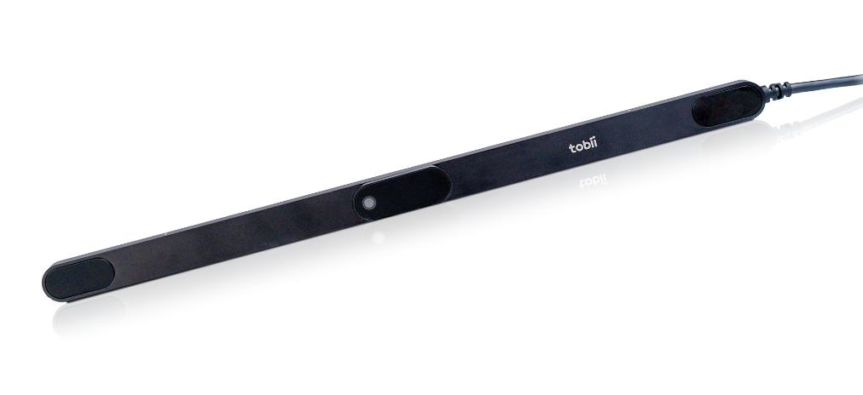
Introduction
Momentary engagement of knowledge workers
  Changes during the day, hard to see in logs
Eye tracking: continuous and contact-free
How to represent a gaze window?
  Raw signal, handcrafted features or pretrained embeddings
  Rarely compared under the same conditions
Screen-mounted eye tracker
2
Notes:
- Engagement (immersion in work) changes during the day; application logs show little of it.
- A screen-mounted eye tracker records gaze and pupil size continuously, without the user doing anything.
- Before training any model we must choose how to represent a window of gaze data.
- Options: raw signal, handcrafted features, or embeddings from pretrained models.
- Published results use different data, labels and splits, so they can't be compared directly — that's our gap.

Slide 3
Four Representations
Raw signal
600 values
Handcrafted features
58–60 features
3-s gaze window
5 channels, 60 Hz
Classifier
Random Forest / MLP
GazeMAE (frozen)
256-d embedding
MOMENT (frozen)
1,024-d embedding
4
Notes:
- Every model sees the same 3-second windows: pupil size (L/R), gaze x/y, eye–screen distance.
- Raw: the signal itself, resampled and flattened — no domain knowledge.
- Handcrafted: blinks, fixations, saccades, pupil statistics — interpretable, from our earlier work.
- GazeMAE: pretrained on eye-tracking data; MOMENT: general time-series foundation model. Both used frozen, out of the box.
- On top: the same classifiers — random forest and an MLP.

Slide 4
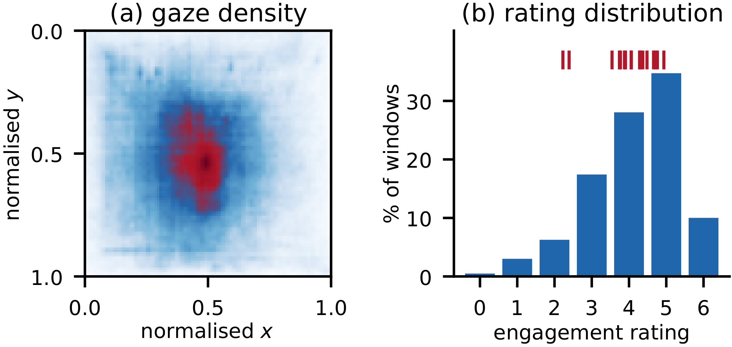
Data
Knowledge workers at their own desks
  17 participants, 657 full workdays
Eye tracker, 60 Hz
  Pupil size, gaze x/y, eye–screen distance
Self-report several times a day
  “Right now I am immersed in my work”
  0–6 scale, labels the preceding 15 min
(a) gaze density on screen (b) engagement ratings;
red ticks = participant means
4
Notes:
- Real-world data: knowledge workers recorded at their own desks during normal workdays.
- 17 participants, 657 full workdays; eye tracker at 60 Hz.
- Several times a day they answered a short questionnaire; our target: “Right now I am immersed in my work”, 0–6.
- Each answer labels the 15 minutes before it.
- Left plot: gaze mostly in the screen centre. Right: ratings; red ticks show each participant's mean — very different between people.

Slide 5
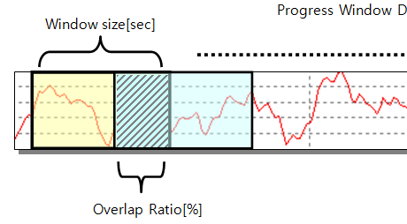
Windows and Target
3-s windows, 25 % overlap
  Quality filter → 140,531 windows
Ratings are person-specific
  Participant means: 2.2–4.9
Binary target
  Above vs. below the participant's mean
  Centring fitted without test labels
4
Notes:
- Recordings cut into 3-second windows with 25 % overlap; windows with too much tracking loss removed → about 140 thousand windows.
- Ratings differ a lot between people (means 2.2–4.9), so an absolute threshold would mostly learn who the person is.
- So we centre ratings per participant and predict above vs. below their own mean.
- For the test participant we use the average of the training participants' means — no test labels leak in.

Slide 6
Methodology
Majority baseline, Random Forest, MLP
Leave-One-Subject-Out CV
  17 folds
  Preprocessing fitted on training subjects only
Main measure: balanced accuracy
  Chance = 0.5
P01
P02
P03
⋮
P16
P17
green = train, orange = test (repeat for every subject)
4
Notes:
- Three predictors on every representation: majority baseline, random forest and an MLP.
- Leave-one-subject-out: train on 16 people (green), test on the one left out (orange); repeat 17 times.
- Imputation, scaling and feature selection are fitted on training people only — no leakage.
- Main measure is balanced accuracy, because class balance differs per person; chance is always 0.5.

Slide 7
Results
Best: raw signal
0.536 balanced accuracy
0.553 ROC-AUC
All close to chance
SD across subjects: 0.075
4
Notes:
- Bars start at 0.5 = chance; above the line is better than guessing.
- Raw signal is best with both classifiers: 0.536 with random forest, 0.534 with MLP (best AUC 0.553).
- Handcrafted next (0.521 with MLP); GazeMAE just above chance; MOMENT at chance.
- Honest part: everything is close to chance, and the spread across participants (SD 0.075) is bigger than the differences.
- Full table with all metrics on the backup slide.

Slide 8
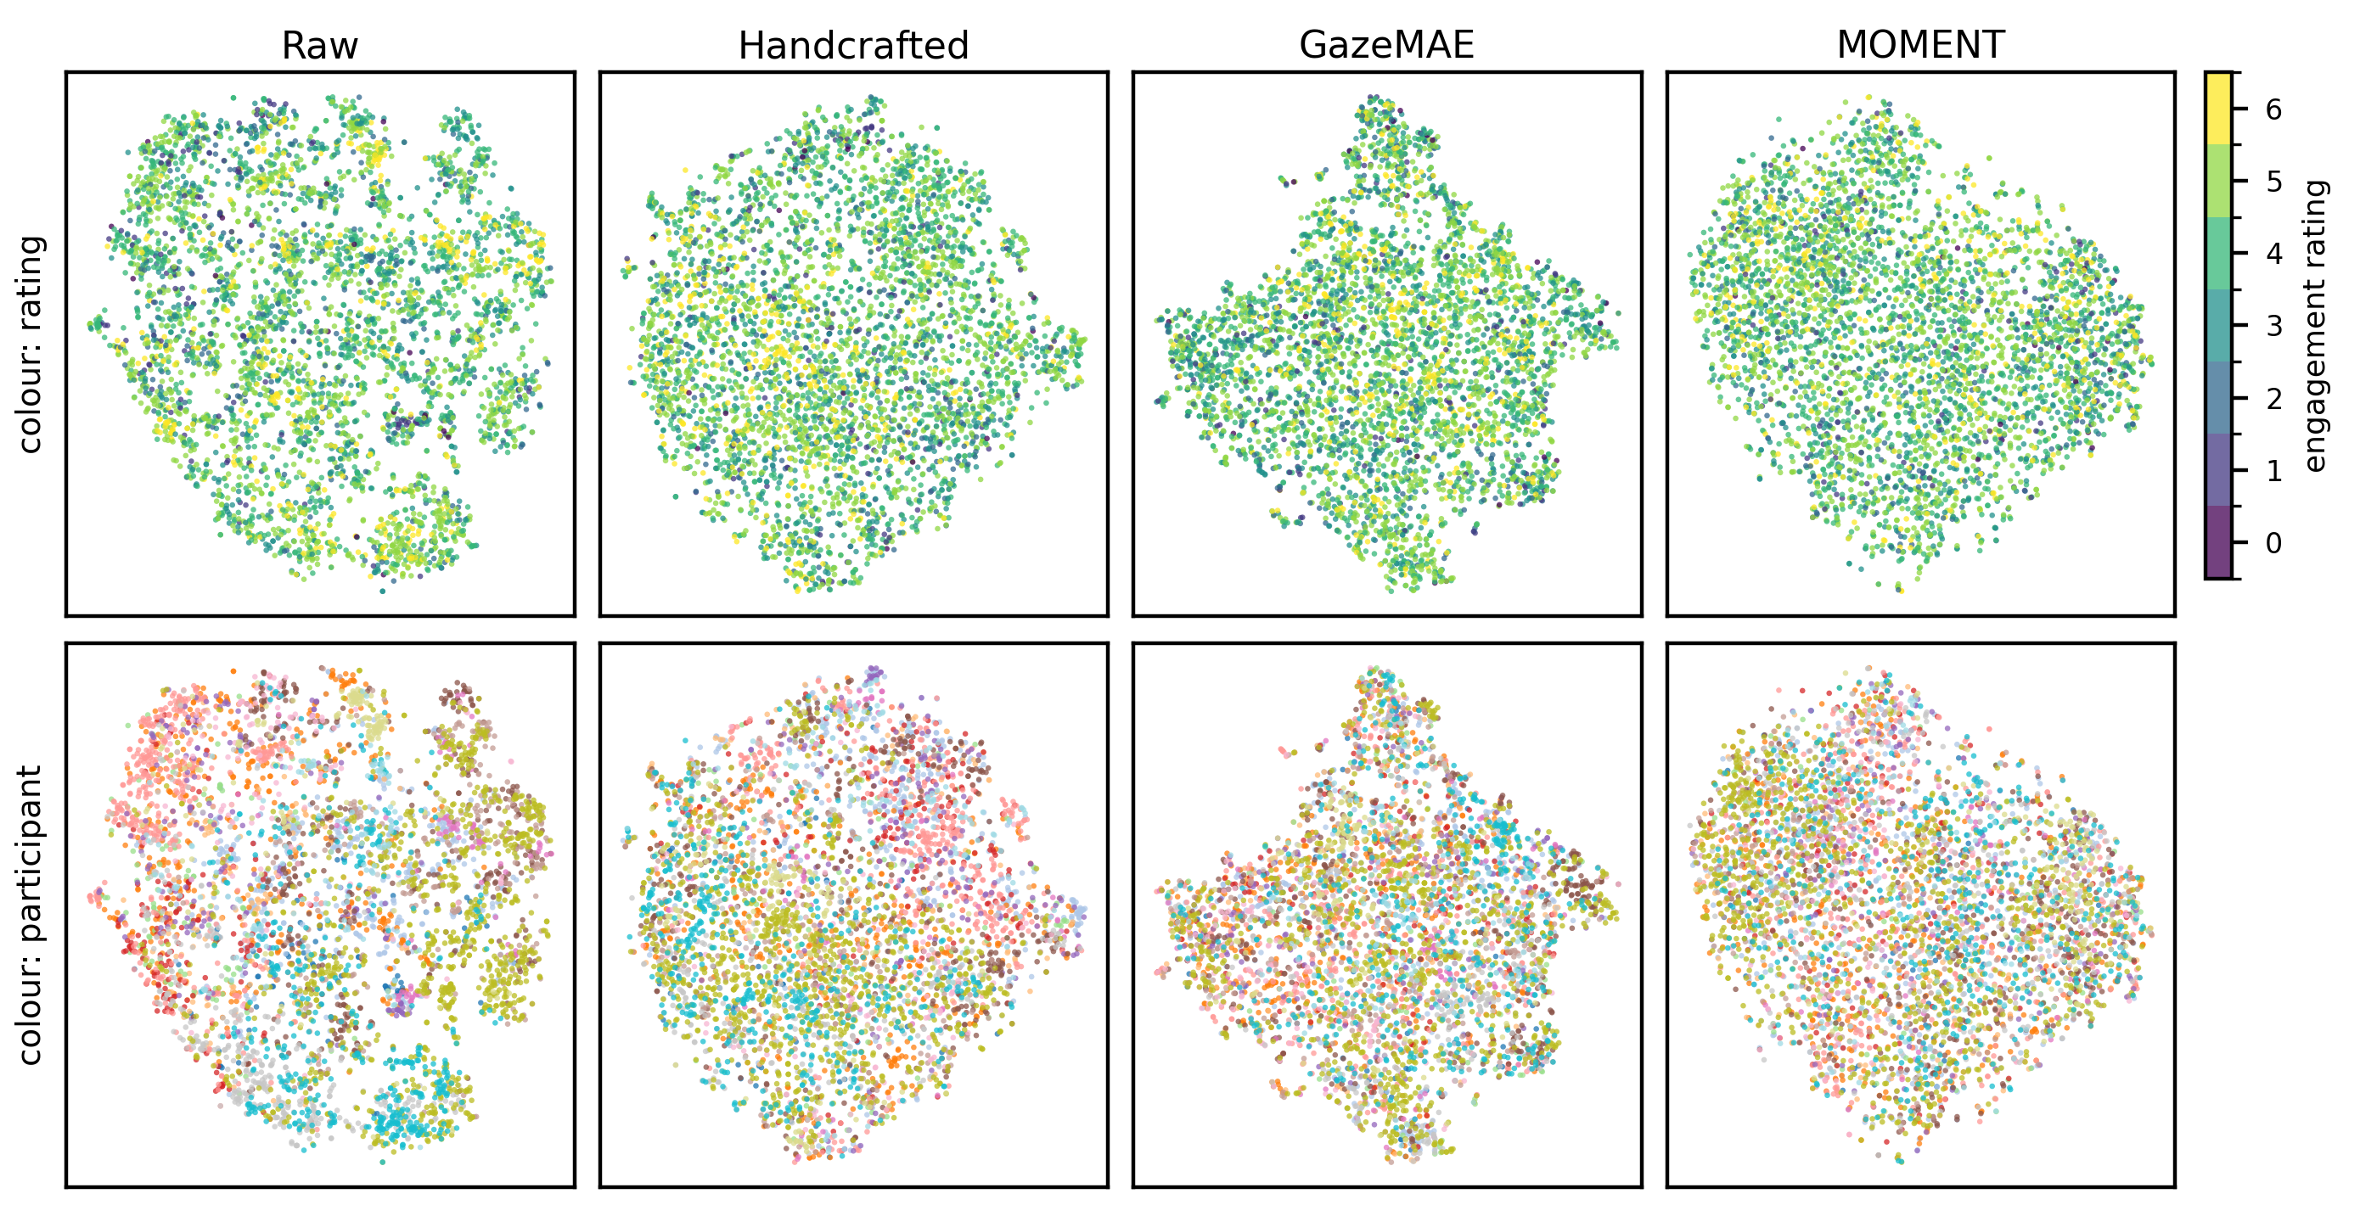
People, Not Engagement
t-SNE, 5,000 windows. Top: by engagement → no structure. Bottom: by participant → clusters.
4
Notes:
- Same four representations projected to 2-D.
- Top row coloured by engagement rating: no region follows engagement in any representation.
- Bottom row coloured by participant: clear clusters in raw, weaker in handcrafted and GazeMAE, almost none in MOMENT.
- So the strongest signal in gaze is who the person is, not how engaged they are — this is why testing on unseen people matters.

Slide 9
Conclusion and Discussion
Raw signal best, handcrafted close
  Frozen GazeMAE and MOMENT did not help
Engagement across people is hard to predict
  Results near chance, large subject variability
Practical: start with raw or handcrafted
Future work
  Fine-tune encoders on office gaze
  Personalisation, longer windows
4
Notes:
- Under a fair, subject-disjoint comparison, the simplest input — raw signal — gave the best result; handcrafted close behind.
- Frozen pretrained encoders did not help: likely a mismatch — trained on lab eye-tracking or generic time series, not day-long office gaze.
- Predicting engagement in new people from 3-s windows in real office work is hard.
- Practical advice: start with raw or handcrafted features; don't expect a frozen encoder to help.
- Next: fine-tune the encoders, personalise to new users, try longer windows.
- Thank you — happy to take questions.

Slide 10
Results: All Metrics
 | Bal. acc. | SD | Macro-F1 | ROC-AUC | Acc.
Majority baseline | .500 | .000 | .326 | .500 | .524
Raw, RF | .536 | .075 | .464 | .550 | .528
Raw, MLP | .534 | .050 | .472 | .553 | .542
Handcrafted, RF | .508 | .035 | .418 | .527 | .528
Handcrafted, MLP | .521 | .032 | .451 | .535 | .531
GazeMAE, RF | .510 | .027 | .441 | .514 | .540
GazeMAE, MLP | .505 | .031 | .447 | .508 | .532
MOMENT, RF | .501 | .013 | .380 | .504 | .521
MOMENT, MLP | .497 | .010 | .362 | .504 | .507
LOSO, mean over held-out participants; SD of balanced accuracy across participants. Best per metric in bold.
4
Notes:
- Only if asked. Paper Table 1.
- GazeMAE RF has good plain accuracy (.540), but plain accuracy partly reflects each person's class balance — that's why balanced accuracy is primary.

