Slide 1
SCAI · Information Society 2026 · Ljubljana
Comparison of Eye-Tracking Representations for Engagement Inference in Knowledge Workers
Tomi Božak, Zoja Anžur, Gašper Slapničar
Jožef Stefan Institute · Jožef Stefan International Postgraduate School
29th International Multiconference Information Society · 5–9 October 2026
Notes:
TIME: ~0:30 (cumulative 0:30)
• Good morning/afternoon, I'm Tomi Božak from the Jožef Stefan Institute; joint work with Zoja Anžur and Gašper Slapničar.
• One-sentence pitch: before you train any model on eye-tracking data you have to decide how to represent a gaze window — we compared four common options under one fair, leakage-safe protocol.
• Spoiler to keep in mind: the simplest option, the raw signal, did best — but everything was close to chance.

Slide 2



Why eye tracking for engagement at work?
Engagement fluctuates
Momentary immersion changes within a working day and is barely visible in application logs.
Target (experience sampling)
“Right now I am immersed in my work”
Gaze is continuous and non-intrusive
A screen-mounted tracker gives pupil size, gaze position, fixations, saccades and blinks without any user action.
Rated in situ on a 0–6 scale, several times per working day. We call it the engagement rating.
Adaptive systems need the state
Interactive systems that adapt to the user need evidence of their momentary psychological state.
Notes:
TIME: ~1:00 (cumulative 1:30)
• Knowledge work: engagement — specifically immersion in the task — changes during the day, and logs of app usage tell us little about it.
• Eye tracking is attractive because it is continuous and passive: pupil size, fixations, saccades, blinks, gaze position — the user does nothing.
• Our target comes from experience sampling: participants are prompted during the day and answer "Right now I am immersed in my work" on a 0–6 scale — rated in the moment, not recalled later.
• That single item is what we try to predict from gaze.

Slide 3



Before any model: how do you represent a gaze window?
Raw signals
Handcrafted
GazeMAE
MOMENT
600-d
181 → 58–60
256-d
1,024-d
5 channels (pupil L/R, gaze x/y, eye–screen distance), resampled to 120 samples and flattened.
Ocular blink, fixation, saccade, pupil, distance and missingness statistics; filtered per fold.
Pretrained gaze-specific autoencoder on position + velocity; kept frozen.
Pretrained general time-series foundation model (MOMENT-1-large); kept frozen.
Pipeline cost: Lowest
Pipeline cost: Medium
Pipeline cost: High
Pipeline cost: High
They differ in effort, storage and compute — yet are rarely compared on the same windows, labels and split.
Notes:
TIME: ~1:15 (cumulative 2:45)
• A window of gaze data can reach a classifier in at least four ways — go left to right.
• Raw: just the five tracker channels, resampled and flattened — no domain knowledge, high dimensional.
• Handcrafted: the classic ocular features — blinks, fixations, saccades, pupil — interpretable, from our earlier work.
• Two learned options, both used frozen, out of the box: GazeMAE is gaze-specific, MOMENT is a general time-series foundation model.
• Key point: costs differ a lot, but published results use different windows, labels and — most importantly — validation protocols, so they cannot be compared.

Slide 4



Research question
Which eye-tracking representation supports the most reliable inference of self-reported momentary engagement in unseen knowledge workers?
Identical 3-s windows
Identical binary target
Identical leave-one-subject-out folds
Controlled comparison: only the representation changes.
Notes:
TIME: ~0:30 (cumulative 3:15)
• Read the question: which representation best supports inferring momentary engagement in people the model has never seen?
• "Unseen" is the point — a deployed system meets new users, so we test on held-out participants.
• Everything else is held fixed: same windows, same binary target, same folds. Only the representation changes.

Slide 5
Data: knowledge workers in the wild
17
657
140,531
60 Hz
participants
full-workday recordings
modelled 3-s windows
Tobii tracker, 5 channels
Recorded at participants' own workplace during their normal routine (multimodal study; eye tracking only here).
Experience-sampling prompts several times per day; each answer labels the preceding 15 minutes of recording.
3-s windows, 2.25-s step (25 % overlap); kept if ≥ 30 % valid frames and ≥ 32 valid frames.
Modelled windows ≈ 2 % of all recorded windows; 2,136–25,447 per participant. Dataset not yet public.
Notes:
TIME: ~1:00 (cumulative 4:15)
• Real-world data: knowledge workers recorded at their own desks over full working days — not a lab task.
• 17 participants, 657 workday recordings, 19–79 recordings per person.
• Labels: each experience-sampling answer is assigned to the 15 minutes before the prompt; only those labelled intervals are used.
• Windows are 3 s with 25 % overlap; quality thresholds are permissive because tracking loss is frequent in unconstrained office work.
• Result: about 140 thousand windows — roughly 2 % of everything recorded. Data collection is ongoing; dataset not public yet.

Slide 6
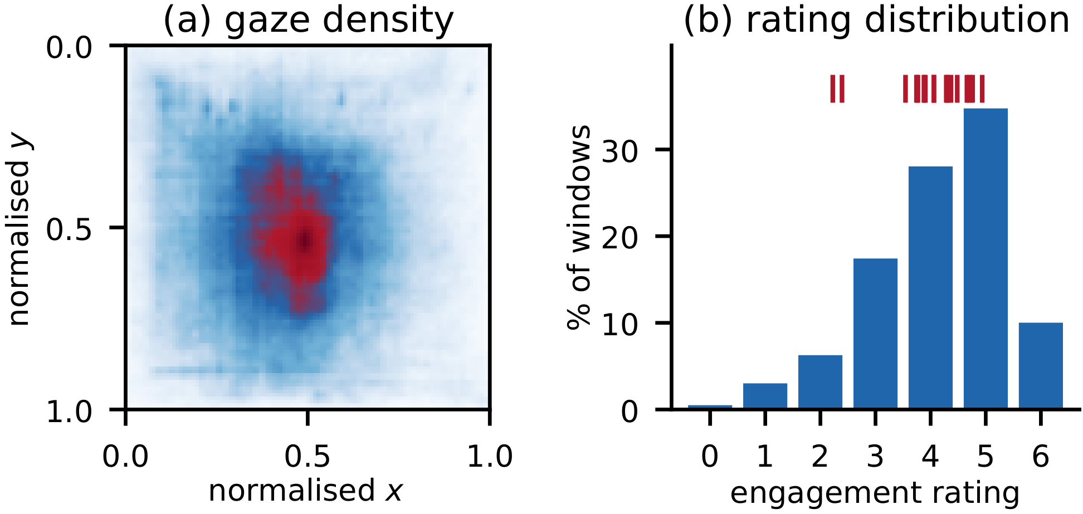

Engagement ratings are person-specific
Means span 2.2–4.9
An absolute threshold would mostly encode who the participant is.
Inside each fold, centre every training participant's ratings on their own mean.
Centre the held-out participant with the mean of training means — no test labels used.
Positive = centred rating > 0 → 57.9 % positive overall (0–95 % per participant).
(a) gaze density on the normalised display · (b) rating distribution; red ticks = the 17 participant means.
Notes:
TIME: ~1:15 (cumulative 5:30)
• Left: gaze concentrates at the screen centre but covers the whole display — 94.7 % of samples are on screen.
• Right: the rating distribution; the red ticks are the individual participant means — from 2.2 to 4.9 on a 0–6 scale.
• So one person's "4" is another person's "2". An absolute cut-off would mostly learn identity.
• We therefore centre ratings per participant, inside each fold. The held-out person is centred with the average of the training participants' means, so no test labels leak into the threshold.
• Binary target: above vs. below centre; 57.9 % positive overall, but 0–95 % depending on the person.

Slide 7




Leakage-safe evaluation protocol
Windows
4 representations
Per-fold preprocessing
3 predictors
Leave-one-subject-out
3 s, joined on one window ID across all four exports
Raw · Handcrafted · GazeMAE · MOMENT
Filtering, imputation, scaling fitted on training participants only
Majority baseline · Random forest (300 trees) · MLP
17 folds; test participant never seen in training
Primary metric: balanced accuracy
Chance is fixed at 0.500 in every fold, unlike plain accuracy, which tracks each participant's base rate. Secondary: accuracy, macro-F1, ROC-AUC. Unweighted mean over participants (16 two-class folds).
Notes:
TIME: ~1:00 (cumulative 6:30)
• Walk the pipeline left to right.
• All four exports are joined on one window identifier — every model sees exactly the same windows.
• Everything data-dependent — feature filtering, imputation, standardisation — is fitted on training participants only.
• Classifiers: majority baseline, random forest, and an MLP. Frozen encoders: only the classifier on top is trained.
• Leave-one-subject-out: 17 folds, the test person is never in training.
• Why balanced accuracy: positive rates differ strongly between people; balanced accuracy has chance at 0.5 everywhere. One participant had only one class, so 16 folds for balanced accuracy.

Slide 8
Raw signals ranked first — but all results are near chance
0.536
best balanced accuracy
raw + random forest
0.553
best ROC-AUC
raw + MLP
0.075
SD across participants
> the 0.036 margin over chance
Notes:
TIME: ~1:45 (cumulative 8:15)
• The chart shows balanced accuracy minus chance — so zero means no better than guessing.
• Raw signals are highest with both classifiers: 0.536 balanced accuracy with the random forest, 0.534 with the MLP; the MLP on raw also has the best AUC, 0.553, and best macro-F1.
• Handcrafted features come next overall — 0.521 with the MLP. GazeMAE is just above chance; MOMENT is at chance with both classifiers.
• Be honest about the size: the best margin is 3.6 points, and the spread across participants (SD 0.075) is larger than that margin and larger than the gap between raw and handcrafted.
• Both classifiers put raw first and MOMENT last; the two middle ones swap — so we don't claim an order between handcrafted and GazeMAE.
• (If asked: full table is in the backup slides.)

Slide 9
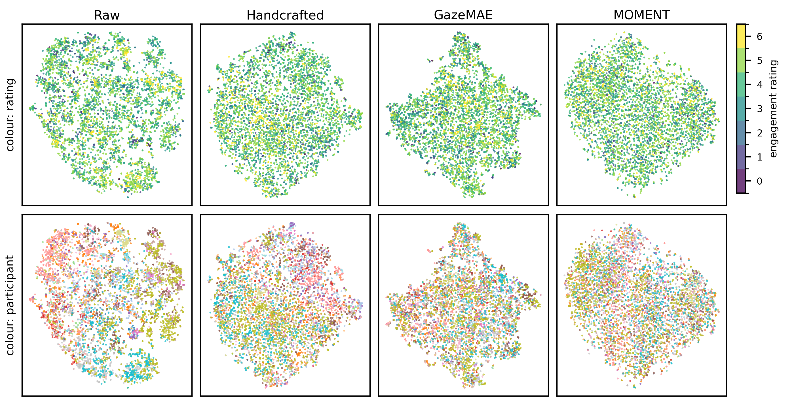

What the representations encode: people, not engagement
No region follows the engagement rating in any representation.
Participant patches: clear in raw, weaker in handcrafted and GazeMAE, near-uniform in MOMENT.
Exploratory view — not evidence of separability.
t-SNE of a common sample of 5,000 windows. Top: coloured by engagement rating. Bottom: coloured by participant.
Notes:
TIME: ~1:00 (cumulative 9:15)
• Same four representations, projected to 2-D with t-SNE, same 5,000 windows.
• Top row, coloured by engagement: no region follows the rating — in raw or in the learned embeddings.
• Bottom row, same projections coloured by participant: raw forms clear per-person patches; handcrafted and GazeMAE weaker; MOMENT almost uniform.
• Message: the most visible structure in gaze windows is the person, not their engagement — which is exactly why subject-disjoint evaluation matters.
• Caveat: projections are exploratory; we don't draw conclusions about separability from them.

Slide 10


Why no gain from frozen encoders — and what to use
Practical guidance
Pretraining mismatch
Raw signals
GazeMAE: pretrained on controlled stimulus-viewing corpora.
MOMENT: pretrained on generic time-series benchmarks.
Office gaze: day-long, spontaneous, with dropouts, idle stretches and heterogeneous displays.
Our result concerns frozen transfer only — fine-tuning is untested.
Simplest pipeline: no feature engineering, checkpoint or encoder pass.
Handcrafted features
Close behind and interpretable; effective on related targets in earlier work.
Frozen general encoder
Not supported as a default choice here.
Notes:
TIME: ~1:15 (cumulative 10:30)
• Our interpretation for the encoders: a domain mismatch. GazeMAE learned from controlled viewing experiments; MOMENT from generic time-series benchmarks. Neither has seen day-long, spontaneous office gaze with dropouts and different monitors.
• Important scope: we only tested frozen encoders — the out-of-the-box setting a practitioner tries first. Fine-tuning may change the picture.
• Practical guidance: start with raw windows — cheapest pipeline. Keep handcrafted features in mind when you need interpretability. Don't assume a frozen general-purpose encoder will help.

Slide 11


Limitations and next steps
Limitations
Next steps
One unpublished, still-growing dataset; 17 participants.
Target: one noisy self-report item, assigned to a 15-min interval and binarised.
Overlapping windows and repeated labels shrink the effective sample size.
One windowing scheme, one seed, one QC rule set, two public checkpoints.
Fine-tune the encoders on office gaze — starting with GazeMAE.
Calibrated personalisation for new users.
Longer windows and aggregated targets matching how engagement is reported.
Validate the comparison on further datasets.
Notes:
TIME: ~1:00 (cumulative 11:30)
• Limitations, briefly: a single, still-growing dataset of 17 people; the label is one noisy self-report spread over 15 minutes; overlapping windows mean the effective sample is smaller than 140k.
• Also one windowing scheme, one seed and two specific checkpoints — the ranking is preliminary guidance, not a definitive benchmark.
• Next: fine-tune the encoders on office gaze (GazeMAE came closest to handcrafted), personalised calibration for new users, and longer windows / aggregated targets that match how people actually report engagement.

Slide 12
Take-home messages
1
Under a leakage-safe, subject-disjoint protocol, raw gaze windows gave the highest observed result (0.536 balanced accuracy, 0.553 ROC-AUC).
2
Frozen GazeMAE and MOMENT embeddings did not improve on raw signals, despite higher preprocessing and compute cost.
3
Cross-person engagement inference from 3-s office gaze is hard: between-participant spread exceeds the differences between representations.
Thank you — questions?
tb85088@student.uni-lj.si
Notes:
TIME: ~0:45 (cumulative ~12:15)
• Three things to remember.
• One: under a fair, subject-disjoint protocol, the simplest representation — raw gaze windows — gave the best observed results.
• Two: frozen pretrained encoders did not help, despite costing more.
• Three: the task itself is hard in the wild — person-to-person variation is bigger than the differences between representations.
• Thank the audience and the funders (ARIS N1-0319, SNSF 214991 — Weave project). Invite questions.

Slide 13
Backup: full leave-one-subject-out results
 | Bal. acc. | Δ | SD | Macro-F1 | ROC-AUC | Acc.
Majority baseline | .500 | — | .000 | .326 | .500 | .524
Raw, RF | .536 | +.036 | .075 | .464 | .550 | .528
Raw, MLP | .534 | +.034 | .050 | .472 | .553 | .542
Handcrafted, RF | .508 | +.008 | .035 | .418 | .527 | .528
Handcrafted, MLP | .521 | +.021 | .032 | .451 | .535 | .531
GazeMAE, RF | .510 | +.010 | .027 | .441 | .514 | .540
GazeMAE, MLP | .505 | +.005 | .031 | .447 | .508 | .532
MOMENT, RF | .501 | +.001 | .013 | .380 | .504 | .521
MOMENT, MLP | .497 | −.003 | .010 | .362 | .504 | .507
Balanced accuracy is primary (chance 0.500); Δ = paired improvement over the majority baseline; SD across participants. All metrics except accuracy over the 16 two-class folds. Dimensionality: raw 600, handcrafted 58–60, GazeMAE 256, MOMENT 1,024. Best per metric in bold.
Notes:
BACKUP — show only if asked.
• Table 1 of the paper. Bold = best per metric column.
• GazeMAE RF has the second-best plain accuracy (.540), but plain accuracy partly reflects each participant's base rate, which is why it is secondary.
• Rounded gap raw RF vs best handcrafted = .536 − .521 = .015 (0.0156 at full precision).

Slide 14
Backup: representation details and sanity check
Raw: 5 channels linearly resampled to 120 samples (whole 3-s window), flattened to 600-d; gaze normalised to [0,1] per display resolution.
Handcrafted: offline event detection (blinks from 90–400 ms gaps, I-DT fixations, saccades between fixations); per-fold filter drops >60 % missing, zero variance, correlation > 0.8 → 58–60 of 181 features.
GazeMAE: public micro–macro checkpoints, position + velocity at 500 Hz, rescaled to 35 px per degree of visual angle; 128 + 128 = 256-d.
MOMENT-1-large: input length 512, mean pooling, 1,024-d; RevIN standardises each channel per window.
MLP: 1028–512–256–128–64, GELU, layer norm, Adam (lr 2e-4, wd 1e-3), early stopping on a 20 % stratified split. Single seed.
Persistence check
0.960
balanced accuracy of carrying the last label forward within recordings (1,434 blocks, 13 two-class participants).
Labels are constant over each 15-min interval by construction — not comparable with the cross-person results.
Notes:
BACKUP — show only if asked.
• Likely questions: why GazeMAE rescaling (the encoder expects 35 px per degree; displays and viewing distances differ between participants); why MOMENT needs no rescaling (RevIN per-window standardisation).
• Physical monitor sizes are not in the data — standard monitor sizes per resolution were assumed, combined with measured eye–screen distance.
• Persistence: 0.999 accuracy, 0.960 balanced accuracy, 0.965 macro-F1 — shows labels are highly autocorrelated because one answer covers 15 minutes; it uses the participant's own labels, so it is not a competitor to the LOSO models.

