Slide 1
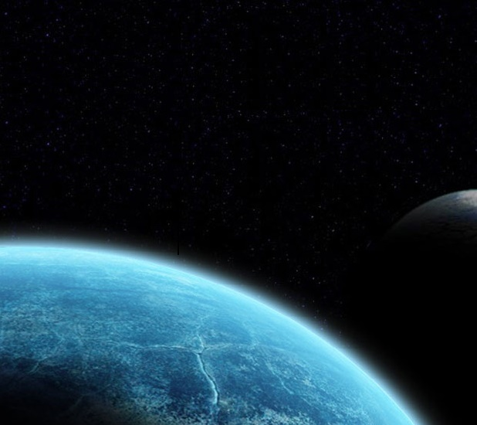
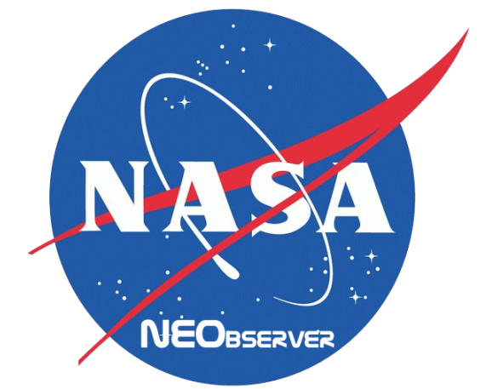

A social network for Near Earth Objects
Team: Galactic Guardians

Slide 2
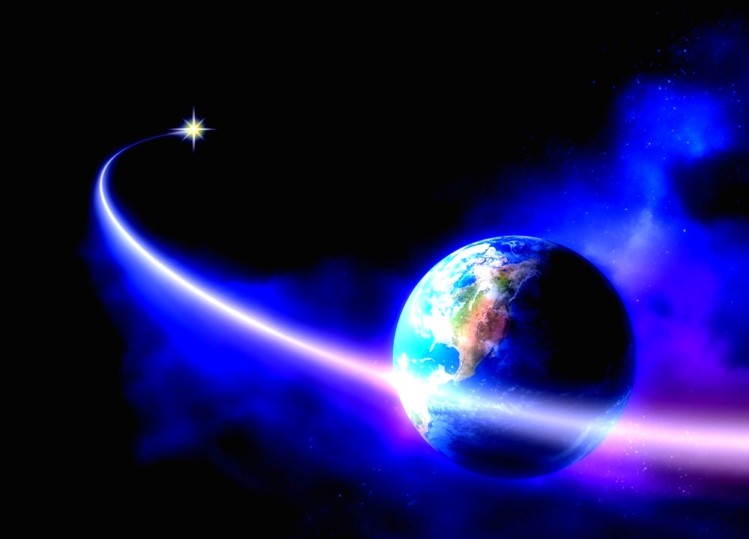
The challenge
Create a more interactive way of submitting, viewing and studying new NEO (Near Earth Object) discoveries.

Slide 3
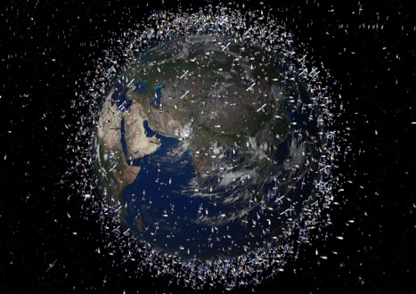
Our solution
We created an interactive social network where more citizen astronomers can:
Submit new NEOs
Keep Track of other citizen
discoveries
Rank other NEOs
By doing all of this, the user will get “points” and obtain a higher status in the social network, which will be shown in their profile.

Slide 4
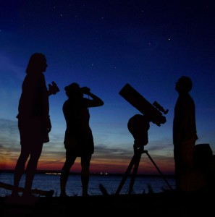
Perks
NEOs with a certain ranking will be considered to become an official discovery by NASA
By developing a more attractive and intuitive way, the participation of citizen astronomers in this subject will increment

