Slide 1

Reach for the stars
Little space

Slide 2
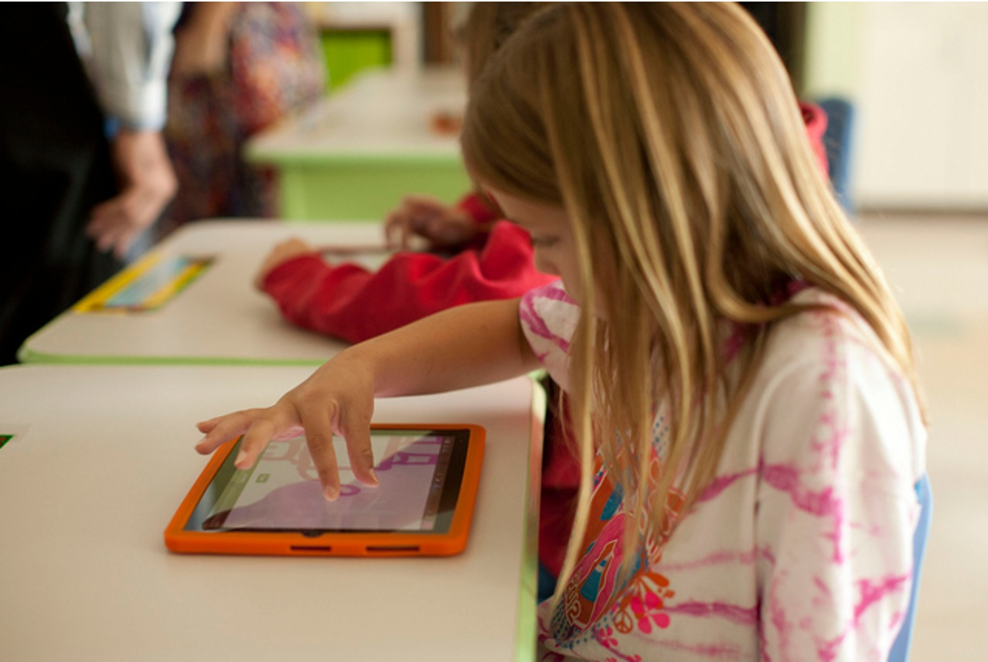
Challenge Description
The challenge we chose was to create an app for kids, to inspire more youth participation in space exploration, and to encourage the development of STEM skills.

Slide 3
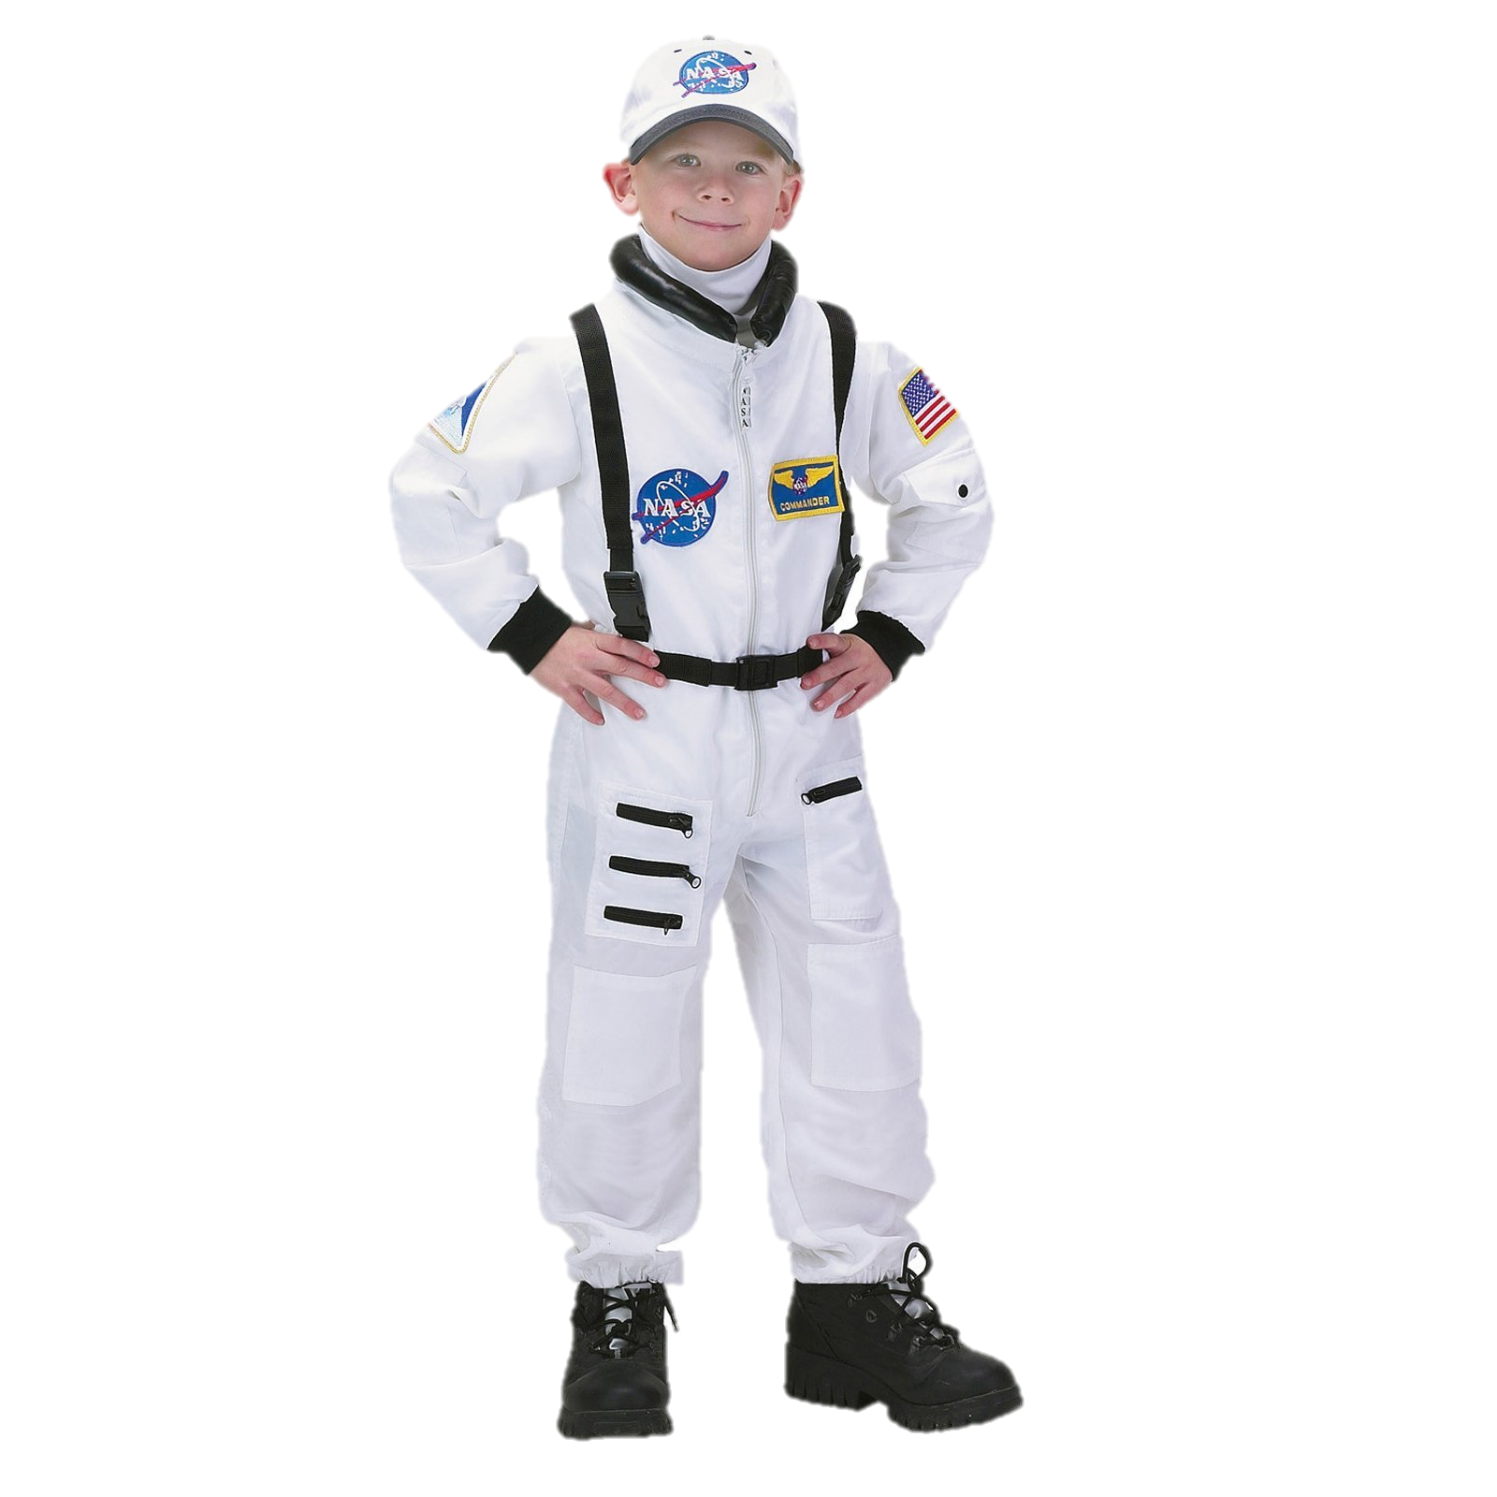
Target market
We decided to focus our target market to kids between the age of 4 and 8 years old.
We think its very important to encourage the desire for knowledge to Young kids as son as possible, but also at a old enough age so they are able to understand more complex topics.

Slide 4
Creating process
First, we decided the challenge , then we triend to think how we would implement it.
We thought of an interface that made the learning experience easy.
We designed and looked for all the graphic material we needed.
We programed the interface and games so that they would be interactive and fun!

Slide 5
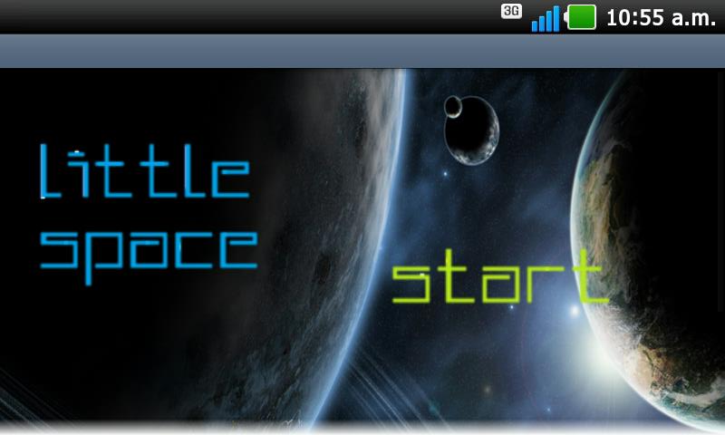
App photos

Slide 6
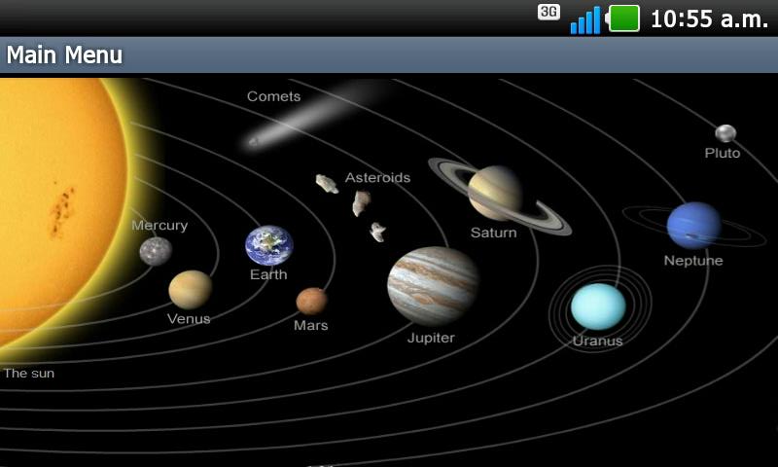

Slide 7
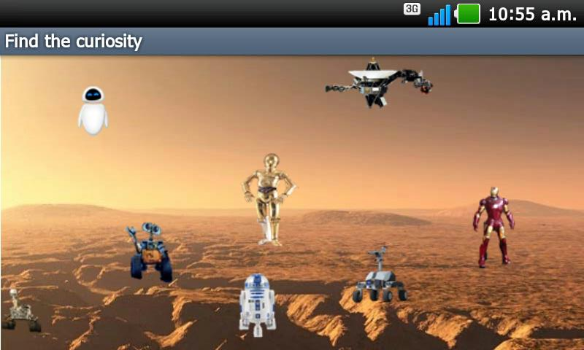

Slide 8
Conclusion
By implementing a new way of helping children to learn about the space, the time teach us how to work in team and that nothing is impossible, the only thing that you need to do is to put your best effort on it.

