Slide 1
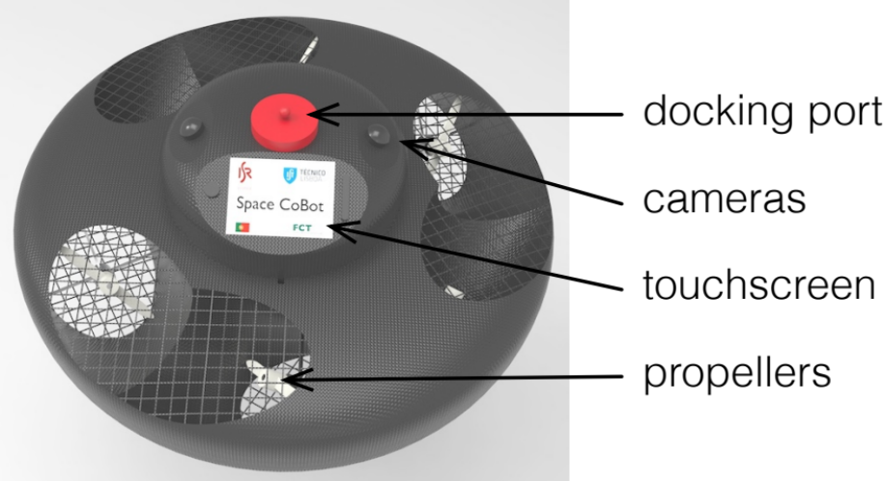
Space CoBot: modular design of an holonomic aerial robot for indoor microgravity environments
Pedro Roque¹ and Rodrigo Ventura¹,
¹Institute for Systems and Robotics, Instituto Superior Técnico, Universidade de Lisboa, Portugal
Aerial vehicle for collaborative tasks inside a space stations
Hexrotor design with tilted propellers for omni-directional motion
Design optimization to maximize thrust along all directions
Convergent position and attitude control

