Slide 1

INVESTOR PRESENTATION
Spur
Elegance. Speech. Redefined

Slide 2
01
MARKET OPPORTUNITY
The global wearable AI market is projected to reach $48.82B, while smart rings are scaling into a fast-growing category
TAM $48.82B
4M+
SAM $417.5M
2025E Global Smart Ring Shipments
SOM*
$130.7M
22.5%
Global Smart Ring Market CAGR (2026–2033)
TAM: Global Wearable AI | SAM: Global Smart Rings | SOM*: APAC Launch Assumption
* $130.7M = $417.5M × 31.3% APAC share; a serviceable-market estimate, not projected company revenue.
Sources: Fortune Business Insights (2026-07-20); Grand View Research (2026); Omdia (2025-11)
01
Notes:
[Sources]
- Fortune Business Insights, Wearable AI Market, updated 2026-07-20: 2025 global market USD 48.82B; https://www.fortunebusinessinsights.com/wearable-ai-market-109561
- Grand View Research, Smart Rings Market 2026-2033: 2025 global market USD 417.5M; APAC share 31.3%; CAGR 22.5%; https://www.grandviewresearch.com/industry-analysis/smart-rings-market-report
- Omdia, Empowering the Health and Fitness Ecosystem with Smart Rings, 2025-11: 2025 full-year shipment forecast just over 4M units; https://omdia.tech.informa.com/blogs/2025/nov/empowering-the-health-and-fitness-ecosystem-with-smart-rings
- calculation: USD 417.5M × 31.3% = USD 130.7M; this is a serviceable-market scenario based on an APAC launch assumption, not a reported company revenue opportunity.

Slide 3

02
PROBLEM
Important ideas and decisions are often lost because they are not captured in the moment
Plenty of tools can record, but the path from instant capture to understanding to action is still broken.
01
02
03
USER FRICTION
FRAGMENTED CONTEXT
CURRENT SOLUTIONS
Too late to capture. Too hard to find.
Personal context is scattered across tools
Capture tools do not fit real-world moments
Ideas, commitments and critical details disappear quickly. Pulling out a phone interrupts the moment, while long recordings are rarely organized.
Recordings, notes, chats and meeting tools remain siloed. AI assistants lack continuous, first-hand personal context.
Phones and recorders take effort to start;
meeting transcription depends on fixed settings;
most smart rings focus on health, not voice memory.
Outcome: lost ideas and missed tasks
Outcome: information exists, but is hard to find or reuse
Outcome: frequent micro-moments remain underserved
Opportunity: connect the lowest-friction voice interface with searchable, actionable personal AI memory.
02
Notes:
[Sources]
- Problem framing is strategic synthesis for the user-provided AI recording ring concept. It introduces no quantified market, user or company-performance claims.

Slide 4
03
SOLUTION
Existing solutions span multiple form factors, but none closes the execution loop without friction
Hardware ranges from no added cost to ~¥2,000. Free quotas and subscriptions vary; the real differences are wearability, organization and action.
Cards & Recorders
Pin / Headset / Recorder Pod
DingTalk / Phone / App
AI Rings
¥300–2,000
¥899–1,399
¥0–1,299
$229–299
e.g. Plaud Note ¥1,150; recorders ¥300–2,000
Strengths: dual-mode / 30h / 64GB; strong audio & battery
Limits: extra device; weak organization
e.g. NotePin S / iFlytek Pro 2 / Anker recorder pod
Strengths: wearable; Chinese ASR; 5m pickup
Limits: clip / in-ear / carry; no execution loop
e.g. A1 / A1 Pro / phone recorder / FLOMO
Strengths: enterprise collaboration or no hardware cost
Limits: ecosystem lock-in; phones interrupt ideas
e.g. Stream / Vocci
Strengths: private mic, haptics and gestures
Limits: limited vertical models; no Agent execution loop
COMMON GAPS ACROSS CURRENT PRODUCTS
① Capture still requires carrying, clipping, wearing or reaching for a phone
② Transcription is mature, but cross-platform capability is limited
③ End-to-end AI Agent execution remains unresolved
03
Notes:
[Sources]
- All product names, prices, quotas, subscription terms, strengths and weaknesses on this slide are summarized exclusively from the workbook.

Slide 5







04
WHY NOW
Technology, cost, industry, ecosystem and user behavior are converging—opening a product window for lightweight AI wearables
01 TECHNOLOGY READY
On-device AI + LE Audio
for private wearable voice
05 COST CURVE
02 MARKET WINDOW
Inference cost down 280× in two years
Hardware + subscriptions now viable
4M+ units in 2025E
Policy + major players accelerate
WINDOW OPEN
BUILDABLE × SELLABLE × SCALABLE
04 OPEN ECOSYSTEM
03 USER BEHAVIOR
APIs and tool calling connect
calendars, tasks and knowledge
AI assistants + voice memory
become routine
Sources: Apple · Bluetooth SIG · Omdia · Stanford AI Index · NDRC China | 2025–2026
04
Notes:
[Sources]
- AI-generated abstract deep-space background created for this deck; no factual company claim implied.
- Apple Newsroom, 2025-06-09: Foundation Models framework enables offline, privacy-protected, free-of-cost on-device inference and built-in tool calling; https://www.apple.com/uk/newsroom/2025/06/apple-supercharges-its-tools-and-technologies-for-developers/
- Bluetooth SIG, LE Audio: LC3 delivers higher quality at lower bit rates and enables power/form-factor tradeoffs; https://www.bluetooth.com/learn-about-bluetooth/feature-enhancements/le-audio/
- Omdia, 2025-11: smart-ring shipments forecast just over 4M units for 2025; https://omdia.tech.informa.com/blogs/2025/nov/empowering-the-health-and-fitness-ecosystem-with-smart-rings
- Stanford HAI, AI Index Report 2025, Chapter 1: GPT-3.5-level inference cost fell more than 280-fold from November 2022 to October 2024; https://hai.stanford.edu/assets/files/hai_ai-index-report-2025_chapter1_final.pdf
- China NDRC, 2025-09-29: the AI+ action prioritizes adoption of next-generation intelligent terminals and agents and sets a 2027 adoption target; https://www.ndrc.gov.cn/xwdt/wszb/9yxwfbh/wzsl/202509/t20250929_1400770.html
- User-habit and ecosystem statements are strategic synthesis based on the public availability of AI assistants, speech transcription, model APIs and tool-calling frameworks; they are not presented as measured company traction.

Slide 6






05
SOLUTION
A wearable AI voice interface that captures ideas and conversations anywhere, then transcribes, organizes and summarizes them—and directs AI Agents by voice so nothing gets lost
PRODUCT LOOP
The AI recording ring captures the moment; the App and AI handle transcription, organization and recall.
01
AI Voice Ring
Meetings & Ideas
INITIAL USERS
Press to record | Lowest-friction capture
02
App
Sync, organize, search and revisit
Content Creators
Founders, product leaders and other communication-intensive professionals
Think it. Capture it. Turn it into action.
03
Personal AI Memory
Transcripts, summaries, tasks and reminders
CAPTURE → UNDERSTAND → ACT
05

Slide 7
06
SOLUTION
Turn fleeting voice moments into searchable, actionable personal memory
01
02
03
04
INSTANT CAPTURE
SYNC & MANAGE
AI UNDERSTANDING
PERSONAL MEMORY
Press to record
Stay in the moment
Audio syncs to the App
Stored and managed in one place
Transcribe · summarize · classify
Extract people and action items
Store important information and ideas for easy retrieval
From “I forgot” to always captured, automatically understood and instantly retrievable
[PLACEHOLDER] · CONFIDENTIAL
06

Slide 8
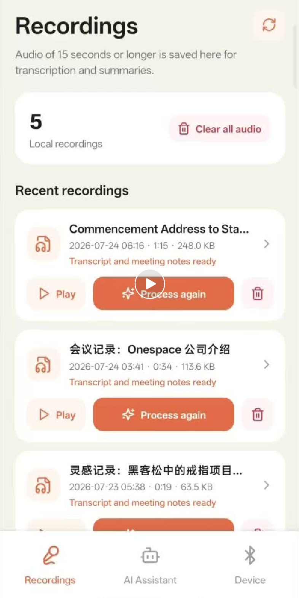
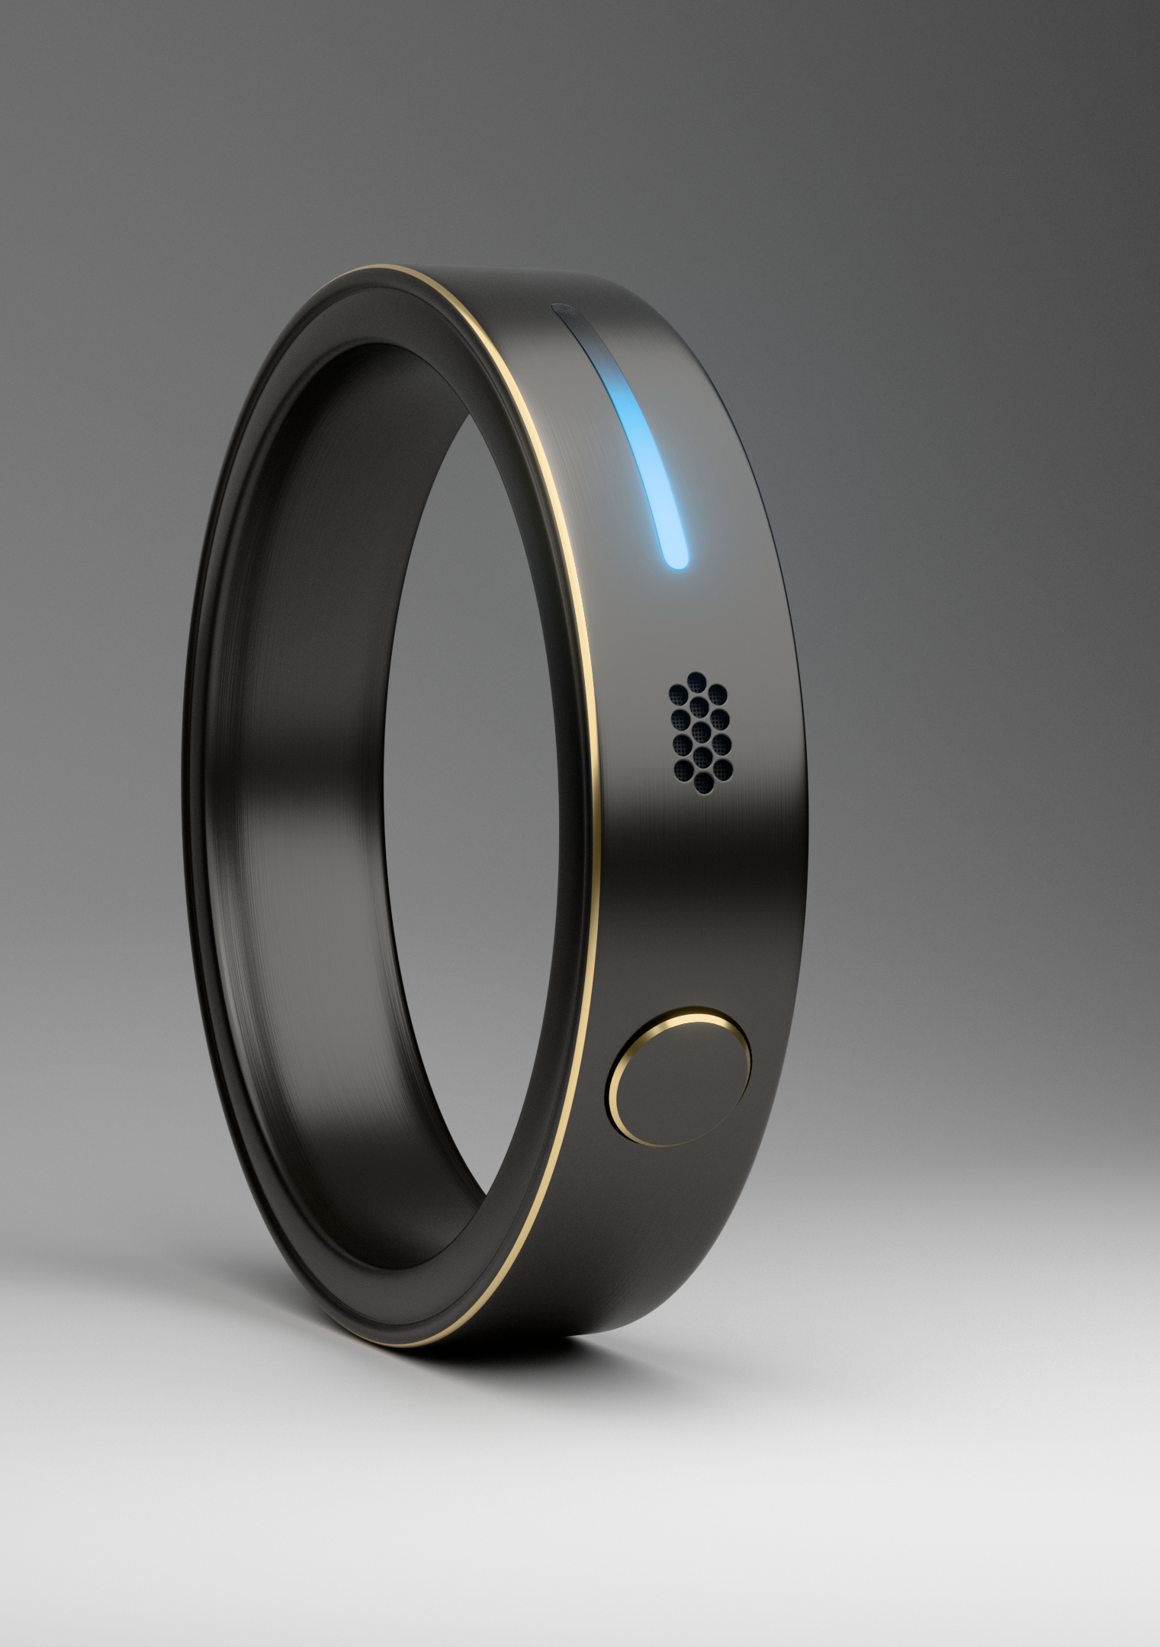
07
HERO PRODUCT
Turn fleeting ideas and long meetings into searchable, actionable personal knowledge—an essential everyday tool for work and life
VISUAL ASSET
One-touch ring recording removes the friction of opening a phone, launching an App and creating a note.
CORE CAPABILITIES
CORE PRODUCT
Recordings sync to the App for automatic transcription, summaries, categorization and tagging.
Use voice to connect with and control AI Agent tools such as Codex and OpenClaw, making the ring a universal Agent interface.
USE CASES
For creators, work and meetings: turn recordings directly into drafts, to-dos and meeting notes.
Capture creative or startup ideas with one press—while commuting or moving through daily life.
Weight ≤5g
Up to 8 hours of continuous recording
Up to 5m pickup range for small meetings
Water resistance
8MB–64MB SPI NOR roadmap
Secure local cache + incremental phone sync
PRODUCT DETAILS
07

Slide 9
08
TECHNOLOGY
A six-layer stack closes the loop: the ring captures, algorithms and AI understand, and personal memory improves with use
ECOSYSTEM APIs
Extensible API / Webhook / MCP | Connect calendars, tasks, knowledge bases and personal Agents
CLOUD MODELS
Multi-model routing + personal memory retrieval | Transcription, summaries, Q&A and action recommendations
DATA FLYWHEEL
Corrections, search and action feedback | Improve vocabulary, relationships and summary preferences
App
Sync, transcribe, organize, search and remind | Manage voice memory in one place
AUDIO INTELLIGENCE
Noise reduction, voice enhancement and segmentation | Accuracy in complex environments
HARDWARE
Button trigger + microphone + local storage + BLE | Battery / weight: [PLACEHOLDER]
CORE MOAT: HARDWARE INTERFACE × PERSONAL DATA × AI UNDERSTANDING × ECOSYSTEM CONNECTIVITY
08

Slide 10
09
BUSINESS MODEL
Subscription services could reach approximately 30% of revenue within 36 months
HARDWARE SALES
AI SUBSCRIPTION
SOFTWARE & SERVICES
$249–299 / unit
$9.99–14.99 / month
Usage-based / premium
Revenue mix: 90% → 68% | Gross margin target: 35% → 50%
Paid penetration: 15% → 35% | Revenue mix: 8% → 24%
Revenue mix: 2% → 8% | Focused on high-frequency power users
PROJECTED REVENUE MIX
Y1
90% HARDWARE
Y3
68% HARDWARE / 32% SUBSCRIPTION
DEVICE
SUBS.
SERVICES
Baseline excludes ODM / OEM, API licensing and ecosystem revenue share; add to the upside case after real orders are secured.
09
Notes:
[Sources]
- Sandbar Stream official store, accessed 2026-08-05: preorder price USD 249 and preorder-member data plan USD 10/month; https://shop.sandbar.com/
- Vocci official product page, accessed 2026-08-05: Pro plan USD 29.99/month or USD 239.99/year; https://vocci.ai/products/vocci-ring
- Oura official store and membership pages, accessed 2026-08-05: Ring 4 starts at USD 349; membership USD 5.99/month or USD 69.99/year; https://ouraring.com/store and https://ouraring.com/membership
- Forecast methodology: management-style base-case scenario created by Codex using public competitor price anchors. Hardware ASP, gross margin, paid penetration and revenue mix are assumptions—not company actuals or third-party market forecasts.

Slide 11
10
3-YEAR BUDGET
Starting with small-batch delivery, the model scales through validation, mass production and subscription growth to an estimated $31.2M in Year 3 revenue
Y1 | ENGINEERING & INITIAL DELIVERY
Y2 | MARKET VALIDATION & 2.0
Y3 | SCALE
3,000 units | ASP $299
25,000 units | ASP $279
100,000 units | ASP $269
UNITS / DELIVERIES
3,000 units
UNITS / DELIVERIES
25,000 units
UNITS / DELIVERIES
100,000 units
REVENUE
$0.92M
REVENUE
$7.70M
REVENUE
$31.20M
BLENDED GROSS MARGIN
36%
BLENDED GROSS MARGIN
45%
BLENDED GROSS MARGIN
52%
OPERATING EXPENSES
$1.20M
OPERATING EXPENSES
$3.20M
OPERATING EXPENSES
$8.00M
OPERATING CASH FLOW
−$0.87M
OPERATING CASH FLOW
+$0.27M
OPERATING CASH FLOW
+$8.20M
KEY BUDGET ASSUMPTIONS
ASP $299 / $279 / $269 · BOM $120 / $100 / $85 · AI $12.99/month · Paid penetration 15% / 30% / 35%
Model scope: hardware + subscription revenue; Y3 100,000 units equal ~2.5% of the 2025 global shipment baseline. Sources: Omdia · Oura · Vocci
10
Notes:
[Sources]
- Scenario methodology by Codex: Y1/Y2/Y3 unit shipments of 3,000 / 25,000 / 100,000; ASP USD 299 / 279 / 269; estimated BOM USD 120 / 100 / 85; AI subscription USD 12.99/month; paid penetration 15% / 30% / 35%. Subscription revenue uses an average active installed-base convention. Revenue, margin, operating expense and operating cash flow are scenario estimates, not company guidance.
- Omdia, 2025-11: global smart-ring shipments reached 1.6M in H1 2025 and were on track for rapid expansion; deck market slide uses the reported full-year forecast of just over 4M units. Y3 scenario shipments of 100,000 equal approximately 2.5% of that 2025 baseline; https://omdia.tech.informa.com/blogs/2025/nov/empowering-the-health-and-fitness-ecosystem-with-smart-rings
- Oura official store, accessed 2026-08-06: Oura Ring 4 starts at USD 349 and US membership is USD 5.99/month; https://ouraring.com/store/rings/oura-ring-4
- Vocci official product page, accessed 2026-08-06: Vocci Ring listed at USD 229; https://vocci.ai/products/vocci-ring
- Competitor price anchors support the modeled USD 269–299 hardware ASP range. BOM, margin, operating expense, penetration and cash-flow assumptions are not externally reported facts and require supplier quotes and management validation.

Slide 12
11
PRODUCTION PROGRESS
Strategic direction, market positioning, technical architecture and feasibility are established, with functional hardware and software prototypes in place. Next: engineering and reliable delivery
STRATEGY & MARKET
TECHNOLOGY & PROTOTYPE
COMPONENTS & SUPPLY CHAIN
ENGINEERING & SUPPLIER LOCK
COMPLETE
COMPLETE
ASSESSMENT COMPLETE
IN PROGRESS
Strategic direction and positioning
are aligned
Technical architecture and feasibility explored
Functional hardware/software prototypes complete
Core components and suppliers
screened and evaluated
Engineering validation pending
Core components and suppliers to be finalized
11

Slide 13
12
FUNDRAISING
Raising $1.2M to complete engineering validation, product deployment and market validation
• Core team & company setup
• EVT / DVT / PVT through a 1,000-unit build
• App / AI / cloud deployment
• IP, certification & compliance
• Research, crowdfunding & alpha validation
EXPECTED OUTCOMES
ANGEL ROUND
US$1.2M
EXECUTION
EVT FEASIBLE
↓
DVT STABLE
↓
PVT READY
↓
1,000-UNIT DELIVERY
≈15% EQUITY
NOW
M1–3
M4–7
M8–12
8–12 MONTH RUNWAY
DONE
EVT
DVT
PVT
• Strategy / market / tech
• Feasibility & supplier review
• Functional prototypes
• Core team
• Engineering prototypes
• Component / supplier lock
• Reliability / battery / connectivity
• App / AI / cloud
• IP / certification / compliance
• Production & yield
• 1,000-unit pilot
• Research / crowdfunding / alpha
CORE QUESTIONS
① Will users buy and use it?
② Can it be mass-produced and delivered reliably?
③ Is an AI Agent interface a real user need?
12

Slide 14
13/ CLOSING
THANK YOU
CONTACT
Website: https://www.hispurring.com/#top

