Slide 1
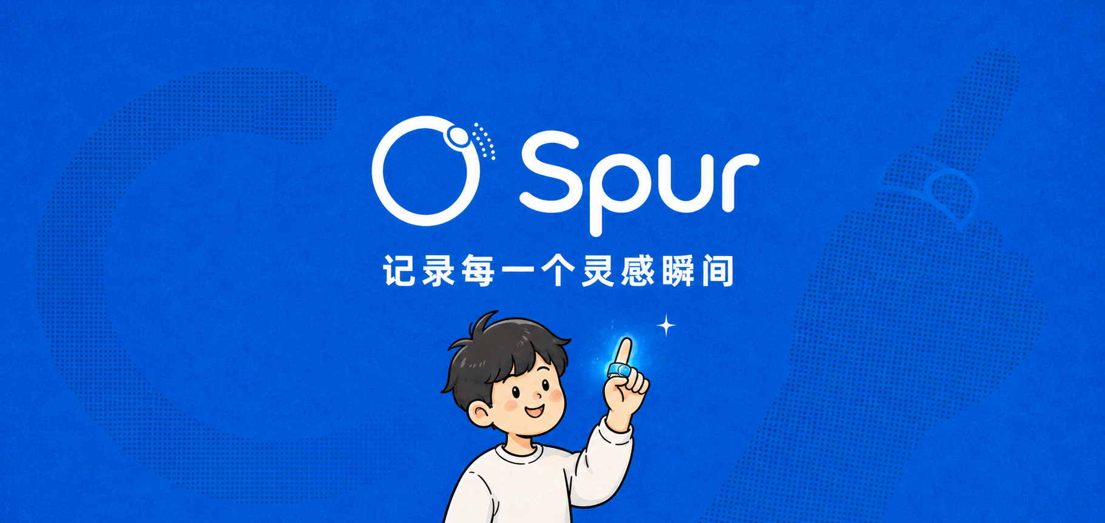

Your personal AI agent
Spur Ring
A ring on your finger. A private voice entry to your AI—capture ideas and meetings, get organized results in the Spur app.
On your hand
One press to capture voice—no need to unlock your phone.
Organized for you
Transcripts, notes, and meeting summaries in the Spur app.
Ready to act
Turn what you said into tasks and documents you can use.
Scan to take the survey
www.hispurring.com
17302289985@163.com

