Slide 1
Space Game
Johnathan Snyder, Brian Tillery, Craig Robinson

Slide 2
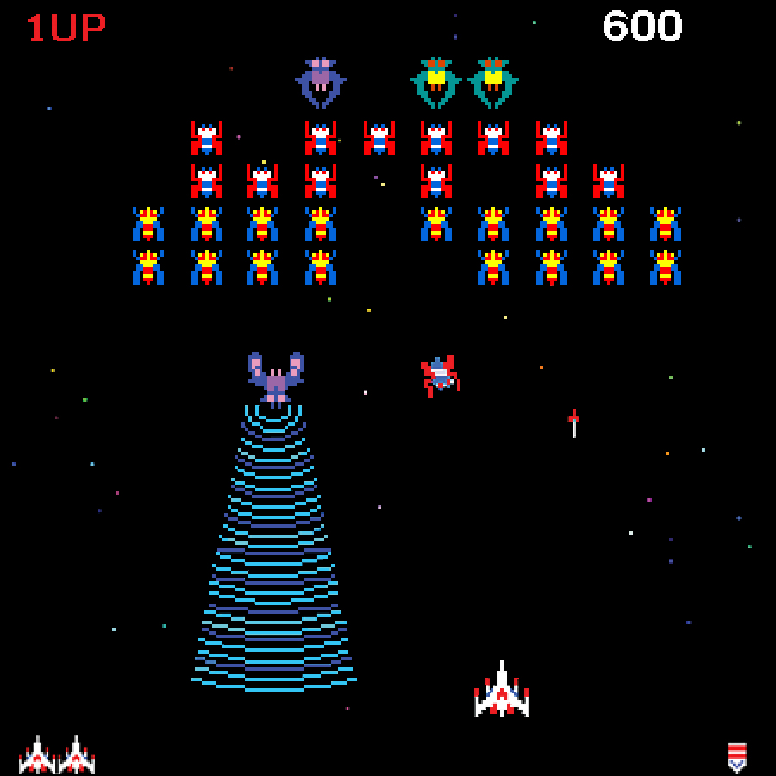
The Goal
The goal of Space Game is simple: to provide a fun, free, and engaging experience to a general audience.
The great spaceship games of yesterday provide an inspiration to create a fresh new outlook on exploring the final frontier with the mobile computing capabilities of today.

Slide 3
Scope of System
Currently, Space Game is only designed for Google’s Android platform and is purely intended as a form of entertainment for any participating user.
All progress, high scores, and other data will be stored locally in a database.

Slide 4
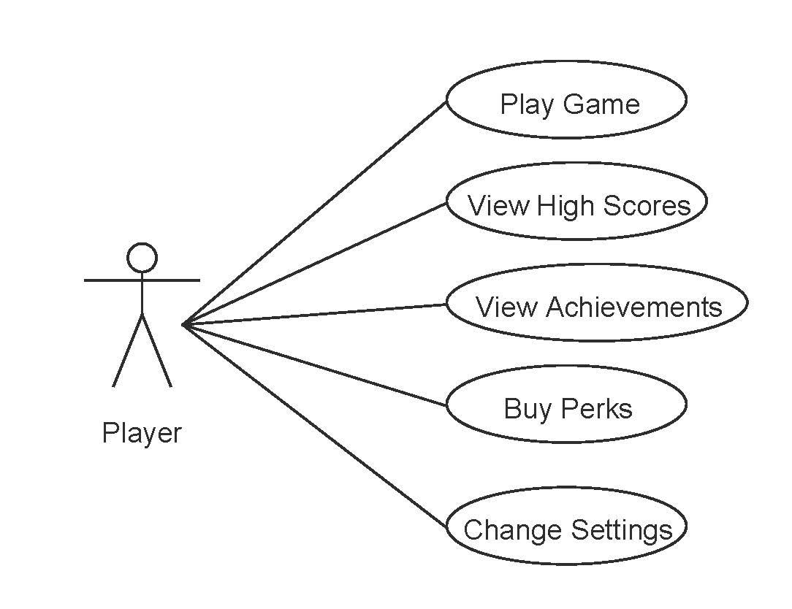
Use Case #1 - User at Main Menu

Slide 5
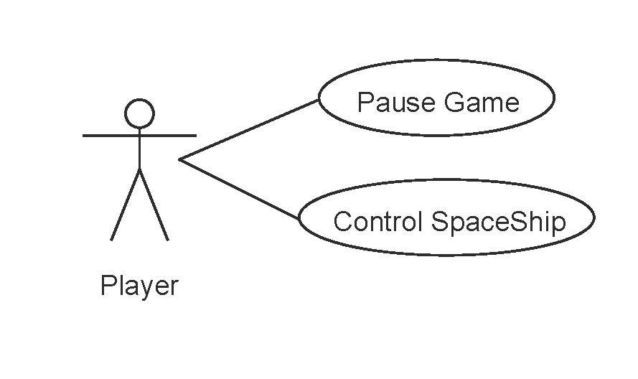
Use Case #2 - User In-game

Slide 6
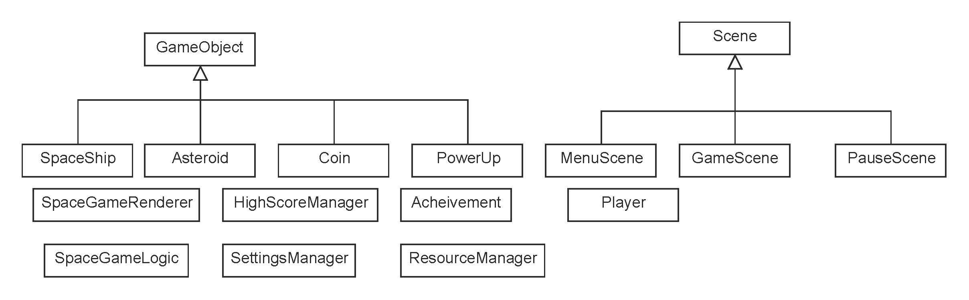
High Level Class Diagram

Slide 7
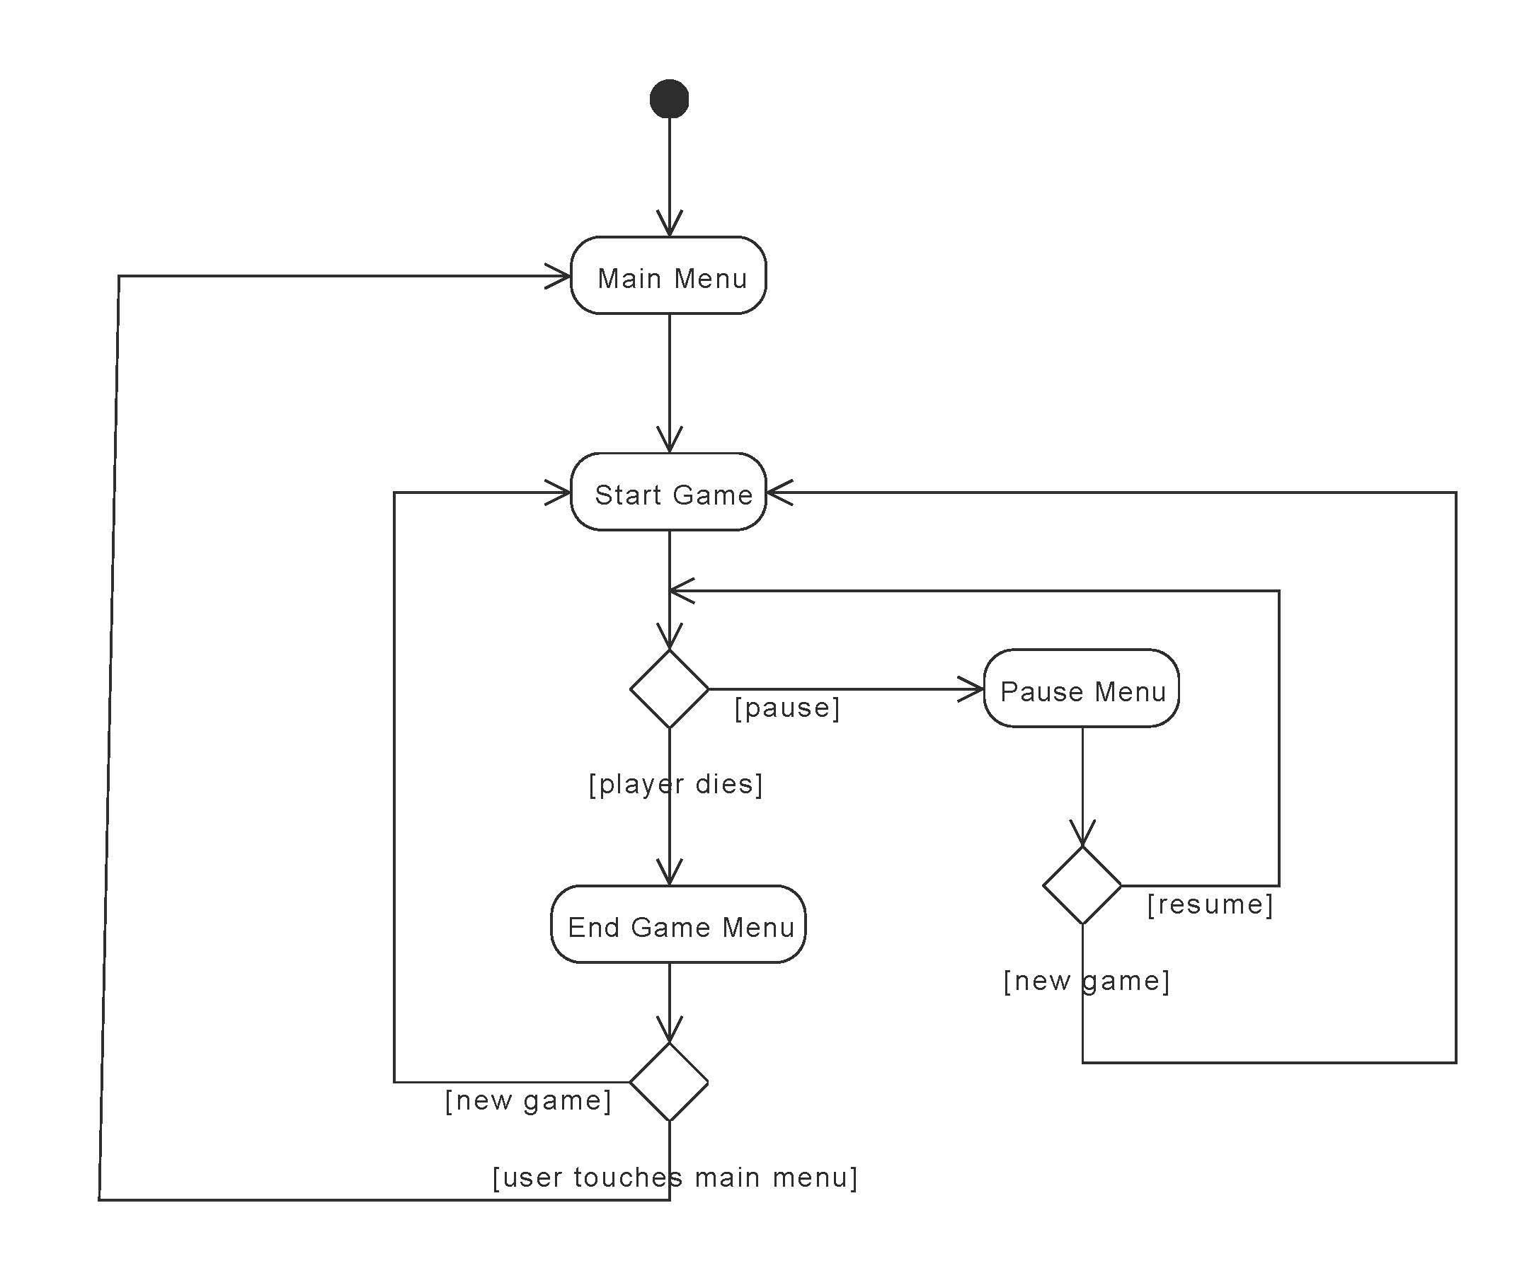
Activity Diagram #1 - Gameplay

Slide 8
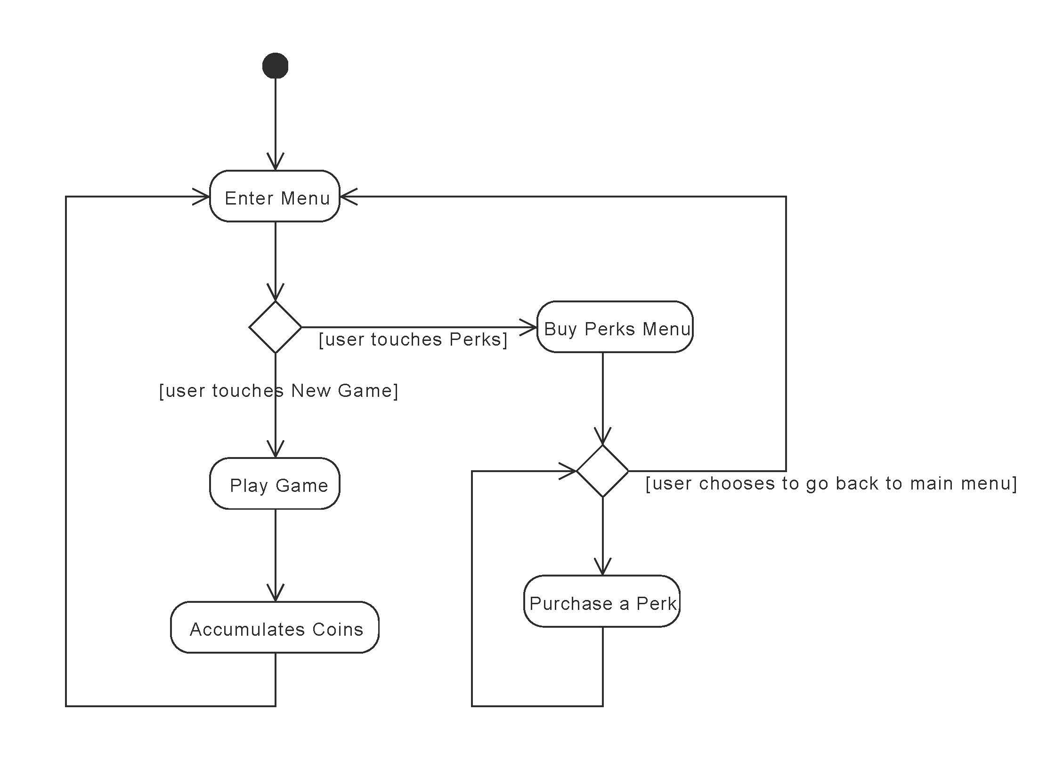
Activity Diagram #2 - Perks

Slide 9
Required Features
dynamic level
score system
space coins
perks & achievements
ability to pause game
gesture detection
object collision detection

Slide 10
Possible Features
Sharing high score on social media sites
ability to own multiple ships

Slide 11
Future Work
adding multiple levels (different backgrounds)
health system (repair kits, shields, etc.)

Slide 12
Potential Risks
level of complication (too much, too little)
not enough time
game is boring

Slide 13
Summary Discussion
responsibilities of each member
Craig - Game Design
Johnathan - Coding
Brian - Coding

Slide 14
Questions?

