Slide 1

Space Game
Johnathan Snyder, Brian Tillery, Craig Robinson, The Hat

Slide 2


OVERVIEW
You know what Space Game is by now.
Goals (mostly) reached
no promises
Made a cool new game

Slide 3



Lessons Learned
The Great Database Heartache of ‘14
Learned a new way to interact with databases
Time flies when you’re having spacegame
AndEngine is super useful
Johnathan can fix everything
especially recursive issues

Slide 4
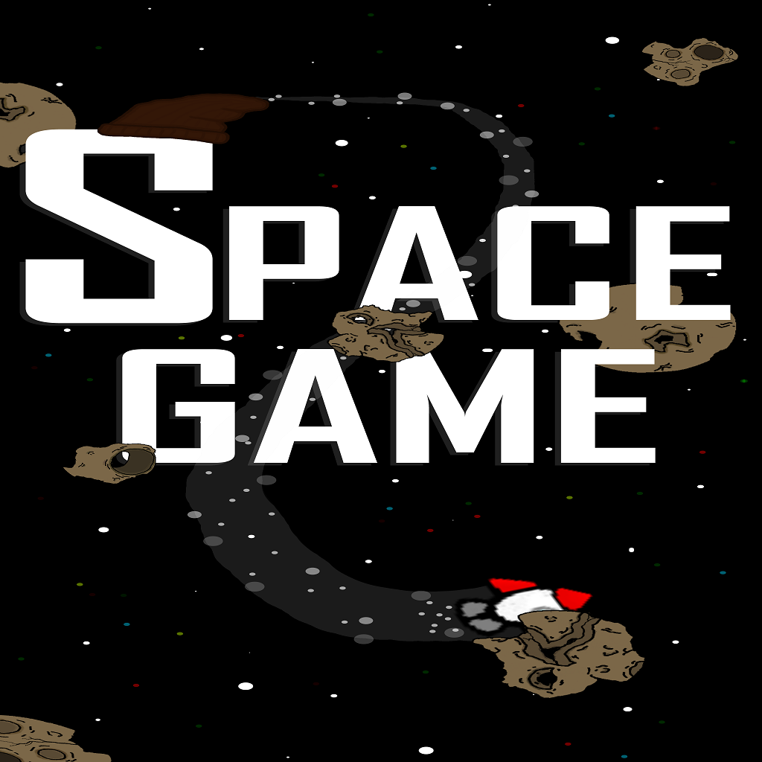
Discussion
Proud of what we achieved
Wish we could have done more
Good learning experience
Had fun!

