Slide 1
Lab 01
Introduction to Mininet
CEG5101 Modern Computer Networking
Graduate Assistants: Mr. Binghui Wu (e0675868@u.nus.edu) and Ms. Divya D Kulkarni, (e0974142@u.nus.edu)
Prepared by: Ms. Anum Talpur (Ex-Graduate Assistant)
Lecturer: Assoc. Prof. Mohan Gurusamy
ECE Department, CDE., National University of Singapore

Slide 2
Introduction
Mininet is a network emulator for prototyping a large network on a single machine.
It is a virtual environment that allows network administrators to experiment and run a collection of network devices on a Linux kernel, such as routers, switches, and other related network devices.
Mininet is used to design simple as well as complex custom-defined topologies.
Mininet offers a user-friendly environment for development and research and allows users to deploy custom networks through the CLI and/or GUI interfaces.
Notes:
- Scalability
- Ease of use
- Performance Accuracy

Slide 3
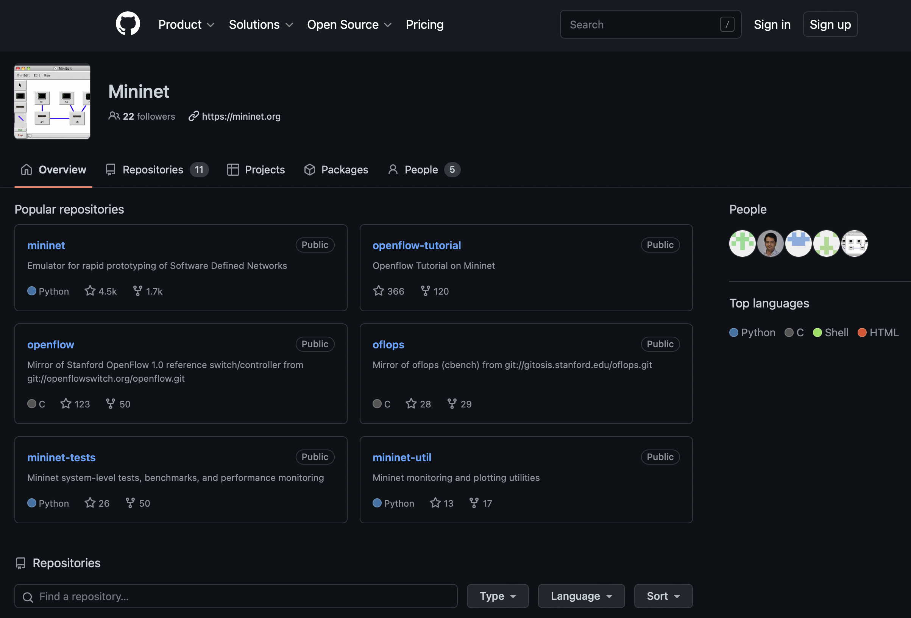
Mininet is an open-source project
https://github.com/mininet

Slide 4
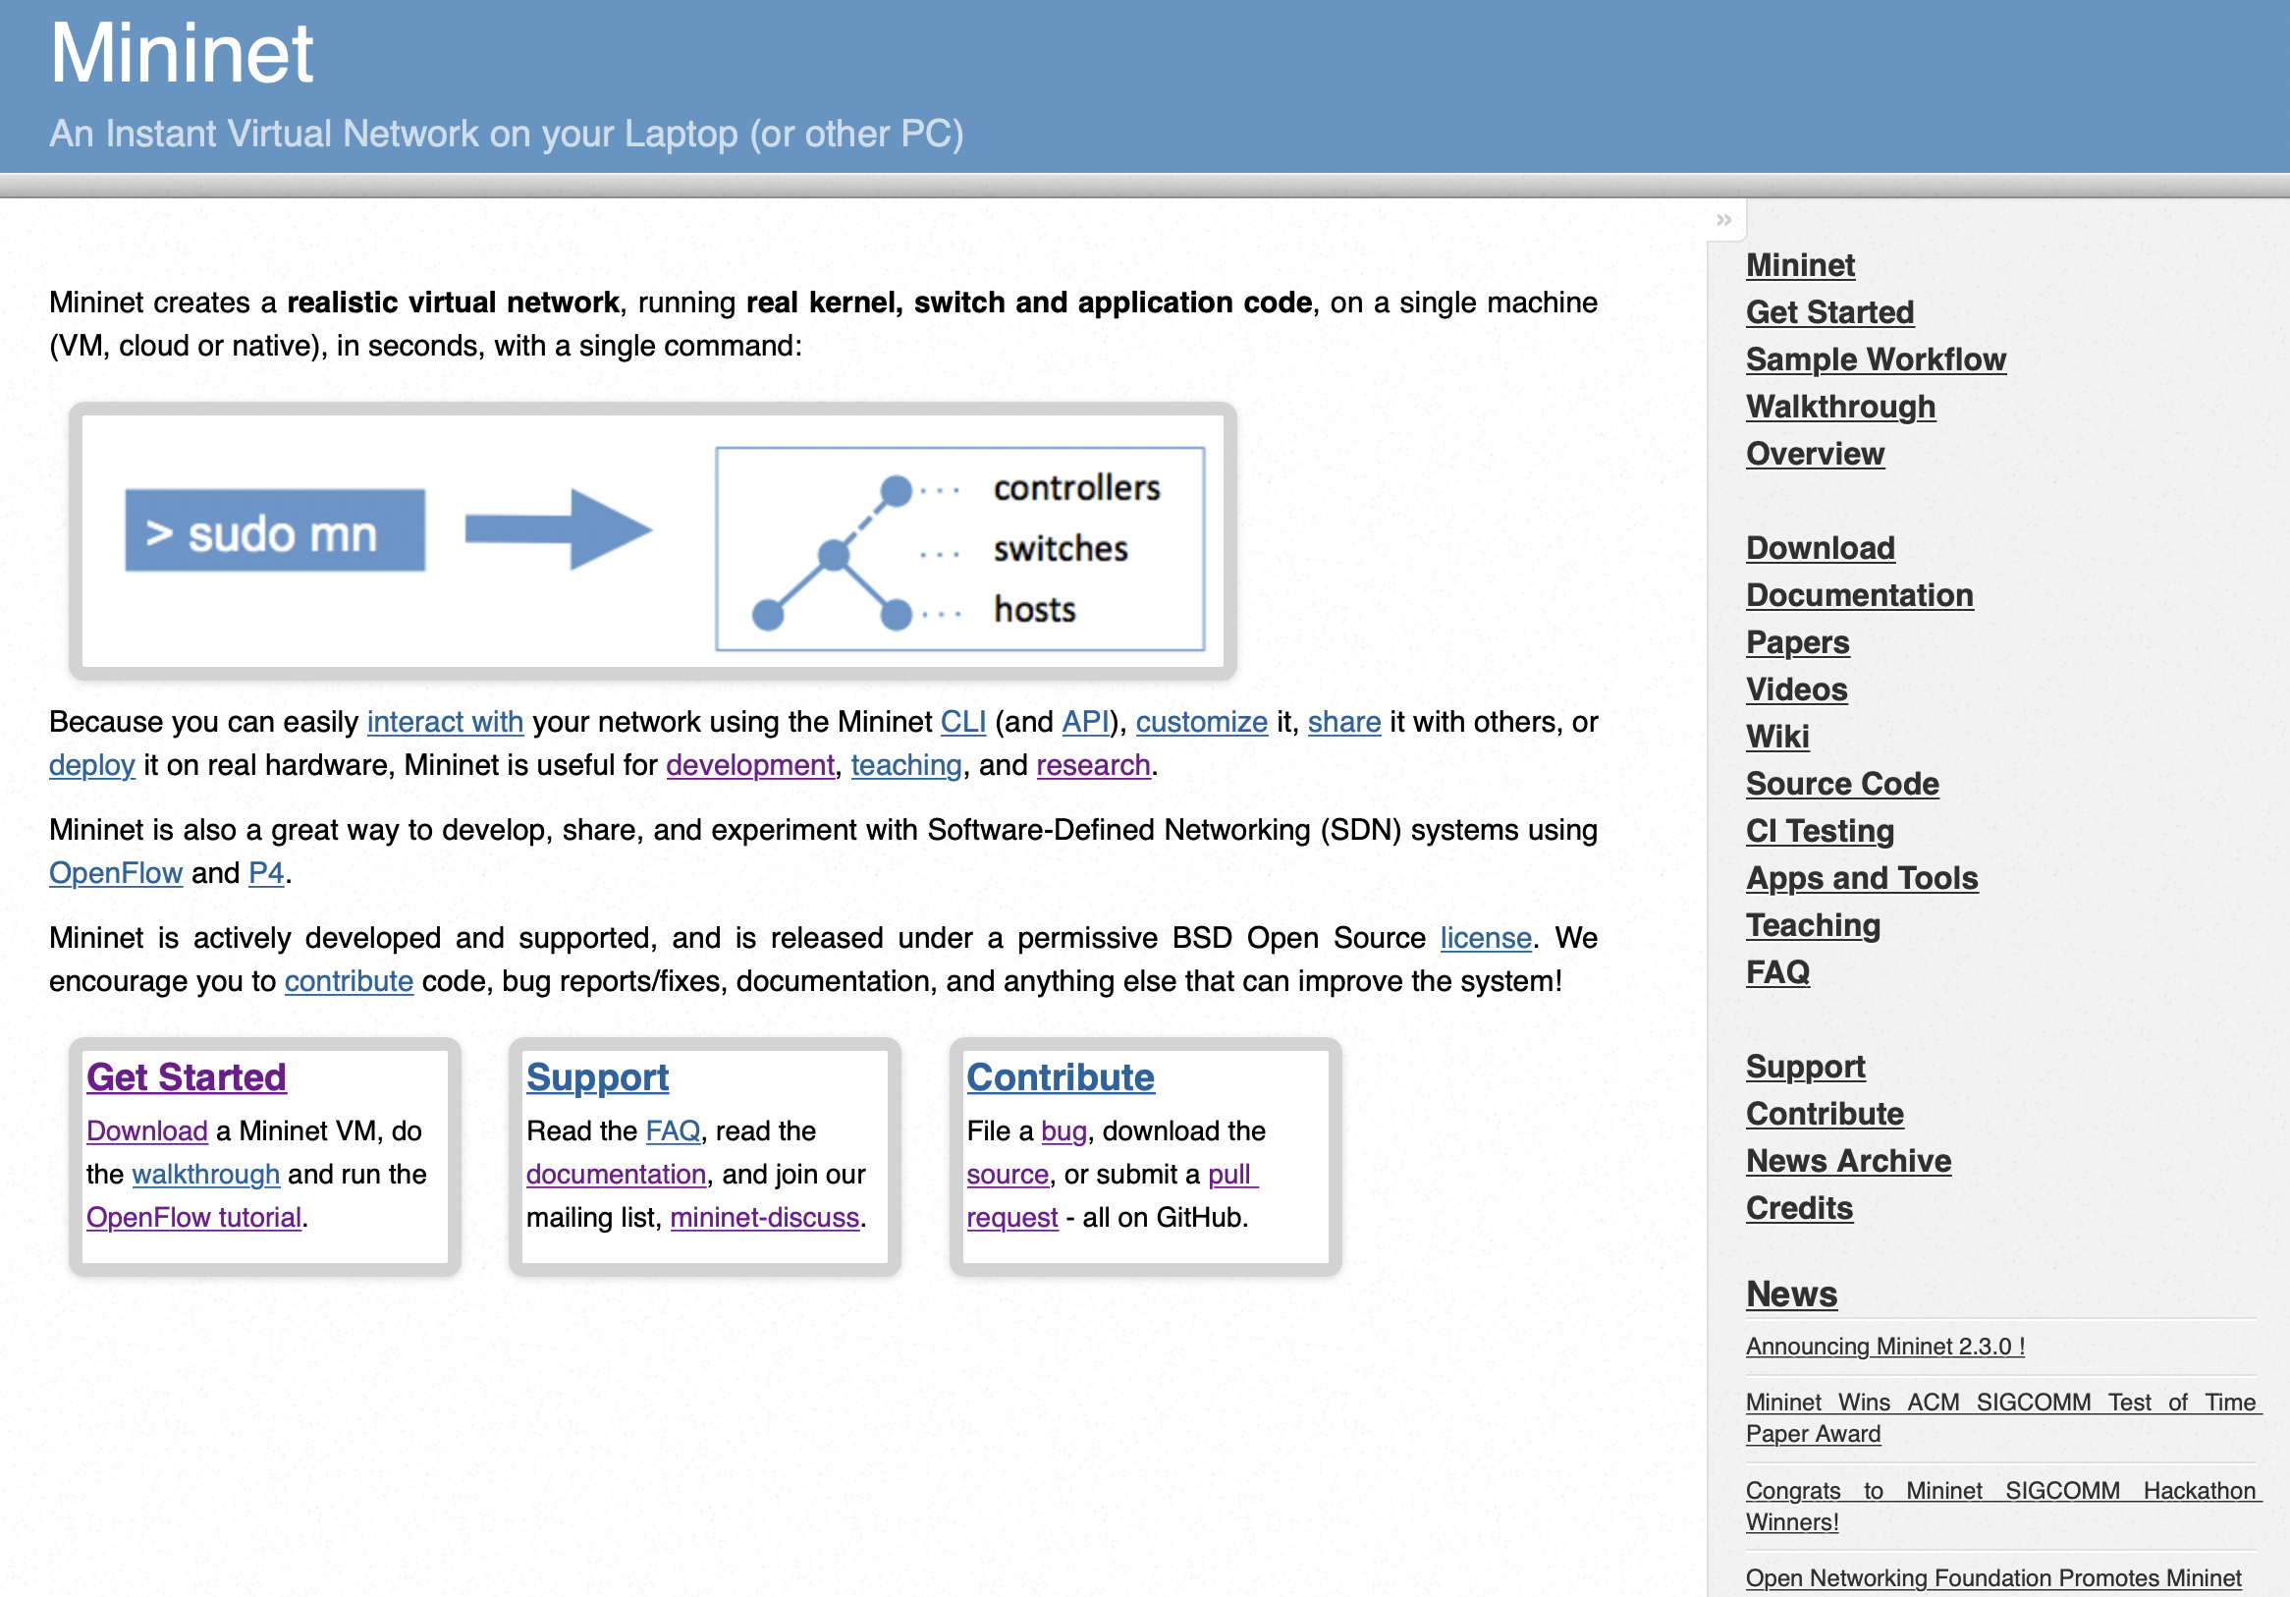
Mininet help
http://mininet.org/

Slide 5
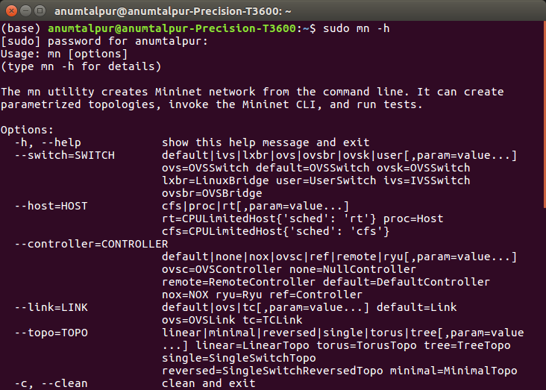
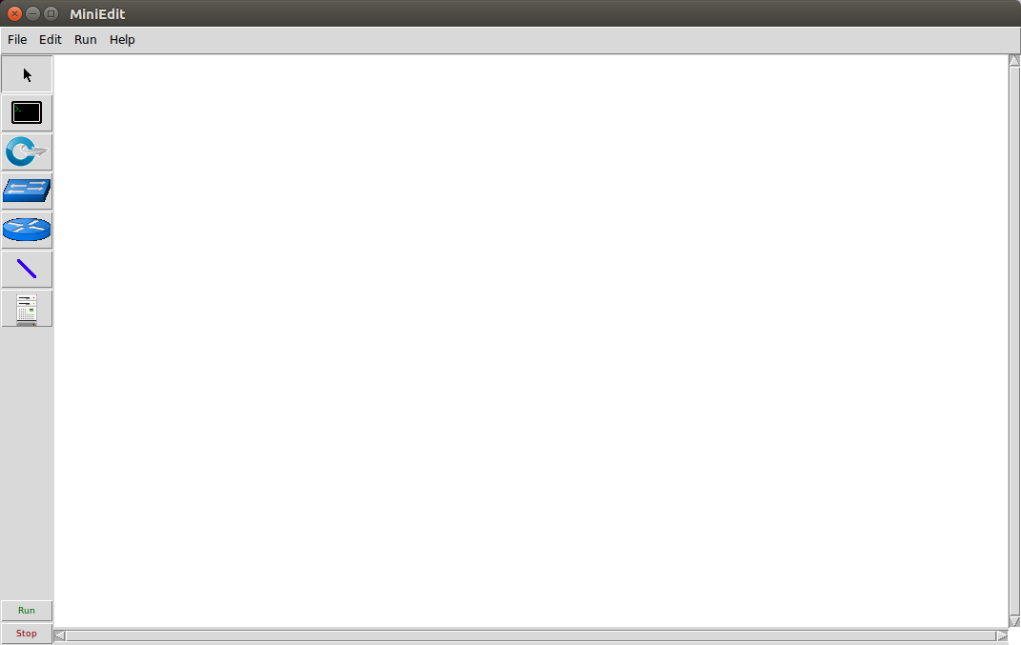
Mininet Interface
CLI and GUI (demo)
Notes:
Mininet provides an extensible Python API for network creation and experimentations.

Slide 6

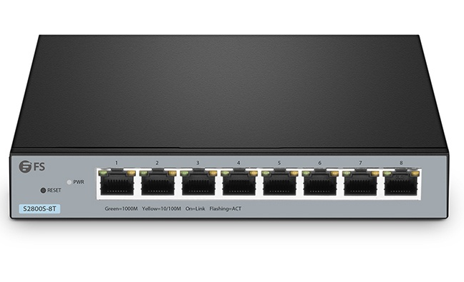
Creating a Network
To model a network, we need hosts, switches, links, and network controllers (for SDN/OpenFlow.)
Lets start with a simple network, (demo)
Host
switches
Host

Slide 7
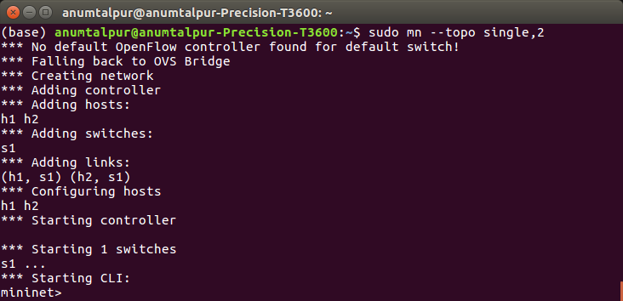
CLI
sudo mn --topo single,2
Notes:
h1 ifconfig h1-eth0 10.0.0.3 netmask 255.255.255.0

Slide 8
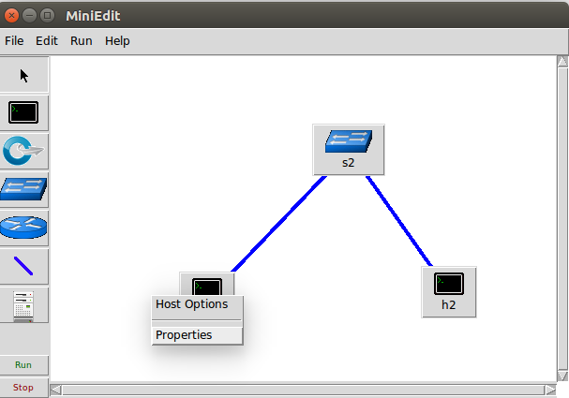
GUI

Slide 9
References
https://github.com/mininet - Code
https://github.com/mininet/mininet/wiki/Videos - Videos
http://mininet.org/ - Basics and Installation

