Slide 1
Lab 02
Open Virtual Switch (Open vSwitch)
CEG5101 Modern Computer Networking
Graduate Assistant: Mr. Binghui Wu (e0675868@u.nus.edu) and Ms. Divya D Kulkarni, (e0974142@u.nus.edu),
Prepared by: Ms. Anum Talpur (Ex-Graduate Assistant)
Lecturer: Assoc. Prof. Mohan Gurusamy
ECE Department, CDE., National University of Singapore

Slide 2
Class Activity
To become familiar with Open vSwitch and its basic operation
To implement Open vSwitch flow tables
To enable traffic forwarding using layer 3

Slide 3
Class Activity
To become familiar with Open vSwitch and its basic operation
To implement Open vSwitch flow tables
To enable traffic forwarding using layer 3

Slide 4
Introduction
Open vSwitch, abbreviated as OVS, is a virtual multilayer switch
Working with virtualization and cloud technologies
Used in virtual management system to enable network automation through programmatic extension
Service for controlling network connections between virtual machines (VMs)
https://www.openvswitch.org
Notes:
Open vSwitch offers a strong service for controlling network connections between VMs running in highly dynamic, multiserver environments such as the cloud. With Open vSwitch, admins get a network control system that can respond and adapt to their systems as they change.
Given its widespread use, it is worth obtaining a basic understanding of Open vSwitch, especially for those working with virtualization and cloud technologies.
Open vSwitch is a Linux Foundation collaborative project

Slide 5
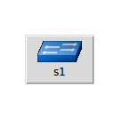
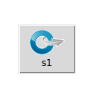
Introduction
Legacy Switch
Open vSwitch
Standalone fail-mode
Secure fail-mode

Slide 6
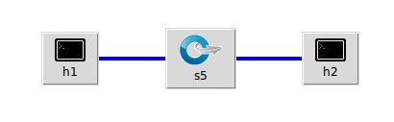
Class Activity
Topology (demo)
Assign 10.0.0.1/8 and 10.0.0.2/8 to host h1 and h2, respectively
Run the network
To become familiar with Open vSwitch and its basic operation
To implement Open vSwitch flow tables
To Enable traffic forwarding using layer 3
Notes:
If the OVS fail mode is set to "secure", the switch will only forward packets according to how its flow table is currently programmed. If a packet does not match any flow, it will be dropped.
If the OVS fail mode is set to "standalone", the switch will mimic a learning switch and forward packets automatically between switch ports.

Slide 7
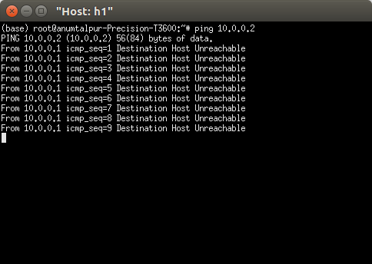
Class Activity
Topology (demo)
check the installed version of Open vSwitch
  sudo ovs-vsctl -V
list all active Open vSwitches
  sudo ovs-vsctl list-br
Verify connectivity
Not working
To become familiar with Open vSwitch and its basic operation
To implement Open vSwitch flow tables
To Enable traffic forwarding using layer 3
ovs-vsctl is ovs-vswitched management utility

Slide 8
Class Activity
To become familiar with Open vSwitch and its basic operation
To implement Open vSwitch flow tables
To enable traffic forwarding using layer 3

Slide 9
Class Activity
Topology (demo)
Task:
Command:
  sudo ovs-ofctl [TASK] [NAME_SWITCH] [ACTION]
To become familiar with Open vSwitch and its basic operation
To implement Open vSwitch flow tables
To Enable traffic forwarding using layer 3
dump-flows | List available flows
add-flow | Add flow within flow table
del-flows | Delete flows from flow table
1
2
3
ovs-ofctl is monitoring and administering utility

Slide 10
Class Activity
Topology (demo)
Task:
Command:
  sudo ovs-ofctl [TASK] [NAME_SWITCH] [ACTION]
  Verify connectivity
ovs-ofctl is monitoring and administering utility
To become familiar with Open vSwitch and its basic operation
To implement Open vSwitch flow tables
To Enable traffic forwarding using layer 3
dump-flow | List available flows
add-flow | Add flow within flow table
del-flows | Delete flows from flow table
sudo ovs-ofctl add-flow s5 action=normal
sudo ovs-ofctl dump-flows s5
Traditional
switch
forwarding

Slide 11
Class Activity
To become familiar with Open vSwitch and its basic operation
To implement Open vSwitch flow tables
To enable traffic forwarding using layer 3

Slide 12
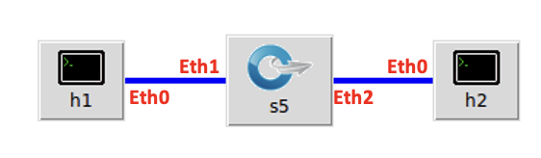
Class Activity
Topology (demo)
Task:
Manual entries using layer-3 info:
  First, verify which port of the switch is connected to which host?
  sudo ovs-ofctl [TASK] [NAME_SWITCH] [ACTION]
ovs-ofctl is monitoring and administering utility
To become familiar with Open vSwitch and its basic operation
To implement Open vSwitch flow tables
To Enable traffic forwarding using layer 3
dump-flow | List available flows
add-flow | Add flow within flow table
del-flows | Delete flows from flow table
sudo ovs-ofctl add-flow s5 ip,nw_dst=10.0.0.1,action=output:1
.
.
sudo ovs-ofctl add-flow s5 arp,action=normal

Slide 13
Class Activity
Topology (demo)
Actions:
Verify flow tables – dump-flows
Verify connectivity - ping
ovs-ofctl is monitoring and administering utility
To become familiar with Open vSwitch and its basic operation
To implement Open vSwitch flow tables
To Enable traffic forwarding using layer 3
dump-flows | List available flows
add-flow | Add flow within flow table
del-flows | Delete flows from flow table
We can work with src IP instead of destination
sudo ovs-ofctl add-flow s5 ip,nw_src=10.0.0.1,action=output:2
.
.
sudo ovs-ofctl add-flow s5 arp,action=normal

Slide 14
Class Activity
Topology (demo)
Actions:
sudo ovs-ofctl [TASK] [NAME_SWITCH] [ACTION]
Layer 1: Use physical ports
  sudo ovs-ofctl add-flow s5 in_port=1,action=output:2
  sudo ovs-ofctl add-flow s5 in_port=2,action=output:1
Layer 2: Use mac address
  sudo ovs-ofctl add-flow s5 dl_dst=XXXXXXXXX,action=output:1
  sudo ovs-ofctl add-flow s5 dl_dst=XXXXXXXXX,action=output:2
  sudo ovs-ofctl add-flow s5 arp,action=normal
ovs-ofctl is monitoring and administering utility
Use different information (different layer data) to enables forwarding
dump-flows | List available flows
add-flow | Add flow within flow table
del-flows | Delete flows from flow table

Slide 15
References
https://www.openvswitch.org – Open Virtual Switch
http://mininet.org/ - Basics and Installation
http://www.openvswitch.org//support/dist-docs/ovs-ofctl.8.txt - ovs-ofctl command help

