Slide 1
Lab 03
Software-Defined Network (SDN) with POX Controller
CEG5101 Modern Computer Networking
Graduate Assistant:Mr. Binghui Wu (e0675868@u.nus.edu) and Ms. Divya D Kulkarni (e0974142@u.nus.edu)
Prepared by: Ms. Anum Talpur (Ex-Graduate Assistant)
Lecturer: Assoc. Prof. Mohan Gurusamy
ECE Department, CDE., National University of Singapore

Slide 2
Class Activity
To become familiar with the concept of SDN and Controller.
To download and install the POX controller.
To invoke the POX controller as a layer-2 learning switch.
To invoke the POX controller as a forwarding hub.
To invoke the POX controller as a load balancer.

Slide 3
Class Activity
To become familiar with the concept of SDN and Controller.
To download and install the POX controller.
To invoke the POX controller as a layer-2 learning switch.
To invoke the POX controller as a forwarding hub.
To invoke the POX controller as a load balancer.

Slide 4
Introduction
SDN or software-defined networking is a concept in which application programming interfaces (APIs) are used to enable intelligence within the network.
SDN decouples the control plane from the data plane and implements it as software instead to enable flexibility within a network through programmatic access.
The data plane is the part of the network which handles traffic forwarding and the control plane is the part that instructs or configures the data plane on the traffic forwarding process.
In this lab activity, we will learn to use a controller to update data forwarding rules on the Open vSwitch (OVS) to enable communication between different hosts/machines.

Slide 5
Class Activity
To become familiar with the concept of SDN and Controller.
To download and install the POX controller.
To invoke the POX controller as a layer-2 learning switch.
To invoke the POX controller as a forwarding hub.
To invoke the POX controller as a load balancer.
Page 02

Slide 6
Class Activity
To become familiar with the concept of SDN and Controller.
To download and install the POX controller.
To invoke the POX controller as a layer-2 learning switch.
To invoke the POX controller as a forwarding hub.
To invoke the POX controller as a load balancer.

Slide 7
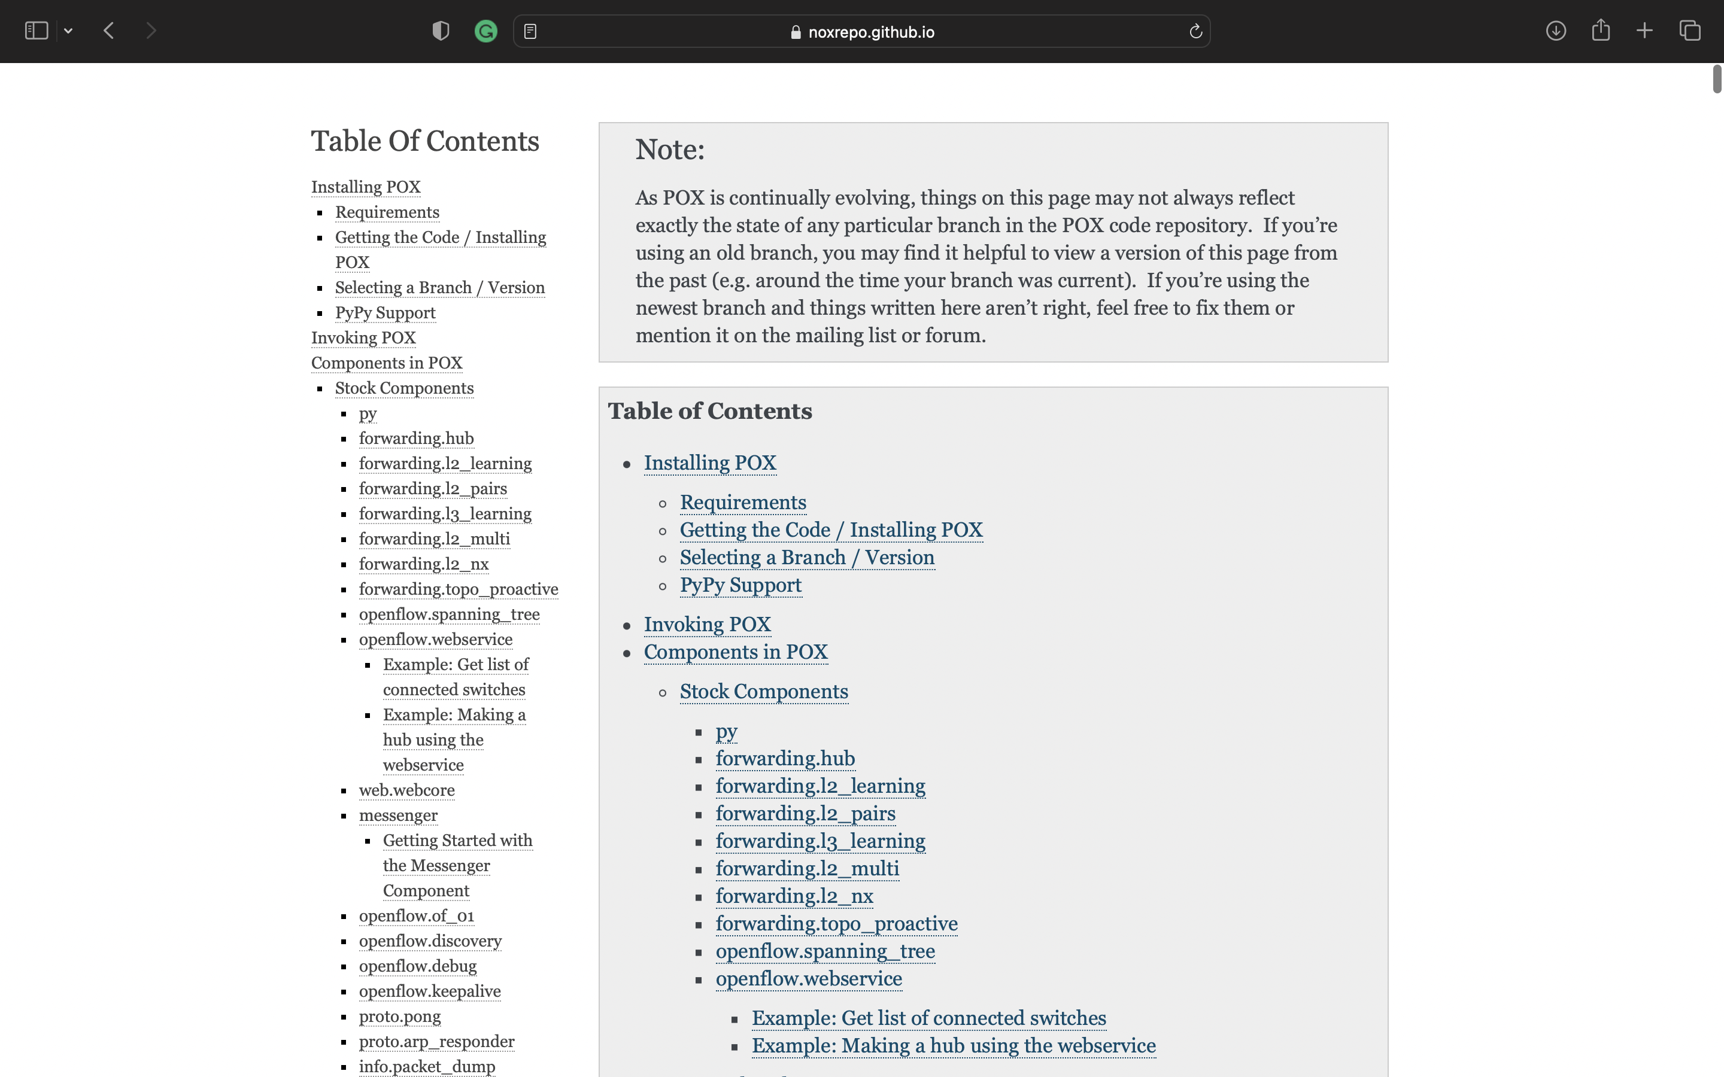
Class Activity
POX Controller
  POX controller is a python-based controller platform that allows fast prototyping and controlling of the network using stock components that are pre-programmed.
  The stock components provide different functionalities and features and are listed on GitHub*.
  It comes with a handful of components, but POX’s target audience is really people who want to be developing their own.
To invoke the POX controller as a layer-2 learning switch.
To invoke the POX controller as a forwarding hub.
To invoke the POX controller as a load balancer.
https://noxrepo.github.io/pox-doc/html/#stock-components

Slide 8
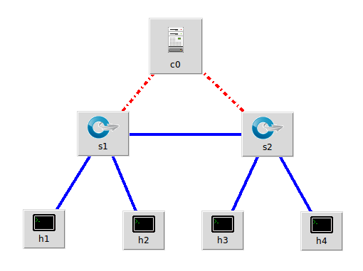
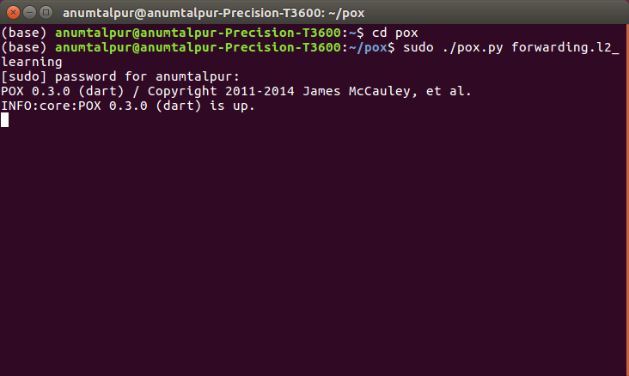
Class Activity
Topology (demo)
Start a POX controller and run the network
  forwarding.l2_learning
sudo ./pox.py [stock component] [parameter]
To invoke the POX controller as a layer-2 learning switch.
To invoke the POX controller as a forwarding hub.
To invoke the POX controller as a load balancer.
Device | IP Address | Port Number
c0 | 127.0.0.1 | 6633
h1 | 10.0.0.1 | -
h2 | 10.0.0.2 | -
h3 | 10.0.0.3 | -
h4 | 10.0.0.4 | -
*remote controller
* Start CLI
cd pox
sudo ./pox.py forwarding.l2_learning

Slide 9
Class Activity
Topology (demo)
Check OVS flow table entries
  Using ovs-ofctl utility
Test Connectivity
  tcpdump on 3 hosts and ping from 1 host
Check OVS flow table entries again
To invoke the POX controller as a layer-2 learning switch.
To invoke the POX controller as a forwarding hub.
To invoke the POX controller as a load balancer.
Device | IP Address | Port Number
c0 | 127.0.0.1 | 6633
h1 | 10.0.0.1 | -
h2 | 10.0.0.2 | -
h3 | 10.0.0.3 | -
h4 | 10.0.0.4 | -
*remote controller

Slide 10
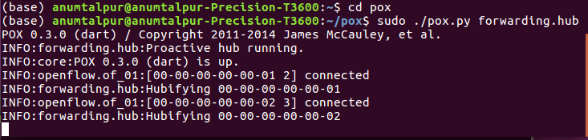
Class Activity
Topology (demo)
Start a POX controller and run the network
  forwarding.hub (flooding)
To invoke the POX controller as a layer-2 learning switch.
To invoke the POX controller as a forwarding hub.
To invoke the POX controller as a load balancer.
Device | IP Address | Port Number
c0 | 127.0.0.1 | 6633
h1 | 10.0.0.1 | -
h2 | 10.0.0.2 | -
h3 | 10.0.0.3 | -
h4 | 10.0.0.4 | -
*remote controller
cd pox
sudo ./pox.py forwarding.hub

Slide 11
Class Activity
Topology (demo)
Test Connectivity
  tcpdump on 3 hosts and ping from 1 host
Check OVS flow table entries
  Using ovs-ofctl utility
To invoke the POX controller as a layer-2 learning switch.
To invoke the POX controller as a forwarding hub.
To invoke the POX controller as a load balancer.
Device | IP Address | Port Number
c0 | 127.0.0.1 | 6633
h1 | 10.0.0.1 | -
h2 | 10.0.0.2 | -
h3 | 10.0.0.3 | -
h4 | 10.0.0.4 | -
*remote controller

Slide 12
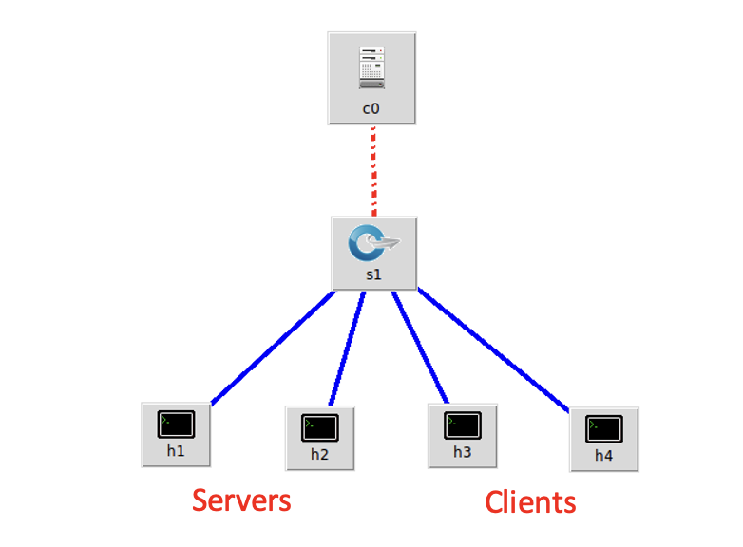
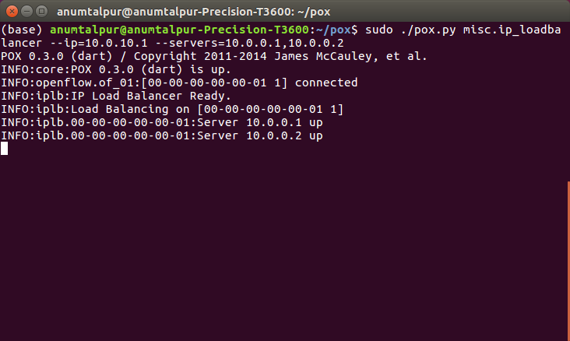
Class Activity
Topology (demo)
Start a POX controller and run the network
  Misc.ip_loadbalancer (balance the load among servers)
sudo ./pox.py [stock component] [parameter]
To invoke the POX controller as a layer-2 learning switch.
To invoke the POX controller as a forwarding hub.
To invoke the POX controller as a load balancer.
Device | IP Address | Port Number
c0 | 127.0.0.1 | 6633
h1 | 10.0.0.1 | -
h2 | 10.0.0.2 | -
h3 | 10.0.0.3 | -
h4 | 10.0.0.4 | -
*remote controller
cd pox
sudo ./pox.py misc.ip_loadbalancer --ip=10.0.10.1
--servers=10.0.0.1,10.0.0.2

Slide 13
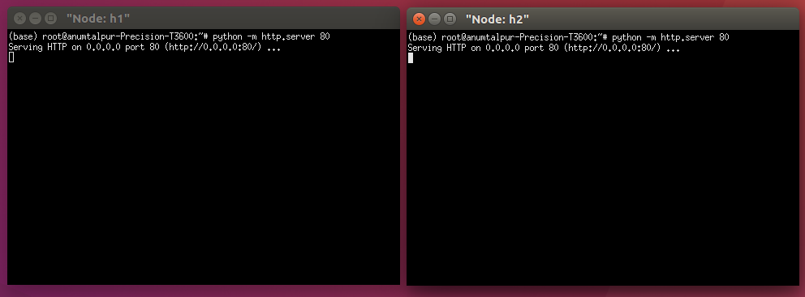
Class Activity
Topology (demo)
Test Connectivity
  Start tcp servers and send data from client to server using curl
To invoke the POX controller as a layer-2 learning switch.
To invoke the POX controller as a forwarding hub.
To invoke the POX controller as a load balancer.
Device | IP Address | Port Number
c0 | 127.0.0.1 | 6633
h1 | 10.0.0.1 | -
h2 | 10.0.0.2 | -
h3 | 10.0.0.3 | -
h4 | 10.0.0.4 | -
*remote controller
SERVER : python –m http.server 80
CLIENT : curl 10.0.10.1

Slide 14
Class Activity
Topology (demo)
Check OVS flow table entries
  Using ovs-ofctl utility
To invoke the POX controller as a layer-2 learning switch.
To invoke the POX controller as a forwarding hub.
To invoke the POX controller as a load balancer.
Device | IP Address | Port Number
c0 | 127.0.0.1 | 6633
h1 | 10.0.0.1 | -
h2 | 10.0.0.2 | -
h3 | 10.0.0.3 | -
h4 | 10.0.0.4 | -
*remote controller

Slide 15
Assignment Problem

Slide 16
References
https://noxrepo.github.io/pox-doc/html/#stock-components – POX Controller
http://mininet.org/ - Basics
https://docs.python.org/3/ - Python

