Slide 1
Team B- Space Jockey
Preliminary Design Review
Ardya Dipta Nandaviri, Brian Boyle, Nathaniel Chapman, Songjie Zong
October 28, 2013

Slide 2
Outline
Project Overview
Functional and System Architectures
Subsystem Breakdowns and Status
Milestone and Test Overview
Work schedule
Revised parts list & budget
Risk analysis

Slide 3
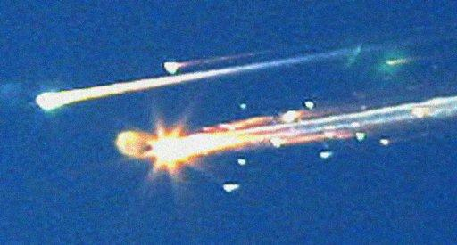
Motivation
Spacecraft surfaces degrade in space
The results can be
catastrophic
Repair by astronauts is dangerous, expensive, and time-consuming

Slide 4
Project Description
User Needs:
Aid the inspection and maintenance the outer hull of a spacecraft
Operate in a vacuum in microgravity
Be cheaper and safer than Astronaut Extra-vehicular Activity (EVA)

Slide 5
Project Description
Proposed System:
Mobile robot that can be deployed onto the surface of a spacecraft
Able to traverse the hull with minimal tethers and infrastructure
Sensors detecting hull flaws or degradation
Adequate battery life for representative mission
Command console program which can control the robot
Teleoperation with some elements of autonomy
Display sensor data in a meaningful and useful way
Computation-heavy tasks such as localization and path-planning

Slide 6
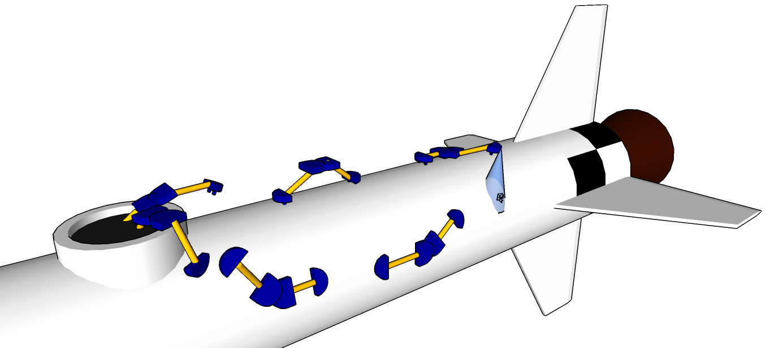
Graphical Representation
3. Inspect/Repair
2. Traverse
1. Deploy
5. Stow 4. Return

Slide 7
Mandatory System Requirements
Functional
Non-Functional
# | Code | Description
1 | ATTACH | Maintain attachment to the hull* TPM: Supports own weight on a 1G vertical surface
2 | TRAV | Traverse the craft at a reasonable speed TPM: 10 meters per hour
3 | PLANE | Plane Transitions TPM: 60-degree transitions
4 | SENSE | Visual feedback from cameras, joint encoders, and foot sensors
5 | *FOOT | Detect footholds with actionable accuracy
# | Code | Description
1 | BATT | Battery Powered
2 | EARTH | System can be validated in terrestrial conditions
3 | MASS | As light-weight as possible to reduce launch requirements TPM: <10kg
4 | SIZE | Minimal volume for efficient storage TPM: 8 Cubesats (10cm cube)
5 | COST | Total system cost must not Exceed $4000

Slide 8
Desirable System Requirements
Functional
Non-Functional
# | Code | Description
1 | MANIP | Use a rotary tool to tighten a fastener or perform other maintenance function
2 | TEMP | Thermal Imaging capability
3 | SPACE | Develop plan to convert into a space-ready system
4 | DETECT | Autonomous identification of surface flaws
5 | PLANE2 | Plane Transitions (90-degree)
# | Code | Description
1 | WIFI | Completely wireless operation
2 | INFRA | Minimal Spacecraft Support Infrastructure
3 | ATTACH2 | Maintain attachment to the hull* TPM: Supports own weight on a 1G inverted surface

Slide 9
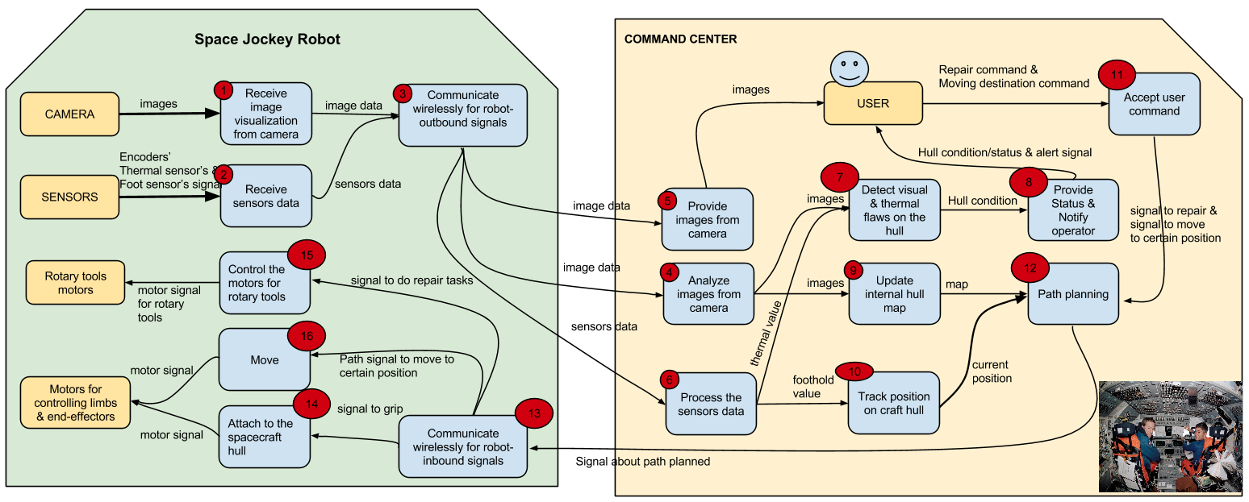
Functional Architecture

Slide 10
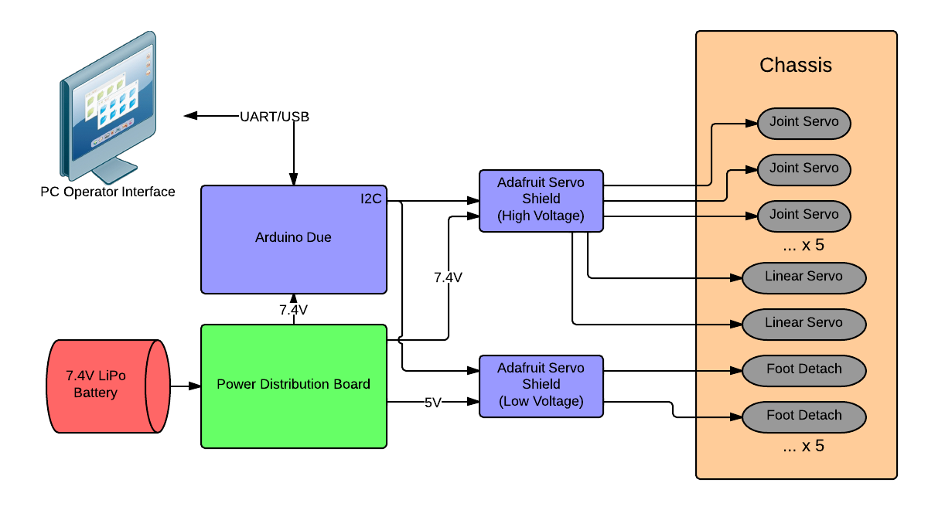
Physical Architecture - Fall

Slide 11
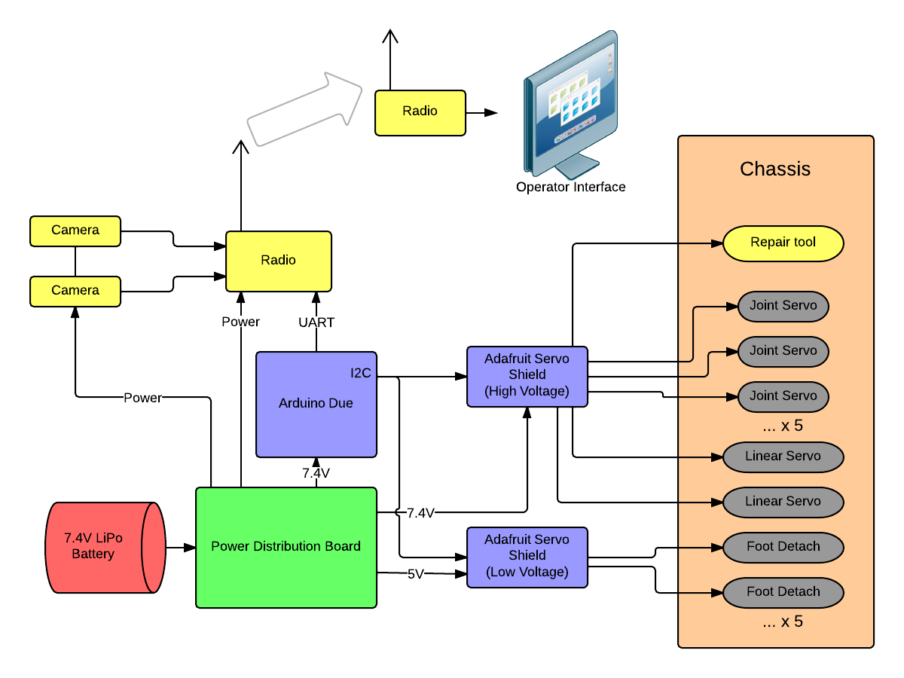
Physical Architecture - Spring

Slide 12
Subsystem Breakdown
Space Jockey Robot
Command Center
Power
Communication
Computing
G.U.I
Chassis/Mobility
Simulation
Attachment
Localization
Peripherals
Planning
Manipulation

Slide 13
Subsystem Descriptions
Subsystem | Module | Description
Power | Robot | Batteries and power distribution system
Computing | Robot | Sensor/Motor Drivers, Communication
Chassis/Mobility | Robot | Mechanical structure & Actuators
Attachment | Robot | “Sticky” Feet or Hardpoint Grasping System
Peripherals | Robot | Sensors, Cameras
Manipulation | Robot | Tool Use (Desired)
Communication | Command Center | Serial Communication, later WIFI
G.U.I. | Command Center | GUI Control Panel, Sensor Displays
Simulation | Command Center | Simulation and Robot Representation
Localization | Command Center | Sensor Fusion, Mapping, Localization
Planning | Command Center | Joint Trajectory Generation, Path Planning

Slide 14
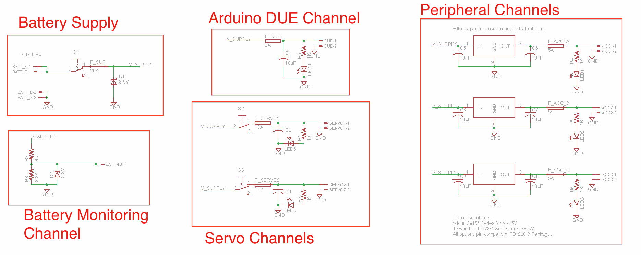
Status - Power Subsystem
Power Subsystem - Batteries and power distribution system
Power distribution board under development
Battery acquired

Slide 15
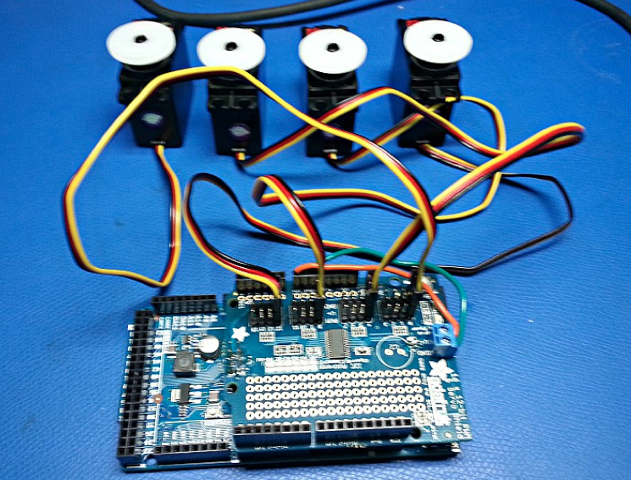
Status - Computing Subsystem
Computing Subsystem - Sensor/Motor Drivers, Communication
Arduino DUE acquired
Servo driver tested

Slide 16
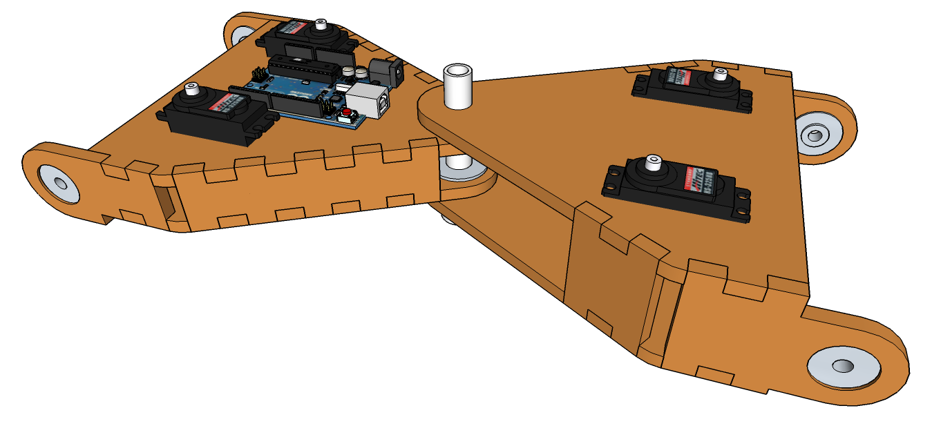
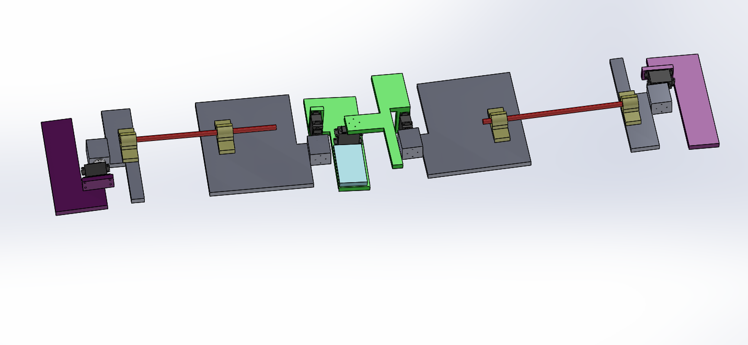
Status - Chassis/Mobility Subsystem
Computing Subsystem - Mechanical Structures & Actuation
Servos acquired and tested
CAD concept and partial design for the chassis

Slide 17
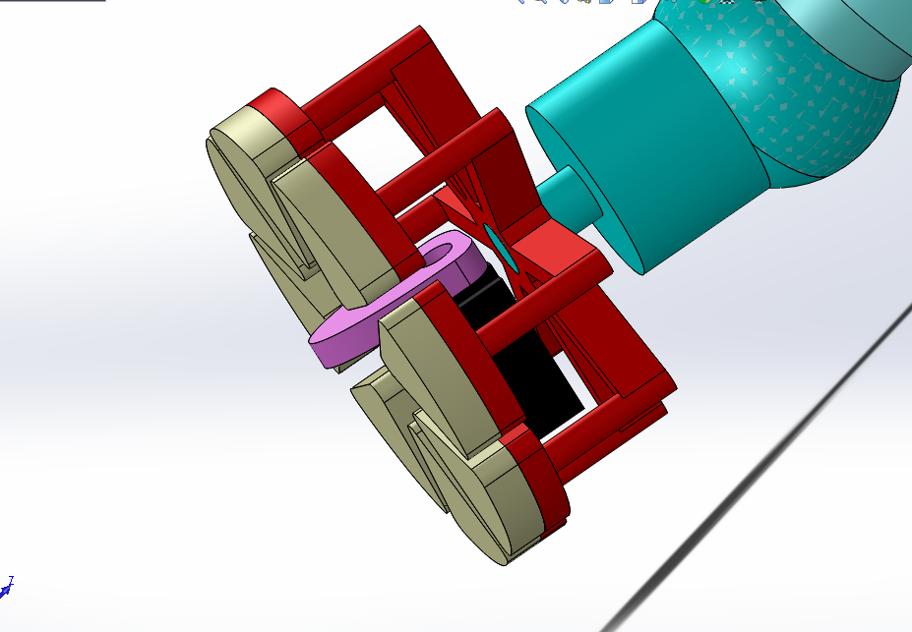
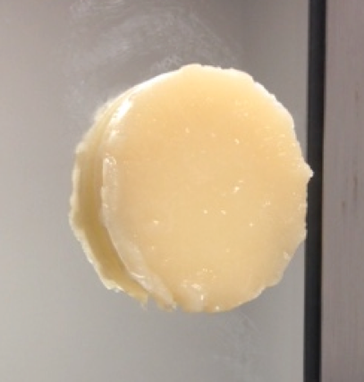
Status - Attachment Subsystem
Attachment Subsystem - “Sticky” Feet
Foot Mechanism Design
Vytaflex-10 Trial Moldings

Slide 18
Status - Peripheral & Manipulation
Peripheral Subsystem - Sensors, Cameras
Servo encoders implicit in their operation
Camera & IMU (Spring) options budgeted for
Manipulation
Spring semester desirable
Mounted to one or more end segments

Slide 19
Status - Command Center Subsystems
Software Progress
GUI fleshed out
Doubles as software functions wishlist
Interface to all other Command Center subsystems
ROS familiarization and partial package list
Basic servo control
Ready for GUI/ROS/driver integration

Slide 20
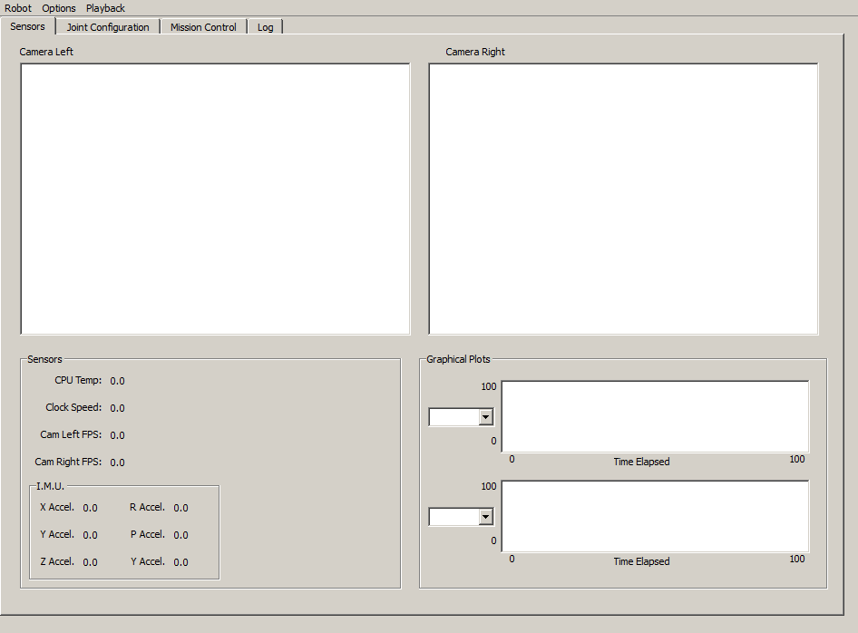
Status - GUI Subsystem
Sensor Management Pane - Assists Comm. Subsyst. Verification

Slide 21
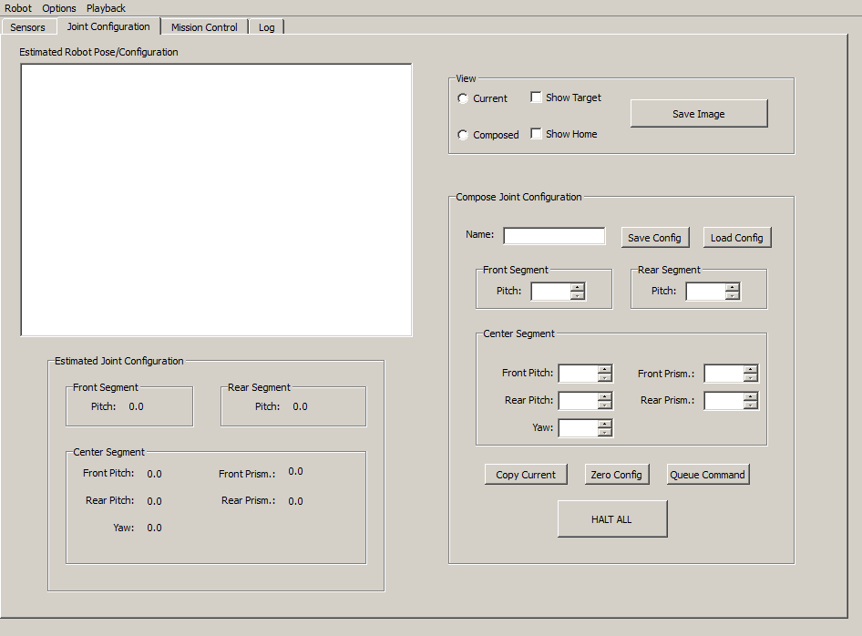
Status - GUI Subsystem (2)
Configuration Management Pane - Assists Simulation Subsystem

Slide 22
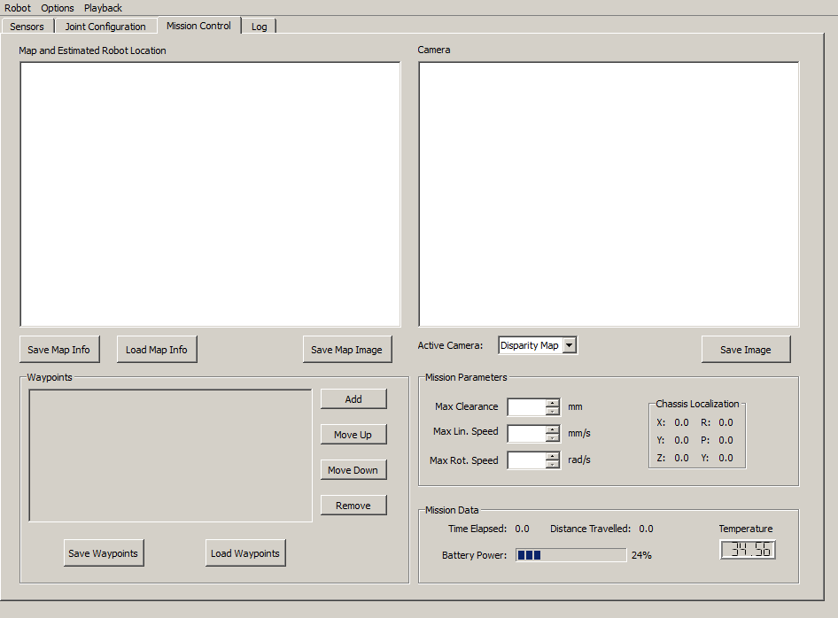
Status - GUI Subsystem (3)
Mission Control Pane - Assists Localization & Planning Subsysts.

Slide 23
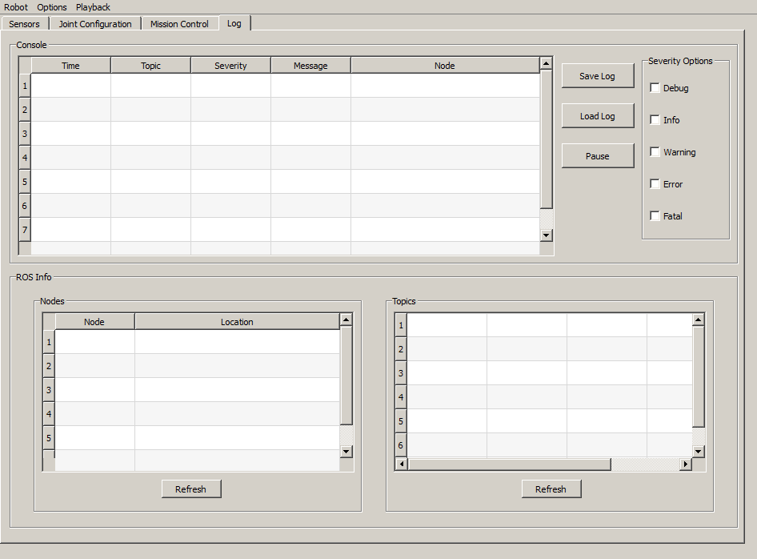
Status - GUI Subsystem (4)
Log Management Pane - Assists Comm. Subsyst. General Integration

Slide 24
Fall Capability Milestones
 | Date | Summary | Test Description
PR 3 | 11/6 | Prototype Precursors | ROS Integration, Simulation Started 1st Prototype Designed Power Distro Board complete Foot Material Cast
PR 4 | 11/20 | 1st Prototype | Fully fabricated, assembled chassis with power distribution board Stance commands and basic gait Foot prototyped & tested
PR 5 | 11/25 | Fall Validation Experiment | See Next Slide

Slide 25
Fall Validation Test - Setting
Demo Setup
Location: NSH Level B
Equipment:
Robot
Command Center
Table or whiteboard as a surface
Safety Tether
Estimated operating area: 6’x6’

Slide 26
Fall Validation Test - Procedure
Robot shall be powered on and GUI started
GUI will display sensor data from the robot
Robot commanded to assume pre-configured stances that collectively demonstrate actuation of all motors
Robot will maintain or recover its stance in response to external disturbances
Robot commanded to move forward and backward and demonstrate such motions with reasonable smoothness of motion [TPM: 1 meter in 6 minutes]
Robot commanded to execute a 45 degree turn while moving forward, and will demonstrate such motion [TPM: Turn within 5 degrees]

Slide 27
Spring Capability Milestones
Month | Summary | Test Description
Jan. | Spring Preparation | Simulation is complete Mechanical redesign priorities list Electrical miniaturization plan
Feb. | 1st Prototype Endgame | Camera and IMU integrated Final prototype mostly designed Electrical system redesign finished
March | Final Prototype Completion | Final prototype assembled Mapping and localization operational Radio communication Test environment constructed
April | Demo Preparation | Software demonstrates all mandatory capabilities, Demo procedure rehearsed and finalized
May | Spring Demo | See Next Slide...

Slide 28
Spring Demo - Setting
Demo Setup
Rehearsals in NSH Level B, Demo in Atrium
Equipment:
Robot
Command Center
Spacecraft Analogue Structure with plane changes
Scaffolding
Safety Tether
Spacecraft analogue suspended from floor 4 if possible
Estimated operating area: 12’x12’

Slide 29
Spring Demo - Procedure
Demo Procedure
Robot is powered on and GUI indicates communication
Robot is commanded to move by teleoperation and begins inspection
Waypoints are set using GUI
Path planning generates a motion plan
Robot will autonomously travel between the waypoints while updating sensor map [TPM: 10m/hr]
At least one waypoint shall require a plane transition [TPM: 60 degrees]
Desirable Extras
During teleoperation, the robot will be moved to and tighten a fastener using a rotary tool [TPM: Done in <10 min]
In the course of mapping, the command console will identify and alert the user to a flaw in the hull [TPM: 80% Success]

Slide 30
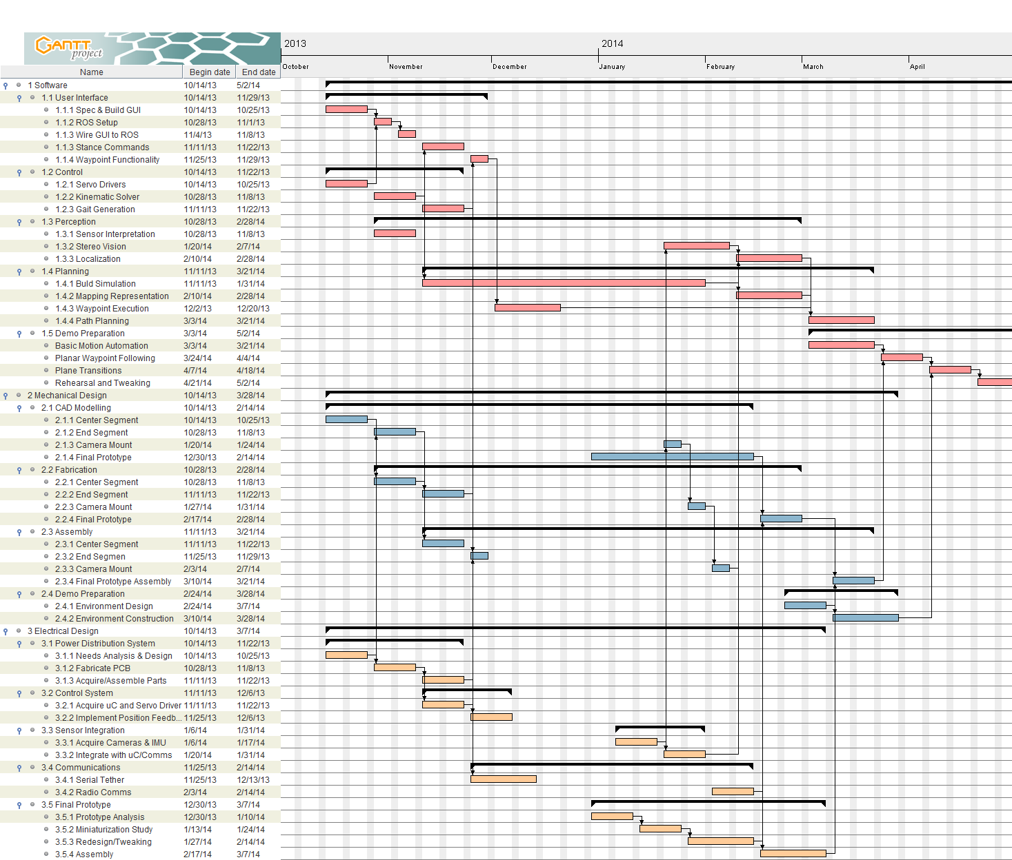

Slide 31
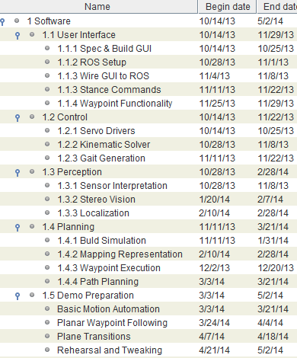
Schedule - Software

Slide 32
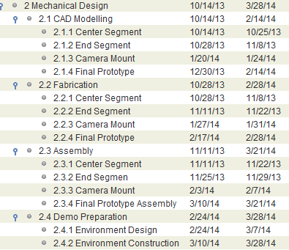
Schedule - Mechanical

Slide 33
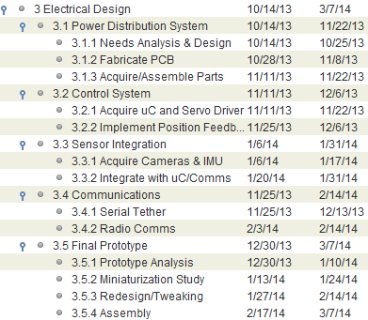
Schedule - Electrical Design

Slide 34
Risk Management - Sources
Risk | Associated Requirements | Description | Type | Cause | Likelihood | Consequences
Team Member Illness | Timely Project Completion | A team member is severely ill for a significant period | Schedule | Largely Chance | Somewhat Likely | Lost Man-Hours and Expertise
Insufficient Servo Torque | Mobility, Traversal | Unable to lift segments with given motors | Technical | Unexpectedly High Mass | Rather Likely | Reduced or No Mobility
Overweight Linear Actuators | Mobility, Traversal | COTS linear actuators too heavy | Technical | Servo Torque constraints | Extremely Likely | Reduced or No Mobility
Insufficient “Stick” | Attachment | Adhesive foot material provides Insufficient “Stick” to support robot | Technical | Robot Weight, Foot material properties | Somewhat Likely | Poor attachment on vertical or inverted surfaces
Actuator cost over-budget | Cost | Actuators and associated component cost exceed expectations | Cost | Budget constraints | Somewhat likely | Total project over-budget
ROS Package Incompatibility | Technical | A ROS package we need is not compatible with our ROS version | Technical (Software) | ROS Developers | Likely | Limited software capability

Slide 35
Risk Management - Mitigation
Risks | Reduction Plan | Actions Planned | Expected Outcome | Comments
Team Member Illness | Redundant system knowledge between team members. Healthy living / Flu shots. | Primary and secondary assignees for all project tasks. | Minimal loss of expertise. | Nothing can be done about lost man-hours
Insufficient Servo Torque | Designed with Mid-range servos in mind, larger torques available if needed. | Weight budgeting and motor trade studies. Support additional gear/linkage reduction in design. | All torque needs met. Some time lost in redesign/shipping.
Overweight linear actuators | Find workarounds for specialized actuators. | Retrofit and modify hobby servos to suit linear applications | Time lost, but lower weight actuators.
Insufficient “Stick” | Hardpoint-attachment | Test feet with generous weight Develop hardpoint attachment backup plan | Smooth transition to hardpoint plan if necessary | Peg-in-hole attachment method
Actuator cost over-budget | Total project budget significantly less than class limit. | Cut into managerial overhead | Total budget does not exceed $4000
ROS Package Incompatibility | Spec packages early | Attempt upgrade or write package ourselves | Lost Dev. Time

Slide 36
Parts List - To Date
Description | Part # | Vendor | Qty. | Cost | Total
Adafruit 16-Channel 12-bit PWM/Servo Shield | 1411 | Adafruit | 2 | $17.50+5.35 | $35.35
3x4 Right Angle Male Header | 816 | Adafruit | 2 | $2.95 | $5.90
Shield Stacking Headers | 85 | Adafruit | 2 | $1.95 | $3.90
Arduino Due Board | 1050-1049-ND | Digikey | 2 | $51.91 | $103.83
Std. Size 7.4V Hitec Servo | HS-5496MH | Servo City | 4 | $34.99+6.99 | $146.95
Vytaflex 10 - Trial Size | Vytaflex-10 | Smooth-On | 1 | $25.96+8.13 | $34.09
XT60 Bullet Connectors x10 | XT60 | Amazon | 1 | $6.82+4.4 | $11.22
3’ USB A to Micro B Cable x2 | N/A | Amazon | 2 | $8.99 | $17.98
MDF Project Panel ‘2x’4x’1/4 | 1508104 | Home Depot | 3 | $6.67 | $20.01
Total |  |  |  |  | $379.23

Slide 37
Parts Budget Projection - Fall
Description | Qty. | Cost | Total
Costs to date | N/A | $379.25 | $379.25
Additional rotary joint servos + linkages | 5 | $60 | $300
Linear Actuator Assemblies | 2 | $160 | $320
7.4V LiPo Battery Packs (MRSD Stock) | 2 | $50 | $100
Micro Servos (Foot Peeling Mechanism) | 6 | $25 | $150
Prototyping Supplies and Misc. Hardware. | N/A | $500 | $500
Fall test environment construction | N/A | $200 | $200
Fall Total |  |  | $1950

Slide 38
Parts Budget Projection - Spring
Description | Qty. | Cost | Total
Cameras (Wifi or UHF) | 2 | $150 | $300
IMU | 1 | $150 | $150
Radios (XBee Pro) + Breakout | 2 | $75 | $150
Misc. Hardware | N/A | $500 | $500
Spring demo environment construction | N/A | $100 | $100
Spring Total |  |  | $1200

Slide 39
Total Project Budget
Fall Expenditures | $1950
Spring Expenditures | $1200
Managerial Overhead | $500
Total | $3650

Slide 40
Q&A
Thank You!
Acknowledgements:
Dimi Apostolopoulos
Metin Sitti
MRSD Project Course Advisors (John, Neil, Ben)

