Slide 1

Solana Consumer Hack 05
LEGENDS
NEVER DIE

Slide 2
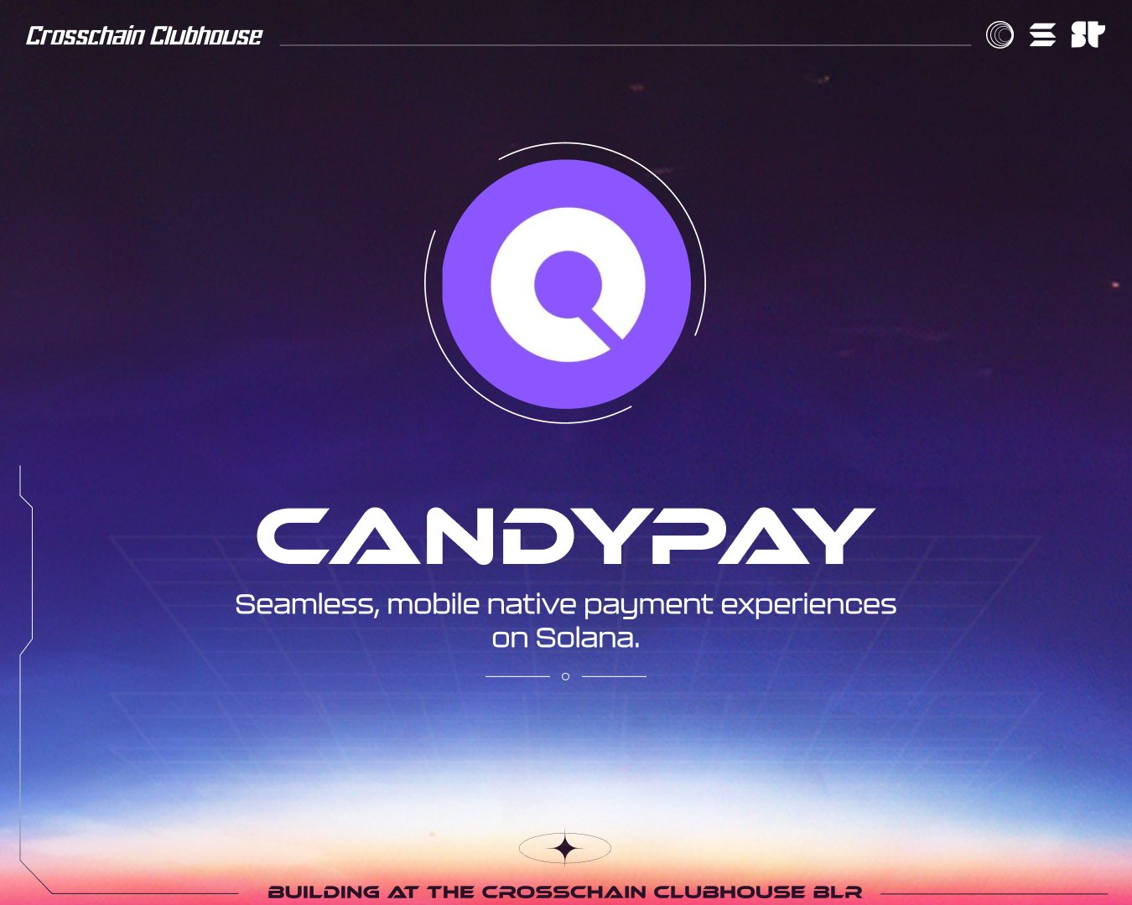
Application of CandyPay technology in payment

Slide 3


MEMBER GROUP
MEMBER
Name: Nguyễn Mẩn Đạt
Student ID: PS30042
Name : Tống Đinh Tiên Hoàng
Student ID: PS30071

Slide 4


Presentation Topic
Main Function
Market Trend
Blockchain Future

Slide 5
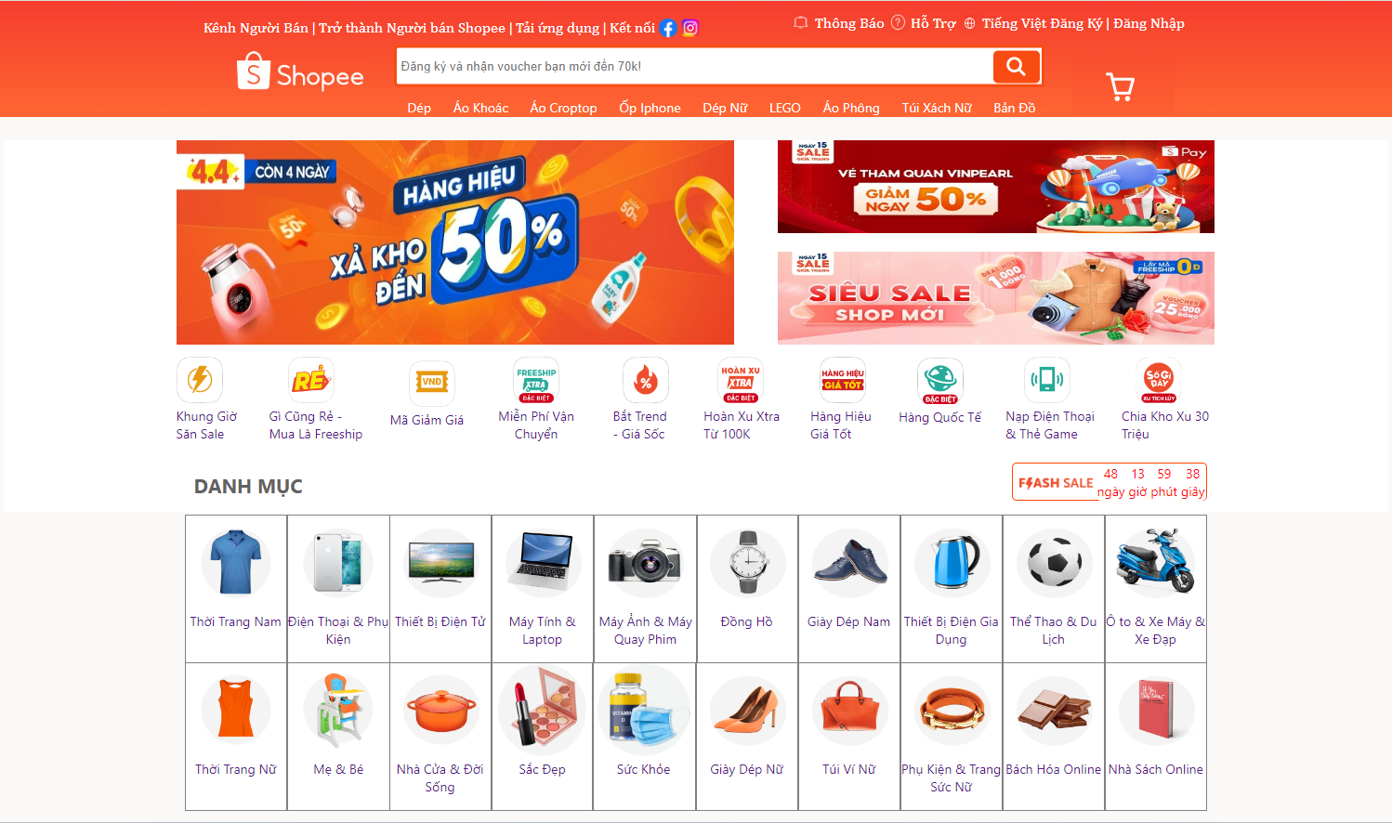

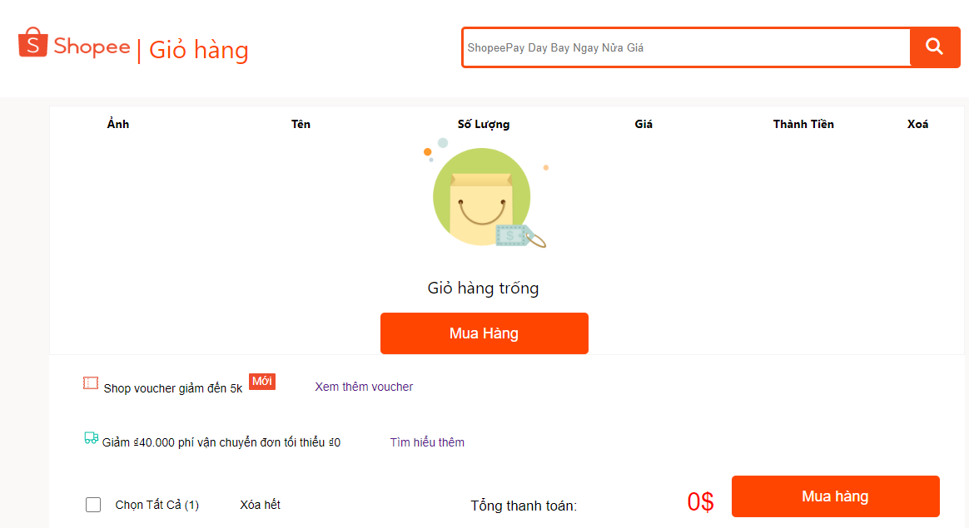
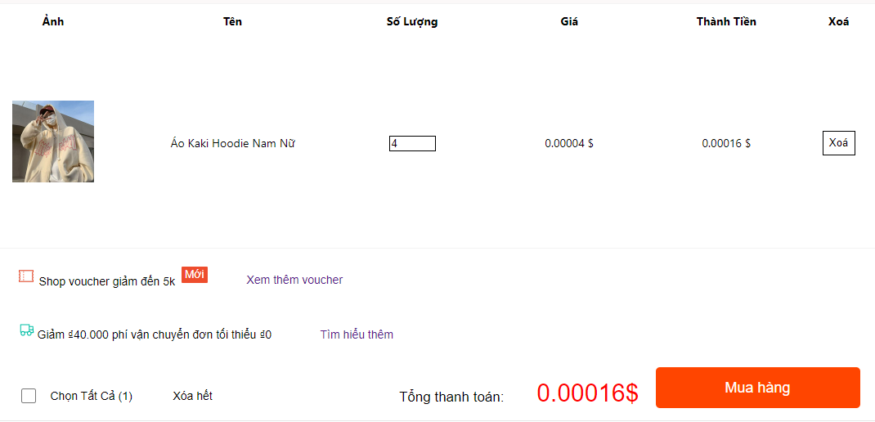

MainFunction
Content
Function
Search Product
Choose Product
Pay
- Use Candypay
CARTS

Slide 6


Market Trend
Content
Cash
Wallet
Crypto

Slide 7
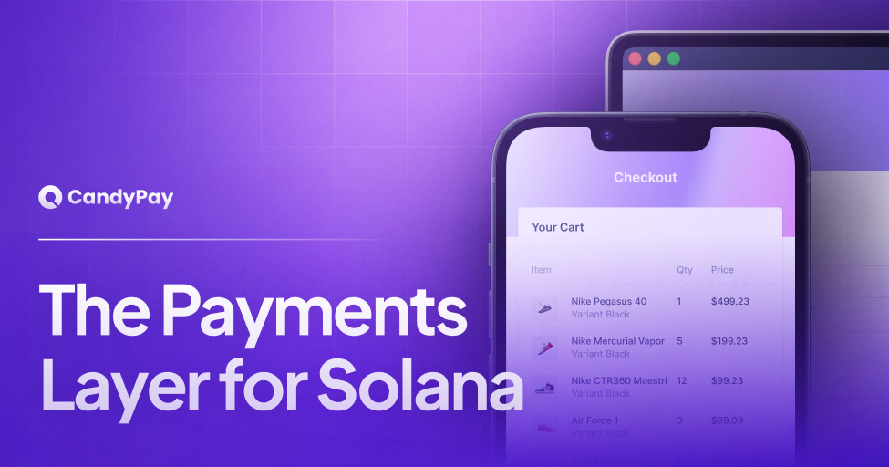
BlockchainFuture
Trending
Content
Security
Transparency
Speed
Cost effectiveness

Slide 8
Disadvantage
Advantage
- Time
- Knowledge
- Learn more knowledge Blockchain
- Support from Mentor
- Access to new technology

Slide 9
Thanks For Listening!
LEGENDS
NEVER DIE

