Slide 1
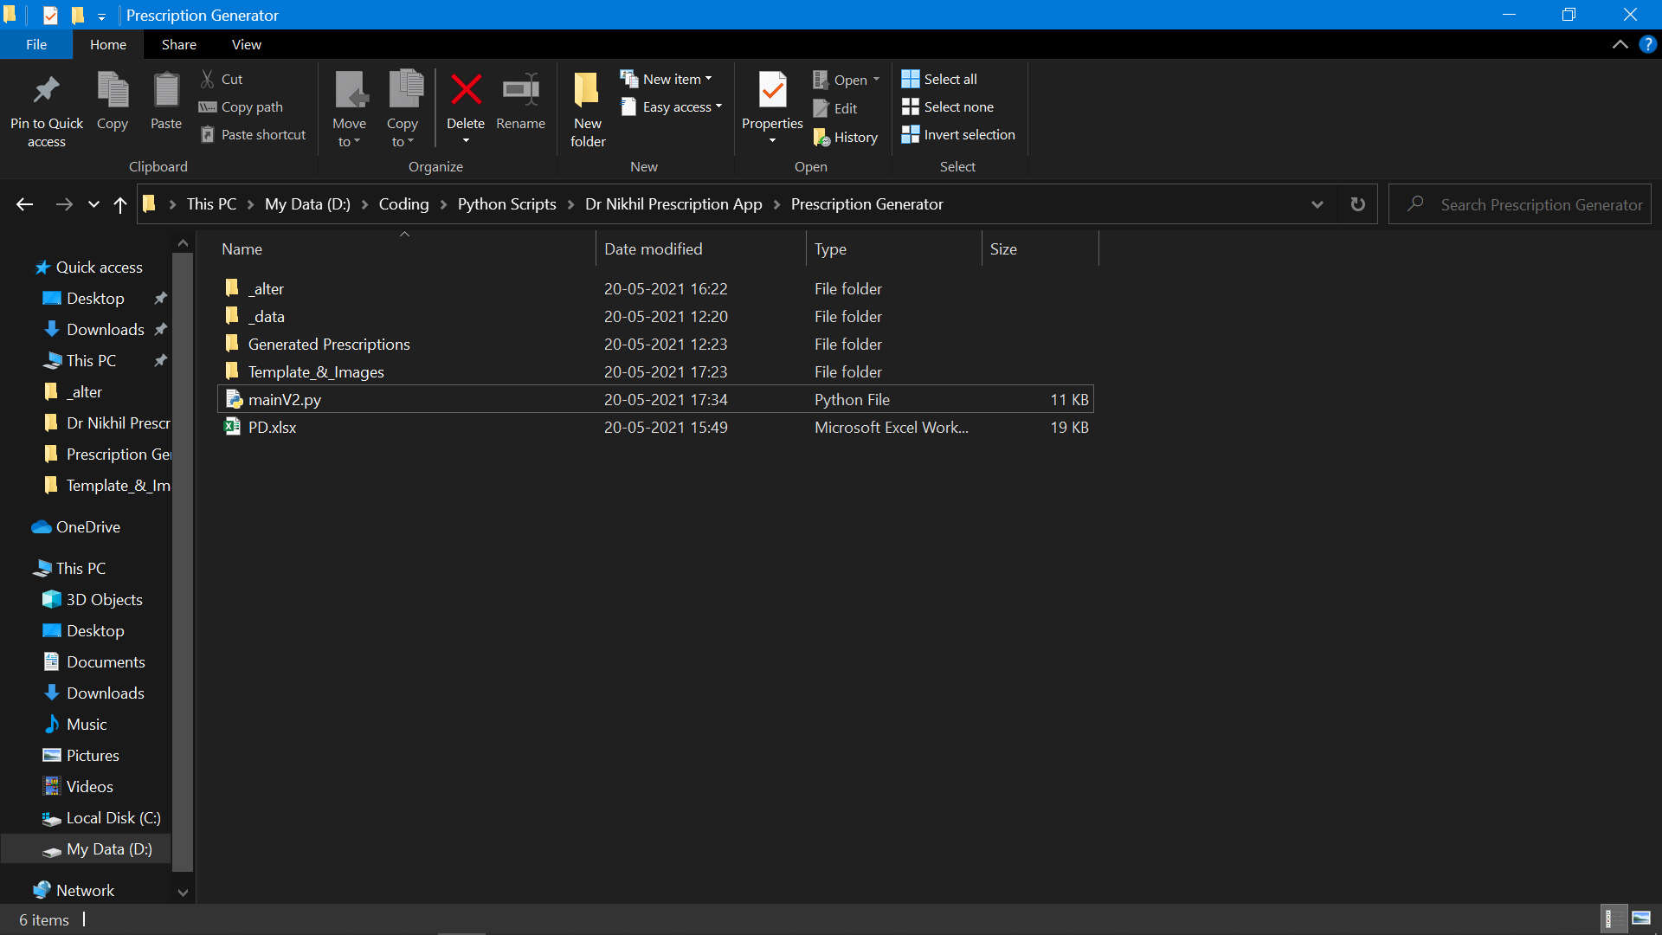
THIS IS
THIS IS THE MAIN FOLDER YOU WILL RECEIVE.
YOU WILL RECEIVE IT AS A .zip file. Use
WINRAR to extract it to wherever you like on your PC

Slide 2
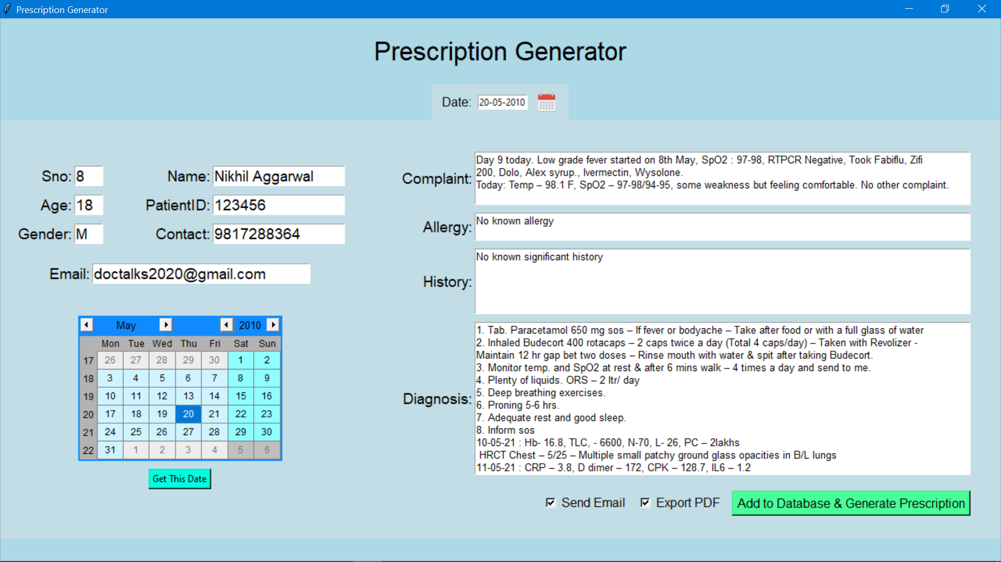
YOU CAN INSERT DATA ON THIS PAGE AND CLICK ON THE Checkboxes as you like.

Slide 3
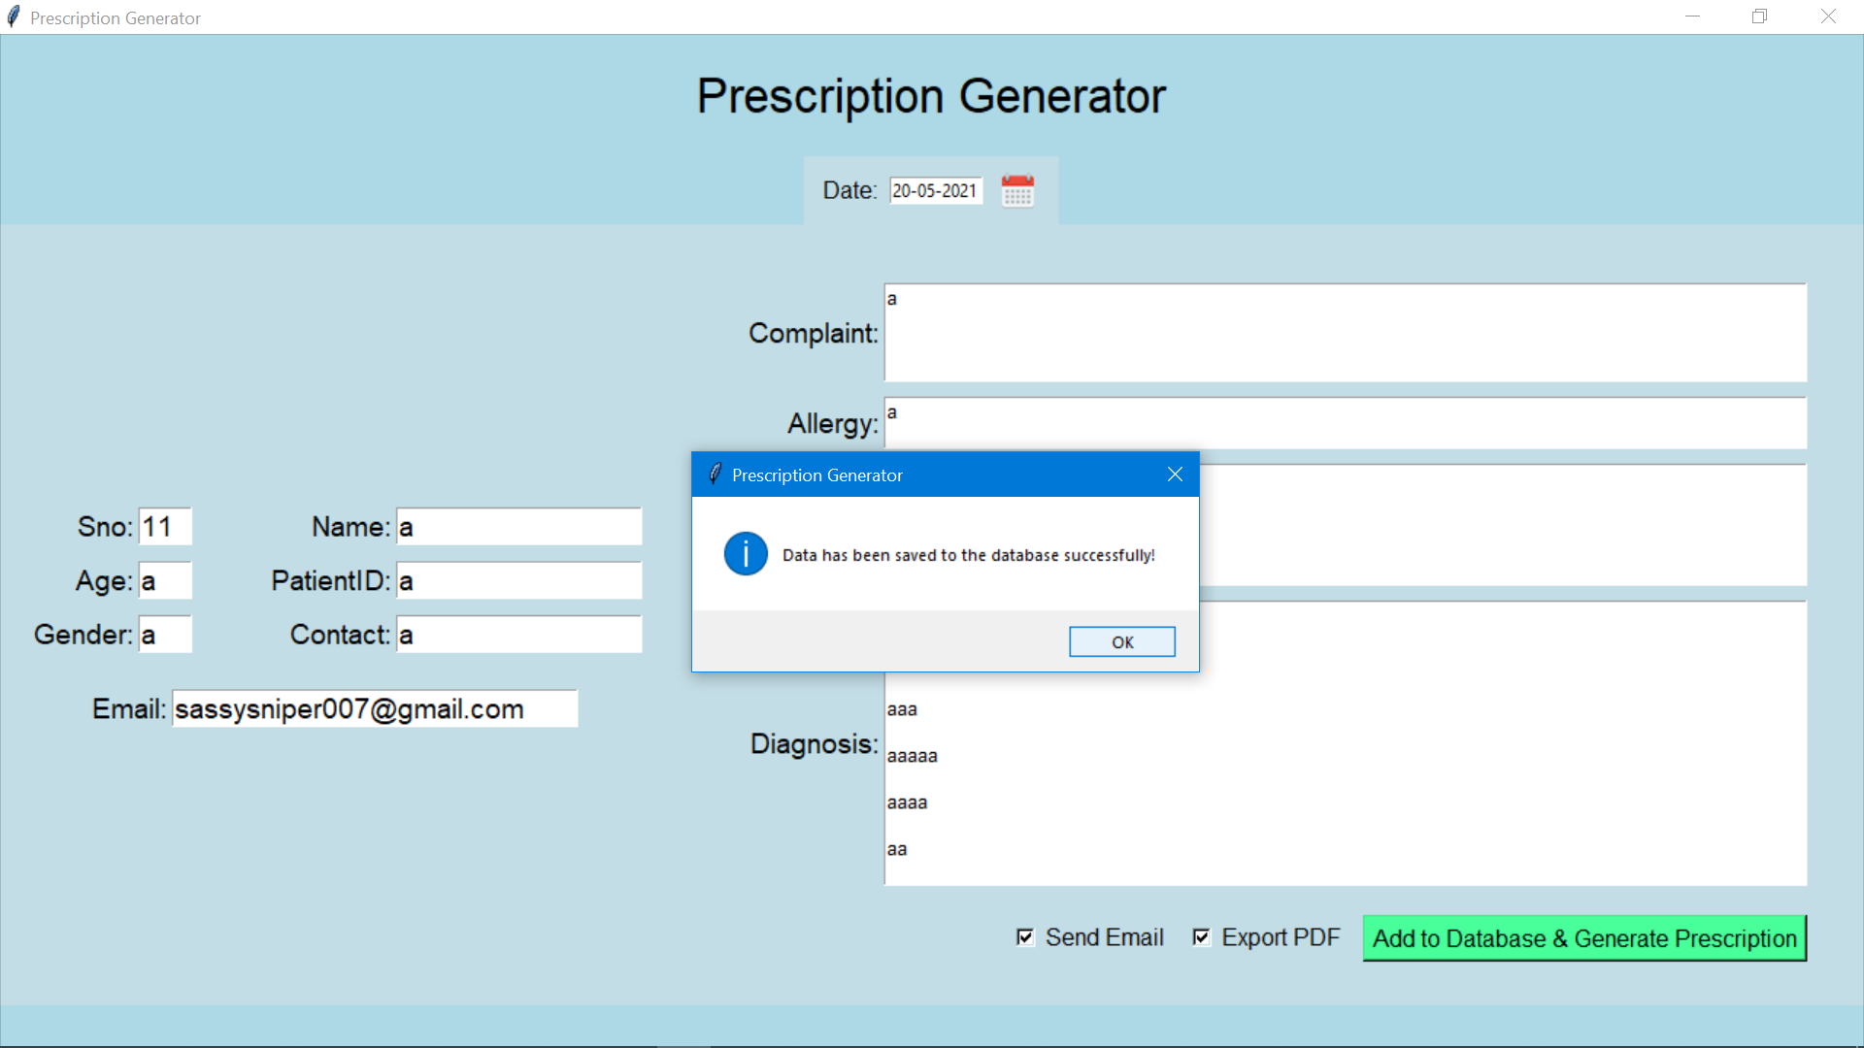
Notification received after saving the data in the database

Slide 4
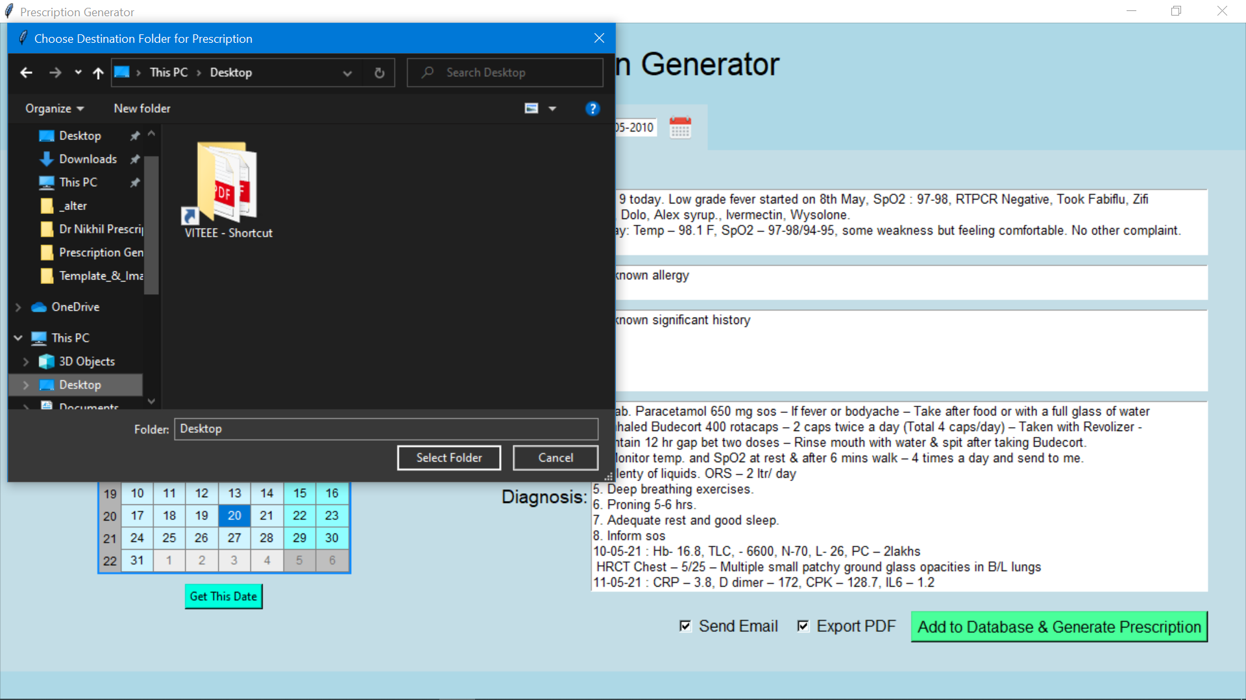
Choose destination location to save the Prescription

Slide 5
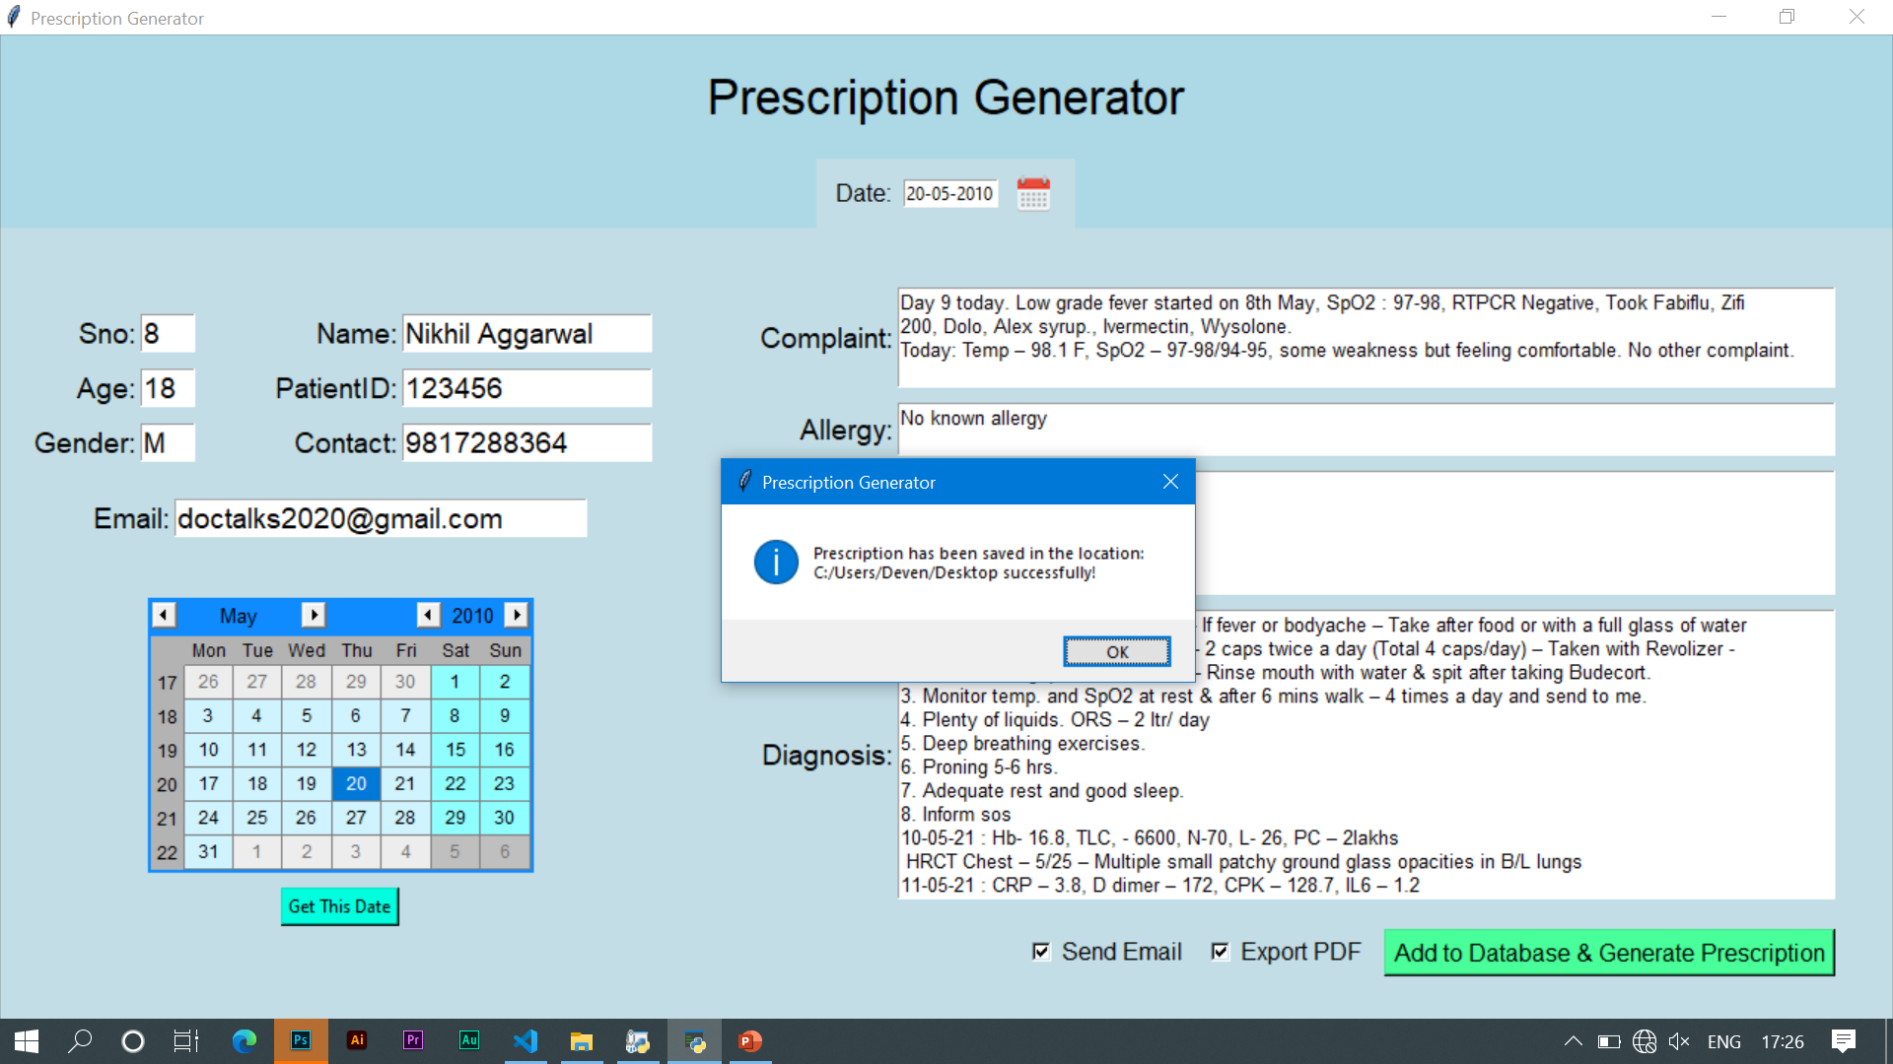
Prescription saved in desired folder!

Slide 6
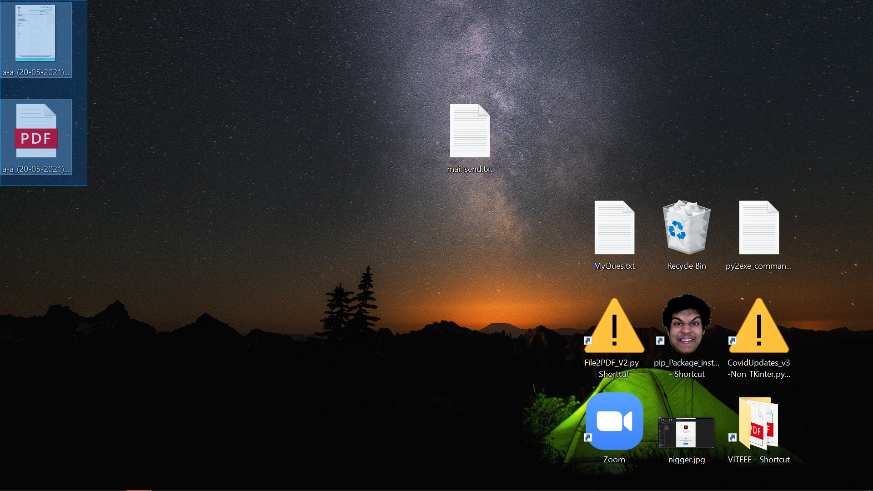
Files Are there in desired location! ☺

Slide 7
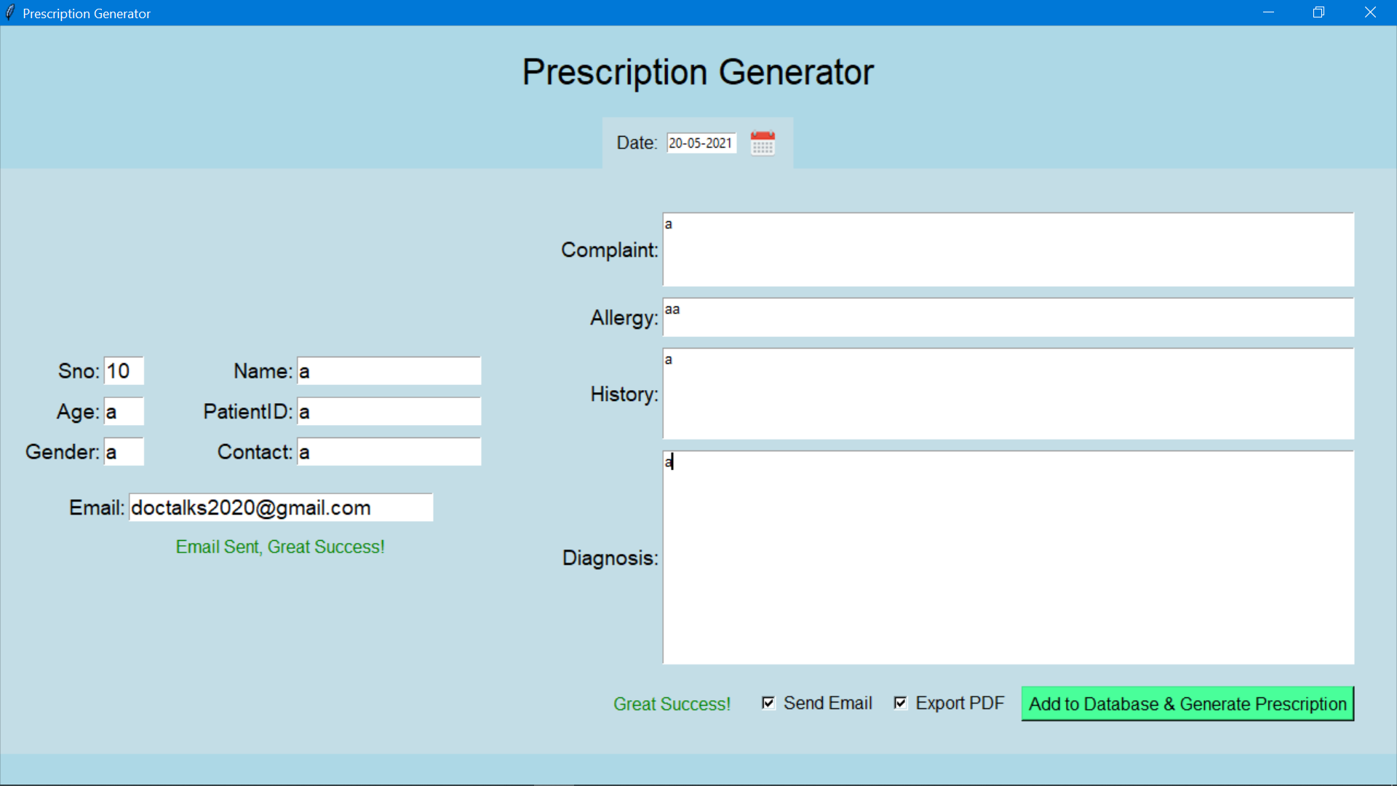
Confirmation Message on Screen.

Slide 8
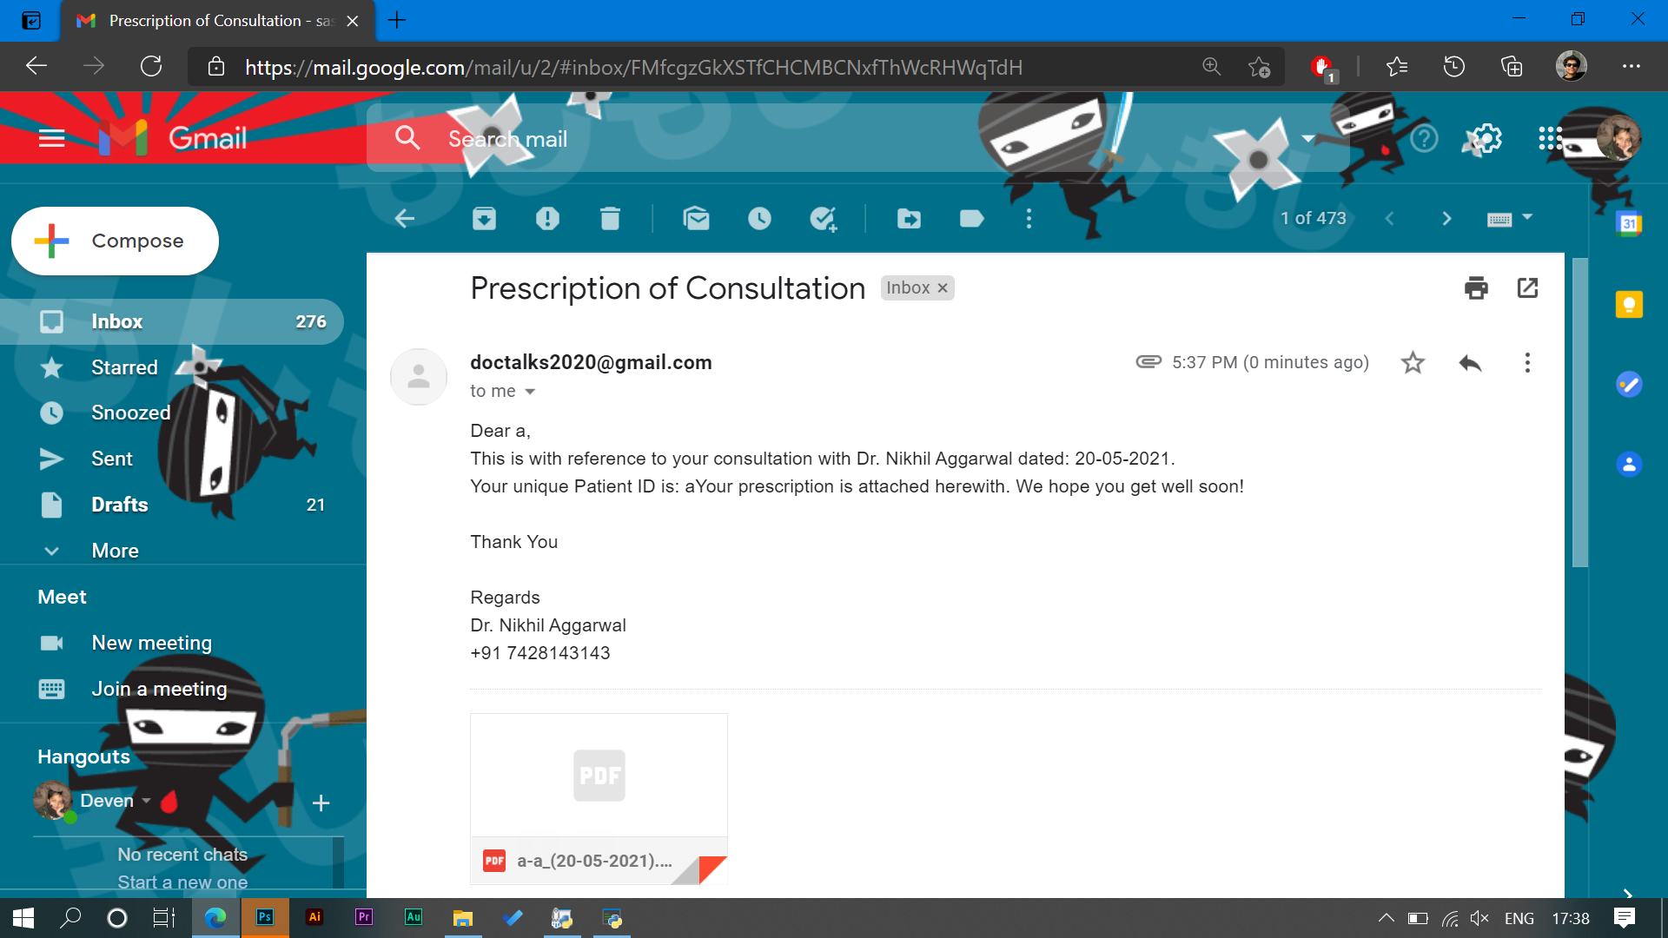
EMAIL SENT SUCCESSFULLY WITH ATTACHMENT!

