Slide 1


Cure your Fear of Git
Chris Gomez
@SpaceShot
chris@chrisgomez.com
www.chrisgomez.com

Slide 2
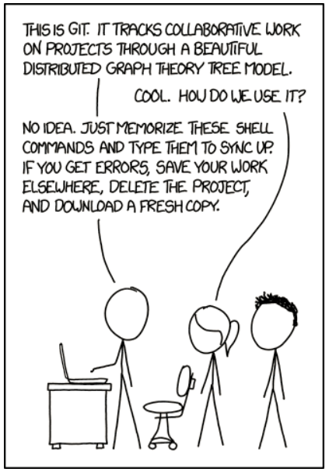
http://xkcd.com/1597

Slide 3
Common Problems
I forgot to branch when I started coding again!
I just tried to get latest and I have to deal with merging again!
I just want to check-in code and I have to deal with merging again!
I’m afraid to delete branches!
git rebase just SOUNDS SCARY!
How should I leave my code over the weekend?

Slide 4
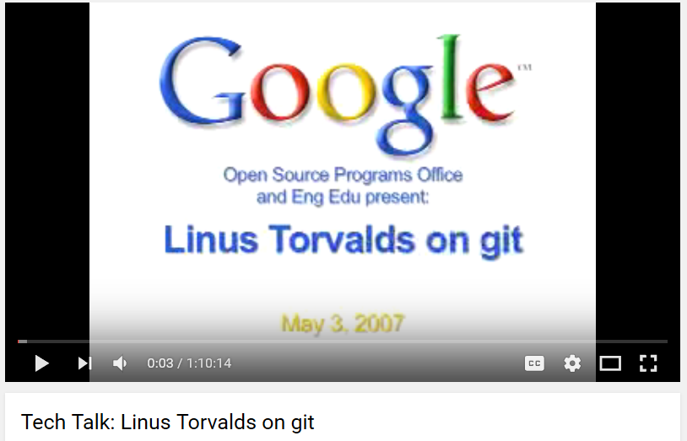
Git: The Source Control For Linus
https://www.youtube.com/watch?v=4XpnKHJAok8

Slide 5
Source Control to Manage Linux
Large project
Many contributors & many he does not know
Wants to take patches from people he trusts
Wants to know that his commits are immutable

Slide 6
Scary Definitions of Git
“Content Addressable File System”
“A Directed Acyclic Graph”
“Distributed Version Control”

Slide 7
How Git Works
Let’s Ignore the Scary Phrases
The Git Internal Model
The Git Folder
The Commit Graph

Slide 8
The Git Internal Model
For everything like commits, files, and folders, Git simply creates a SHA1 hash of the content, and that’s the key it uses to store the value
Notes:
echo Philly.NET| git hash-object –stdin
61bf8b2fc819641b01d63266e72517b305608995
Type?
git cat-file 61bf8b2fc819641b01d63266e72517b305608995 –t
Pretty Print
git cat-file 61bf8b2fc819641b01d63266e72517b305608995 -p

Slide 9
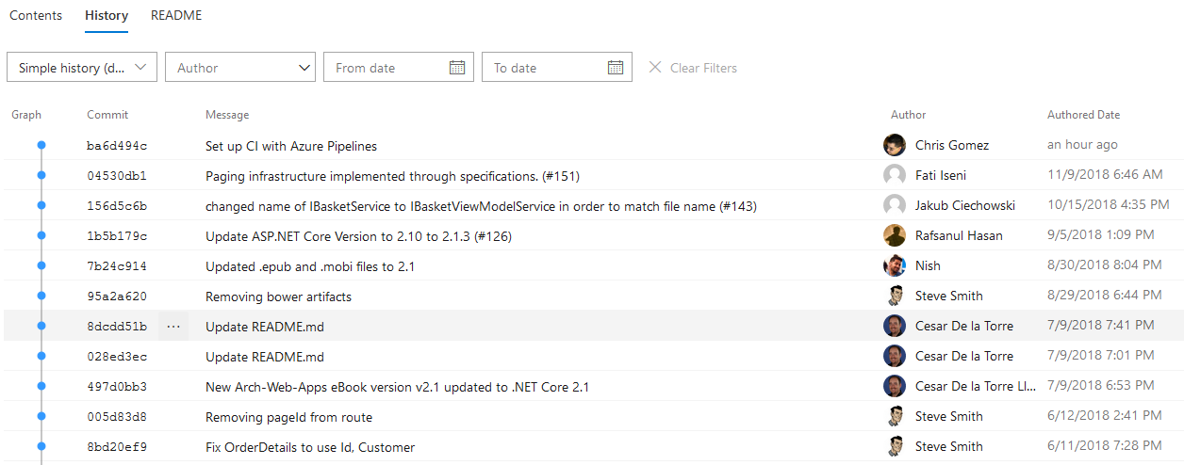
Those hashes aren’t random

Slide 10
One Way Hashes
Mathematical functions that take any arbitrary value and creates a value that represents that content.
Notes:
echo Philly.NET| git hash-object –stdin
61bf8b2fc819641b01d63266e72517b305608995
Type?
git cat-file 61bf8b2fc819641b01d63266e72517b305608995 –t
Pretty Print
git cat-file 61bf8b2fc819641b01d63266e72517b305608995 -p

Slide 11
One Way Hashes
Often used in cryptography
Hashes are “difficult” to reverse
Wide enough range of outputs to avoid collisions
Notes:
echo Philly.NET| git hash-object –stdin
61bf8b2fc819641b01d63266e72517b305608995
Type?
git cat-file 61bf8b2fc819641b01d63266e72517b305608995 –t
Pretty Print
git cat-file 61bf8b2fc819641b01d63266e72517b305608995 -p

Slide 12
One Way Hashes Git uses hashes for identification only:
Wide enough range of outputs to avoid collisions
Commits have hashes
So do your committed files (blobs)
So does your folder structure (trees)
Notes:
echo Philly.NET| git hash-object –stdin
61bf8b2fc819641b01d63266e72517b305608995
Type?
git cat-file 61bf8b2fc819641b01d63266e72517b305608995 –t
Pretty Print
git cat-file 61bf8b2fc819641b01d63266e72517b305608995 -p

Slide 13
Commits Are Immutable
A commit, and therefore its hash, can never be changed.
If you have some Git experience, this may surprise you.
Notes:
echo Philly.NET| git hash-object –stdin
61bf8b2fc819641b01d63266e72517b305608995
Type?
git cat-file 61bf8b2fc819641b01d63266e72517b305608995 –t
Pretty Print
git cat-file 61bf8b2fc819641b01d63266e72517b305608995 -p

Slide 14
Commits Have Parents
Every commit, except the first commit, has one or more parents.
This also cannot be changed for a particular, immutable commit.
Notes:
echo Philly.NET| git hash-object –stdin
61bf8b2fc819641b01d63266e72517b305608995
Type?
git cat-file 61bf8b2fc819641b01d63266e72517b305608995 –t
Pretty Print
git cat-file 61bf8b2fc819641b01d63266e72517b305608995 -p

Slide 15
The Git Folder
.git (often set as hidden)
Some files are readable
Your repository and history are in here
Notes:
echo Philly.NET| git hash-object –stdin
61bf8b2fc819641b01d63266e72517b305608995
Type?
git cat-file 61bf8b2fc819641b01d63266e72517b305608995 –t
Pretty Print
git cat-file 61bf8b2fc819641b01d63266e72517b305608995 -p

Slide 16
The Git Folder
.git (often set as hidden)
Some files are readable
Your repository and history are in here
Notes:
Use git cat-file to examine a commit, tree, and blob
Show that the some file in two different commits is still referenced, but not changed, and is the exact same blob
Type?
git cat-file 61bf8b2fc819641b01d63266e72517b305608995 –t
Pretty Print
git cat-file 61bf8b2fc819641b01d63266e72517b305608995 -p

Slide 17
The Git Folder
Your branches and tags point to commits.
They do not point to “history”.
Git can “walk” history timeline because commits know their parents.
Notes:
Use git cat-file to examine a commit, tree, and blob
Show that the some file in two different commits is still referenced, but not changed, and is the exact same blob
Type?
git cat-file 61bf8b2fc819641b01d63266e72517b305608995 –t
Pretty Print
git cat-file 61bf8b2fc819641b01d63266e72517b305608995 -p

Slide 18
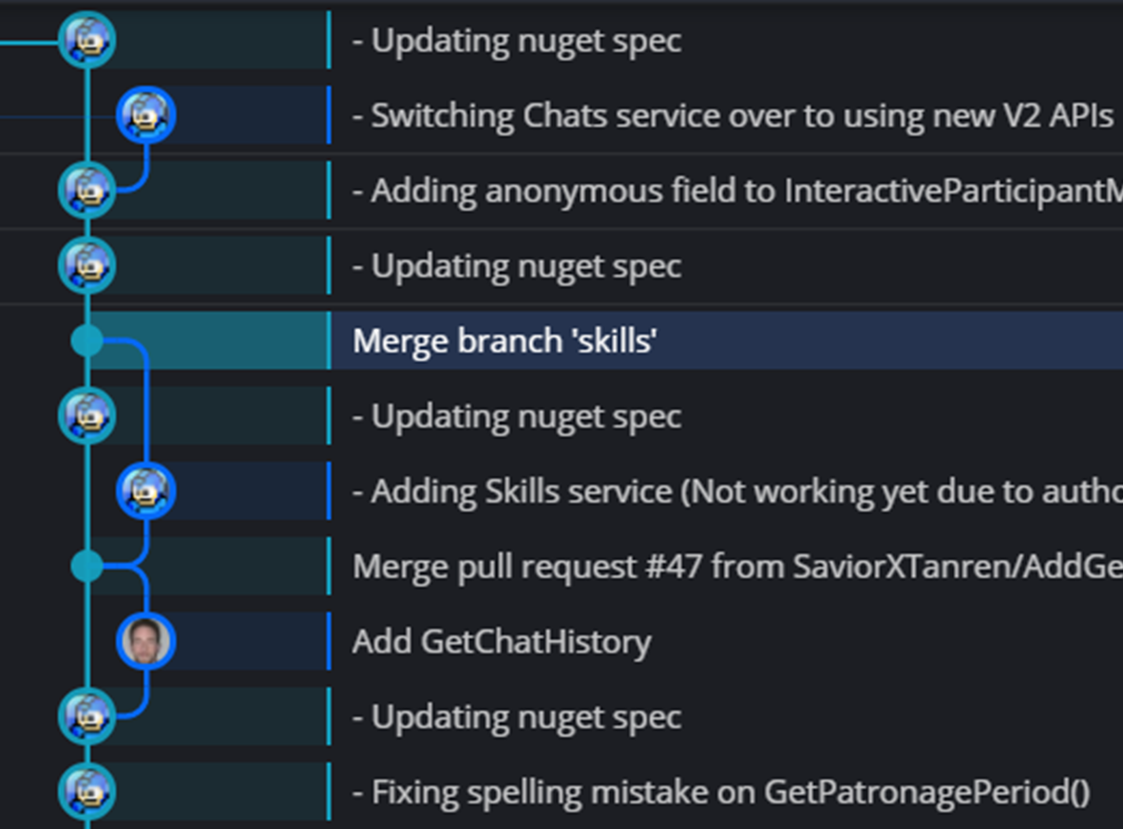
The Commit Graph
Branches and tags are sticky notes.
These ARE mutable.
Trust the graph, worry less about branches
Notes:
Use git cat-file to examine a commit, tree, and blob
Show that the some file in two different commits is still referenced, but not changed, and is the exact same blob
Type?
git cat-file 61bf8b2fc819641b01d63266e72517b305608995 –t
Pretty Print
git cat-file 61bf8b2fc819641b01d63266e72517b305608995 -p

Slide 19
Isolated Source Control
You work on your machine in your own git repository
We “pull” what we need from other servers to try to get back in sync with work others have done
We “push” our work so others can benefit from what we have done.
Notes:
Use git cat-file to examine a commit, tree, and blob
Show that the some file in two different commits is still referenced, but not changed, and is the exact same blob
Type?
git cat-file 61bf8b2fc819641b01d63266e72517b305608995 –t
Pretty Print
git cat-file 61bf8b2fc819641b01d63266e72517b305608995 -p

Slide 20
Branches are just sticky notes
Licensing to say “Post-It” too expensive
You can pick up sticky notes and move them anywhere.
You can create new ones very easily.
Let’s learn about git reset
Notes:
Use git cat-file to examine a commit, tree, and blob
Show that the some file in two different commits is still referenced, but not changed, and is the exact same blob
Type?
git cat-file 61bf8b2fc819641b01d63266e72517b305608995 –t
Pretty Print
git cat-file 61bf8b2fc819641b01d63266e72517b305608995 -p

Slide 21

Git Reset (some options)
git reset <place> --hard
Move the sticky note and reset the files and index
git reset <place> --mixed
Move the sticky note, reset index, leave working file changes
git reset <place> --soft
Move the sticky note, leave the index and working file changes alone
https://www.kunal-chowdhury.com/2016/11/git-cheatsheet-git-reset.html
Notes:
Use git cat-file to examine a commit, tree, and blob
Show that the some file in two different commits is still referenced, but not changed, and is the exact same blob
Type?
git cat-file 61bf8b2fc819641b01d63266e72517b305608995 –t
Pretty Print
git cat-file 61bf8b2fc819641b01d63266e72517b305608995 -p

