Slide 2
The Spatial Narratives project
Aims:
a) create methods to extract all geographical and temporal references from textual corpora;
b) develop methods to analyse and visualise these places and times and the relationships between them;
c) demonstrate broad applicability by conducting analyses of two contrasting corpora; and
d) work with non-academic partners to apply our approaches within their organisations and beyond to present multiple forms of knowledge to the public.
Objectives:
1) To develop methods that go beyond geoparsing to identify, extract and locate all forms of qualitative and quantitative spatio-temporal information described in textual corpora.
2) To create interdisciplinary methods that allow us to represent and reason about the qualitative and quantitative relationships between these places, times, experiences, and the texts that describe them.
3) To use visual analytics and representation (VA) and deep mapping to make these representations and relationships, and how they vary, understandable to researchers and non-academic audiences.
4) To conduct applied analyses that explore how writers describe, represent, and respond to the multiple experiences of place they describe.
5) To disseminate our methods, enhanced datasets, visualisations and findings to academic and non-academic audiences in ways that enhance their own activities and/or their user/visitor experience.

Slide 3
The corpora: Lake District writing and Holocaust survivors
Corpus of Lake District Writing
80 texts from 1622 to 1900
1.5 million words
Includes a wide variety of texts:
Daniel Defoe
Celia Fiennes
Thomas Gray
Thomas West
Robert Southey
Samuel Taylor Coleridge
William Wordsworth
Harriet Martineau
Holocaust survivor testimonies
1000 transcripts randomly sampled from total collection of c. 54,000 transcripts
Transcripts are oral history interviews with Holocaust survivors recorded in 1990s-2000s by the Shoah Foundation Visual History Archive (based at USC)
39,172 coordinate-based place names (2.57% of total word tokens)
37,564 (95.9%) in the U.K.
34,530 (88.1%) in northern England and southern Scotland
23,459 (59.9%) in the modern National Park

Slide 4
Defining place:
Agnew (2011)
Location:
Where a site is located or an event occurs
Locale:
The ‘material things’ that make up the place
Sense of place:
The events that are perceived to occur in the place or the emotional attachment to the place
Note that sense of place cannot exist on its own – it needs to be tied to place

Slide 5
Place in text
Textual references to place:
Toponyms – Locations?
With a satisfactory point location or other coordinate
Where a coordinate is available but not satisfactory
Where no coordinate information is available
Geo-nouns – Locales?
Geographical features – ‘the town’, ‘a river’, ‘the hills’
Cannot be ‘mapped’
Relationships
Describe how two or more places are related:
Simplest form is two references to place being close together in the text
Can be directional: “A is close to B”, “A is 10 minutes from B”
Can be descriptive “A and B are beautiful”

Slide 6
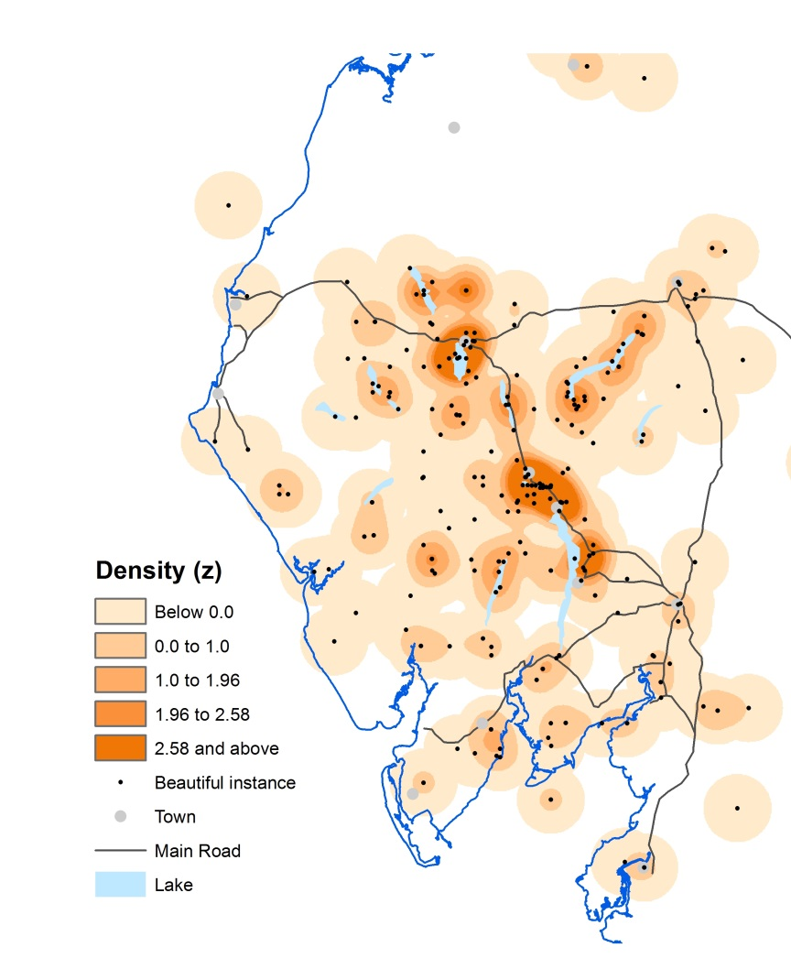
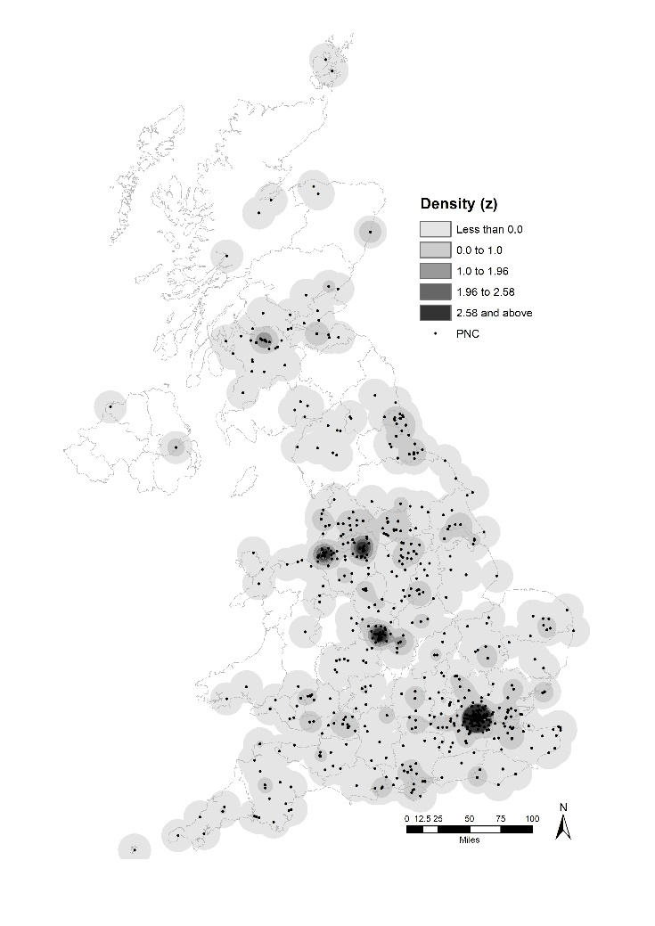
Previous work: Geographical Text Analysis
What places are associated with this theme?
For example – what places are associated with words such as ‘beautiful’ or ‘steep.’ In some work we have used multiple search-terms for this (up to around 60 terms related to poverty in the UK)
What themes are associated with this place?
Given one particular place (which may be one toponym or a number of toponyms that cluster together) what do the texts tell us about it.
64 search terms related to poverty in 325 million words of the Daily Mail
‘Beautiful’ places in 1.5 million words of Lake District writing
Notes:
For 1: Find all of the toponyms near the search term(s) and maps these as points. Smoothing then highlights the pattern
2: Tends to involve finding clusters of place names and exploring their cotext to identify common themes

Slide 7
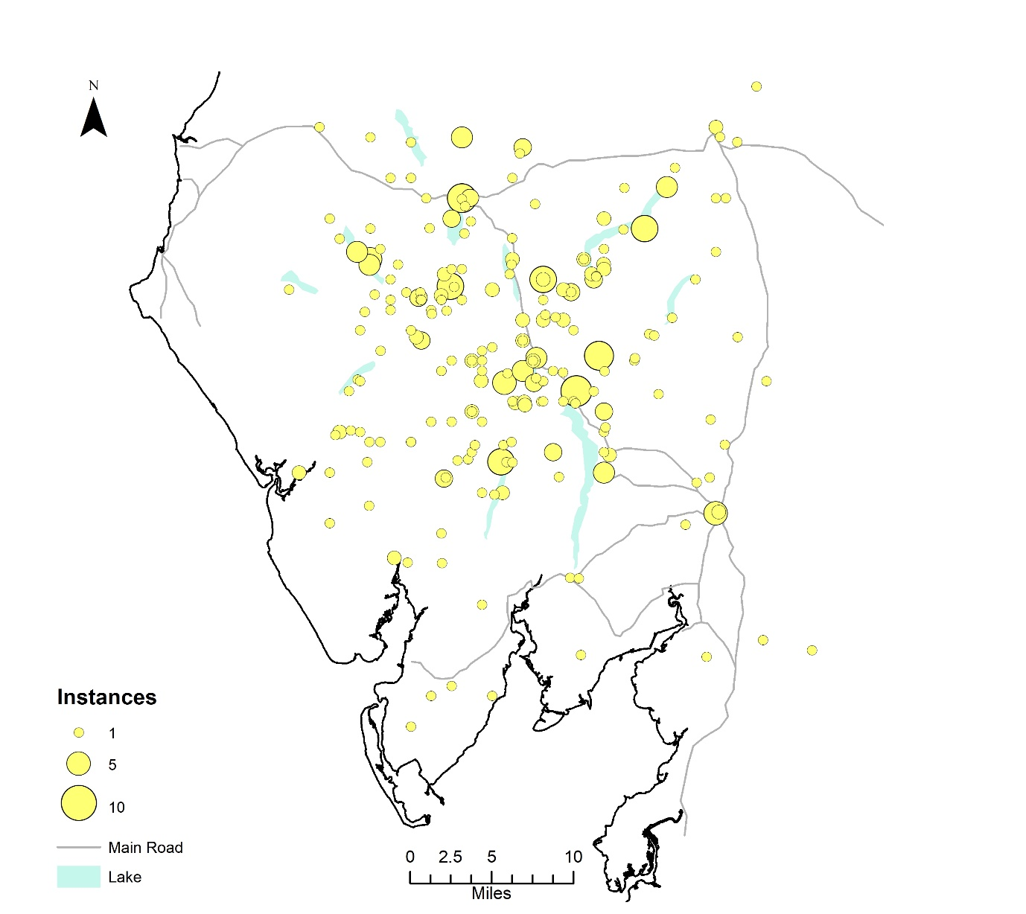
Previous work: ‘Steep’ places in the Lake District
Maps toponyms (place names) within 10 words of the word ‘steep’
Places most associated with ‘steep’:
Ambleside (a town)
Keswick (a town)
Kirkstone (a pass)
Coniston (ambiguous – could be a village, lake or mountain)
Borrowdale (a valley)
Helvellyn (a mountain)
Ullswater (a lake)
What we should know:
‘Roads’ are steep
Steep roads often go over passes
Steep roads include the Ambleside to Keswick road over Dunmail Raise
Notes:
Key point: place names that collocate with ‘steep’ tend not to be steep (e.g. Ambleside and Keswick). This is because roads are steep and roads tend to link towns. Searching by toponym misses this because it has not concept of ‘steep’

Slide 8
Basic questions:
What places are associated with this theme (eg. ‘steep’, ‘beautiful’)?
To broaden the definition of ‘place’ to include toponyms for which we do not have coordinates and geographical features (locales).
To add more diverse/complex themes/sense of place. These could include events or more complex concepts such as ‘having attractive scenery.’
What themes are associated with this place?
This is ultimately about defining the sense of place for a particular location or locale.
Are there more sophisticated ways in which we can build this up?
How did the writers perceive the geographies around them?
Rather than attempting to map everything using Euclidean distance, how did writers describe how places are related to each other?
Relationship/connections can be: prepositions (at, in, near, etc), locative adverbs (three miles ahead), or verbs (we walked from A to B)
How can we ‘map’ these given they involve relative locations and the perceived distances and directions between them rather than absolute locations defined by coordinates.
Different writers may perceive distance and direction differently.

Slide 9
Breaking this down:
What places are there? These can be:
Toponyms (Keswick, Pooley Bridge, the River Lowther, etc)
Geographical features (the town, a hill, the road)
Connections ‘between’ places (‘between A and B there are nice views of the lake’, ‘on the way to A we did something’)
What are those places like (what is their sense of place/how are those places described)?
What events happened at those places?
Which places are related to each other?
how are they related?
What can we infer about places by bringing this information together. For example:
‘At Pooley Bridge we hired a boat to row on the lake’
‘Pooley Bridge is at the head of Ullswater’
‘Ullswater is a lake’
Can we infer that at Pooley Bridge you can hire boats to row on Ullswater?
‘On the road from Pooley Bridge to Penrith there is a bridge after three miles’
‘The road from Pooley Bridge to Penrith crosses the River Lowther’
Can we infer that the bridge after three miles is over the Lowther’?

Slide 10
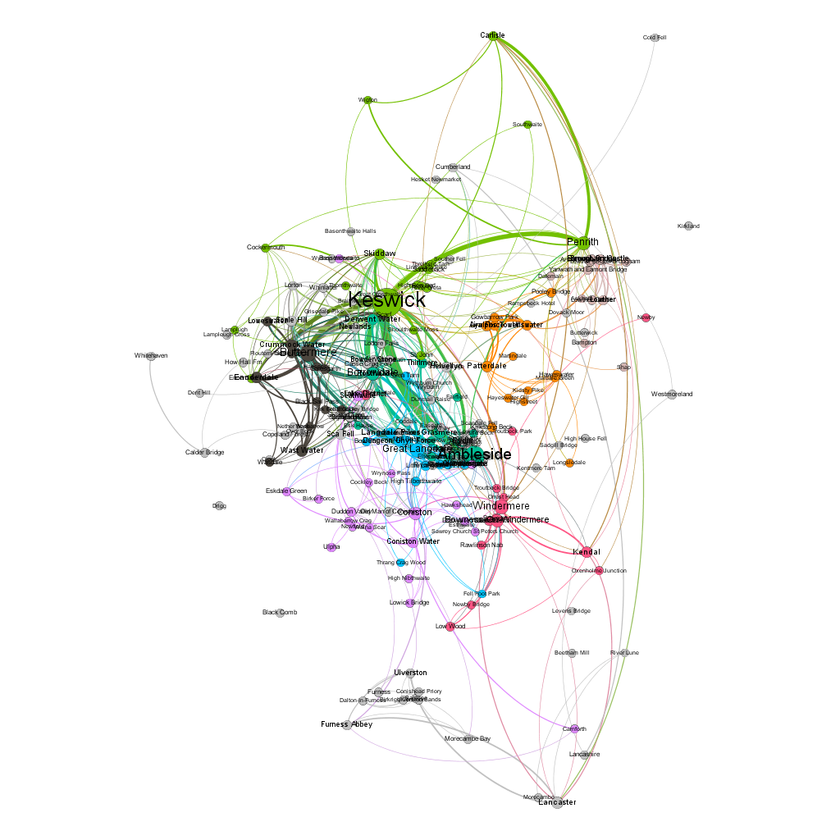
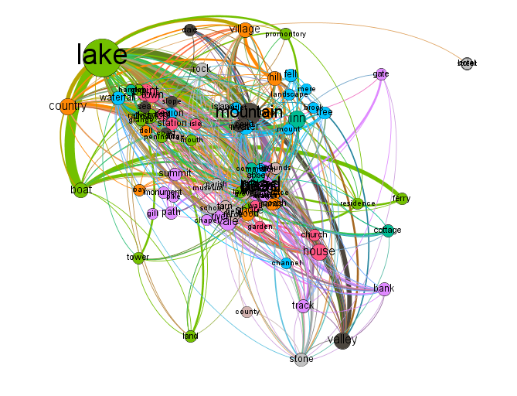
‘Tourist’ places
Toponyms Geographical Feature Nouns
Nodes are proportion to number of instances
Edges are where toponyms/GFNs occur in the same sentence
Colours show modularity clusters
Notes:
Shows ways of ‘mapping’ the connections between places defined as either toponyms or geo-nouns. The edges show where two or more toponyms/geo-nouns occur in the same sentence. Colours show clusters defined by modularity clustering.

Slide 11
Conclusions
Place can be represented as a tri-dimensional concept:
Location
Locale
Sense of place
Mapping toponyms as points is a good start but only shows locations and a limited sense of place
Need to identify and visualise toponyms that cannot be represented as points and geo-nouns
Need to identify sense of place as more than a collection of search-terms

