Slide 1
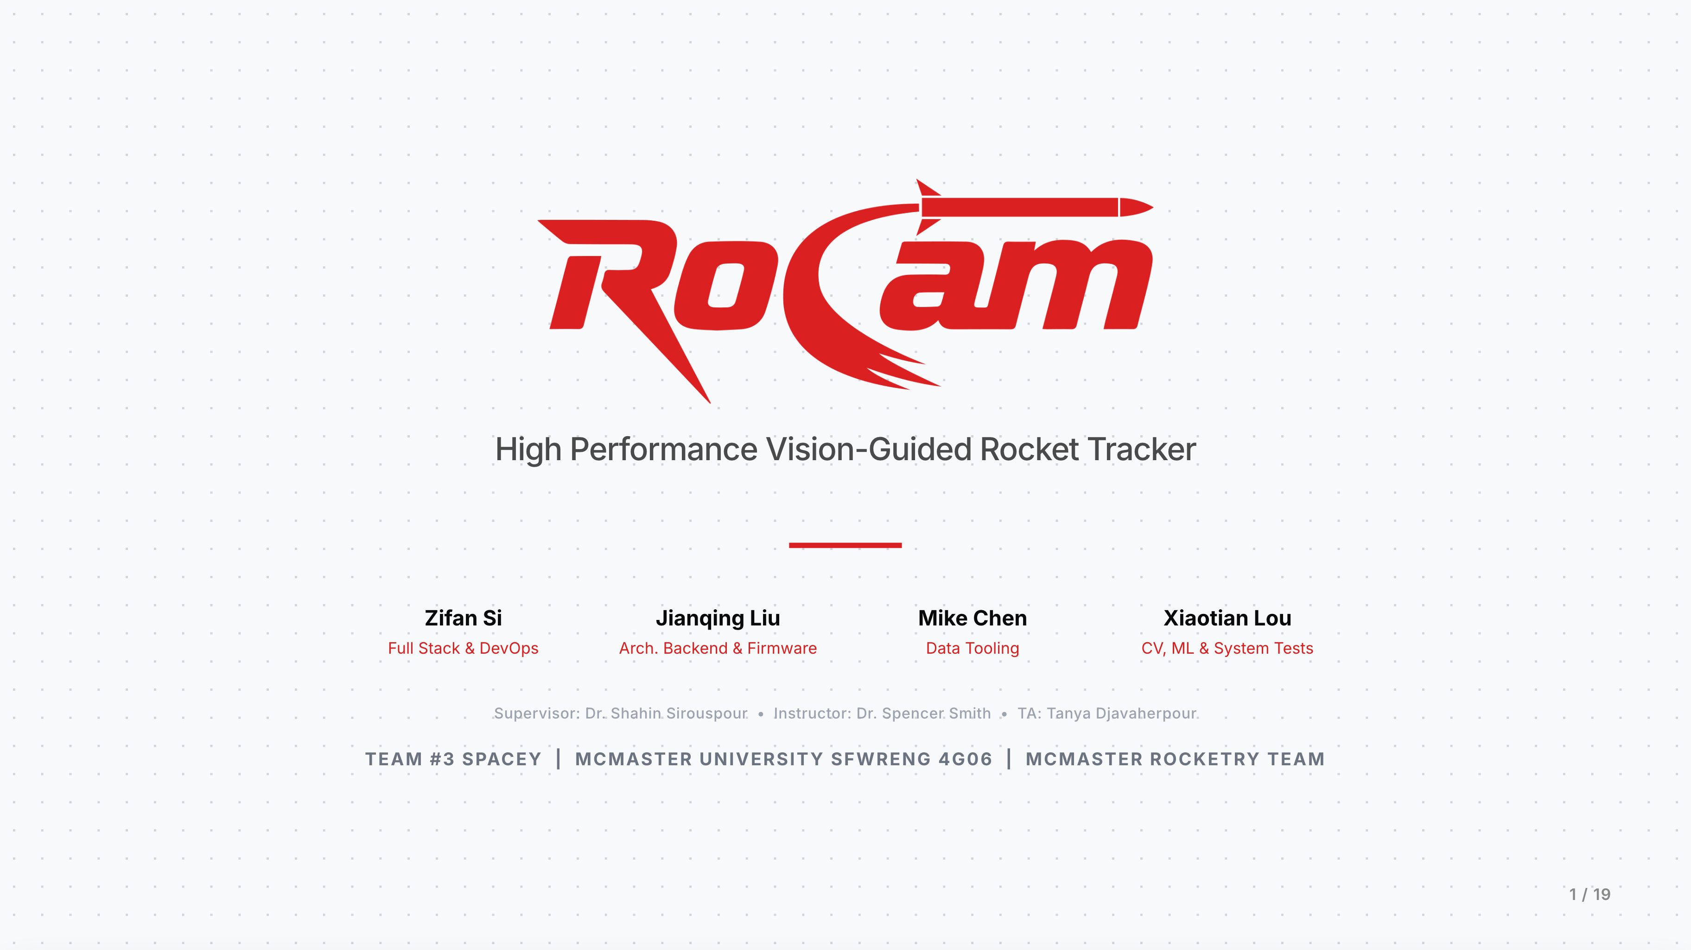

Slide 2
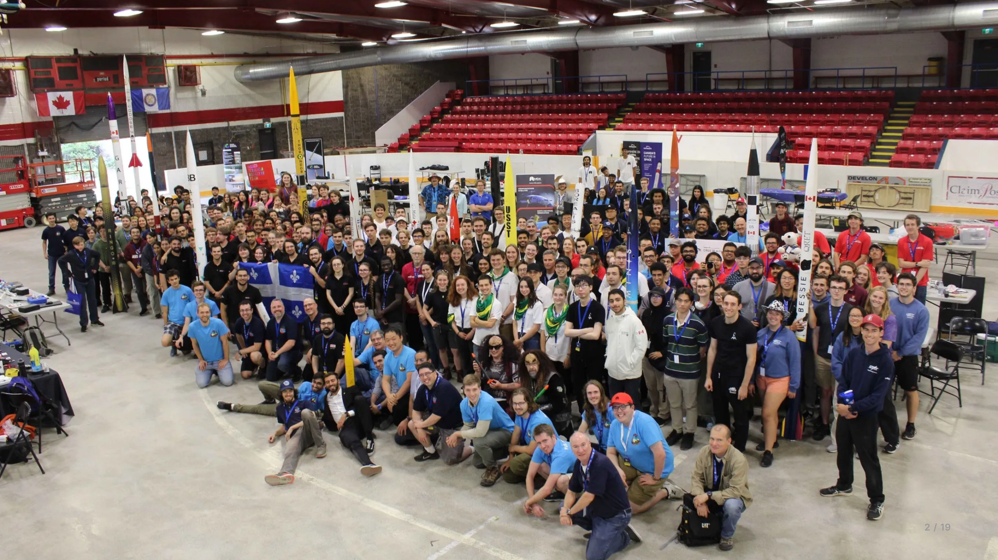

Slide 3
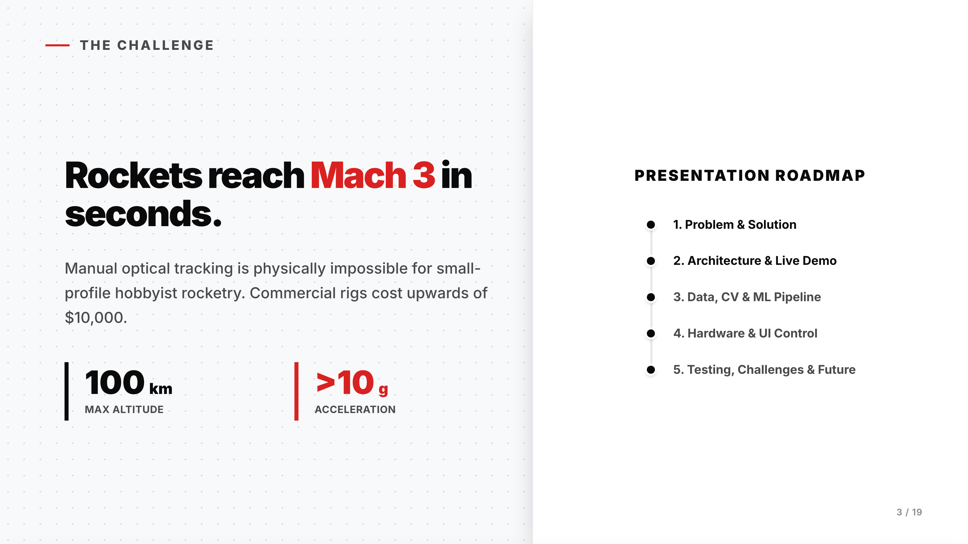

Slide 4
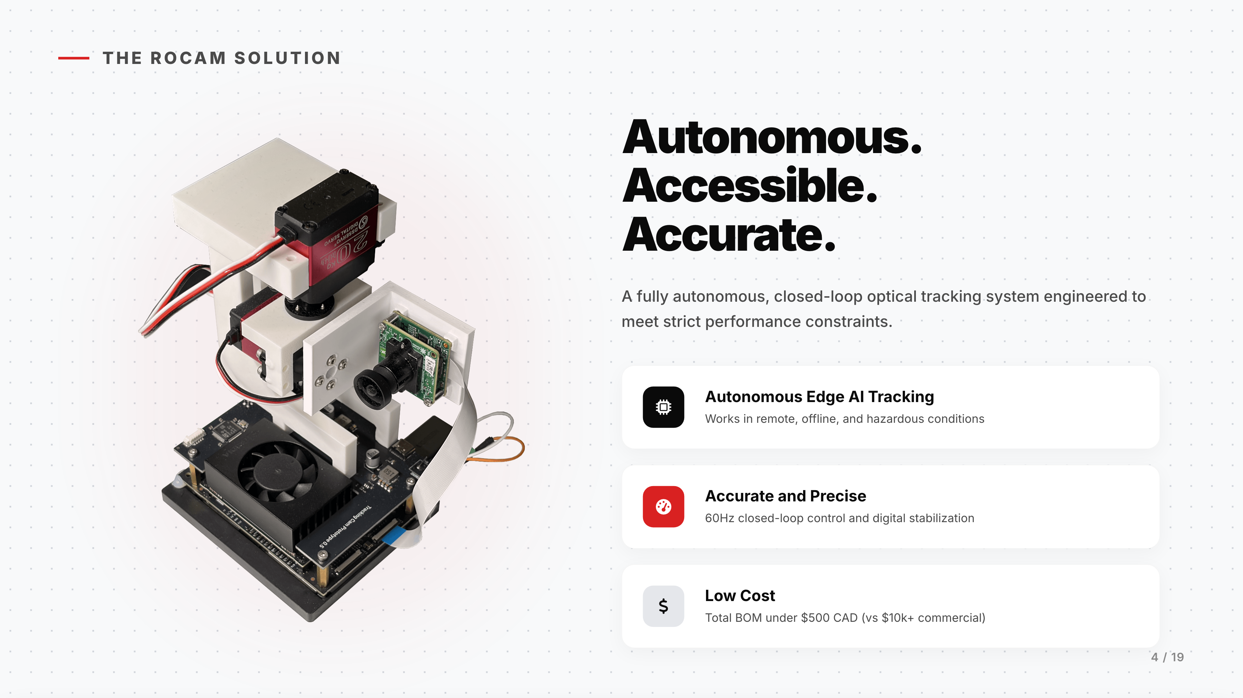

Slide 5
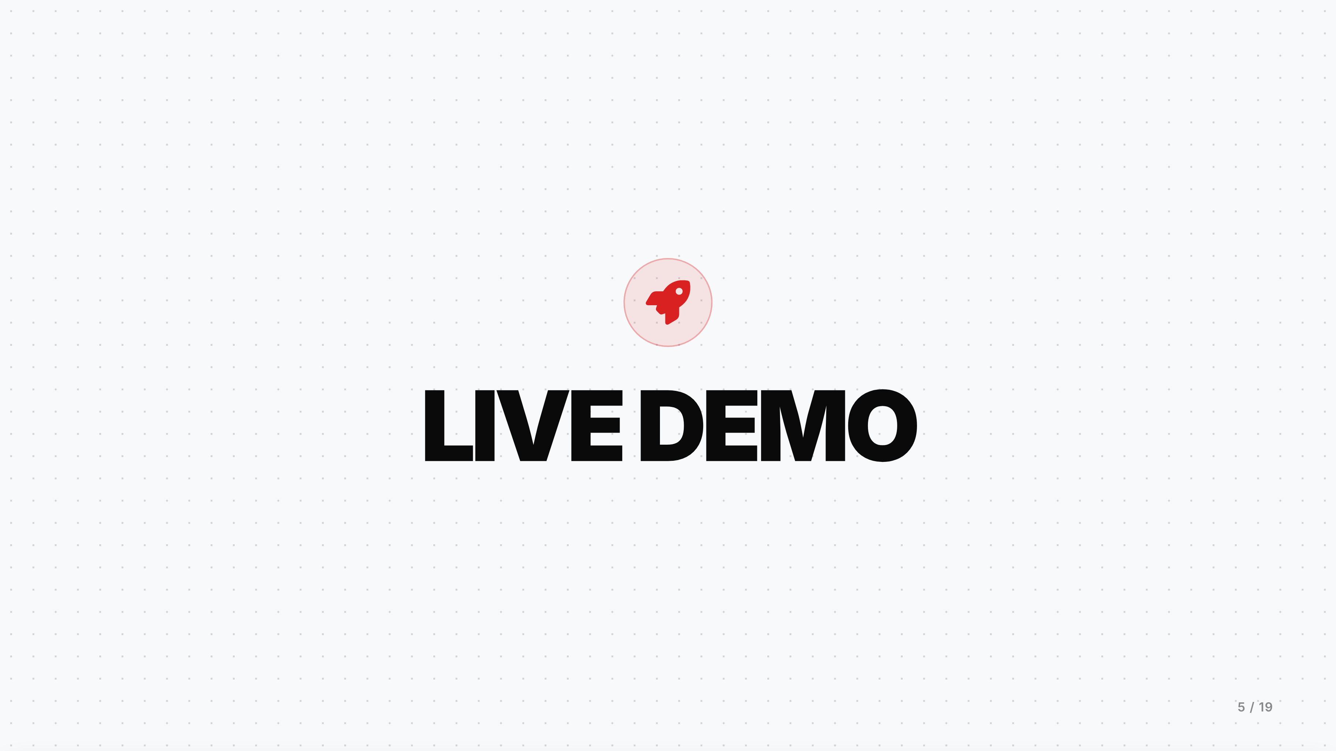

Slide 6
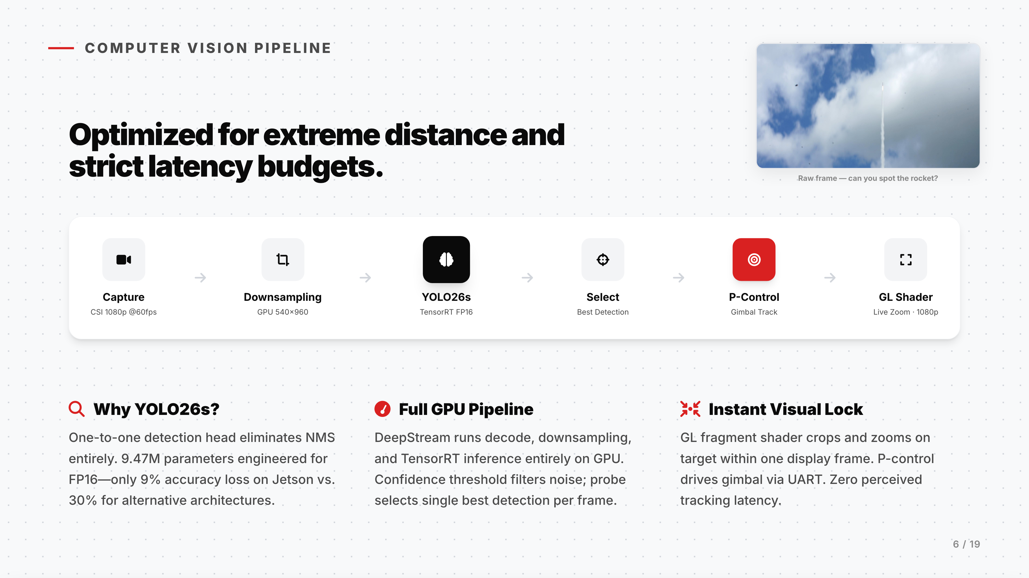

Slide 7
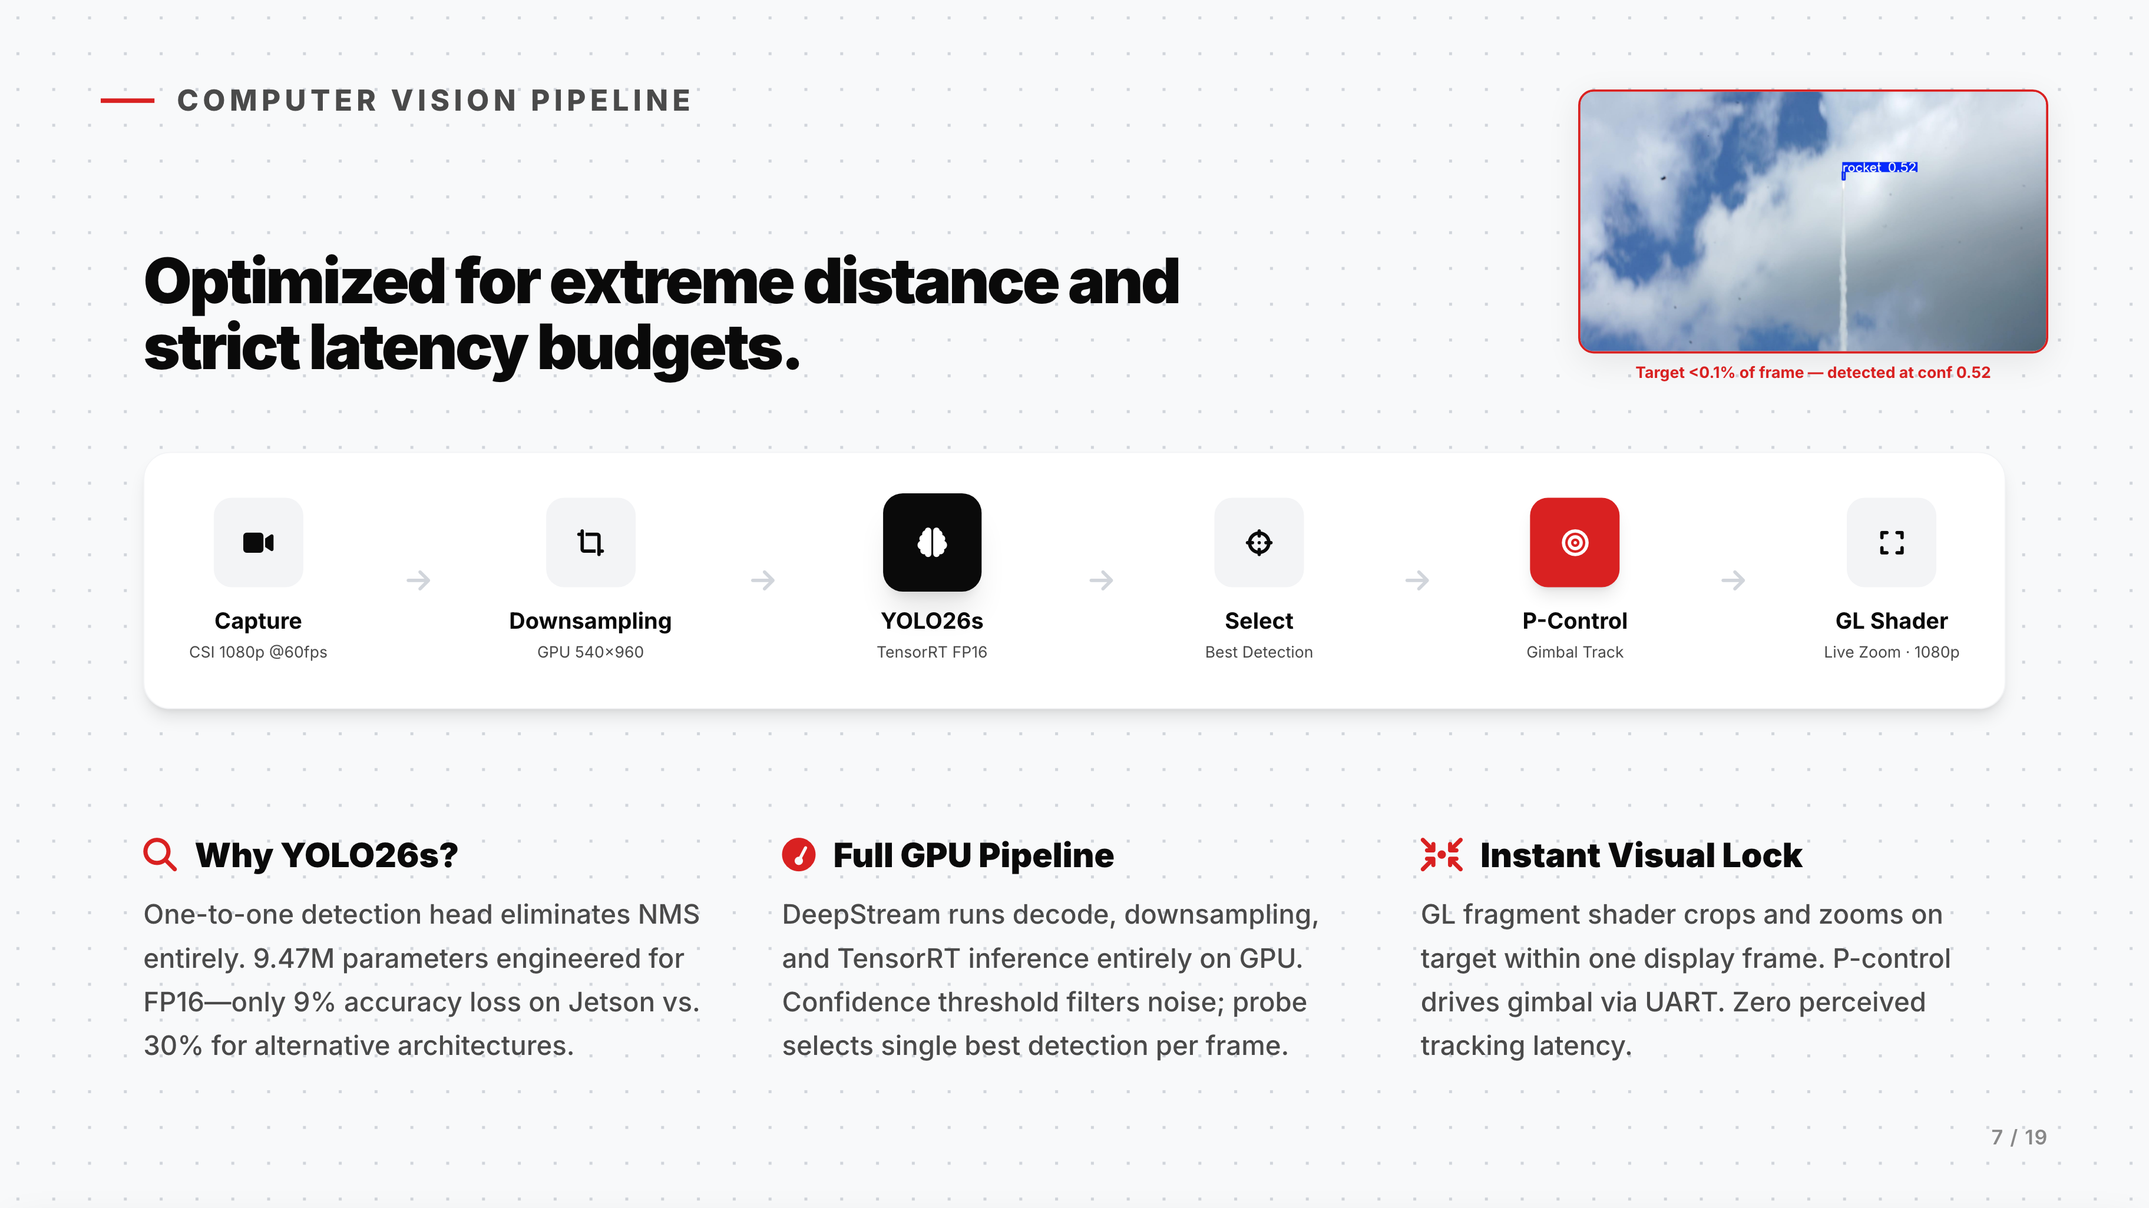

Slide 8
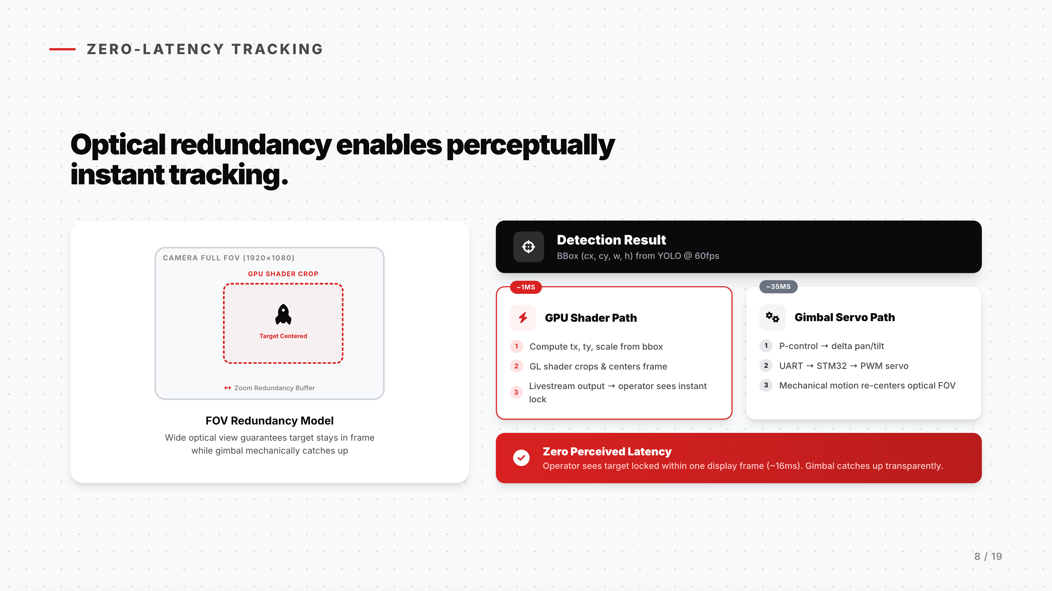

Slide 9
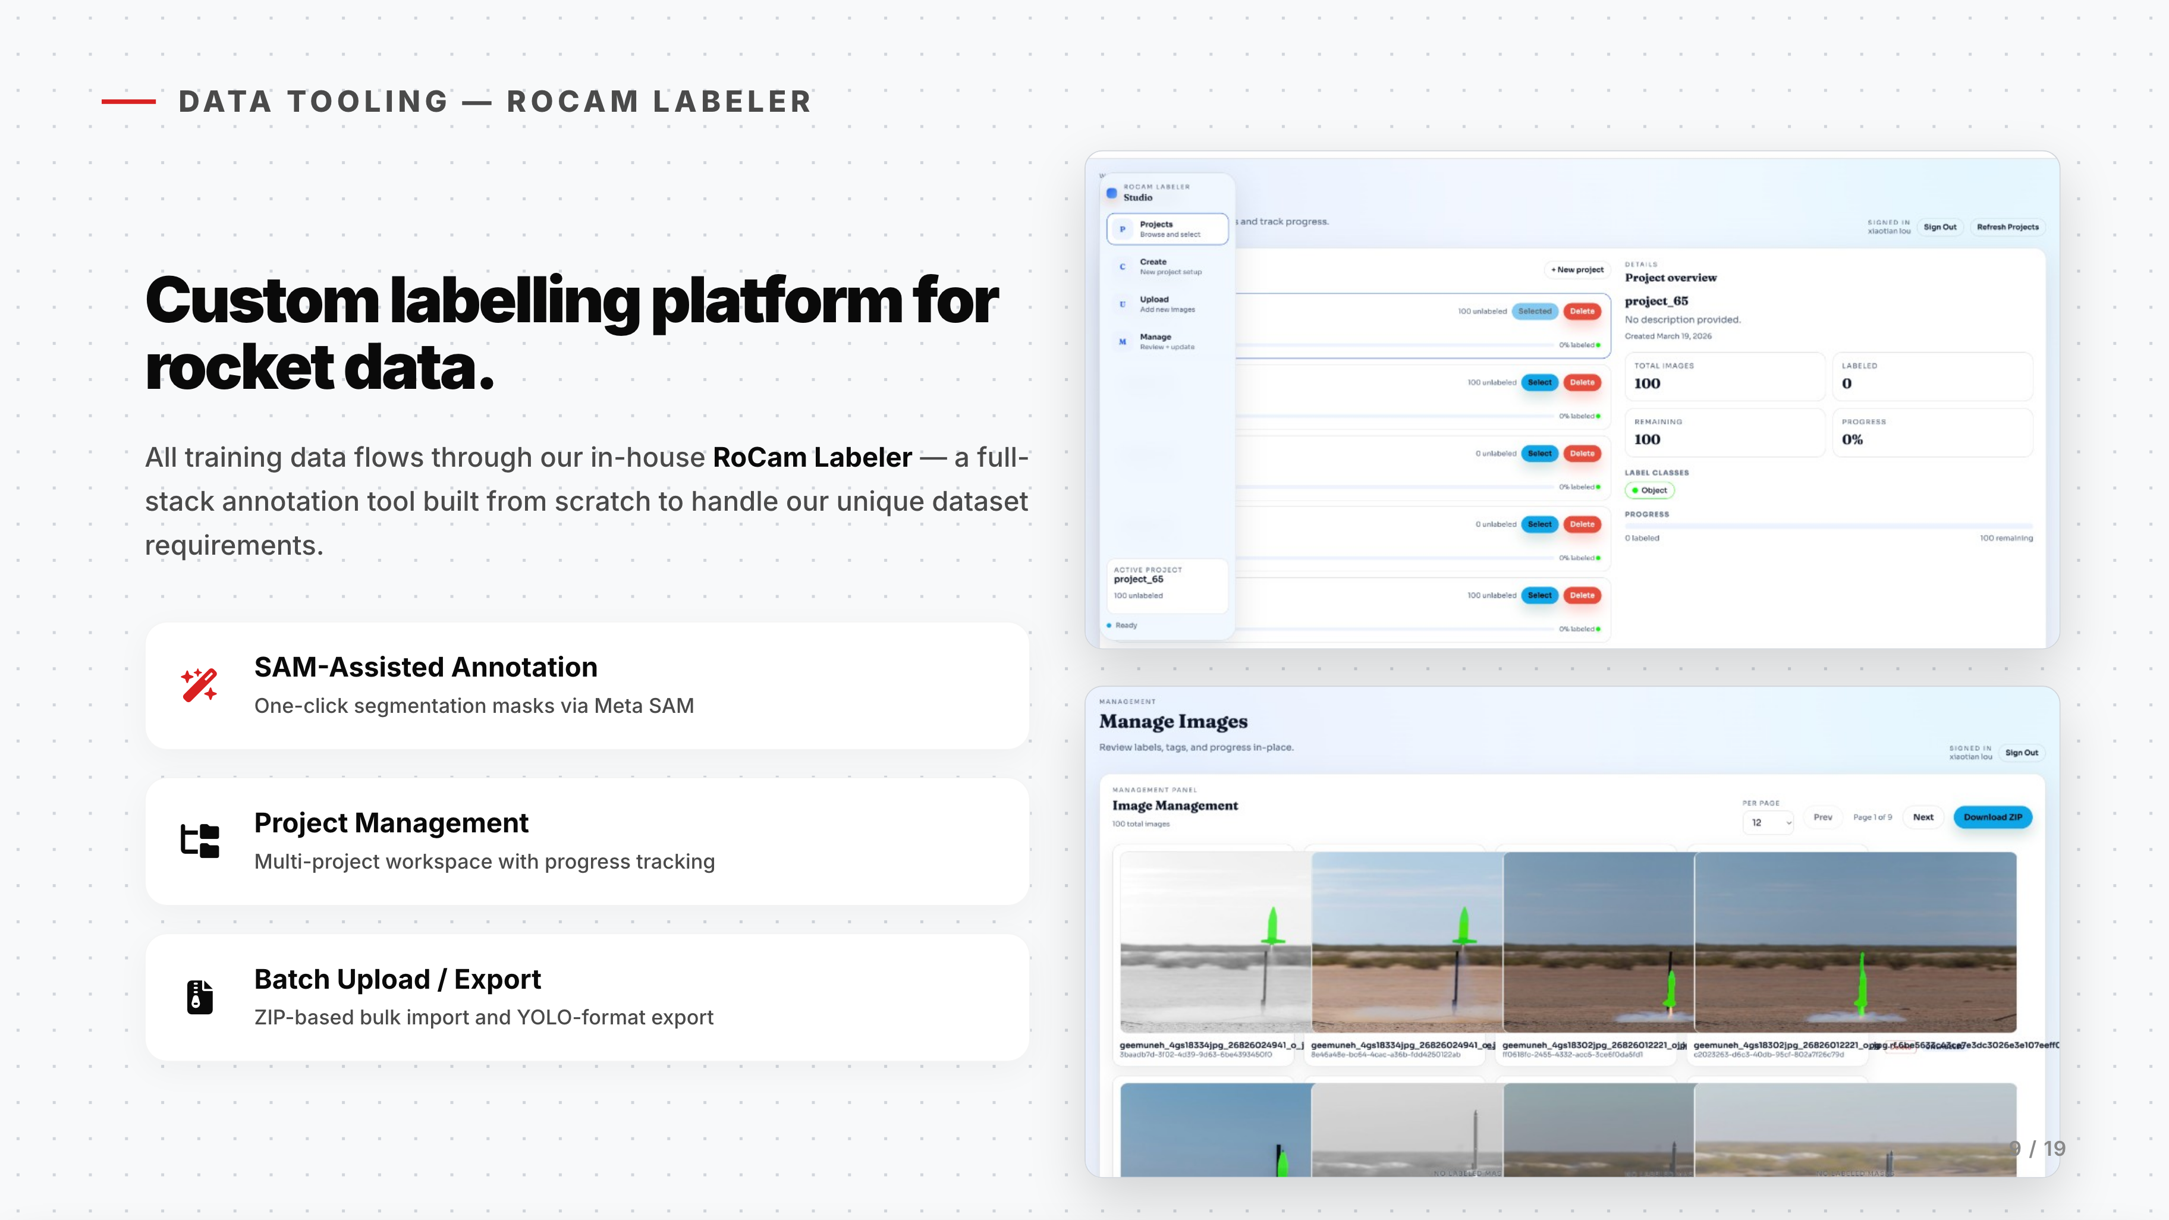

Slide 10
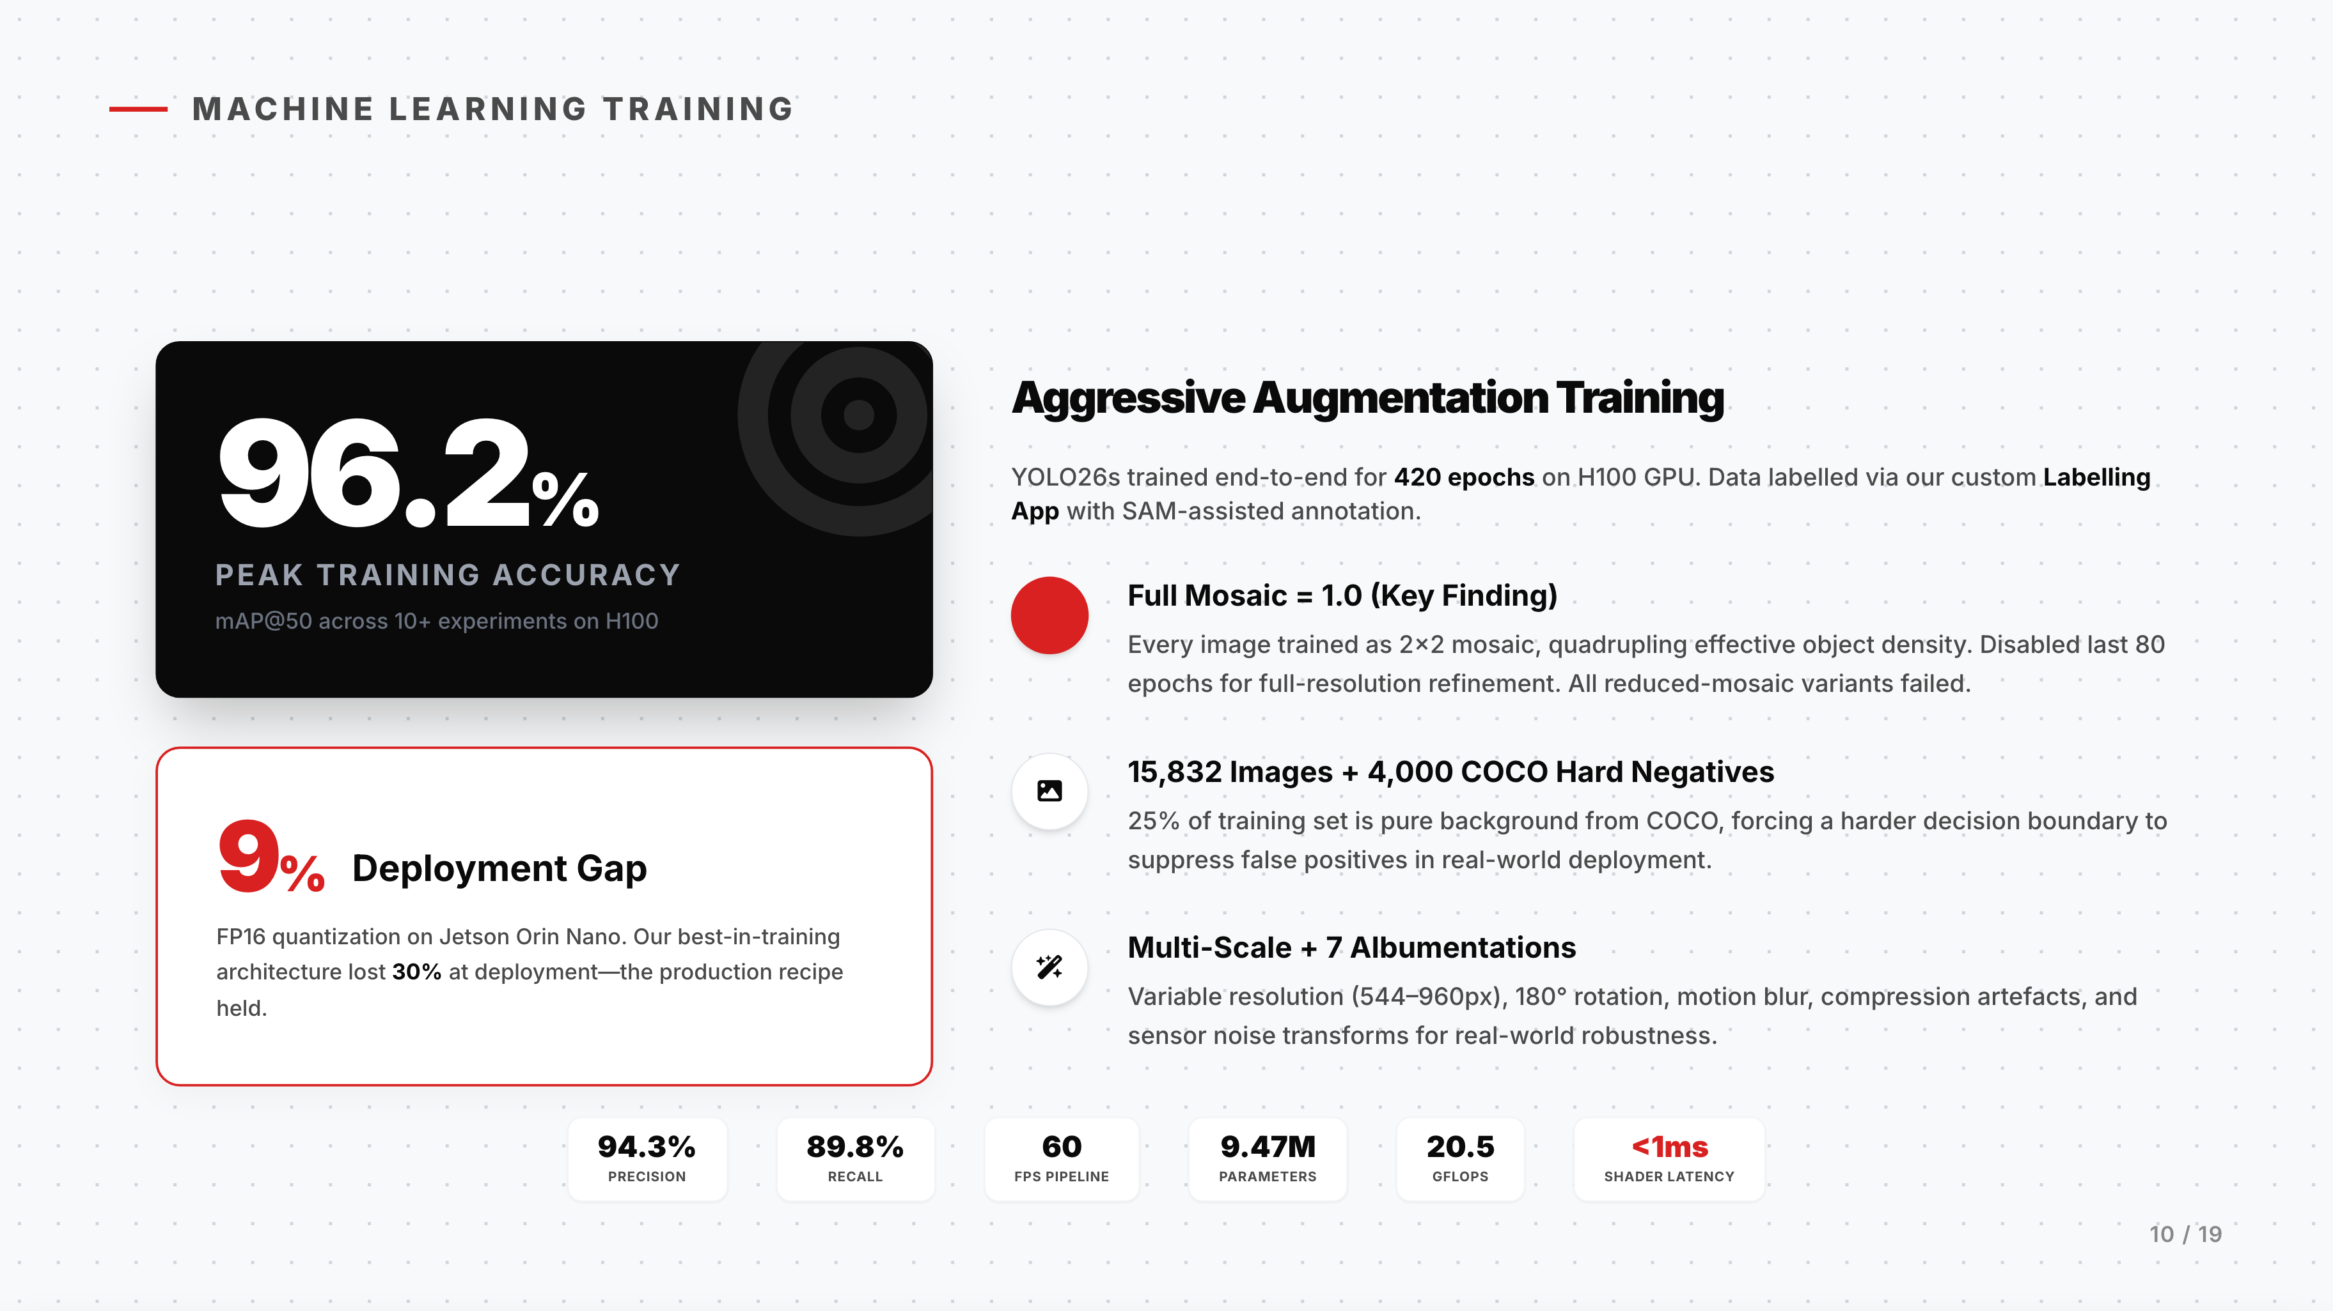
Notes:
We trained our model on the university's H100 GPU cluster. Given the limitations of our edge device and the strict 60 FPS requirement, conventional training approaches could achieve high accuracy, but suffered major losses after FP16 quantization.
During our exploration, we found that training at full resolution while keeping mosaic augmentation enabled, combined with COCO hard negative images, effectively minimized the deployment gap without losing accuracy.
In the end, we achieved 94.3% precision while maintaining 60 FPS on edge deployment.

Slide 11
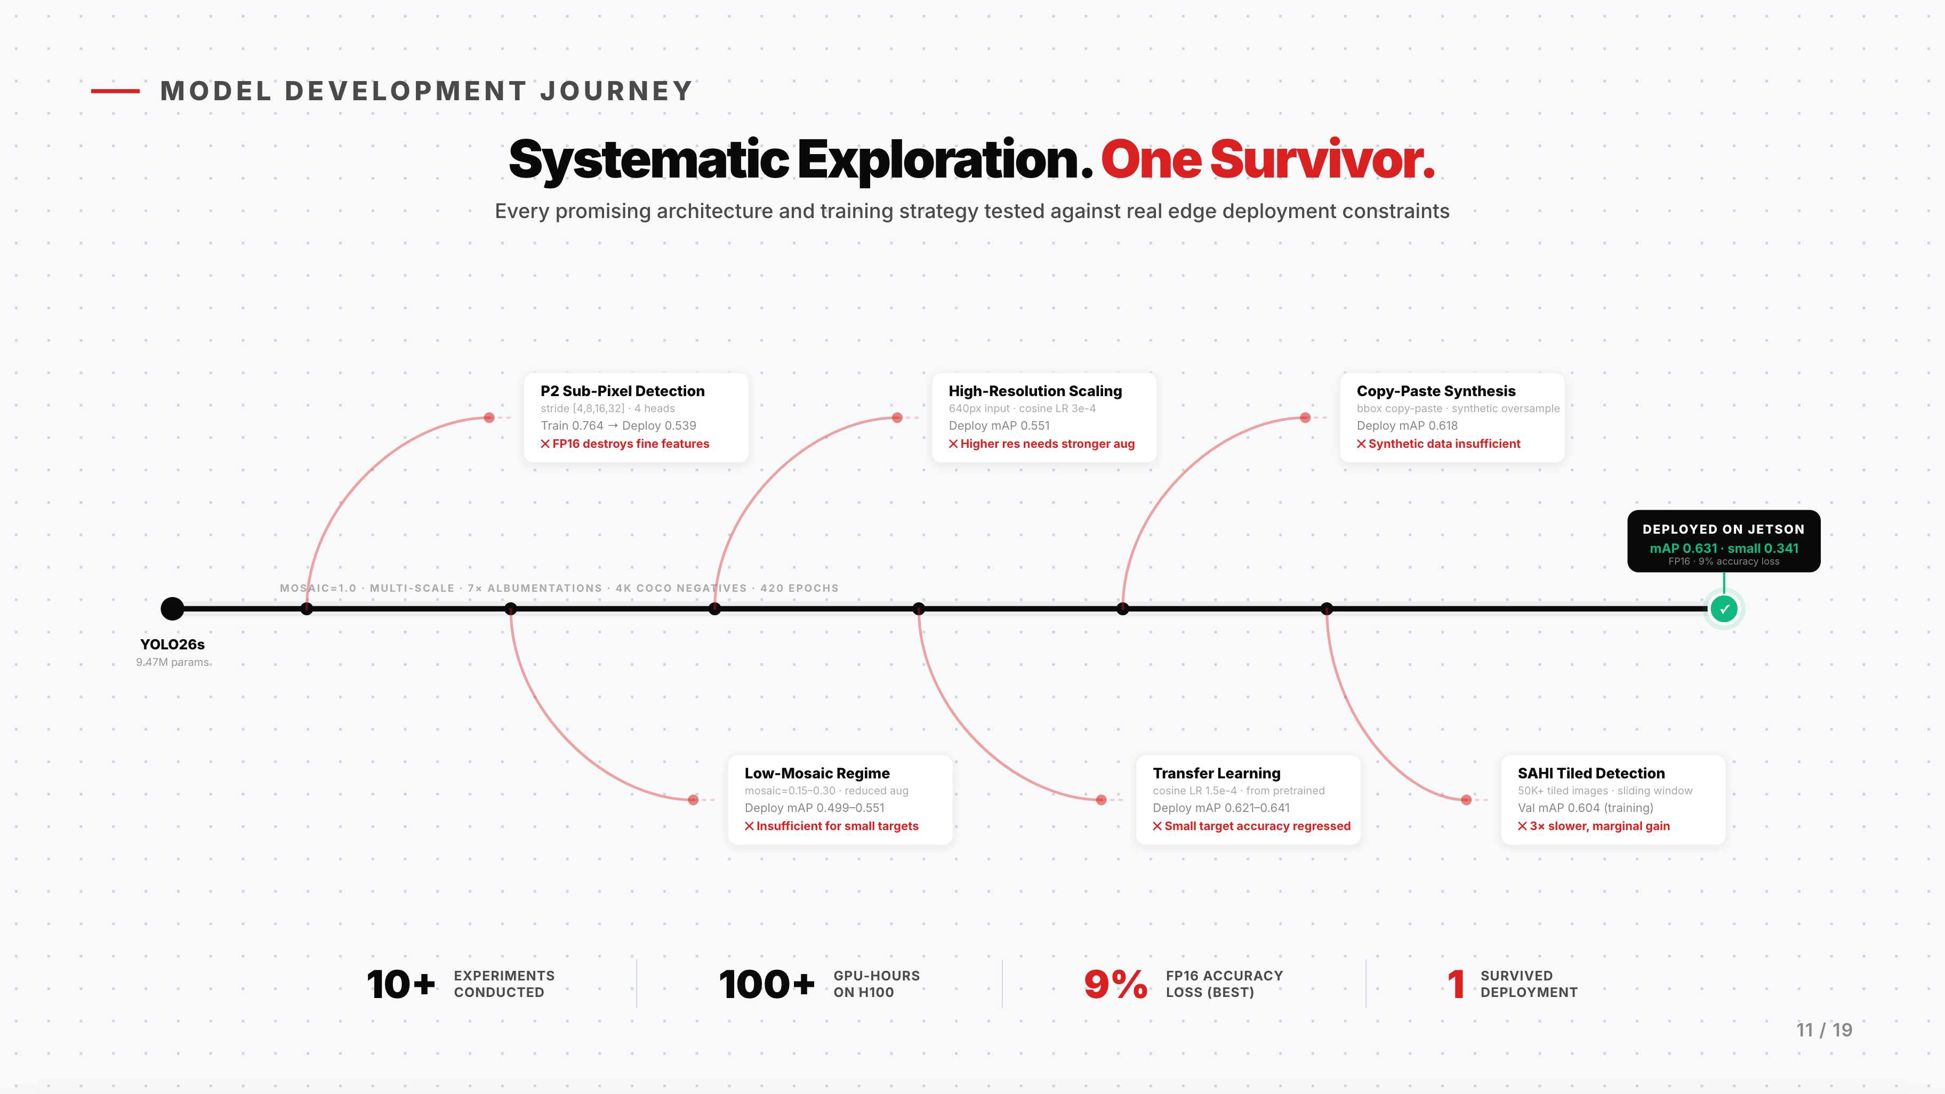
Notes:
This slide shows our YOLO training and experimentation journey. Since rockets are small targets, we initially chose YOLO26s with a P2 detection head — adding a stride-4 layer to capture finer spatial features. And it did achieve the best training accuracy among all our experiments.
However, the four-head architecture relies on very fine-grained activation values. After FP16 quantization, half-precision truncated those values, and the sub-pixel precision simply disappeared. The deployment accuracy dropped by nearly 30%.
After many experiments across six different directions, we returned to the standard three-head YOLO26s. As it turns out, sometimes simplicity is the best sophistication.

Slide 12
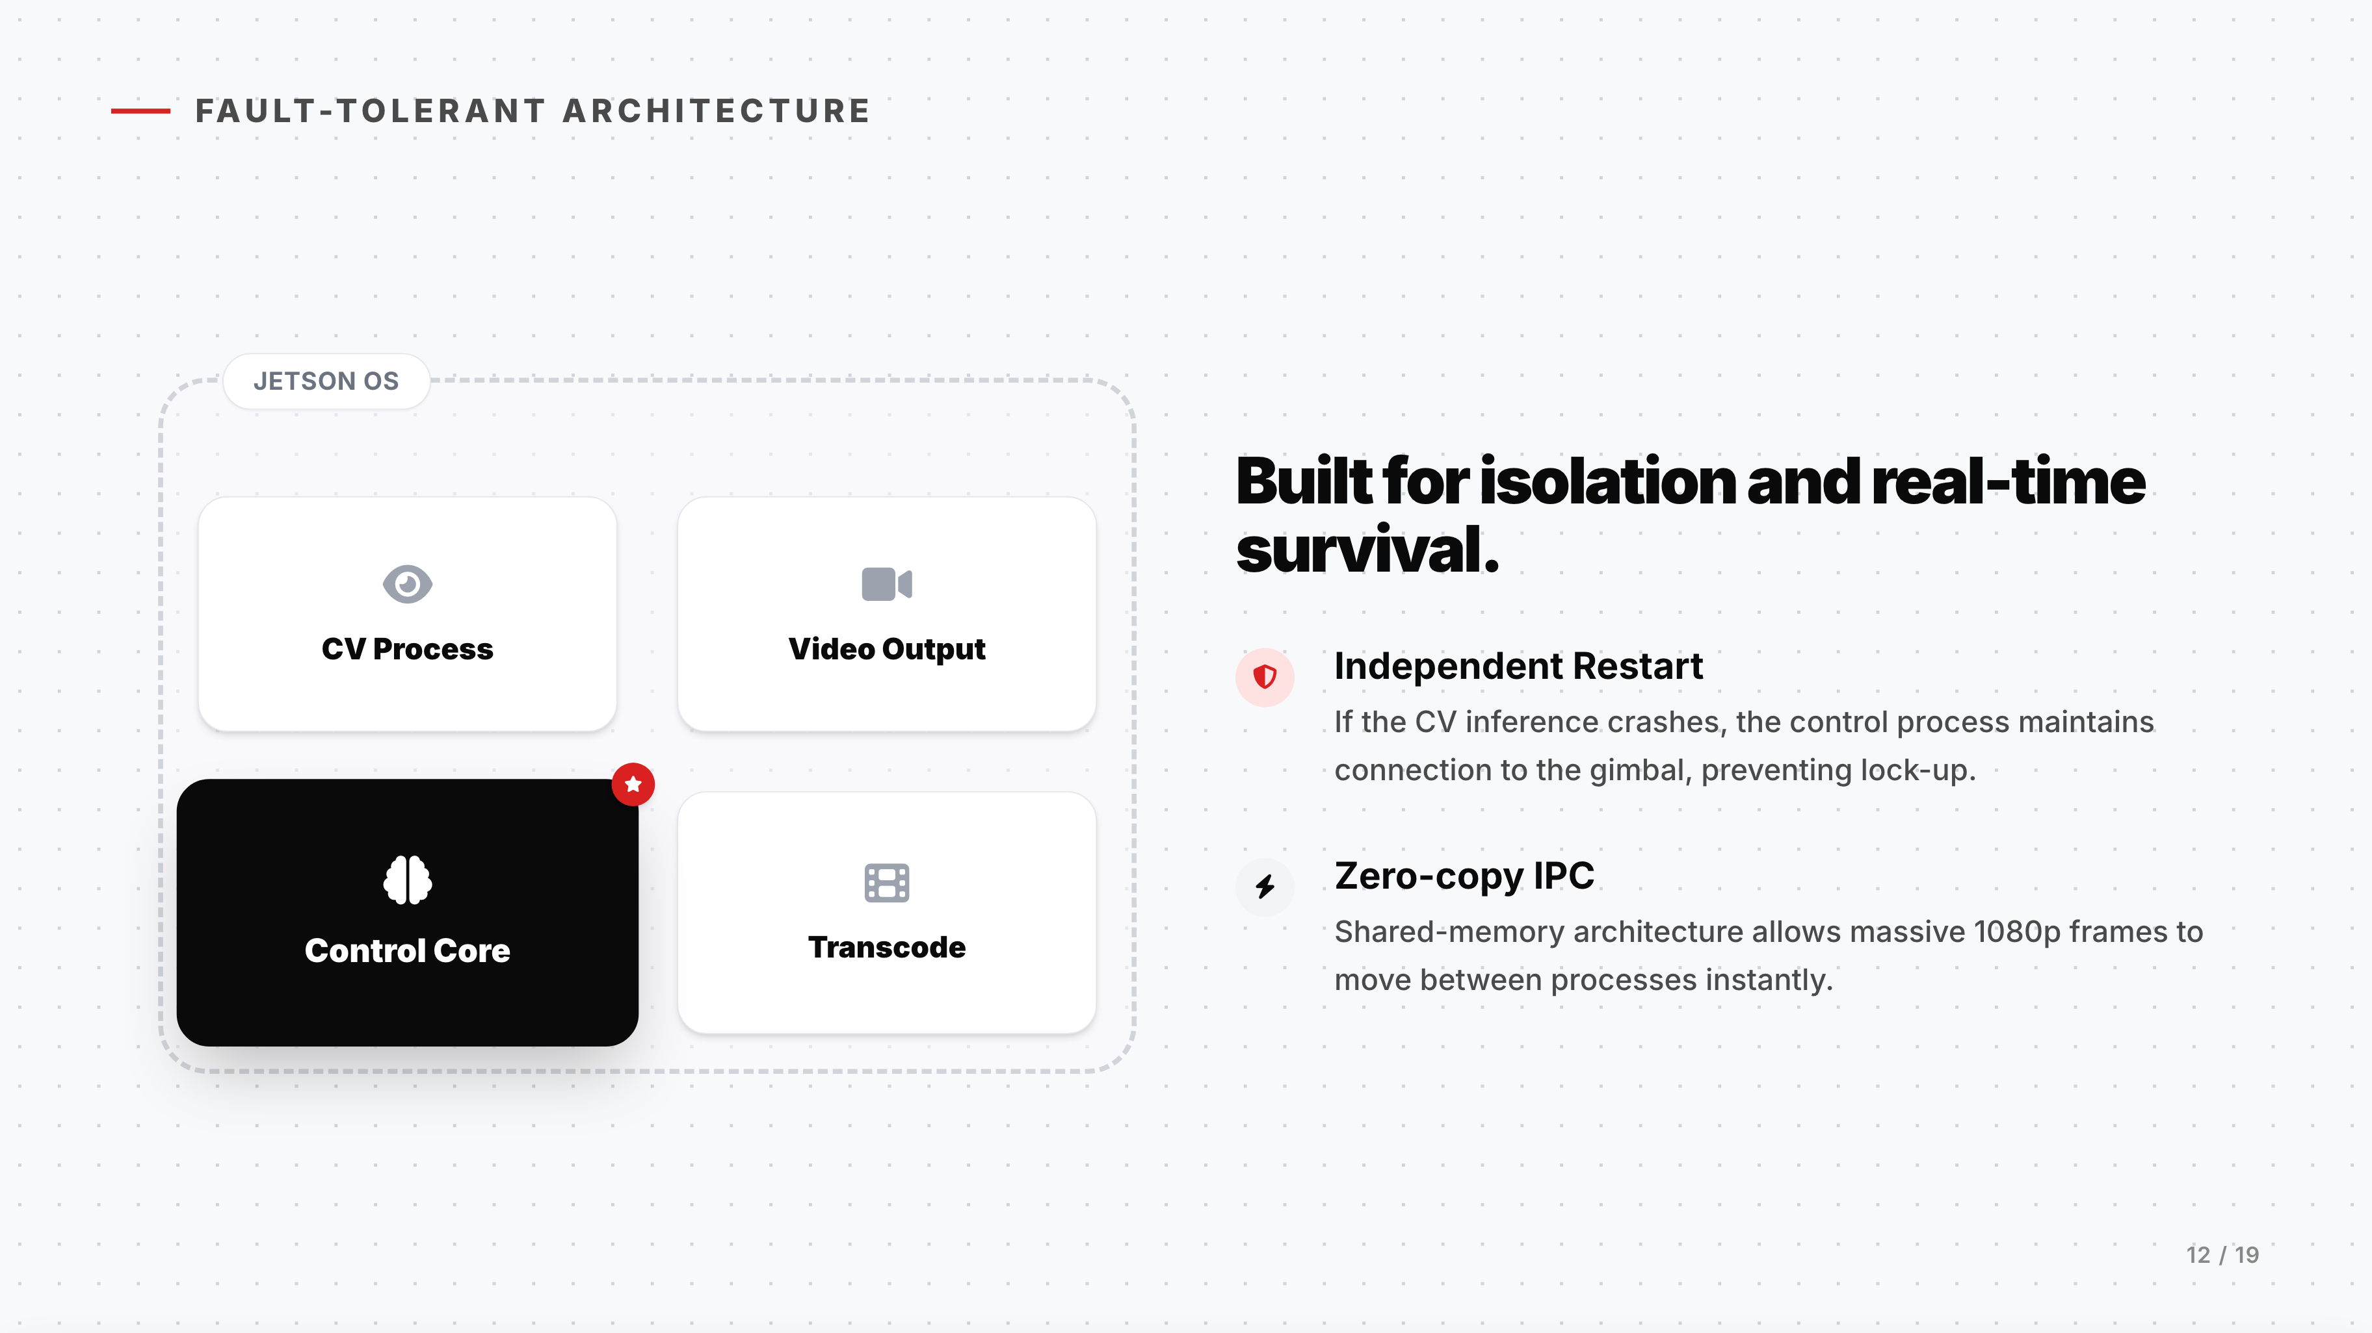

Slide 13
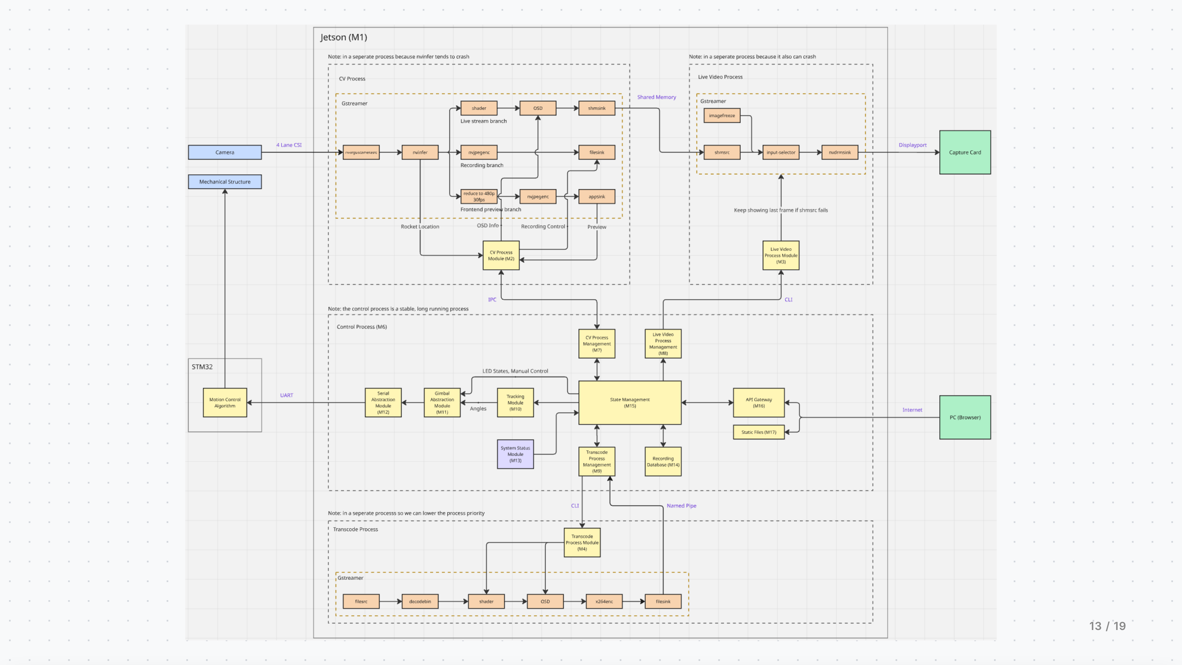

Slide 14
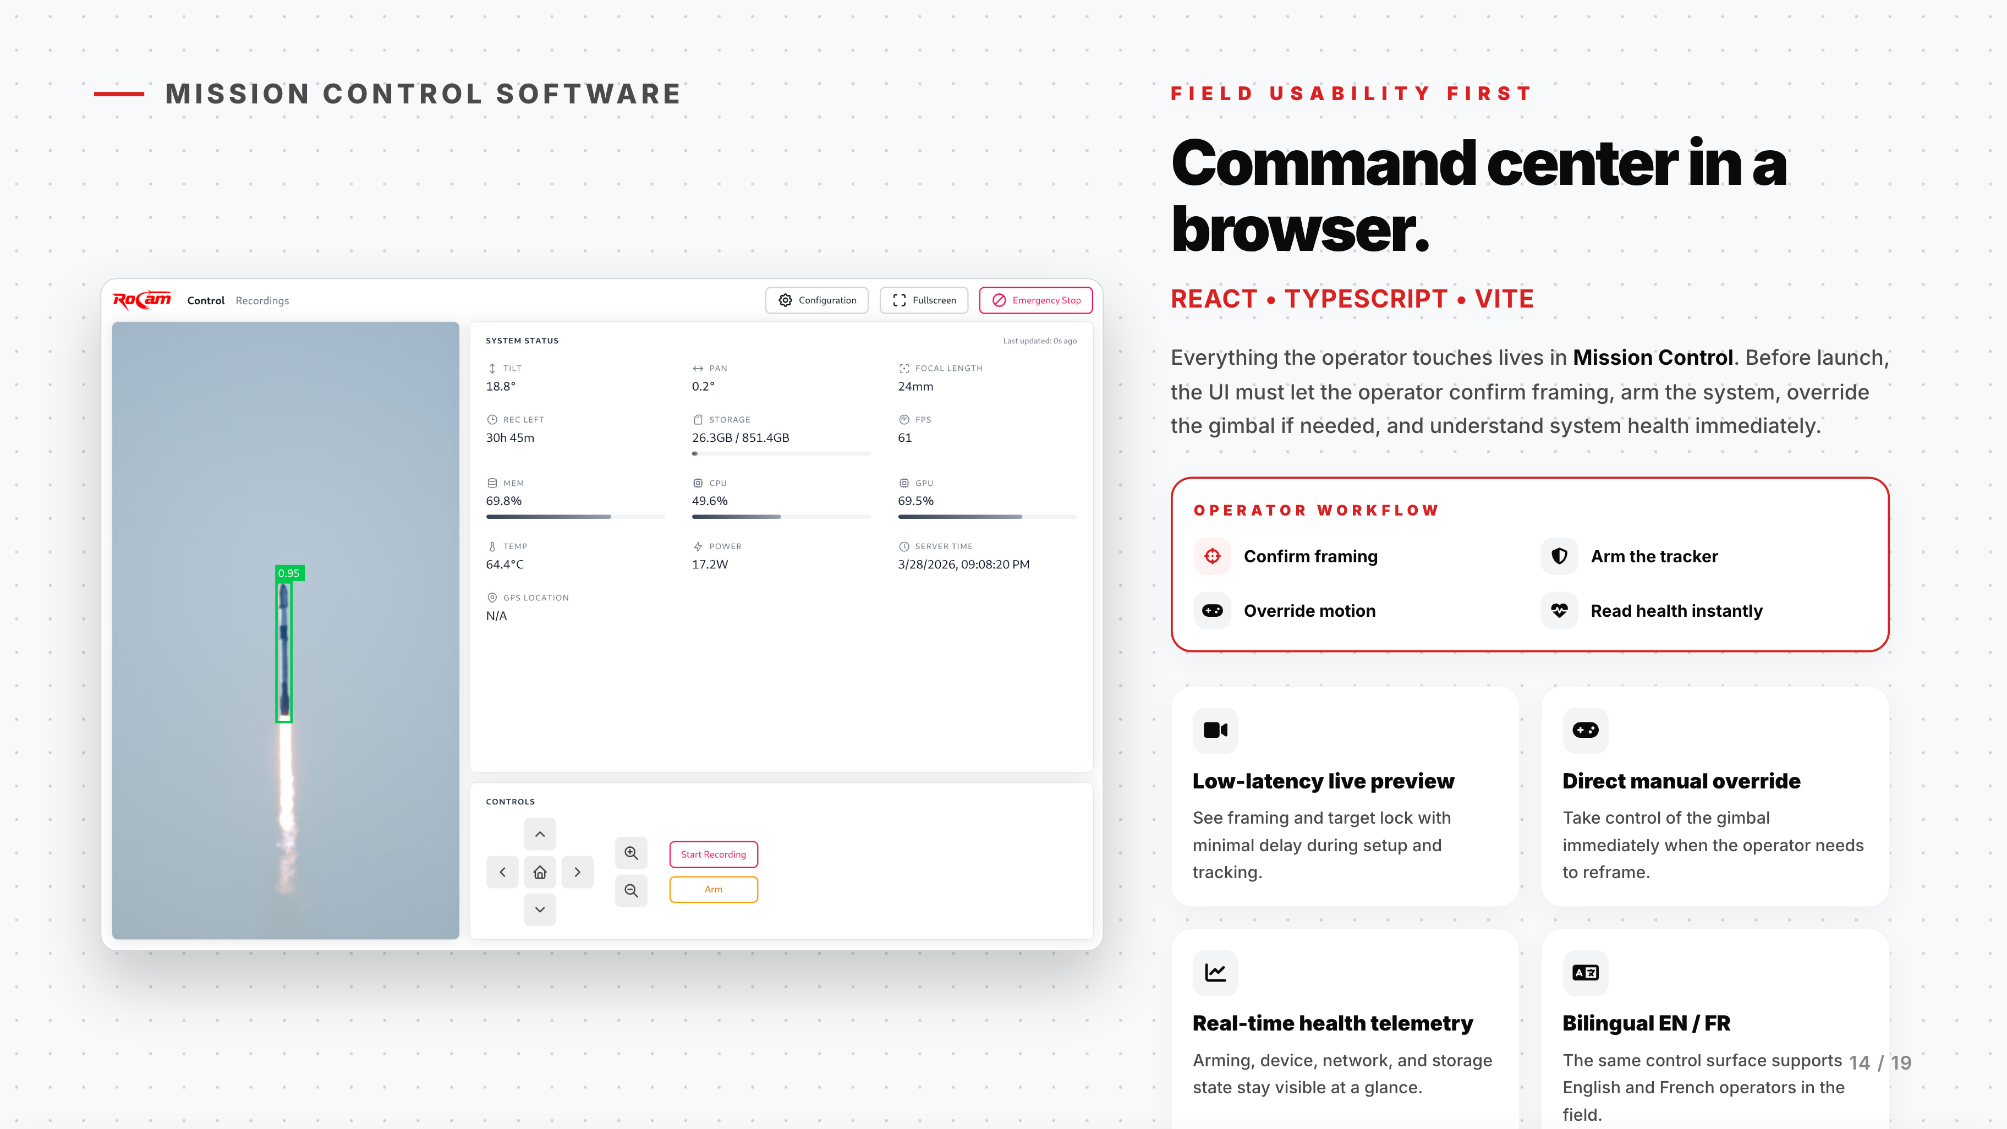

Slide 15
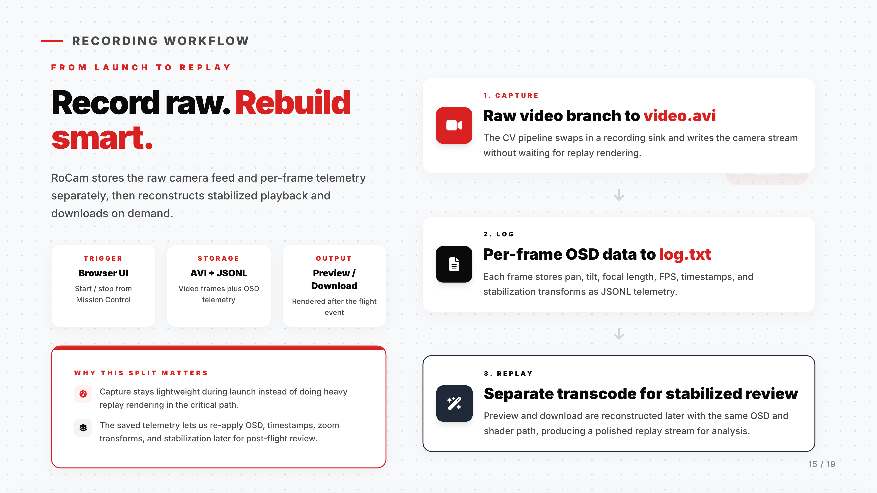
Notes:
We have 481 automated tests covering both backend and frontend, running on every pull request through GitHub Actions. With four team members working on tightly coupled subsystems, this was essential — it gave us the confidence to keep making changes without breaking things.

Slide 16
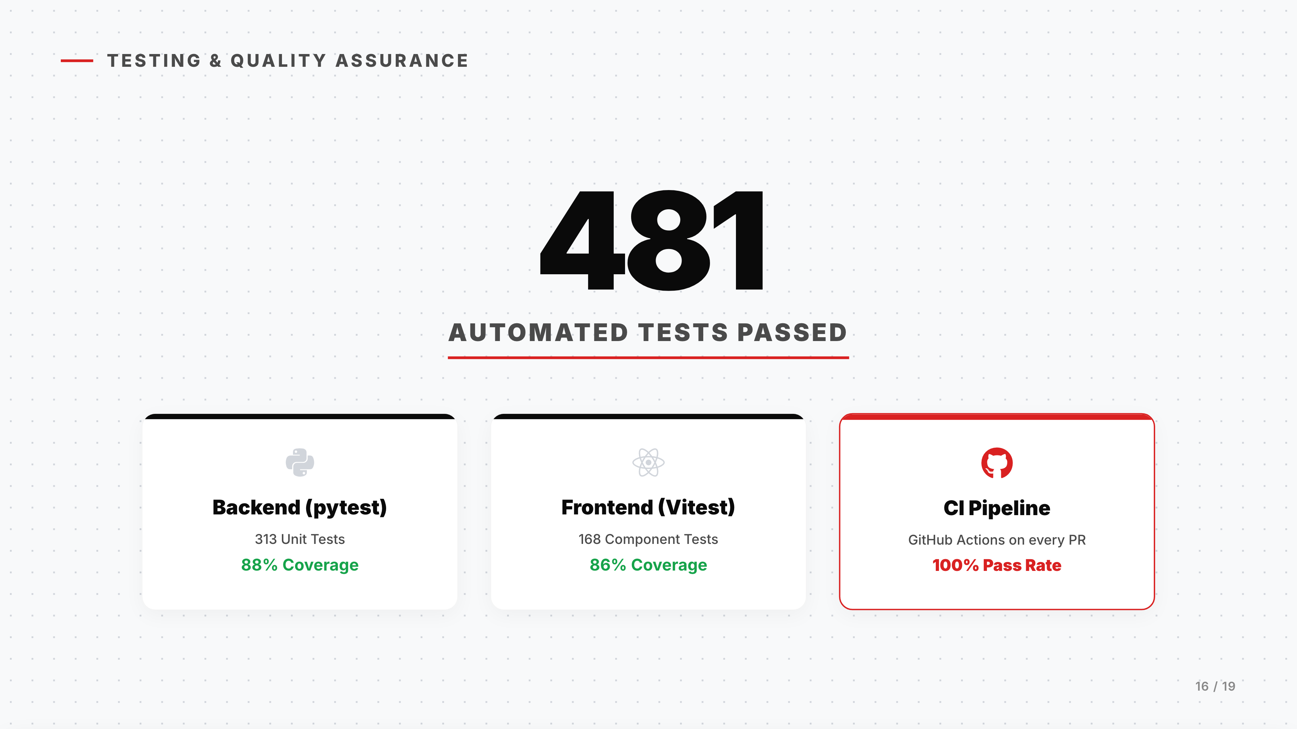

Slide 17
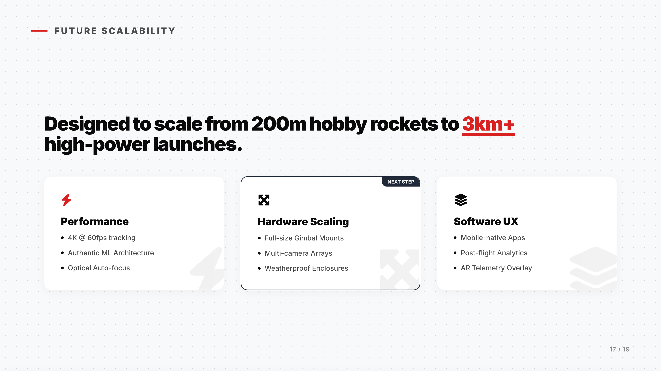

Slide 18
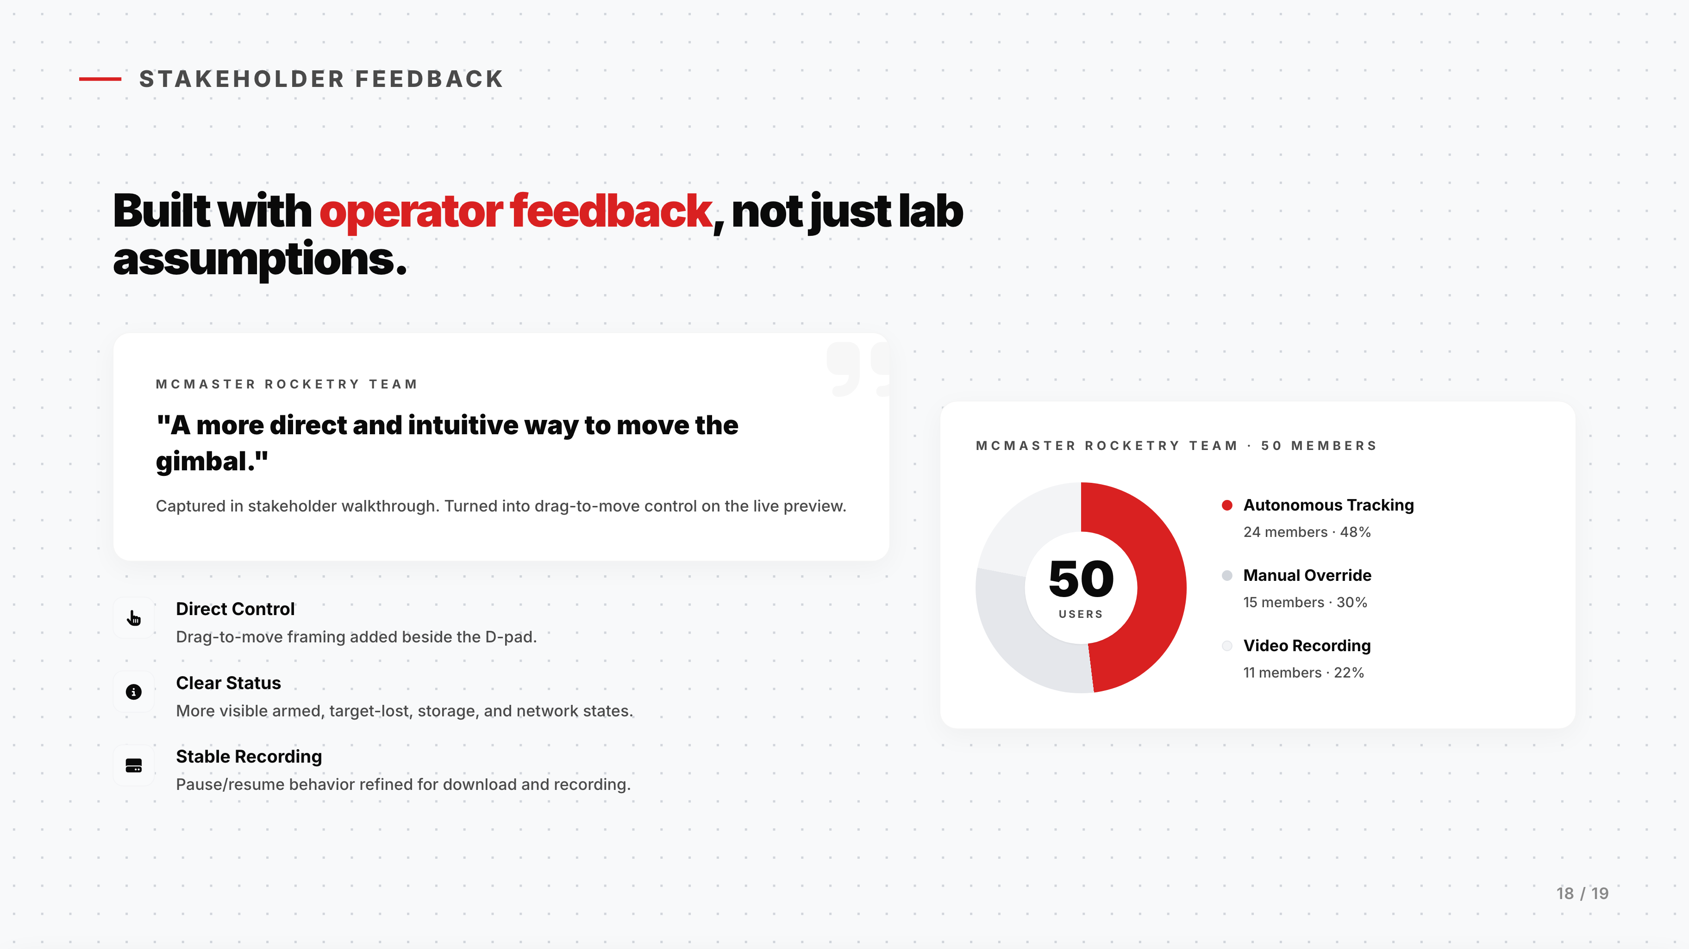

Slide 19
