Slide 1
MTN Nigeria SQL Analytics Project
Final Report Summary & Key Insights
Presented by: Peter Ogoba

Slide 2
Executive Summary
10 major insights from MTN Nigeria's customer data
SQL-driven analysis and interactive visualizations using Plotly
Covers segmentation, churn, KYC, plan revenue, payment, and support

Slide 3
Problem Statement
MTN Nigeria aims to reduce churn and improve customer experience
Key challenges include service quality, retention, and plan performance
Project answers 10 core business questions using SQL and Python

Slide 4
Data Source & Tools
Source: PostgreSQL database (10,000+ MTN customer records)
Tools: SQL, Python, pandas, Plotly, Jupyter Notebook
Cloud connection using SQLAlchemy + psycopg2

Slide 5
Data Cleaning & Preparation
Removed duplicates, filtered nulls, standardized text fields
Validated date columns and filtered financial anomalies
Used SQL and pandas to ensure data consistency and quality

Slide 6
Customer Segmentation
Data plans dominate across all states and genders
Urban states (Abia, Ebonyi, Enugu) have highest customer count
Older adults (50+) form a surprisingly large customer base (~50%)

Slide 7
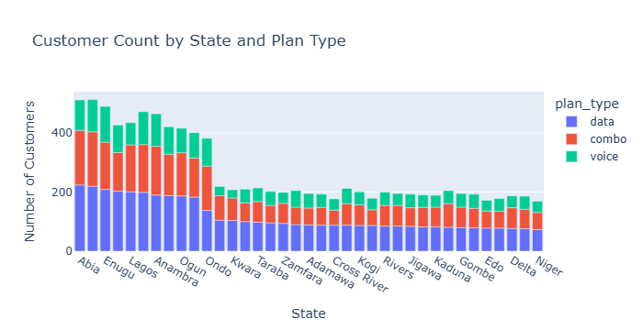
Customer Segmentation By State

Slide 8
Churn Risk Analysis
No customers with unpaid bills are fully inactive
Indicates strong billing compliance or cleaned dataset
MTN likely enforces deactivation policies on inactive accounts

Slide 9
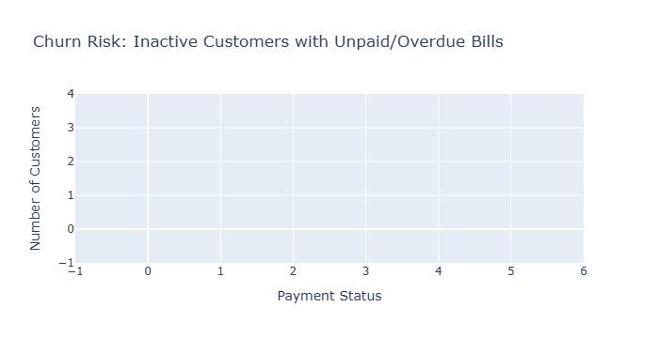
Churn Risk Analysis Chart

Slide 10
Top Users & Revenue
Top data users are heavy internet users, ideal for loyalty programs
Top revenue contributors may differ from top data users
Reward both groups to drive retention and satisfaction

Slide 11
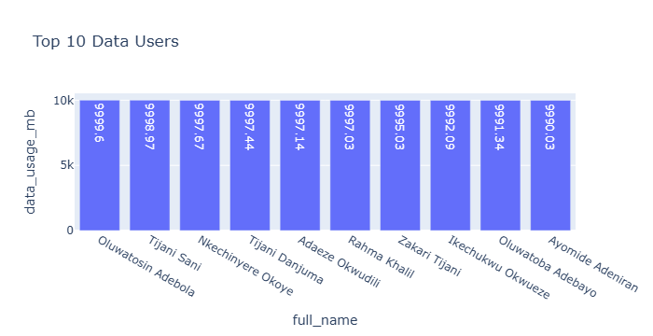
Top users and Revenue Contributors

Slide 12
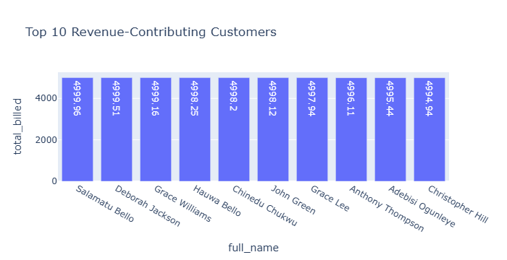
Top 10 Revenue Contributors

Slide 13
KYC Compliance
Unverified users show higher default rates
KYC status is a strong risk signal
Verified customers are more financially reliable

Slide 14
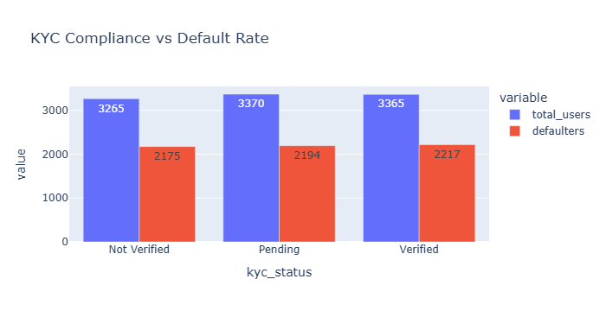
KYC Compliance and Default Rate

Slide 15
Plan Performance
Combo plans (XtraValue, Zone) generate highest revenue
Data plans follow closely, especially 10GB and 1GB options
Voice-only plans show lowest revenue contribution

Slide 16
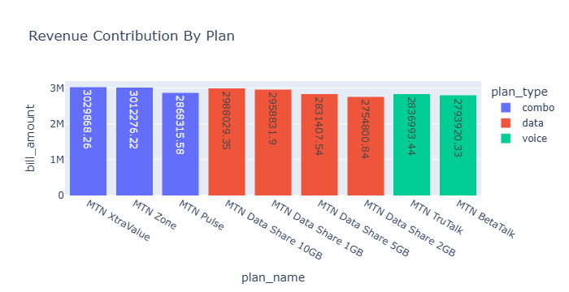
Revenue Contribution By Plan

Slide 17
Network Quality Evaluation
Kogi, Plateau, Cross River lead in quality score
Niger, Ogun, Ondo have the poorest scores
National average is mediocre (~3.01/5); network upgrades needed

Slide 18
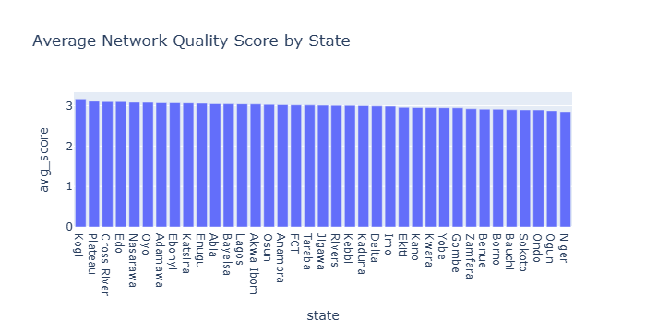
Network Quality Evaluation By State

Slide 19
Payment Behavior Trends
Airtime, Card, and Mobile Money dominate
Mobile-friendly payment options preferred
Bank transfers least popular — potential friction or trust issue

Slide 20
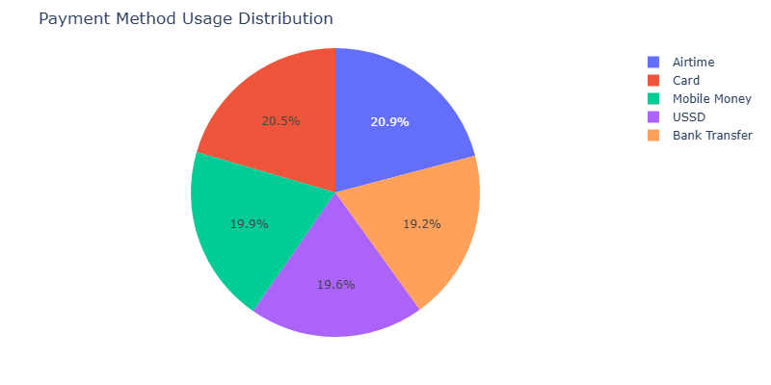
Payment Behaviour Chart

Slide 21
Frequent Defaulters
No user defaulted more than once
Indicates early-stage or isolated defaults
Good financial health of customer base, for now

Slide 22
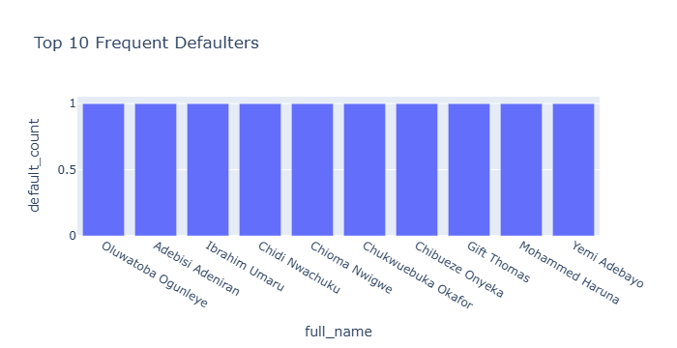
Frequent Defaulters Chart

Slide 23
Customer Support Analysis
Over 55% customers submitted 5+ support tickets
High demand may indicate service issues or support dependency
Inconsistent satisfaction across ticket volume

Slide 24
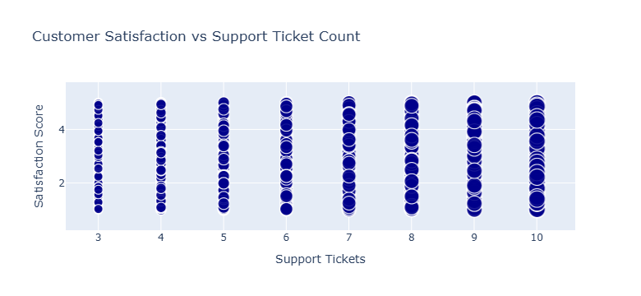
Customer Support Demand Chart

Slide 25
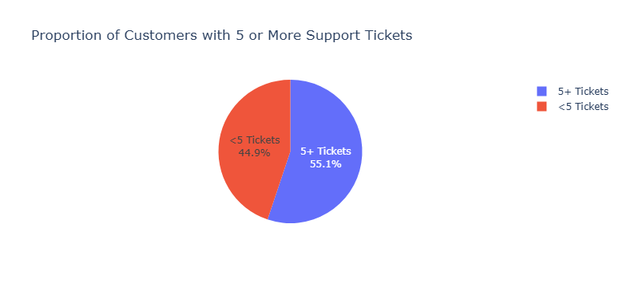
Customer Support Demand Chart

Slide 26
Customer Loyalty & Referrals
All tiers average ~10 referrals per customer
Platinum customers refer most (highest average and total)
Bronze customers show least engagement

Slide 27
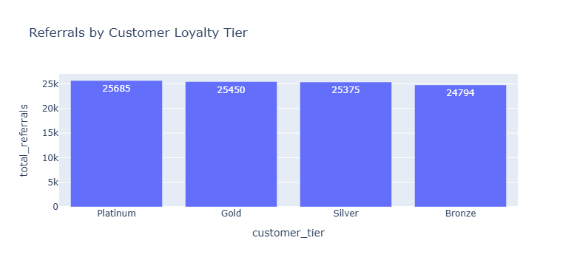
Customer Loyalty Chart

Slide 28
Device Usage Patterns
Android Tablets most used device type
High hotspot usage suggests mobile-only internet access
Smartphones are widely spread across OS types

Slide 29
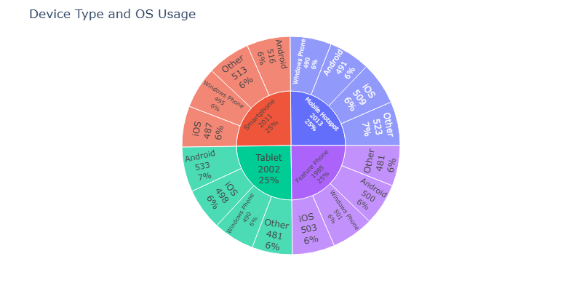
Device Usage Pattern Chart.

Slide 30
Recommendations
Prioritize network improvements in poor-score states
Launch loyalty programs targeting top users & revenue contributors
Revisit voice plan offerings and drive data-based bundles
Streamline support quality and reduce ticket dependency

Slide 31
Thank You
Presented by: Peter Ogoba
Contact: peterogoba@gmail.com
Data Source: MTN Nigeria (via PostgreSQL)

