Slide 1
Electricity Consumption Analysis in Nigeria (2022–2024)
Loctech Data Project – Insights, Challenges, and Predictive Modeling

Slide 2
Project Context and Goals
Nigeria’s power sector is crucial for economic growth.
NERC uses data to guide infrastructure planning and reforms.
Project explores usage, billing, payment, and compliance data.
Supports policy, investment, and consumer behavior insights.

Slide 3
Problem Statement
Challenges: poor compliance, estimated billing, tariff mismatches.
Need to analyze and validate trends, regional behavior, and fairness.
Modeling tools can support early detection of payment risk.
Insights guide better regulation and billing efficiency.

Slide 4
Dataset Overview
10,000 records from Jan 2022 to Dec 2024; cleaned to 9,961.
Key fields: timestamp, state, region, consumer_type, kWh, bill, payment, meter, tariff.
Removed outliers (kWh > 3000, bill > ₦40k).
Imputation based on region & consumer type; transformations for time analysis.

Slide 5
Tools Used
Python (Jupyter Notebook) for analysis & modeling.
Libraries: pandas, seaborn, matplotlib, scikit-learn, plotly.
Statistical testing with scipy.
MS Word for documentation.

Slide 6
Daily, Weekly & Monthly Trends
Daily: Higher consumption on weekdays. Peak: July 19, 2022.
Weekly: Highest week = Week 29 (2022); lowest = Week 6 (2023).
Monthly: Dec 2023, July 2022, Sep 2024 were peak periods.

Slide 7
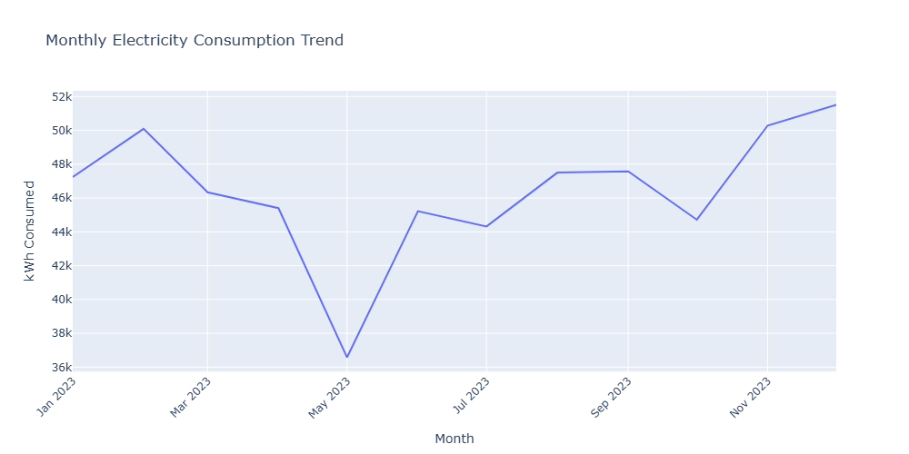
2023 Monthly Consumption Trend

Slide 8
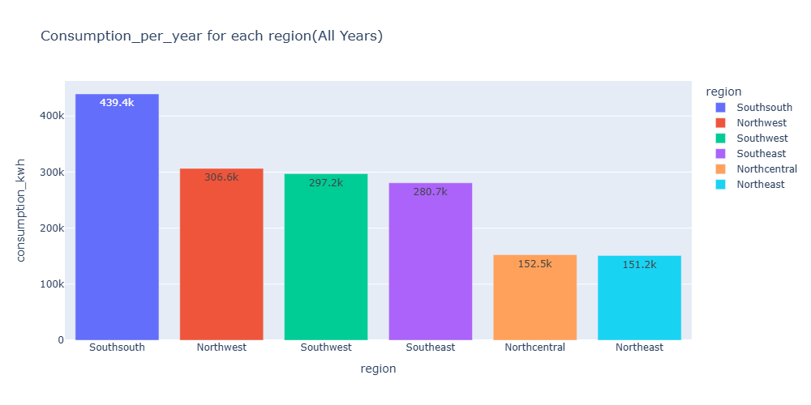
Yearly and Regional Trends
Yearly: 2023 saw highest total usage.
South South and North West had the highest total usage.
The North East and North Central regions had the lowest, possibly due to poor infrastructure or conflict.

Slide 9
Comparative Regional Trends (2022–2024)
South South maintained highest usage yearly.
The North East experienced sharp growth in recent years, followed by a gradual decline.
South West also showed strong growth.
Regions like North Central had flat growth, hinting at stagnant development.

Slide 10
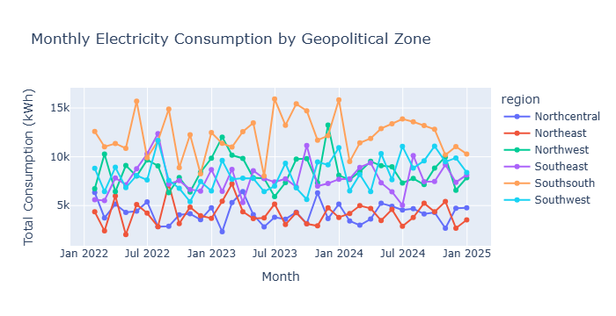
Comparative Regional Consumption Trend

Slide 11
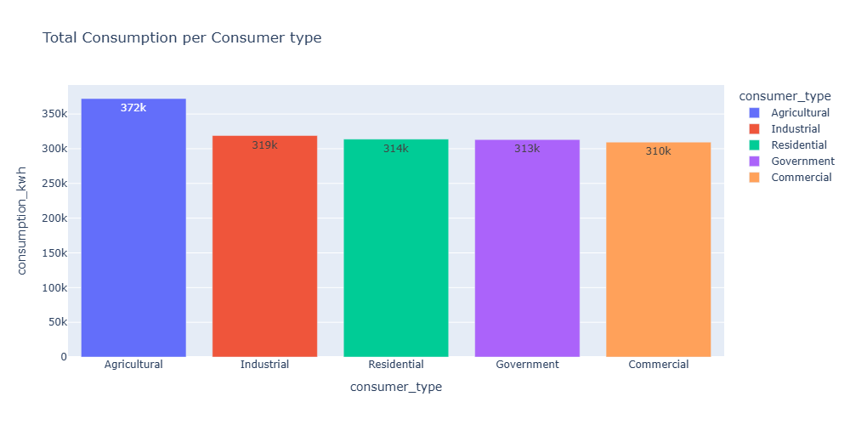
Consumer Profiling - Total and Average
Agricultural: highest total and average (372k kWh, 169.1 kWh avg).
Commercial: lowest total and average (310k kWh, 161 kWh avg).
Residential, Government, Commercial had similar averages.

Slide 12
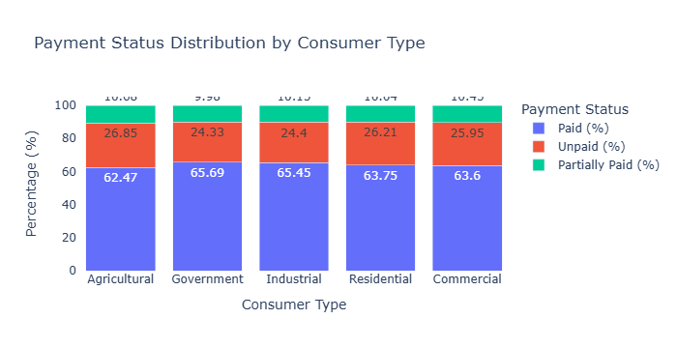
Payment Behavior by Consumer Type
Agriculture had highest volume of both payers and defaulters.
Government had best compliance (66% paid).
Commercial users had lowest compliance rates overall.

Slide 13
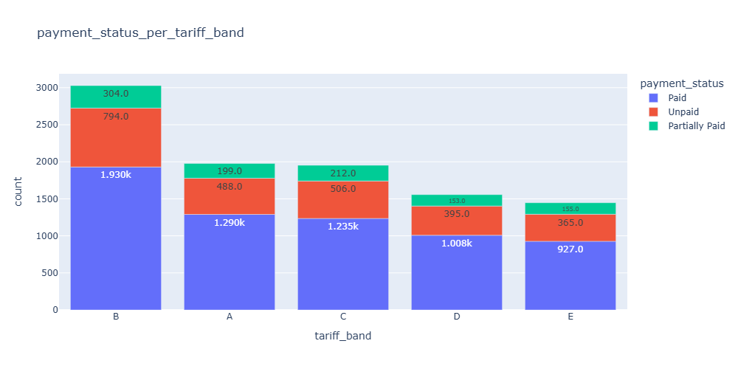
Payment Compliance by Region
South South: largest volume of payers but also largest unpaid.
South East: best compliance % (66.18%), lowest unpaid (23%).
North West: highest unpaid % (27%).

Slide 14
Tariff Band vs Payment Status
Band B: most consumers but also most defaulters.
Band A: highest compliance despite higher cost.
Band E: It has the least number of consumers.

Slide 15
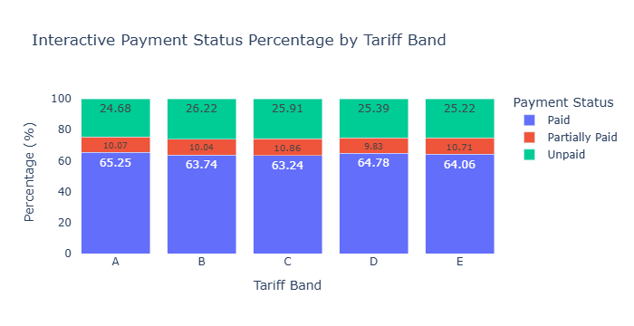
Payment Compliance Across Tariff Bands Chart

Slide 16
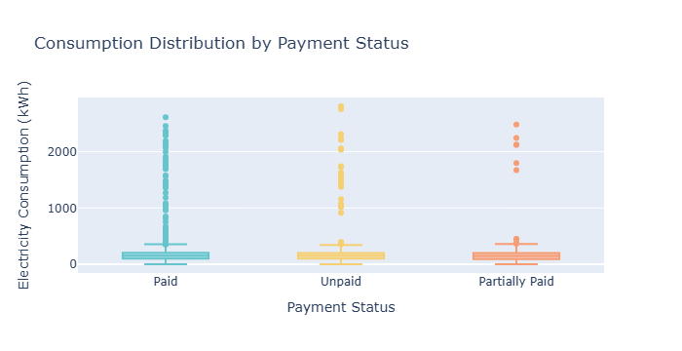
Consumption vs Payment Status
High usage observed among unpaid consumers.
Implies estimated billing, bypass, or poor enforcement.

Slide 17
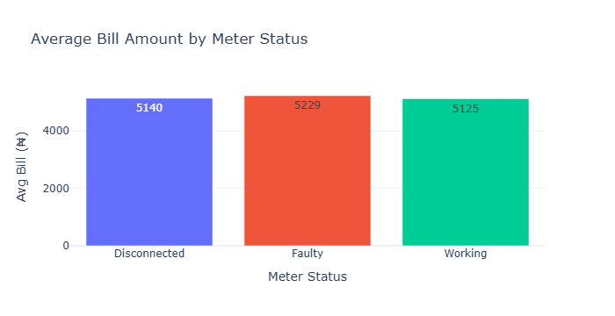
Meter Status and Billing
Working meters: lowest average bill (₦5,125).
Faulty: highest bill (₦5,229), likely due to estimation.
Disconnected: still billed, suggests illegal reconnection or uninformed collection of bills by the electricity body.

Slide 18
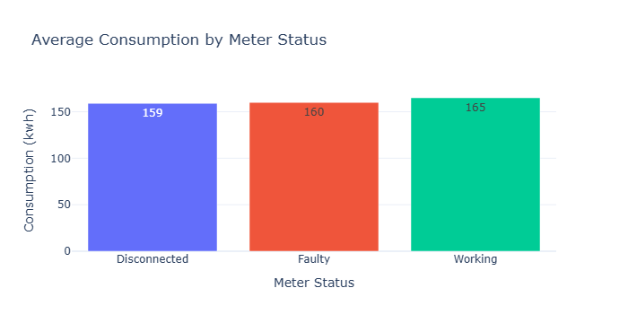
Meter Status and Consumption
Consumption very similar across meter types (165–159 kWh).
Disconnected users are showing high usage, which should not be.
Implies data errors or power theft; calls for tighter audits and monitoring

Slide 19
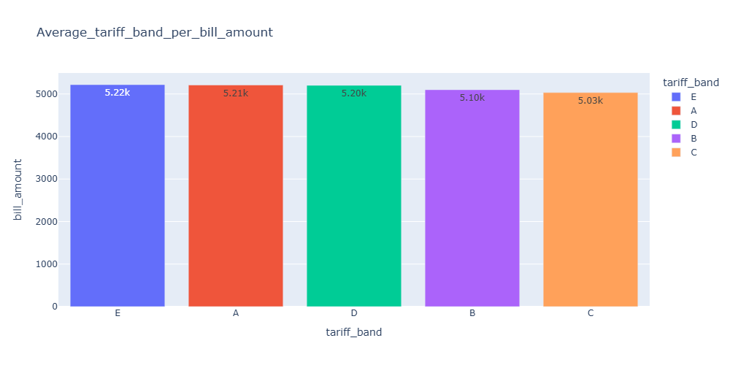
Tariff Band Effectiveness - Billing
All bands had similar average bills (₦5,030–₦5,220).
Band E billed similar to Band A, contradicts expected pricing tiers.
Implies tariff classification not impacting billing. Needs review.

Slide 20
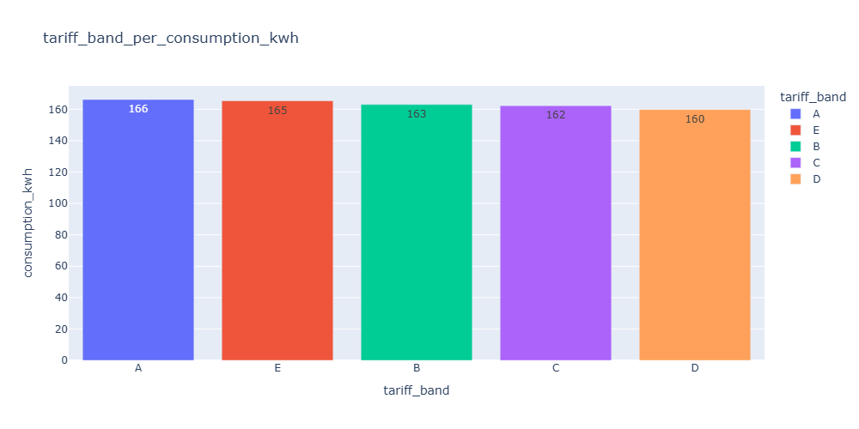
Tariff Band Effectiveness - Consumption
Bands A & E had near-identical usage (166 vs 165 kWh).
Suggests misclassification, illegal connections, or estimation bias.
Tariff system may be functionally meaningless.

Slide 21
T-Test: Residential vs Commercial
t = 0.12487, p = 0.90; no significant difference.
Fail to reject the null hypothesis: The electricity consumption is NOT SIGNIFICANTLY DIFFERENT across Residential and Commercial consumer types
This might support or lead to similar pricing policies being developed for both commercial and residential consumers.
This also raises concerns about whether some residents may be running commercial activities in their homes.

Slide 22
ANOVA: Tariff Band vs Billing
F = 0.415, p = 0.7974: No meaningful difference across bands.
Fail to reject the null hypothesis: The average electricity bill does not vary significantly for those with different tariff bands (from band A to E).
This implies that all bands are charged similarly, which should not be.
This raises concerns over the effectiveness of tariff policy.

Slide 23
Chi-Square: Region vs Payment Status
Chi² = 21.606, p = 0.0172: Significant relationship.
Reject the null hypothesis: There is a significant relationship between a consumer's region and their bill payment status.
Region impacts payment behavior. The payment behavior of consumers is influenced by the region they reside.
This helps to ensure certain policies can be enforced in certain regions, thereby improving payment compliance.
Electricity infrastructure quality in certain regions should also investigated and solved to improve payment compliance.

Slide 24
Logistic Regression (Payment Status)
Accuracy: 65%, predicts only 'Paid' class.
Fails on 'Unpaid' and 'Partially Paid'.
Class imbalance needs addressing (SMOTE, reweighting).

Slide 25
Decision Tree (Payment Status)
Accuracy: 49%, better than logistic regression on other classes.
Still low precision/recall for 'Unpaid' and 'Partially Paid'.
Recommend using XGBoost or ensemble models.

Slide 26
Random Forest Regression (Bill Estimation)
R² = -0.19, MAE = ₦2,068, RMSE = ₦3,212.
RMSE which is root mean square error is greater than MAE to large extent.
The result above show a strong sign of large errors present in the data. This means that the model is not suitable to be used in the real world for prediction.
Data should be checked for outliers. The outliers should be removed.
Performs worse than mean line; poor estimator.
Needs richer features: supply hours, historical bills, outages.

Slide 27
Conclusion & Recommendations
Billing fairness compromised by faulty meters and tariff misalignment, or improper band connection of consumers.
Regional targeting critical for improving compliance.
Tariff band assignment to consumers should be investigated.
Regular monitoring of consumers meters should be carried out to reduce bypass culture.
Classification models need behavior data and balancing.
DisCos should invest in smart meters, audits, and digital platforms.
Further data needed: income, household size, meter type.

