Slide 1




TECHNOLOGICAL TRANSFORMATION
YAREN ÇANĞA 201735009
ZEYNEP BÜŞRA SÜRGÜ 20200305305
ALEYNA KARACENGEL 201735023
MEHMET MERT ÖREN 201735011
Presentation Link:
https://www.aa.com.tr/tr/bilim-teknoloji/2020nin-yukselen-10-teknolojisi-belli-oldu/2059496
https://youtu.be/oa-4KXE_LIs

Slide 2
CONTENTS
WHAT IS TECHNOLOGICAL TRANSFORMATION?
INDUSRTY 4.0
SIMILAR PROJECTS
DEVELOPMENT PROCESS

Slide 3
WHICH PROGRAM GOING TO USE ?
INSTALLATION PROCESS
WHAT HAVE WE DONE ?

Slide 4
What ıs TECHNOLOGICAL TRANSFORMATION?
Although technology has a generally accepted definition due to its different disciplines, it can be designed to benefit from their own life practices in order to use technology.
The concept of technological change is generally expressed as changes in the production process as a result of the application of new knowledge in science and technology.
https://dergipark.org.tr/tr/download/article-file/40340

Slide 5

INDUSRTY 4.0
It was the "Industry 4.0 Preparation Online Self-Check for Businesses" that allowed him to develop and learn our thoughts about the project. This project is related to Industry 4.0.
To briefly mention Industry 4.0:
Industry 4.0 is a goal the main purpose of which is to bring industry and information technologies together. With Industry 4.0, production and technology will be integrated, and the systems will work integrated with each other. Industry 4.0 is a huge transformation process
https://www.industrie40-readiness.de/?lang=en

Slide 6
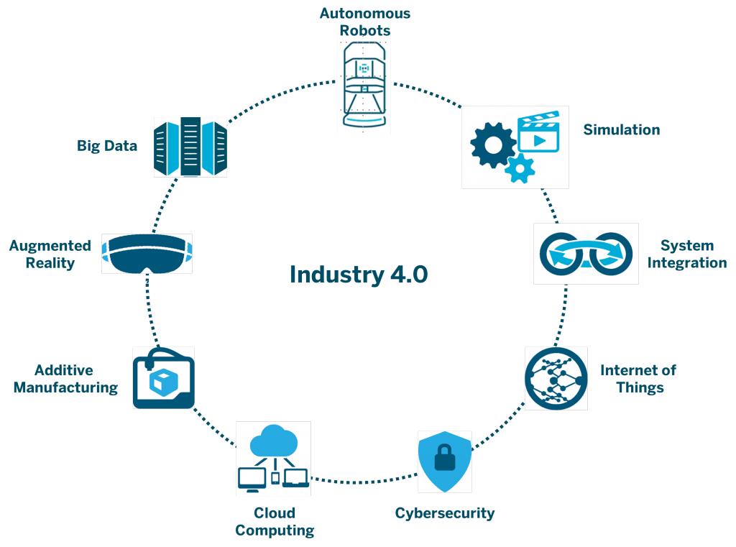
Industry 4.0
Industry. 4.0 examples:
Smart Factories , Smart Robots, Cloud Computing System, IOT,Big Data.
Preparation for Industry 4.0, although it is not very similar to our project Thanks to the impressions we received from the online Self-Check for Businesses page, we brought a different perspective to our project and developed it.
https://www.tarnet.com.tr/medya-merkezi/blog/endustri-4-0-nedir/

Slide 7
SIMILAR PROJECTS
1) How to score well on a Microsoft Access 2007 Assessment Test
https://www.youtube.com/watch?v=atQDXzpldmg
2) Building an Access Database and Survey Form
https://www.youtube.com/watch?v=DkjfIyVzLFU
3)Microsoft Access 2013/2016 pt 3 (Query, Forms, Reports)
https://www.youtube.com/watch?v=pO20JoKa480

Slide 8
development process
Creation of tables.
Making database relations between tables.
Creation of forms.
Designing interfaces.
Application of macros to interfaces.
Creation of queries.
Writing some connection code with visual basic.
Making the data connection of the report page with the queries.
Arrangement of interfaces.
Integration of questions into the form as an admin.
Testing the program as a user and entering data for 10 different users.

Slide 9

Which program going to be use?
Download Access
https://www.microsoft.com/tr-tr/microsoft-365/p/access/CFQ7TTC0HHMX?&ef_id=Cj0KCQiAzfuNBhCGARIsAD1nu-9MMB_fyjjzsUUupa19KpZyd43xGlVKu9Gd1k2j0dTdqDeNoBnu7f8aAqDNEALw_wcB:G:s&OCID=AID2200006_SEM_Cj0KCQiAzfuNBhCGARIsAD1nu-9MMB_fyjjzsUUupa19KpZyd43xGlVKu9Gd1k2j0dTdqDeNoBnu7f8aAqDNEALw_wcB:G:s&lnkd=Google_O365SMB_Brand&gclid=Cj0KCQiAzfuNBhCGARIsAD1nu-9MMB_fyjjzsUUupa19KpZyd43xGlVKu9Gd1k2j0dTdqDeNoBnu7f8aAqDNEALw_wcB

Slide 10

INSTALLATION PROCESS
İmport file,and click running.

Slide 11
What have we done?

Slide 12
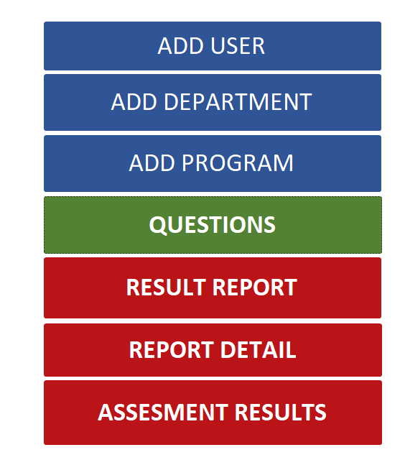
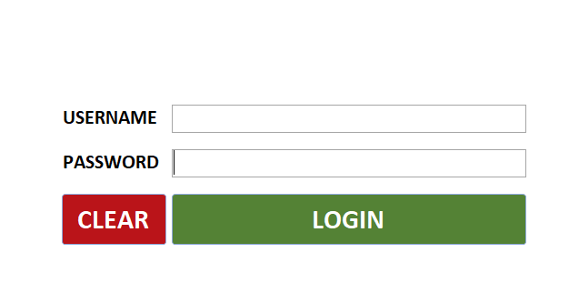
LOGIN AND MAİN PAGEs
Source:Ms Access

Slide 13
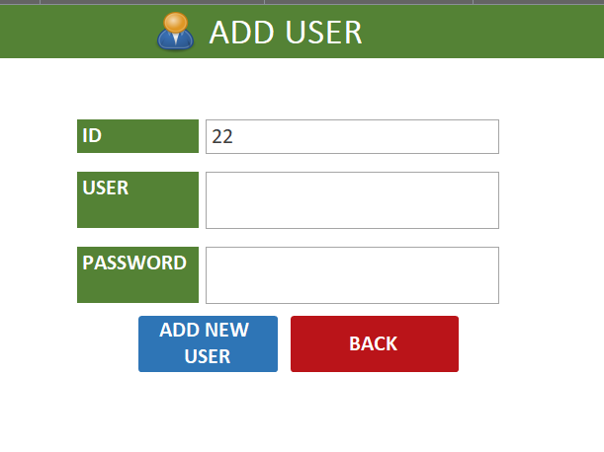
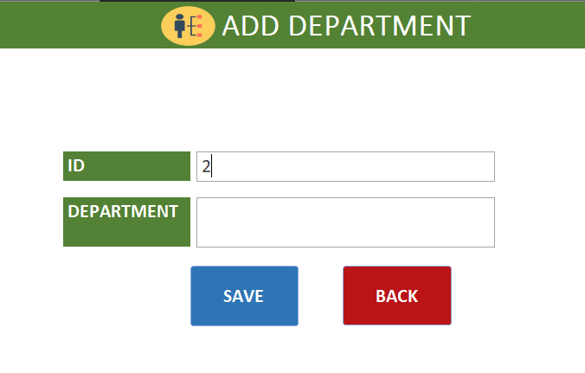
ADD USER AND ADD DEPARTMENT PAGEs
Source:Ms Access

Slide 14
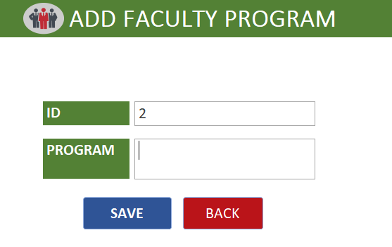
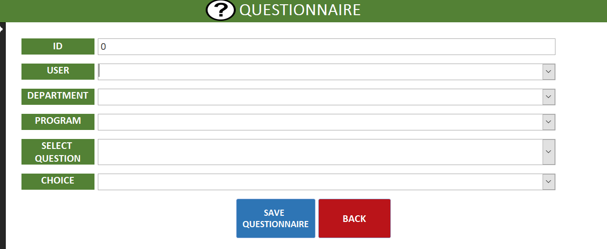
ADD FACULTY PROGRAM AND QUSTIONNAIRE PAGES
Source:Ms Access

Slide 15
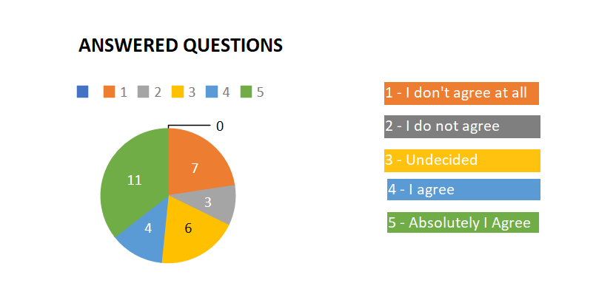
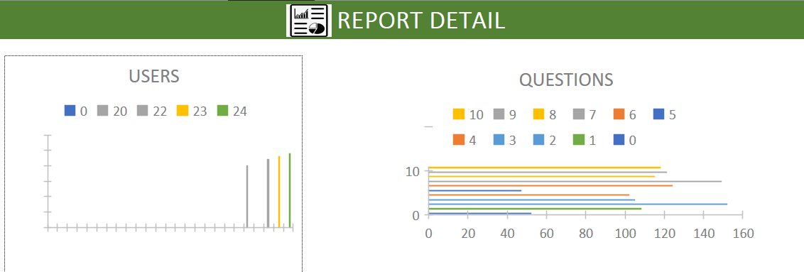
REPORT DETAILS – ANSWERED QUESTIONS PAGE
Source:Ms Access

Slide 16
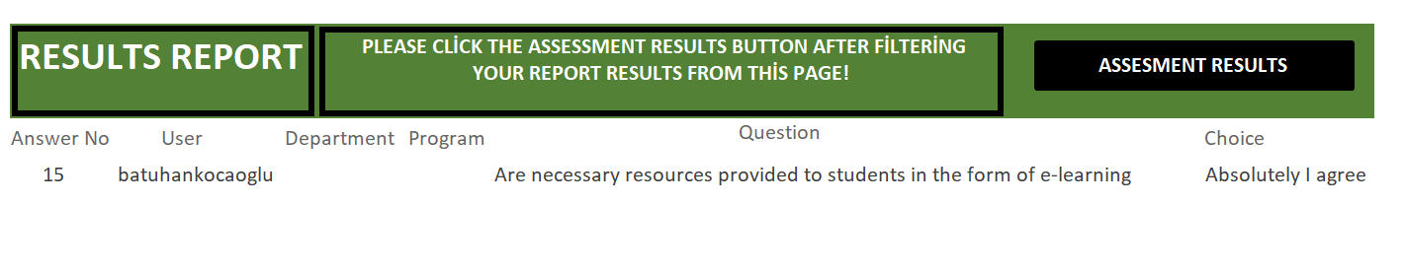
RESULTS REPORT PAGES
Source:Ms Access

Slide 17
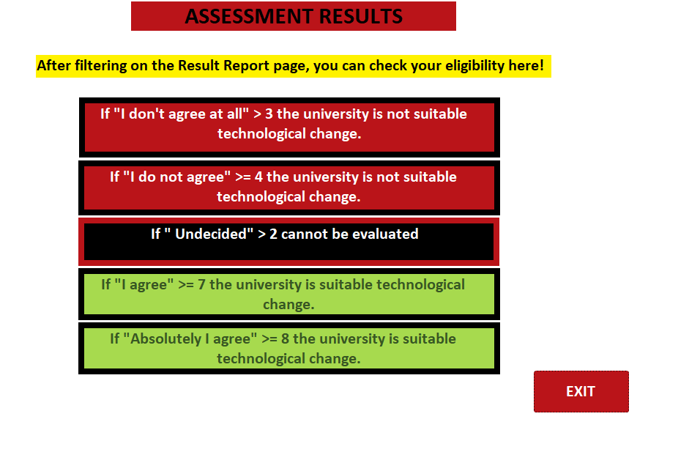
ASSESMENT RESULTS PAGE
Source:Ms Access

Slide 18

THANKS FOR LISTENING TO US.
https://www.facebook.com/pg/BeSmileCenter/videos/

