Slide 1
COMP6800001 Human Computer Interaction
Session 1 (Introduction)
Topic: What is Interaction Design? & The Process of Interaction Design
Focus on: Introduction to HCI
Lab: Introduction to Web Technologies
Ida Bagus Kerthyayana Manuaba
imanuaba@binus.edu

Slide 2





Introduction!
Ida Bagus Kerthyayana Manuaba, S.T., Ph.D
Information that you might needed:
082146366500
imanuaba@binus.edu
bagzcode
bagzmate#5199

Slide 3

Ice Breaking

Slide 4
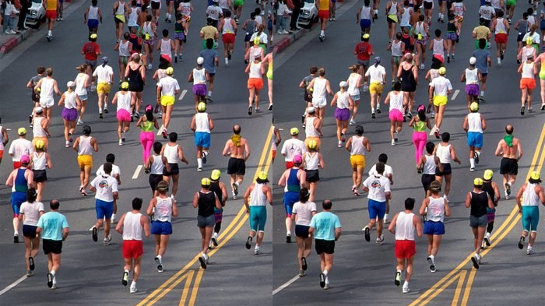

Slide 5
Class Management
Odd Semester 2023/2024

Slide 6
Class Overview (Resources)
Resources (Not limited only to these):
Interaction Design : Beyond Human-Computer Interaction (5th Ed.) : 2019 by Helen Sharp, Jenny Preece, and Yvonne Rogers
http://www.id-book.com/
Human Computer Interaction (3rd Ed.): 2004 by Alan Dix, Janet Finlay, Gregory D. Adowd, Russell Beale
https://www.hcibook.com/e3/plain/

Slide 7
Learning Objectives and Course Administration
No. | Components | Percentage |  | Learning Outcomes
1. | Assignments | 15 % |  | LO 1,2,4
2. | Quizzes | 15 % |  | LO 1,2,4
3. | Design Project | 15 % |  | LO 1,2
4. | Final write-up of Project | 30 % |  | LO 3,4,5
5. | Laboratory Exercises | 25 % |  | LO 2,3,4,5
Total |  | 100 %
LO1: Identify the interaction design, human-computer interaction, and user experience issues.
LO2: Analyse conceptual models for designers and users, knowledge of design and prototyping methods for user interfaces.
LO3: Apply techniques of data collection, analysis, and interpretation.
LO4: Apply knowledge and skills against current social and ethical concerns.
LO5: Implement a user interface that employs best practice principles.

Slide 8
Course Administration
Quiz – will be scheduled at least once (max 2); you are expecting to be ready anytime (during session 4 to 12).
Assignments – given at the class sessions, no late submission count, all graded and average
Lab Exercises – relate to code exercises (expecting to learn HTML, CSS and JavaScript)
Project - Design Project and Final Write Up Project

Slide 9
Time allocation
Each session (2/1)
Tutoring or Material Discussion (2 SCUs) – 100”
Lab Session (1 SCU) - 50”
Except for session 6 and 9
Online Forum
Project Milestone

Slide 10
Session Plan
Week | Topics | Focus Topics on | References | Learning Outcomes
1. | What is Interaction Design? The Process of Interaction Design | Introduction to HCI Lab: Introduction to Web Technologies | Sharp, Ch1, 2 Shneiderman, Part.1 | LO 1,2
2. | Conceptualizing Interaction Cognitive Aspects | User Research and Personas Lab: HTML Basic | Sharp, Ch. 3,4 Wickens, Ch. 14 | LO 1,2
3. | Social Interaction Emotional Interaction | Design Principles Lab: CSS Fundamental | Sharp, Ch. 5, 6 Smith-Atakan, Ch.2 Wickens, Ch. 18 | LO 2,5
4. | Interfaces | Information Architecture Lab: JavaScript Basic | Sharp, Ch. 7 | LO 5
5. | Data Gathering | Interaction Design Lab: Advanced CSS | Sharp, Ch. 8 | LO 4,5
6. | Data Analysis, Interpretation, and Presentation | Usability Testing Lab: Advanced JavaScript | Sharp, Ch.9 | LO 3,4
7. | Data at Scale | Prototyping and Mock-ups Lab: Form Validation with Javascript | Sharp, Ch. 10 | LO 1,2,4
No Mid Exam

Slide 11
Session Plan
8. | Discovering Requirements | Accessibility in HCI Lab: Working with APIs | Sharp, Ch. 11 Smith-Atakan, Ch.6 | LO 2,5
9. | Design, Prototyping, and Construction | Mobile and Responsive Design Lab: CSS Transitions and Animations | Sharp, Ch. 12 Shneiderman, Part.2 | LO 2,4,5
10. | Interaction Design in Practice | Human-Centered Evaluation Methods Lab: Accessibility and Responsive Design | Sharp, Ch. 13 | LO 1,2
11. | Introducing Evaluation: From Controlled to Natural Settings (Potential a Guest Lecturing) | Ethical Considerations in HCI Lab: JavaScript Libraries and Frameworks | Sharp, Ch. 14,15 Smith-Atakan, Ch.9 | LO 1,2,4
12. | Evaluation: Inspections, Analytics, and Models | Trends in HCI Lab: Performance Accessibilities | Sharp, Ch. 16 Manuaba, IDP Slides Material | LO 1,2,4
13. | Project Presentation |  |  | LO 3

Slide 12

More Info Please go to BINUSMAYA

Slide 13

Advise
Look to courses elsewhere, info on the web, friends, …
Content, lectures, projects, … cahtGPT maybe
Go further Go further
Move beyond lectures & book
Further courses
Step into research

Slide 14
How about the Project sir?
Let’s discuss after the break before LAB session

Slide 15

Project Overview

Slide 16
Project Descriptions
This includes two components
Design Project and Final Write-up of Project (Total 45%)
This term you will undertake a group project to accomplish the following goals:
evaluate some computing-related task or problem
develop interface design alternatives for the task or problem based on personas
implement a prototype of your design
evaluate your design

Slide 17
Project Deliverables and Milestone
Week 3: Initiate a Group, brainstorm Topics Ideas and alternatives (1st Progress)
Week 6: Design Project (2nd Progress)
Week 9: Progress (3rd. Progress)
Week 12 (2 days before Presentation Schedule) (Final Progress)
Week 13: Presentation and Demo (No Presentation without Final Progress submitted)
Q: How to submit for each milestone?
A: Upload through the submission form
w3: https://forms.office.com/r/gzRFDD71LS
w6: https://forms.office.com/r/Zsk9qqp7SF
w9: https://forms.office.com/r/EYsgv6FMr7
w12: https://forms.office.com/r/EgGTUZXLY7

Slide 18
Project Progress 1: Week 3
For this stage you basically need to decide:
The group members, max of 3 students
Choose a cool name for your group and register yourself and your team through this form: https://forms.office.com/r/cuq32gENmw (individually)
Possible topics/problems
Each group need to create a pdf document contain group name, members and possible topics/problems (There is No specific document formatting required)

Slide 19
Project Proposal (Poster): Week 6
For this stage you basically need to create a Design Project as a half-done project report.
Information required (but not limited to):
Project name
Group name and members
1. Problem analysis
2. Persona (target User),
3. Information Architecture, Task Flow and UseCase

Slide 20
Project Progress: Week 9
Project progress is an improved version of your proposal.
At this stage, you are expected to have more detailed prototype (semi working ok) with HTML, CSS, JavaScript. And plan of your evaluation method.
Outline:
Project name
Group name and members
1. Description of the Prototype
2. Problem analysis
3. Persona (target User),
4. Information Architecture, Task Flow and UseCase
5. Storyboards, mock-ups for multiple different designs for your solution
6. Screen Shot of the Prototype and GitHub link (or with Live link)
7. Plan of Usability Testing
References

Slide 21
Final PProgress: Week 12
You must submit full report + Video (file) – 2 days before the presentation day
Full report (from – part 1. Description - to - part 7. Summary)
On Part 7 (change from plan to implementation):
Conduct informal Usability Testing with example target users
Characterize what’s working and what’s not
Summary evaluation result
Video for your Solution demo (duration 4-6 min) ~ creative and engaging video about your Solutions
You will have 5 mins for presentation, 5 mins for demo and 5 mins for questions and answer.
You also need to write the answer for my questions in your project report (add a last part after references).
All links information needs to be included into the report and GitHub description

Slide 22
Project Presentation and Demo : Week 13
The detail schedule will be announced a day before presentation day
Only group with final progress submission completed allow to do presentation
The presentation day might be conducted only one day for all groups

Slide 23
Marking guide for the project Your project will be marked by using the following criteria:
Components | Criteria | Weight
Plan Initiation (M1) | Problems or cases descriptions Topics selections Forming group on time | 10%
Formulate Proposal (M2+M3) | Problem analysis Persona (target User), Information Architecture, Task Flow and UseCase | 30%
Progress Final Project | Final Mockup and Storyboard Building Prototype (usage of Interactive Design Principles) GitHub repository Testing Documentation (Inc. Videos) | 40%
Presentation | The presentation is clear, concise, and interesting. Ontime submission Addressing Feedbacks | 20%
 | TOTAL | 100%
Note: Total percentage will be assigned for 15% Project and 30% Final Project Components

Slide 24
Important Notes
Submit a group-written project progress report in PDF format only.
The code prototype should be uploaded into GitHub and set into public
readme file is a must for Project Description information
One Group only need to have One GitHub repo for the Project
Make sure that all group members participate actively in the project. Please report to the lecturer if any member does not do so.
Students will explain and demo their project prototype, so you also need to prepare a slide for the presentation day.

Slide 25
Questions?

Slide 26

Session Learning Outcomes
Upon completion of this session, students are expected to be able to
LO 1: Identify the interaction design, human-computer interaction, and user experience issues.
LO2: Analyze conceptual models for designers and users, knowledge of design and prototyping methods for user interfaces.

Slide 27
HCI
What is it?

Slide 28
HCI is Human Computer Interaction
What happens when a human and a computer get together to perform a task
Task - write document, calculate budget, solve equation, learn about something, drive solve equation, drive home,...
Task might be play, learning, communicating, …
Not just desktop computers

Slide 29
Why is this important?
Computer now affect every person in society
Product success may depend on ease of use, not necessarily power

Slide 30

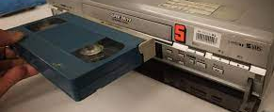
Interfaces in the world
Not just computers!
VCR
Mouse
Phone
Copier
Car
Plane Cockpit
Website
You name it…

Slide 31

Goals of HCI
Allow users to carry out tasks
Safely
Effectively
Efficiently
Enjoyably

Slide 32
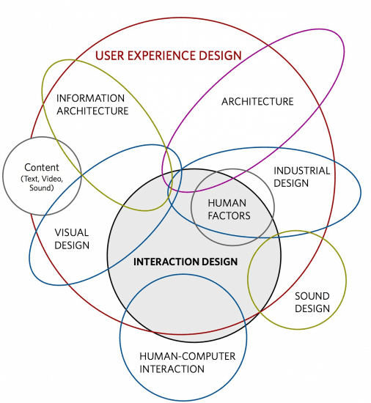
HCI leading to Interactive Design and User Experience Design

Slide 33
What to design?
Need to take into account:
Who the users are
What activities are being carried out
Where interaction is taking place
Need to optimize the interactions users have with a product:
So that they match the users’ activities and needs
Personas

Slide 34

What is interaction design?
“Designing interactive products to support the way people communicate and interact in their everyday and working lives.”
Sharp, Rogers, and Preece (2019)
“The design of spaces for human communication and interaction.”
Winograd (1997)

Slide 35
Goals of interaction design
Develop usable products
Usability means easy to learn, effective to use, and provides an enjoyable experience
Involve users in the design process

Slide 36

Course Aims:
Consciousness raising
Make you aware of these issues
Design Critic
Question bad design
Learn Design Process
Software interfaces and other artifacts
Improve your skills HCI design & evaluation
Go forth and do good work

Slide 37
Another Questions?

Slide 38
Lab Time!

Slide 39
Lab Requirements
Languages:
HTML
CSS
JavaScript
Learning Tools
For this Lab I am encouraging you to use FreeCodeCamp
GitHub Account
Any IDE you like (Suggestion VSCode)

Slide 40

Notes:
https://www.geeksforgeeks.org/web-technology/

Slide 41
References
www.id-book.com
https://www.geeksforgeeks.org/web-technology/
https://www.w3schools.com/html/default.asp
https://www.codecademy.com/search?query=html
https://www.codecademy.com/learn/learn-html/modules/learn-html-elements/cheatsheet

