Slide 1
Session 2 : C o n c e p t u a l Interaction Design & C o g n i t i v e A s p e c t s
by:
Ida Bagus Kerthyayana Manuaba
COMP6800001 - HCI

Slide 2


Slide 3

Review Last week Session:
What are the different between Web Application VS Website?

Slide 4
Web Application VS Website
Web Application: Web application is a piece of software that can be accessed by the browser. It needs authentication. It uses a combination of server-side scripts and client-side scripts to present information.
Example: Google Apps, Amazon, YouTube
Website: Website is a collection of related web pages that contains images, text, audio, video, etc. It can consist of one page, two pages, and n number of pages. It provides visual and text content that users can view and read.
Example: a restaurant’s web page where you can view the menu, hours of operation, etc.
https://www.geeksforgeeks.org/difference-between-web-application-and-website/

Slide 5
Web Application VS Website
Web Application | Website
Web application is designed for interaction with end users. | Website basically contains static content.
The user of web application can read the content of web application and also manipulate the data. | The user of website only can read the content of website but not manipulate .
The web application site should be precompiled before deployment. | The website does not need to be precompiled .
The function of a web application is quite complex. | The function of website is simple.
Web application is interactive for users. | Web site is not interactive for users.
The browser capabilities involved with a web application is high. | The browser capabilities involved with web site is high.
Integration is complex for web application because of its complex functionality. | Integration is simpler for web site.
Web application mostly requires authentication | In web site authentication is not necessary.
EXAMPLE :- Amazon, Facebook, etc. | EXAMPLE :- Breaking News, Aktu website, etc.
https://www.geeksfåorgeeks.org/difference-between-web-application-and-website/

Slide 6

Session Learning Outcomes
Upon completion of this session, students are expected to be able to:
LO 1: Identify the interaction design, human-computer interaction, and user experience issues.
LO2: Analyze conceptual models for designers and users, knowledge of design and prototyping methods for user interfaces.

Slide 7

AGENDA
Introduction
Design Interaction’s Goal
The Advantages of Interaction Design Implementation
Characteristics of Interaction Design
Design Principles

Slide 8
Introduction

Slide 9

What is Interaction Design?
https://userpeek.com/blog/what-makes-a-good-ux-designer/

Slide 10
Designing interactive products to su“pport the way people communicate and
interact in their everyday and working lives
Preece, Sharps, & Rogers (2015)
https://usabilitygeek.com/wp-content/uploads/2017/09/ux-before-ui-main.jpg

Slide 11
The desig“n of spaces
for human communication and interaction
Winograd (1997)
https://usabilitygeek.com/wp-content/uploads/2017/09/ux-before-ui-main.jpg

Slide 12

Definition
“
In general, interaction design is ...
the creation of a dialogue between a person and a product, system, or service
Fundamental in all areas relevant to research activities and design of computer-based systems for humans
HCI| Computer Science Department – BINUS

Slide 13



SCOPE OF INTERACTION DESIGN
Disciplines
Ergonomics Psychology (Cognition) Informatics Engineering Computer Science Social Sciences
Design Application
Graphic Design
Product Design
Artistic Design
Film Industry
Industrial Design
Desain Interaksi
Multidisiplinary
Human Factors
Cognitive Engineering
Human Computer Interaction
Cognitive Ergonomics
Information System
Computer-Supported Cooperative Work (CSCW)

Slide 14
PURPOSE AND BENEFITS OF IMPLEMENTATION

Slide 15




INTERACTION DESIGN OBJECTIVES
Developing usable products
Engage users in the design process

Slide 16

Whether the products we develop are really needed and capable solve user problems ?
POINTS TO PONDER
https://www.youtube.com/watch?v=e
mYd8GMcfo4
....

Slide 17
1
ADVANTAGES OF IMPLEMENTING INTERACTION DESIGN
Design interactive products that meet user needs
2
Offers many solutions because there is no one solution to all problems
3
Not just assuming because assumptions may be wrong
4
Resolve differences in team and user sensitivities and capabilities

Slide 18
CHARACTERISTICS OF INTERACTION DESIGN

Slide 19



INTERACTION DESIGN CHARACTERISTICS (1)
Identify clear Usability Goals and User Experience Goals
Engaging Users
Iteratif

Slide 20




HOW IMPORTANT IS ENGAGING USERS?
For example in the context of use online ojek apps ...
There are two main issues:
VS
Difference Culture
Difference Accessibility
Tayo, 12 Yo Want to go to school
Suharti, 45 Yo Want to go to the mall
Are the needs the same? Is the ability to learn the use of apps the same? Are process-related preferences the same?

Slide 21
KARAKTERISTIK DESAIN INTERAKSI (2)
Identify clear Usability Goals and User Experience Goals
Engaging Users
Iterative

Slide 22


USABILITY GOALS
USABILITY GOAL
Security
Learnability
Efficiency
Memorability
Effectiveness
Utility

Slide 23
USER EXPERIENCE OBJECTIVES
Desired aspects
Avoidable aspects
Satisfying
Motivating
Provocative
Boring
Unpleasant
Enjoyable
Challenging
Surprising
Frustrating
Patronizing
VS
Pleasurable
Enhancing Socialibility
Rewarding
Feel Guilty
Feel Stupid
Exciting
Supporting Creativity
Emotionally Fulfilling
Annoying
Cutesy
Entertainment
Cognitively Stimulating
Childish
Gimmicky
Helpful
Fun

Slide 24
“Usability Goal and User Experience
Goal It may be different, but it affects each other

Slide 25
KARAKTERISTIK DESAIN INTERAKSI (3)
Identify clear Usability Goals and User Experience Goals
Engaging Users
Iterative

Slide 26
MENGAPA BERSIFAT ITERATIF ?
Based on Interaction “Design Foundation (2018) :
“It’s because it is almost always cheaper and easier to create a prototype to test than it is to develop a system or product and then amend that based on user feedback
Characteristics: each time a stage is redone after another stage
There is a cycle in the design process that is carried out in a system development project

Slide 27
PRINCIPLES OF INTERACTION DESIGN
Notes:
https://principles.design/examples/

Slide 28
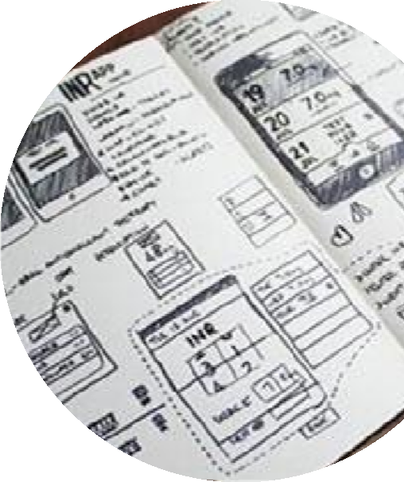
DESIGN PRINCIPLES
General abstraction
Covers what is allowed and what is not to be done
Includes what needs to exist and what doesn't need to exist
A combination of theory, experience, and reason
https://principles.design/examples/

Slide 29




PRINCIPLES OF INTERACTION DESIGN (1)
According to Preece et al (1988) ...
Visibility
Feedback
Constraints
Consistency
Affordance

Slide 30

VISIBILITY
The clearer (visible) a function is, the easier it is for users to know what they need to do next

Slide 31
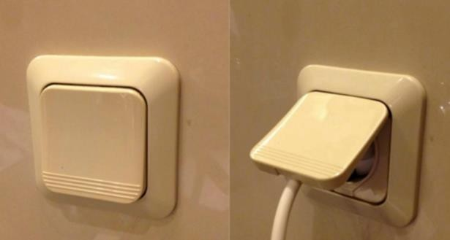

Slide 32

PRINCIPLES OF INTERACTION DESIGN (2)
According to Preece et al (1988) ...
Visibility
Feedback
Constraints
Consistency
Affordance

Slide 33
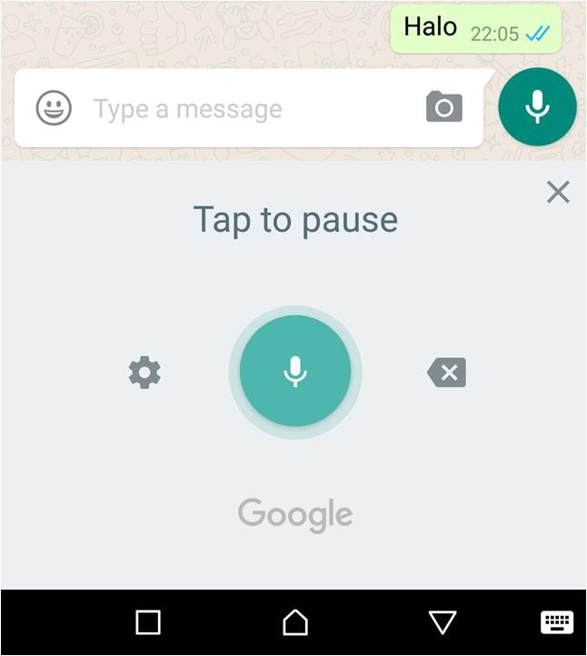
FEEDBACK
Providing information about what has been or has been successfully done. Gives a sign that the user's goal in performing an action is achieved. Related to visibility.

Slide 34

PRINCIPLES OF INTERACTION DESIGN (3)
According to Preece et al (1988) ...
Visibility
Feedback
Constraints
Consistency
Affordance

Slide 35
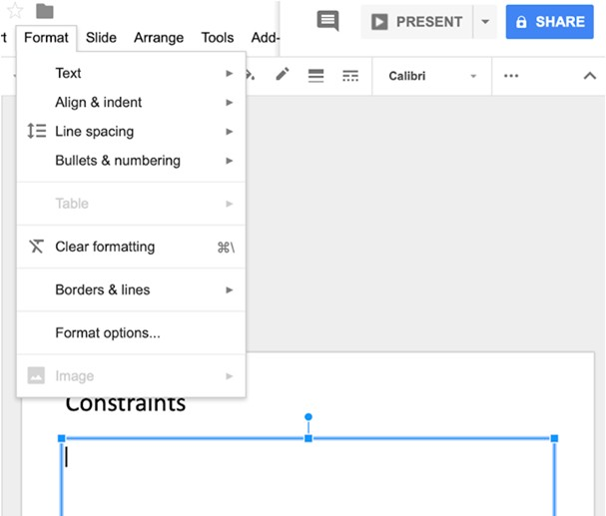
CONSTRAINTS
Limit the activities that users can perform according to situations and conditions at a certain time

Slide 36

PRINCIPLES OF INTERACTION DESIGN (4)
According to Preece et al (1988) ...
Visibility
Feedback
Constraints
Consistency
Affordance

Slide 37

CONSISTENCY (1)
Use of similar interfaces to execute similar functions.
Make products easier to understand and use.
Internal
Eksternal
Alignment of design and function in one area
Alignment of design and function across systems or products
https://bashooka.com/wp-content/uploads/2013/06/ui-sketches-10.jpg

Slide 38
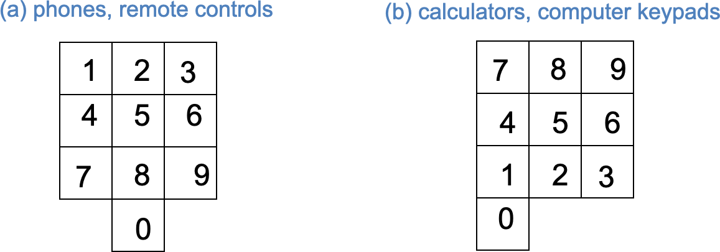
CONSISTENCY (2)
https://bashooka.com/wp-content/uploads/2013/06/ui-sketches-10.jpg

Slide 39

PRINCIPLES OF INTERACTION DESIGN (5)
According to Preece et al (1988) ...
Visibility
Feedback
Constraints
Consistency
Affordance

Slide 40
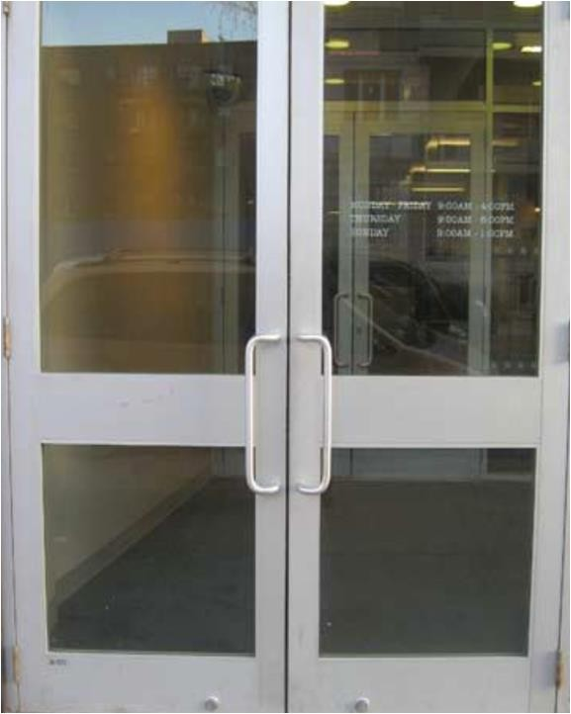
AFFORDANCE
The ability of a product to provide clarity of use of such products.
Norman (1988) defines it as: "Giving Hints"

Slide 41



EXAMPLES OF DESIGN PRINCIPLES (1)
Case study :
UNIFIED
No feature is isolated or an outlier, each design contributes to the system positively and overall
UNIVERSAL
The design can be used and accessed by all users everywhere They are and whoever they are
airbnb.design/the-way-we-build

Slide 42


EXAMPLES OF DESIGN PRINCIPLES (2)
Case study :
ICONIC
Design that characterizes Airbnb
CONVERSATIONAL
Design delivers what Airbnb wants to say uniquely and with quality
airbnb.design/the-way-we-build

Slide 43
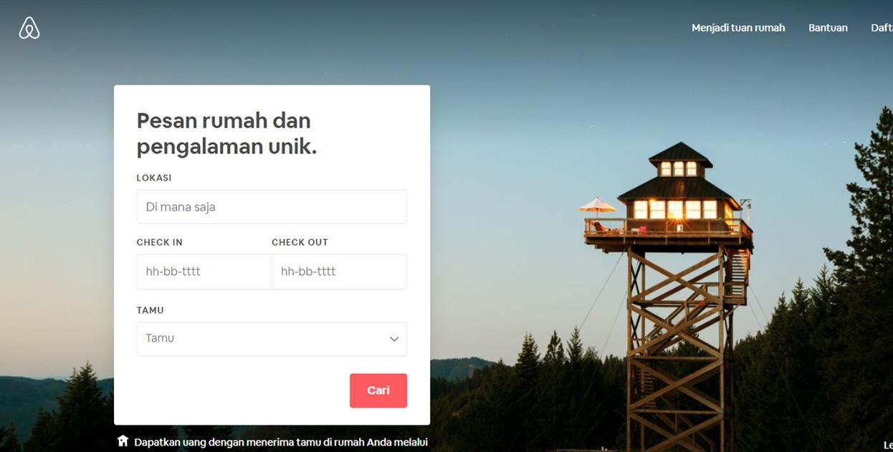
airbnb.co.id

Slide 44
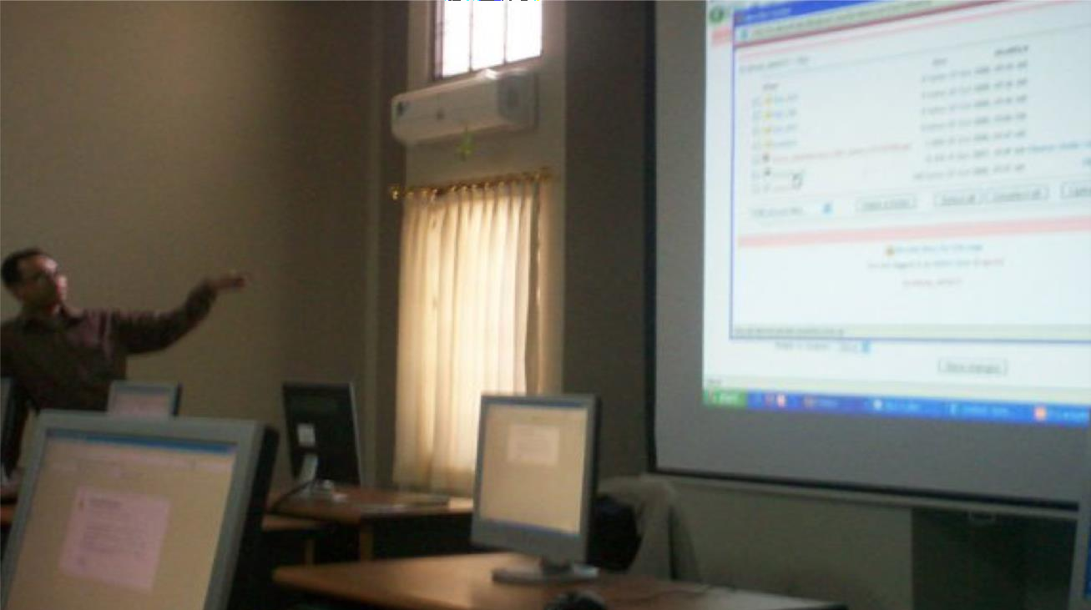
Thank you,
Any Questions?

Slide 45
References
https://www.geeksforgeeks.org/difference-between-web-application-and-website/
https://userpeek.com/blog/what-makes-a-good-ux-designer/
https://youtu.be/emYd8GMcfo4?feature=shared
https://principles.design/examples/
https://airbnb.design/the-way-we-build/

Slide 46
Lab Session

