Slide 1
Iris — Digital gaze tracker
Manit Bisht
Eklavya Nathani
25BCE2441
25BCE0914

Slide 2
IRIS
02
02
Motivation
Features
Iris is a low-cost, wall-mounted interactive AI companion designed to provide a believable sense of presence without expensive mechanical actuators.
Combining a standard TFT display with real-time computer vision, Iris simulates dynamic eye contact, facial expressions, and voice interactions at a fraction of traditional costs.
Ultra-Low Cost
Zero Fragility
Sub-₹1500 total hardware bill of materials.
No motors, mechanical wear, or operational noise.
Dynamic Gaze
Minimal Footprint
Shifts pupil coordinates in real time to break static gaze ambiguity.
Slim, wall-mounted form factor housed in a picture frame.
Distributed Pipeline
Multimodal UX
Offloads vision and LLM compute to a local GPU host.
Synchronized real-time speech, mouth animation, and gaze tracking.

Slide 3
IRIS
03
Problem statement
High Cost Barrier
Mechanical Fragility
The Mona Lisa Effect
Compute &
Thermal Limits
Traditional social robots rely on multi-axis servos and costly actuators, making deployment financially prohibitive for makers and academic labs.
Electromechanical parts suffer from gear wear, motor noise, high power consumption, and frequent physical repair cycles.
Static eye displays create an ambiguous perceived gaze where the robot appears to look past users rather than establishing genuine eye contact.
Attempting to run complex vision models and LLMs directly on small edge hardware causes severe latency and thermal throttling.

Slide 4
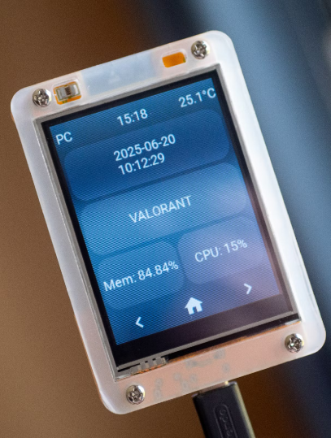
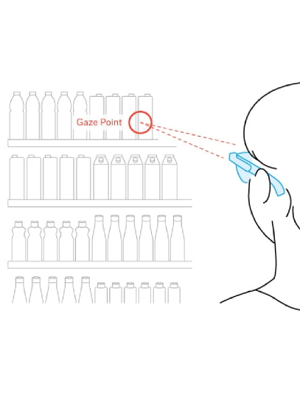
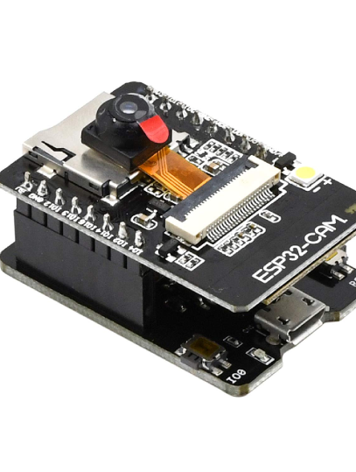
PROJECT NAME
04
Our
Solution
Iris is a low-cost, wall-mounted interactive AI companion that uses a camera-enabled microcontroller, a digital display, and a local host connection to provide dynamic visual gaze tracking and expressive facial responses without any mechanical moving parts.
ULTRA-LOW-COST, SOFTWARE-DRIVEN PRESENCE
DYNAMIC PUPIL TRACKING
MINIMALIST HARDWARE ARCHITECTURE
Uses real-time computer vision to calculate user coordinates and shift virtual pupils on-screen with sub-200ms latency
Offloads heavy computer vision, speech-to-text, and LLM processing to a local host GPU over Wi-Fi
Eliminates all mechanical moving parts by using pixel-level vector animations rendered on an inexpensive display.

Slide 5
IRIS
05
Proposed workflow
Sensing
Processing
Control
Rendering
ESP32-CAM streams QVGA video over WebSocket.
INMP441 mic captures user voice audio in real time.
Wall device stays silent, light, and cool.
Host GPU runs MediaPipe to extract face coordinates.
Whisper model transcribes speech to text.
LLM calculates emotional state and response cadence.
Host constructs lightweight ~80-byte JSON payload.
Transmits pupil position, expression, and mouth wave.
Streams continuously over Wi-Fi at 15–30 FPS.
ESP32 parses JSON via fast C++ firmware.
Draws vector face on ST7789 display (<5ms render).
Plays synced audio response through I2S speaker.

Slide 6
PROJECT NAME
06
Work Distribution & Budget
2000rs.
Component | Purpose | Cost
ESP32-CAM (OV2640) | Microcontroller, camera, Wi-Fi | ₹600
ST7789 2.0 TFT LCD | Display for face rendering | ₹400
INMP441 Microphone | Audio capture for voice interaction | ₹200
MAX98357A + Speaker | Audio playback for voice responses | ₹300
TOTAL BUDGET

Slide 7
IRIS
07
Objectives and Goals
Minimize Build Cost
Achieve Low-Latency Gaze
Maintain High Framerate
Eliminate electromechanical subsystems using commodity microcontrollers and displays.
Dynamically update pupil position in real time as users move through the room.
Render vector shapes fast enough to prevent screen tearing and lag.
MAXIMUM BOM COST
GAZE RESPONSE TIME
DISPLAY REFRESH
₹1500
<200ms
30FPS

Slide 8
IRIS
08
References
Social Eye Gaze in HRI
Validates replacing complex, failure-prone motor subsystems with software-driven display rendering without sacrificing user engagement.
Demonstrates that dynamic software-driven gaze cues provide engagement comparable to complex mechanical eyes.
Dynamic Pupil Tracking
Proves dynamic pupil repositioning defeats the Mona Lisa effect, enabling users to perceive genuine directional eye contact across a room.
Shows that updating pupil positions in real time eliminates static 2D gaze ambiguity on display-based agents.
GazeGrasp Architecture
Confirms the technical feasibility of streaming real-time video over local WebSocket connections using low-cost ESP32 camera modules.
Demonstrates real-time execution of neural vision models on lightweight microcontroller-based hardware platforms.
Active Overhearer Dynamics
Directly guides the design of Iris's dynamic expression states, including sleeping, idle blinking, thinking, and speaking behavior cycles.
Evaluates how subtle visual presence and active turn-tracking strategies heighten natural human-robot interaction.

Slide 9
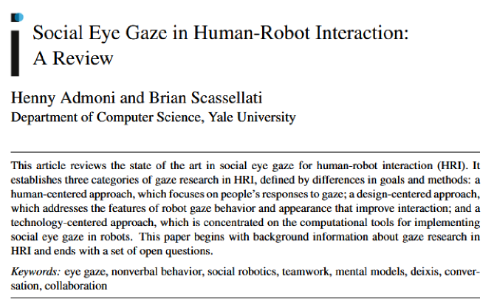
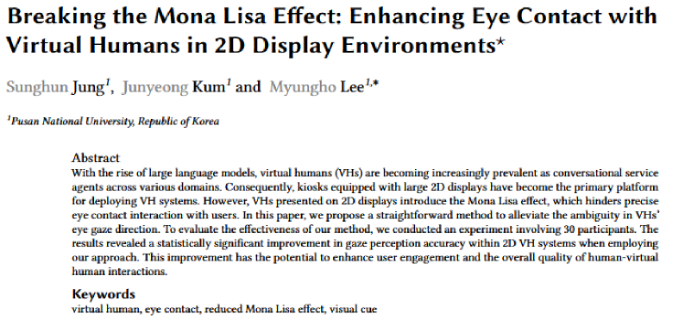
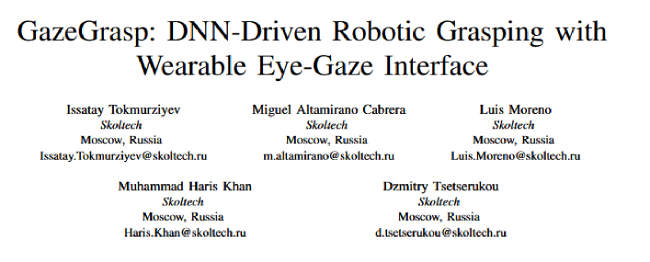
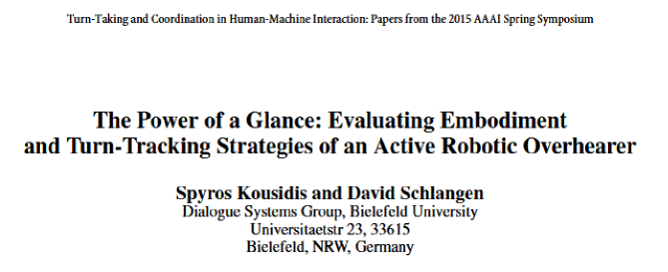
IRIS
09

Slide 10
Thank You!
Manit Bisht
Eklavya Nathani
25BCE2441
25BCE0914

