Slide 1


Heart Disease Diagnostic Analysis
BY
Vedant Adesh kalmegh

Slide 2




Introduction
Heart disease is the leading cause of death in the world over the past 10 years.
The goal of this project is to analyse the heart disease occurrence , based on the combination of features that describes the heart disease.
There are several parameter such as high blood pressure, high cholesterol, fasting blood sugar, coronary artery disease(AHD) etc. for analysing the person have a heart disease or not.

Slide 3




ARCHITECTURE
Dataset
Importing
Libraries
Read Dataset
Missing value
Imputation
Report
Exploratory Data Analysis
Handling Outliers
Data
Cleaning
Data visualization
By using EDA.
Documentation for several graphs.

Slide 4
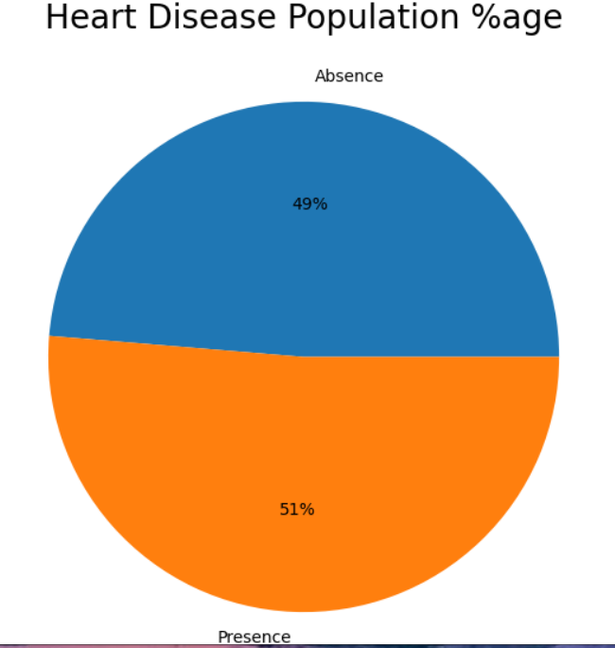
INSIGHTS FROM ANALYSIS
What kind of Population do we have?
51% people are suffering from Heart disease.
49% people do not have heart disease.

Slide 5
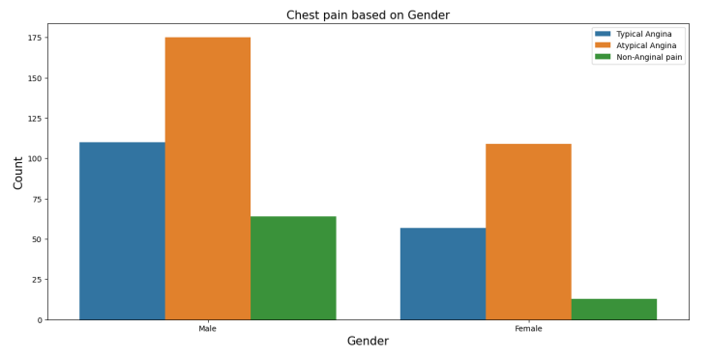
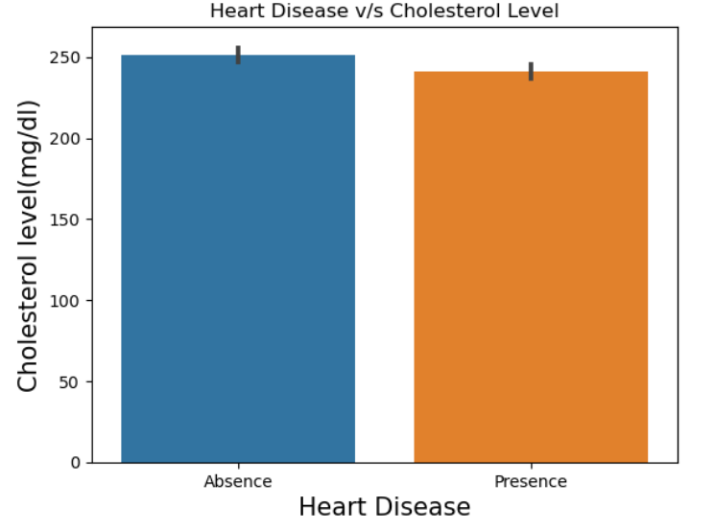
SYMPTOMS
People having higher cholesterol level and asymptomatic chest pain these people having higher chance of heart disease .

Slide 6
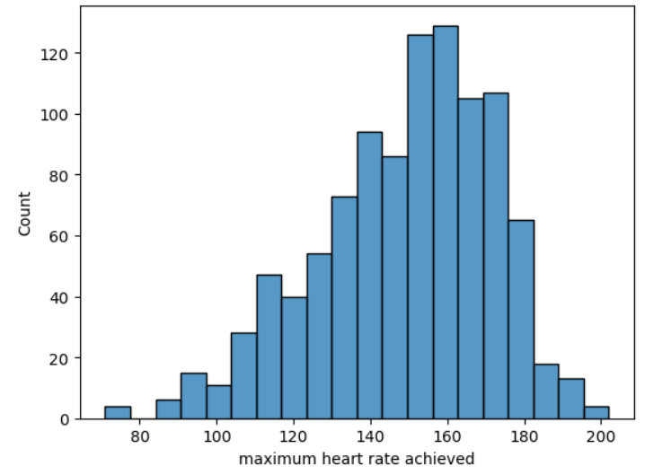
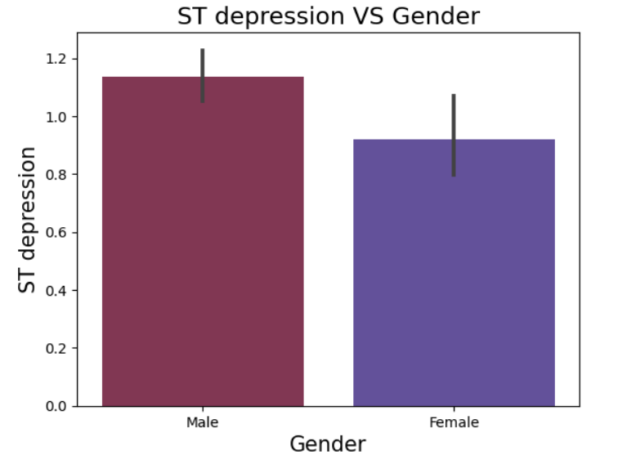

Slide 7
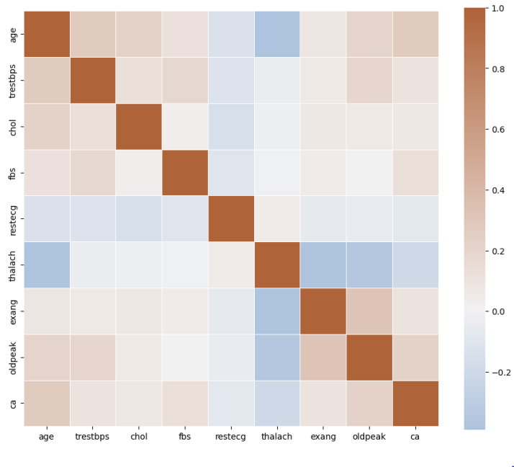
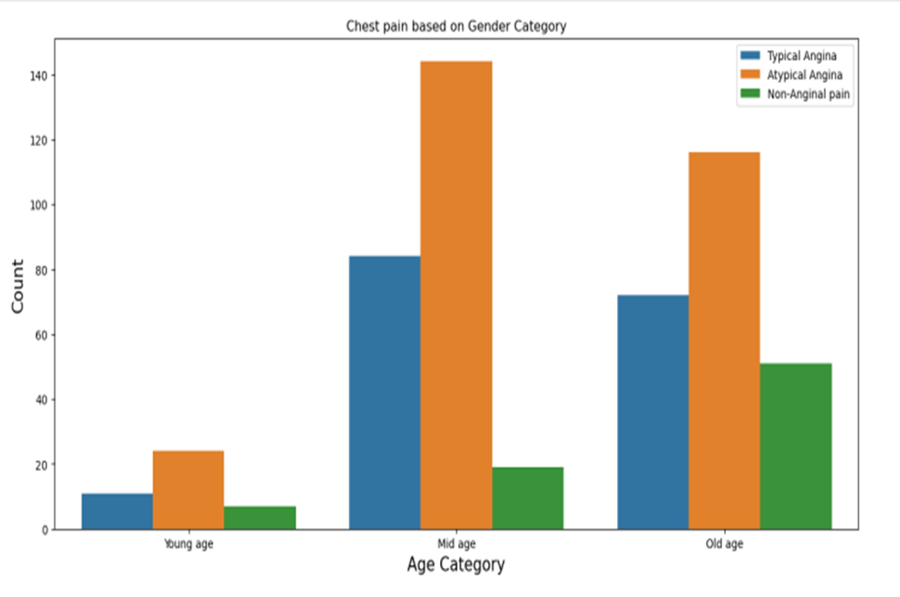
Here is the analysis of factors which causes heart disease such as blood pressure , cholesterol, Chest pain and heart rate.

Slide 8
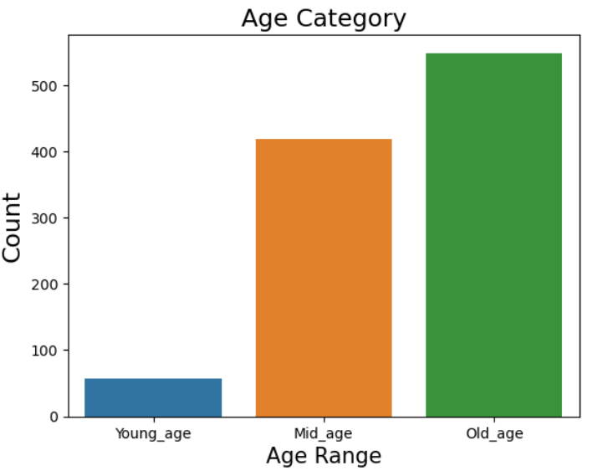
As we classify by age range old people are more prone to heart disease and then mid age people have the chances of heart disease.

Slide 9
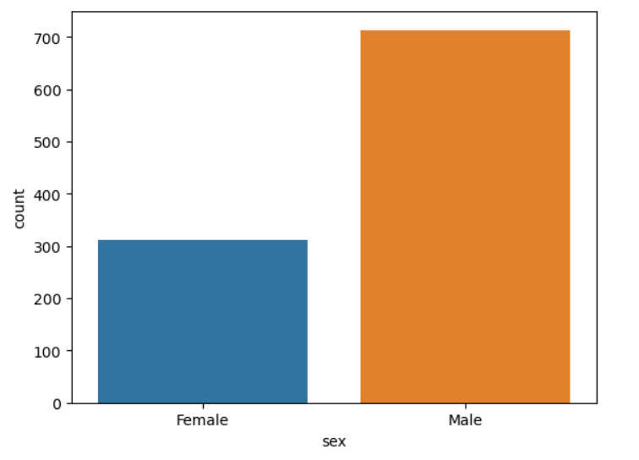
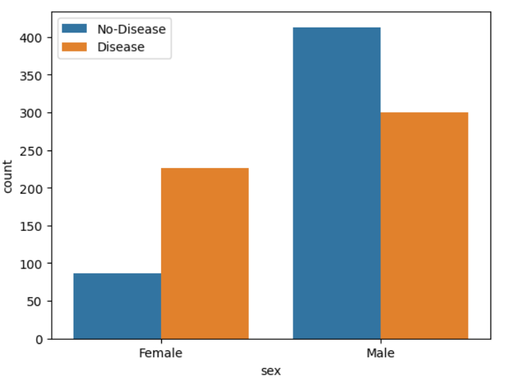
As we classify by gender males are more prone to heart disease than female.

Slide 10
CONCLUSION
From target value we can say that our dataset is almost balanced with 49% of patients having no heart disease and 51 % of patients having heart disease.
Males have higher chances of having heart disease than females.
Patients with age >55 years and having resting blood sugar( i.e in diastolic state) in range 121-140 mmHg have higher chances of heart disease. patients with age group 40 to 45 have little chances and age below 40 has negligible chances of having a heart disease.
Patients suffering from heart disease are mostly in age group of 50-55 year.
Patients who are likely to suffer from heart disease have higher maximum heart rates( rate between 140-160) whereas patients who are not likely to suffer from heart disease are having lower maximum heart rates.

