Slide 1
DYNAMIC WEATHER DASHBOARD
CAPSTONE PROJECT
Presented By:
1. Srishti Kaur - Chandigarh University - University Institute of Engineering (UIE)

Slide 2
OUTLINE
Problem Statement
System Development Approach
Algorithm & Deployment
Result
Conclusion
Future Scope
References

Slide 3
Problem Statement
Weather information is crucial for planning daily activities, travel, agriculture, and disaster management.
Most weather dashboards fail to provide accurate, real-time, hourly, and daily forecasts across global time zones.
Need for a dynamic, interactive, and visually appealing weather dashboard that:
Shows accurate weather metrics (temperature, wind, humidity, precipitation, pressure, UV index)
Adapts to local and global time zones
Displays sun and moon background according to day/night
Provides hourly and weekly forecasts

Slide 4
System Approach
Frontend Technologies:
HTML5 – Structure of the webpage
CSS3 – Styling and responsive layouts
JavaScript – Dynamic interactivity
Weather API: Open-Meteo API
Geocoding API: Open-Meteo Geocoding API for city latitude and longitude
Features Implemented:
Real-time hourly and daily weather metrics
Accurate timezone handling for local and global locations
Dynamic day/night background with sun and moon transitions
Responsive and scrollable weather cards
Deployment:
Code hosted on GitHub for version control
Live website deployed on Netlify for global access

Slide 5
Algorithm & Deployment
User Input: User enters a city or allows geolocation access.
Fetch Coordinates: Fetch latitude and longitude using Geocoding API.
Fetch Weather Data: Request weather data (current, hourly, daily) from Open-Meteo API with timezone=auto.
Current Weather Display:
Convert UTC timestamps to city’s local time
Show metrics: temperature, wind, precipitation, humidity, pressure, UV index, sunrise, sunset
Hourly Forecast Display:
Show next 12 hours with temperature, precipitation, and weather icons
Daily Forecast Display:
Show next 7 days with max/min temperature, precipitation, and weather icons
Sun/Moon Background:
Compare current local time with sunrise and sunset to display day/night transition
Deployment:
Push code to GitHub repository
Deploy live site on Netlify

Slide 6
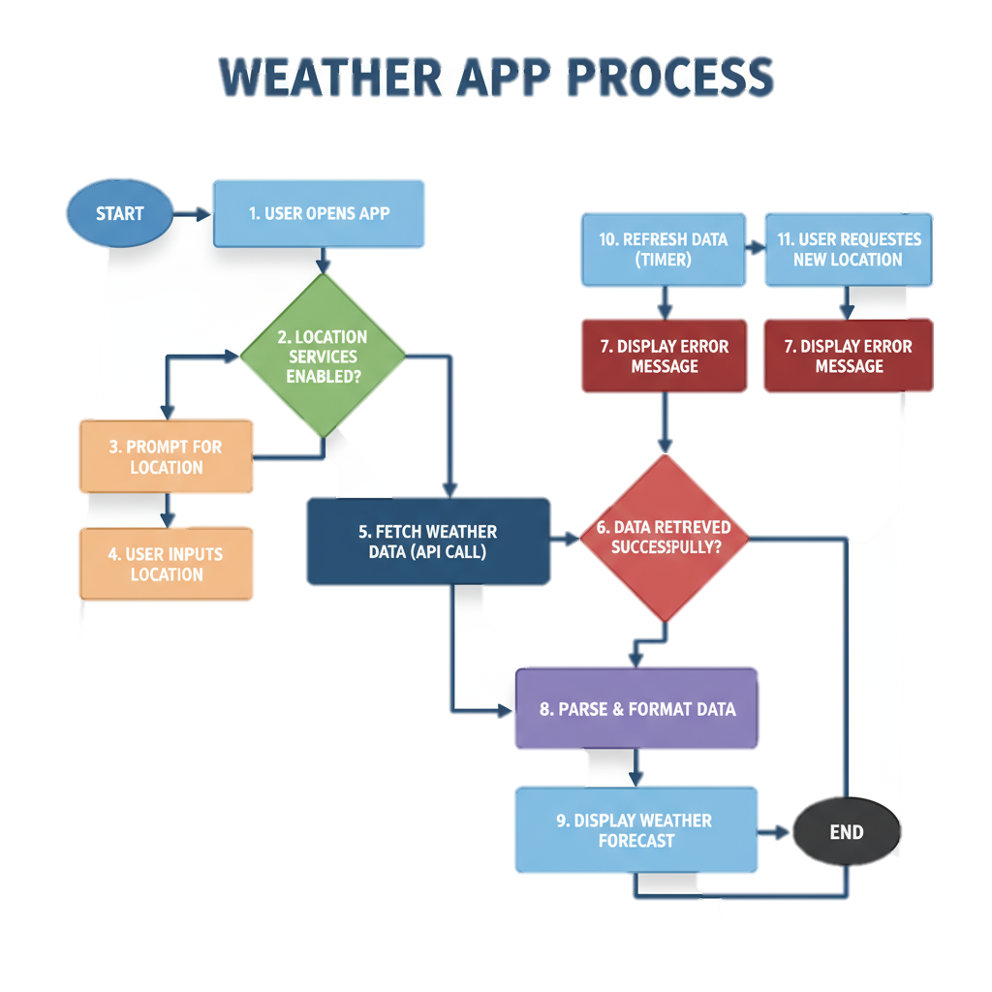

Slide 7
Result
Dynamic Weather Dashboard accessible globally.
Accurately displays temperature, wind, humidity, precipitation, pressure, UV index for any city.
Hourly and daily forecasts visible with proper timezone conversions.
Visual day/night representation with moving sun and moon.
Fully responsive design with scrollable weather cards.
Deployed online via Netlify and maintained version control on GitHub.

Slide 8
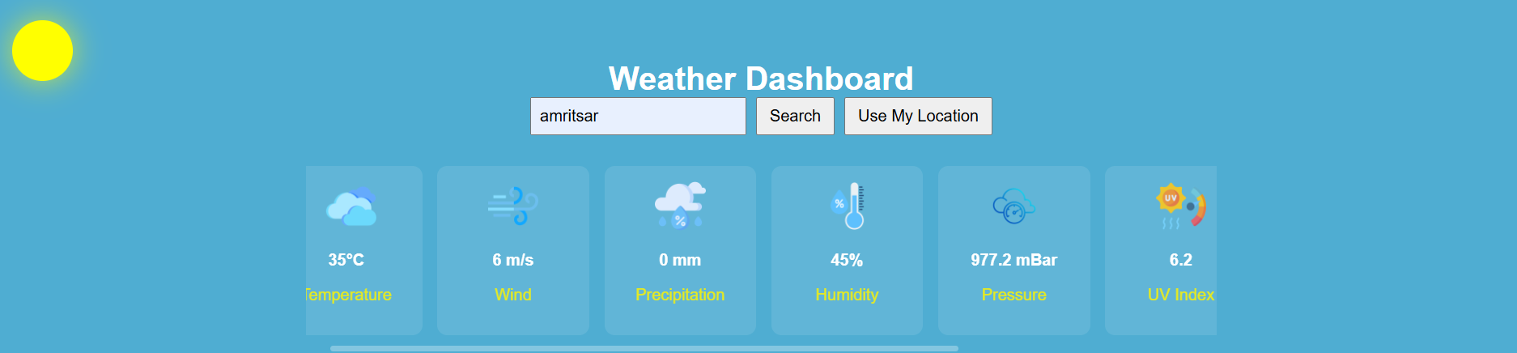
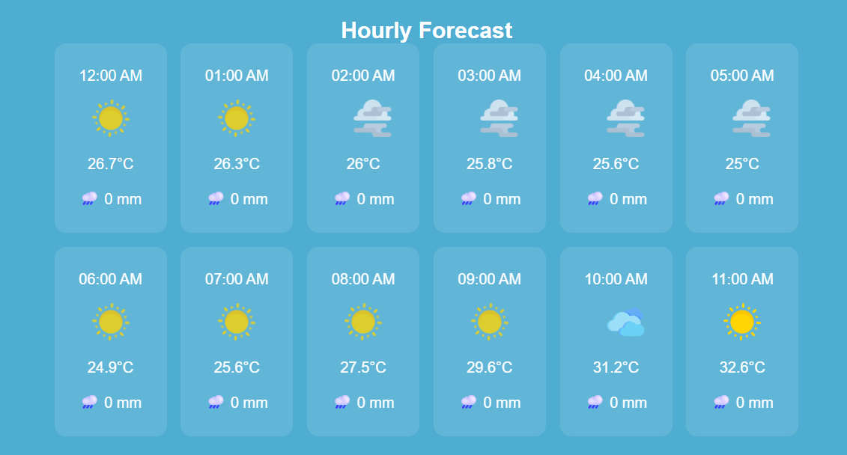
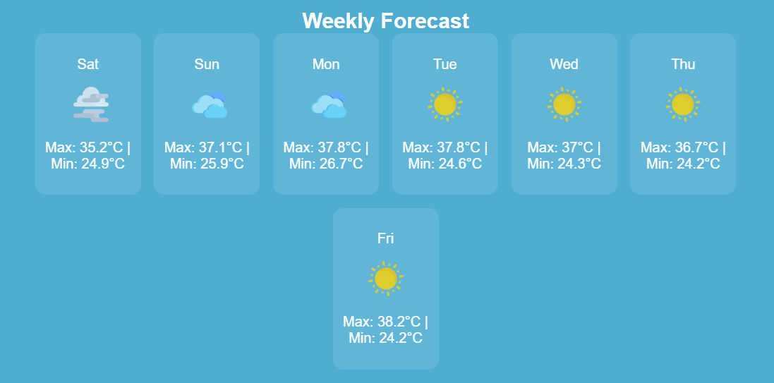
DAY MODE : This is weather forecast for local timezone.
HOURLY FORECAST
WEEKLY FORECAST

Slide 9
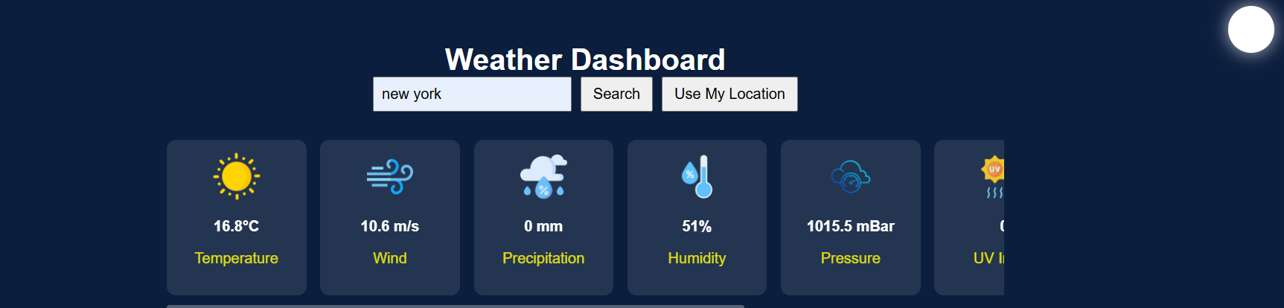
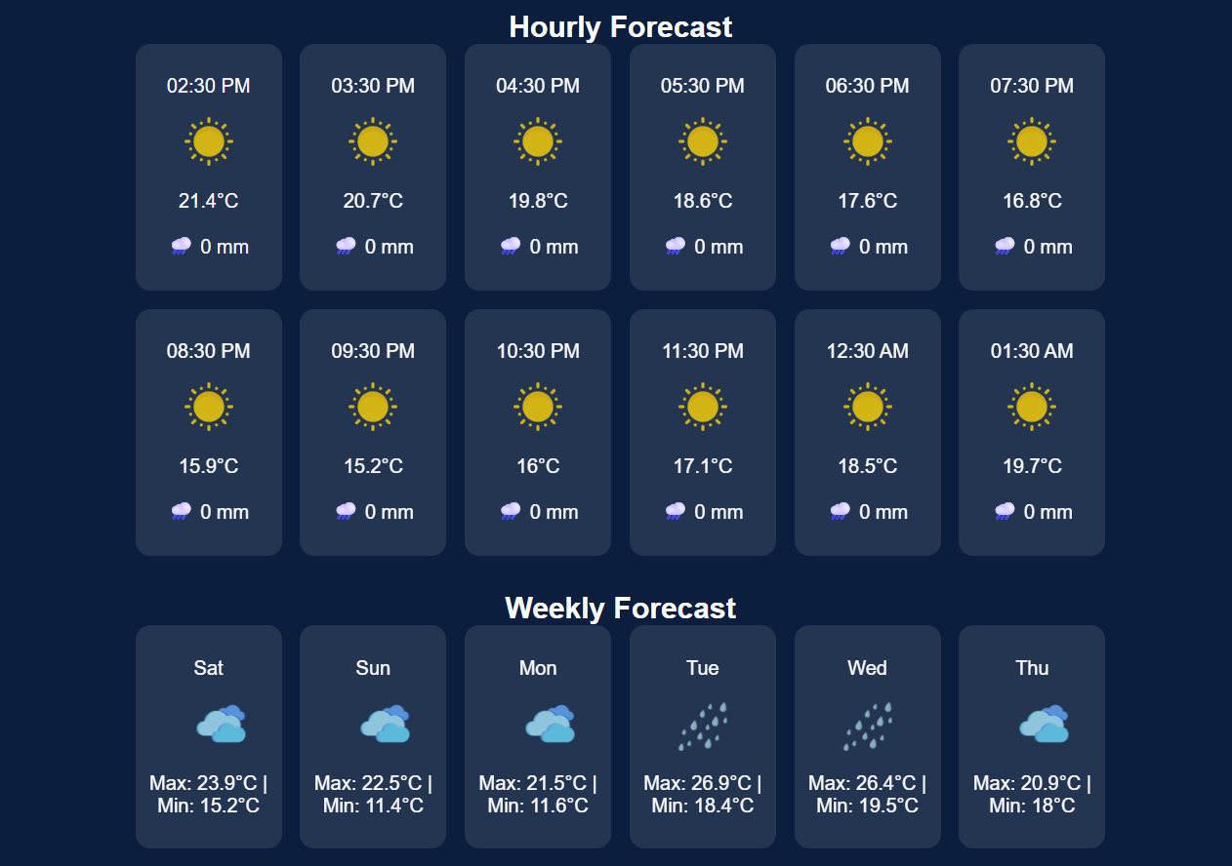
NIGHT MODE: This is weather forecast of global timezone.

Slide 10
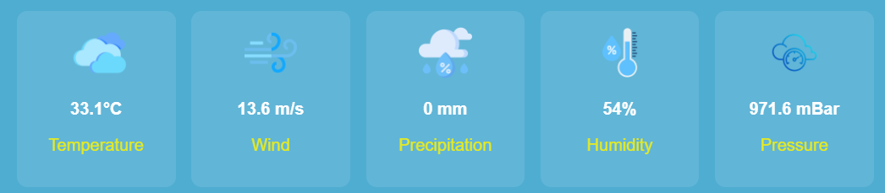
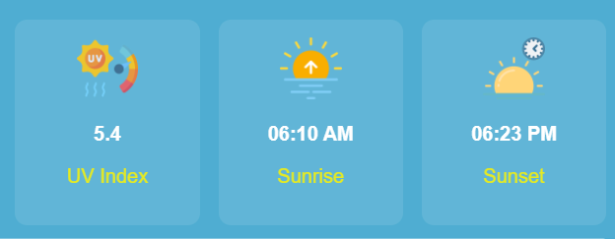
VARIOUS WEATHER PARAMETERS
GITHUB LINK : https://github.com/SpadeZ1027/AICTE-Web-Development-Internship/tree/main

Slide 11
Conclusion
Successfully built a reliable, interactive, and visually appealing weather dashboard.
Real-time updates and accurate metrics ensure trustworthy information for users worldwide.
Effective use of APIs, JavaScript, and responsive design principles.
Achieved cross-timezone functionality for global cities.

Slide 12
Future scope(Optional)
Include severe weather alerts (storms, cyclones, heavy rainfall).
Integration with maps for location-based visualization.
Add user login and preference settings for favorite cities.
Enhance animations for weather conditions like rain, snow, and thunder.
Mobile app version using frameworks like React Native or Flutter.

Slide 13
References
Geocoding API to get latitude/longitude: Google Geocoding API overview.
Weather data API: Open-Meteo official documentation.
Time zone conversion: W3C guidelines for timezones.
Weather app UI/UX: Weather in UI Design (Tubik Studio blog).
Deployment on GitHub and Netlify: A Step-by-Step Guide: Deploying on Netlify.

Slide 14
THANK YOU

