Slide 1
01 · RESEARCH IDEA
Adaptation needs capability and information
How can a robot execute a task in a situation it did not encounter during training?
1
Movement capability
2
Environment interpretation
Learn how to grasp and move
across variations of the same task.
Estimate the current conditions
so the policy can use suitable actions.
Working hypothesis: generalizable behavior and useful environmental context support adaptation.
ROBOT ADAPTATION / PI RESEARCH UPDATE
01 / 08
Notes:
We investigate how a robot can handle a deployment situation it did not encounter during training. The idea has two components. First, the controller needs a repertoire of grasping and movement behavior that generalizes within a task. Second, the system needs a useful interpretation of its current environment so that the conditioned policy can produce appropriate commands. These are research hypotheses, not guarantees provided by reinforcement learning. The task remains pick and lift with a consistent top-down grasp strategy. This framing follows the latest proposal: policy generalization is now an explicit enabling part of the study, while initial environment estimation remains a separate component.

Slide 2
02 · PROPOSED SETUP
An RL policy conditioned on environment
Standard state describes the robot and task; environmental parameters describe current conditions.
Robot + task state
Joints, gripper pose, task state
Grasp and move
actions
Environmental parameters
RL policy
Known in training;
estimated at deployment
Training: learn policy weights from reward. Deployment test: keep those weights fixed.
Assumption to test: varied training produces a policy capable of executing at held-out heights.
ROBOT ADAPTATION / PI RESEARCH UPDATE
02 / 08
Notes:
We assume an RL framework. The policy receives standard robot and task state plus a compact set of environmental parameters, and learns grasping and movement commands from task reward. During simulation training, selected environmental values can be supplied from the simulator. During estimated-context evaluation, the corresponding values must come from the estimator. RL is a method of training the controller; successful generalization must still be measured. Selected context variables could be guided by the existing CREST workflow, but no completed CREST selection is claimed here. The current policy has 45 state values including object pose, relative geometry, supplied weight, and finger-force observations. If the future estimator predicts height or pose, true copies and derived versions of those quantities must not bypass that estimator.

Slide 3
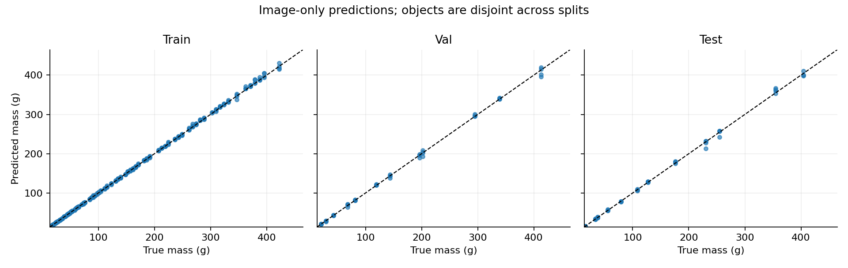
03 · FINDING 1 · COMPLETED
A controlled visual mass estimate works
Fixed-density cubes provide a visible size-to-mass relationship.
TEST MASS ERROR
2.76 g
Mean absolute error
Constant baseline
106.37 g
12 held-out sizes / 48 test images
Scope: one material, fixed density and friction, fixed camera. This tests interpolation over size.
Evidence: runs/visual_mass/initial_rgb_mass/model/metrics.json and predictions.png
ROBOT ADAPTATION / PI RESEARCH UPDATE
03 / 08
Notes:
Completed evidence: the saved initial-image CNN achieved test mean absolute mass error of 2.760891 g and RMSE 4.434443 g on 12 held-out cube sizes and 48 images. The constant training-mean predictor had 106.373742 g test MAE. The complete dataset contains 96 sizes and 384 images; all views of one object stay in one split. The model checkpoint was selected by validation loss, not test results. This is a controlled visual size-to-mass prior: density, material, friction, camera and background are fixed. It does not establish general mass inference for identical-looking objects of different densities. It is not a height-estimation result. Data source: runs/visual_mass/initial_rgb_mass/model/metrics.json. Plot: runs/visual_mass/initial_rgb_mass/model/predictions.png.

Slide 4
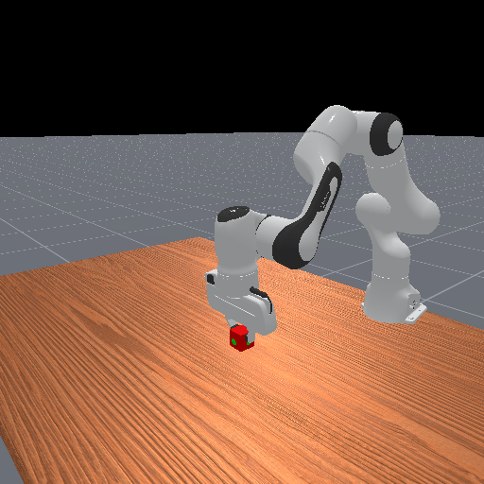
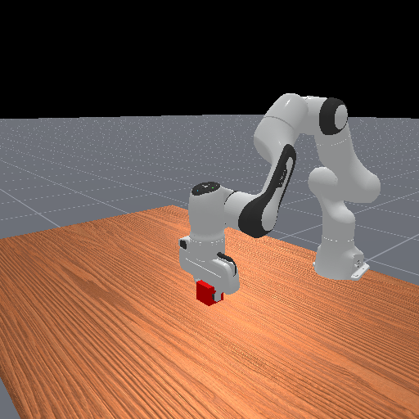

04 · FINDING 2 · COMPLETED
The full pipeline runs in simulation
Initial RGB image → mass estimate → supplied policy input → pick-and-lift execution.
4 cm cube
5 cm cube
6 cm cube
64.0 g → 62.32 g
125.0 g → 121.24 g
216.0 g → 212.45 g
actual mass → predicted mass
actual mass → predicted mass
actual mass → predicted mass
3 configured trials · 3 final successes · 50 actions per trial
One seed per size. Integration is demonstrated; estimation benefit and unseen-height adaptation remain untested.
Evidence: runs/deployment/20261022_014201_067220/summary.json, manifest.json, and final frames
ROBOT ADAPTATION / PI RESEARCH UPDATE
04 / 08
Notes:
Completed integration demonstration: three configured cases, one seed per cube size, each completed the full 50-action, 2.5-second rollout and ended with task success and a grasp. The 4, 5 and 6 cm cubes had masses 64, 125 and 216 g; predicted masses were approximately 62.32, 121.24 and 212.45 g. Across the three trials the mass MAE was 2.996986 g. The estimate remained fixed throughout each episode. Final continuous success lasted about 2.10, 2.10 and 2.05 simulated seconds. These images are actual saved simulation frames. This establishes that the components can run together. Three trials are not a reliability estimate, and there is no matched true-estimate-versus-fixed-estimate benefit comparison here. The run used a saved frozen-movement/independent-strength v1 checkpoint, not a newly trained policy that generalizes over initial object elevation. Source: runs/deployment/20261022_014201_067220/summary.json and manifest.json.

Slide 5
05 · PLANNED POLICY EXPERIMENT
TO BE DONE
Train pick and lift across object heights
Vary initial object elevation relative to the arm while keeping the task and grasp strategy consistent.
Training height h1
Training height h2
Training height h3
The robot base stays fixed. The object starts at different elevations.
First height study: control mass, friction, object geometry, and required lift clearance.
ROBOT ADAPTATION / PI RESEARCH UPDATE
05 / 08
Notes:
This is proposed work and has not yet been done. Train a pick-and-lift RL policy across initial object elevations relative to a fixed robot base, for example by changing the height of a physically supported object. The three symbolic heights are schematic, not a chosen numerical training schedule. Height here means the initial object/support elevation, not merely the final lift target. Existing training varies a floating goal height; that does not establish training over initial object elevations. Keep mass, friction and geometry controlled in the first height study and keep required lift clearance above the supporting surface consistent. Define reachability and collision validity before training. The aim is to establish a controller that can execute the same task from multiple initial heights. Generalization to held-out heights remains an empirical question.

Slide 6
06 · PLANNED DEPLOYMENT TEST
Deploy at a held-out initial height
Freeze the trained policy and provide environmental context estimated from deployment observations.
HEIGHT SPLIT: SCHEMATIC
held-out height
h1
h2
h*
h3
h4
Initial
observations
Estimator
(selected context)
Trained
policy
Pick-and-lift
execution
Report within-range held-out heights separately from heights beyond the training range.
Current estimator: mass. Estimator target for the height study still needs to be specified.
ROBOT ADAPTATION / PI RESEARCH UPDATE
06 / 08
Notes:
The proposed deployment test uses initial object heights that are excluded from policy training. The number line is a schematic of within-range held-out evaluation, not a result or a chosen numeric schedule. A withheld height interval is stronger than treating a previously unsampled floating-point value as meaningfully novel. Evaluate outside-range extrapolation separately. Keep policy and estimator weights fixed during evaluation and record what heights each model saw during training. Use initial observations to estimate the selected context. The present estimator predicts mass, not object height. It is still open whether the new estimator should predict height, physical properties while height tests policy generalization, or both. If it predicts height, remove simulator-true object heights and any derived height features from deployment policy inputs. If it predicts mass only, height generalization and mass-estimation quality are separate factors and should be described as such.

Slide 7
07 · PROPOSED TEST RULES
Separate policy capability from estimation
At each held-out height, compare the same frozen policy under three context inputs.
CONTEXT INPUT
QUESTION
True context
Can the policy execute at the unseen height?
Estimated context
How much performance is lost to estimation?
Fixed / incorrect context
Does useful context improve execution?
1
Reserve test heights before training.
2
Match physical scenes and starts.
3
Freeze models; predefine held success.
4
Remove true copies of estimated inputs.
ROBOT ADAPTATION / PI RESEARCH UPDATE
07 / 08
Notes:
Proposed protocol. First define training and test height sets or held-out bands. Do not tune on final test episodes. At each held-out height and matched physical setting, run the same frozen policy with true selected context, estimated context, and a fixed or deliberately incorrect context. Match seeds and robot starts across these context conditions. True context tests the trained policy’s capability without that estimation error; compare estimated context against it to expose the estimation gap. Fixed or incorrect context tests whether useful conditioning matters. Use repeated starts and report counts, success rates with uncertainty, estimation error, grasp loss and relevant force or timing metrics. Set the goal tolerance, required support-relative clearance, and final hold window before evaluation. Ensure estimated-context deployment observations cannot also expose simulator-true copies of the estimated variables, including derived relative-position values when height or pose is estimated. The existing state interface includes such geometry, so this must be addressed if height is the estimator target. No evaluation result is claimed on this slide.

Slide 8
08 · STATUS AND NEXT STEP
What we can say now—and test next
Current evidence supports the components; the proposed comparison must establish adaptation.
DEMONSTRATED
NEXT EXPERIMENT
Controlled image-to-mass estimate
Train across initial object heights
2.76 g MAE on held-out cube sizes
Establish policy capability with true context
Estimator-to-policy integration
Evaluate estimated context at held-out heights
Three configured full-horizon successes
Compare against true and fixed inputs
If true context fails: inspect policy capability and task feasibility.
If true context succeeds but estimates fail: inspect estimation and policy sensitivity.
Later stage: revise environmental estimates through interaction, success, and failure.
ROBOT ADAPTATION / PI RESEARCH UPDATE
08 / 08
Notes:
The defensible current claims are a controlled visual mass prior and a working integrated simulation pipeline for three configured cases. Neither proves that estimates improve execution relative to nominal inputs, nor that an RL policy generalizes over unseen initial object heights. The next experiment is to train across initial object heights, establish execution capability using correct context, and compare estimated and fixed context on matched held-out cases. If correct context fails, investigate policy generalization, task feasibility and control limitations before attributing failures to the estimator. If correct context succeeds but estimated context fails, investigate estimation errors and policy sensitivity to those errors. This is a diagnostic guide, not a unique causal identification claim. Later work can update estimates from interaction. For PI discussion, specify the estimator target, height split and evaluation criteria before running the proposed study.

