Slide 1
Robot learning / Research discussion
What can a robot remember
about a cube?
A simulated Panda arm interacts with cubes whose mass and friction can vary.
Two experiments examine different uses of physical information.
Forecasting motion
Remembering a mass estimate
How does supplied physics change a forecast?
What carries over to the next try with the same cube?
ManiSkill PickCube / Two archived experiments with a frozen motion policy
1

Slide 2
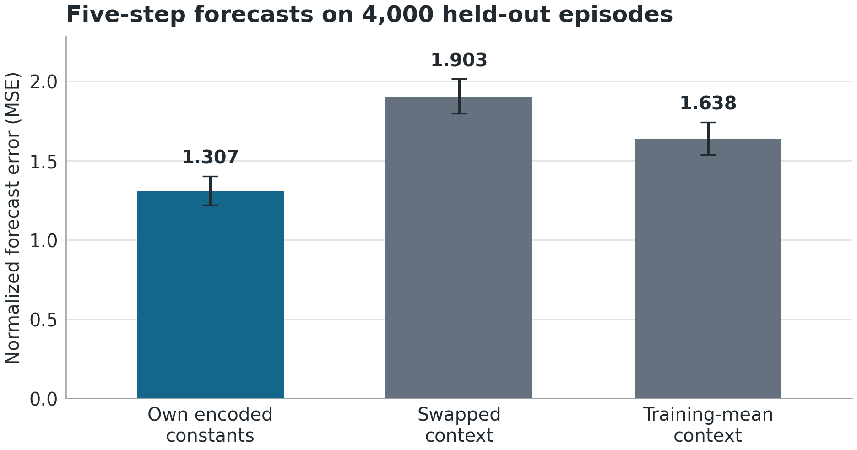
Experiment 1 / Forecasting
Supplied physics improved motion forecasts
45.6%
higher forecast error after
swapping the context
The context encoded ten true
simulator settings for the cube,
robot and table. The score
averages all steps, including
free motion.
MSE is mean squared prediction error. Whiskers show 95% intervals across whole episodes.
Source / PickCube world model with eight context values
2

Slide 3
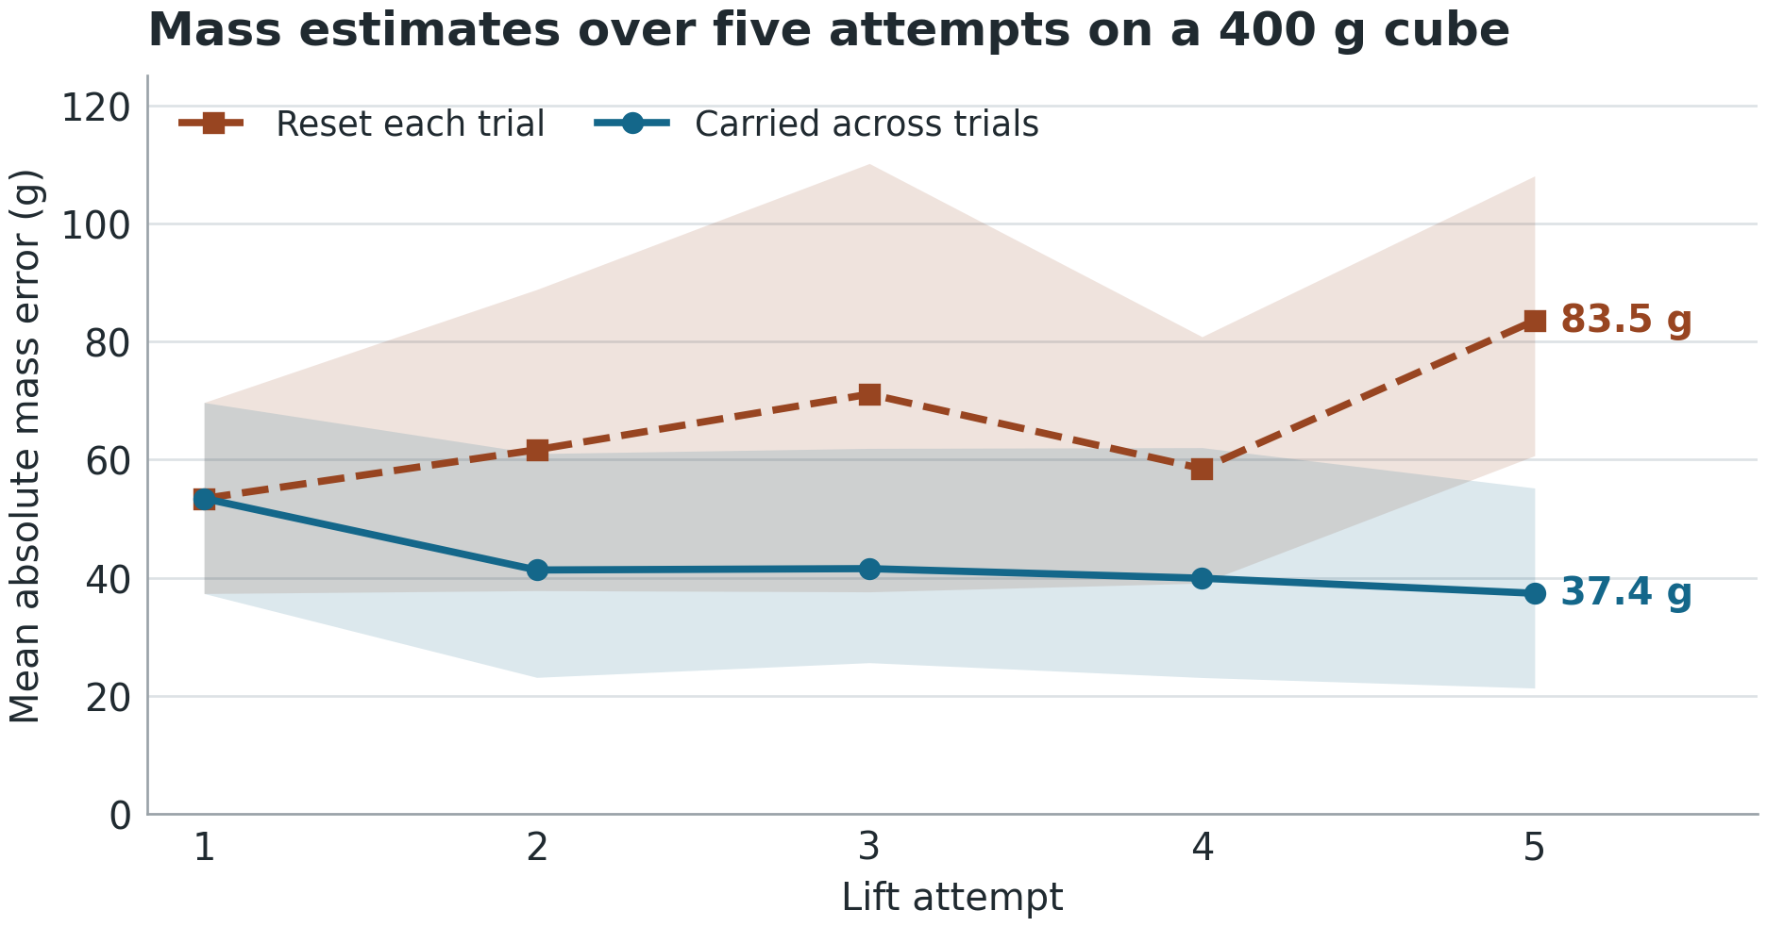
Experiment 2 / Retention
Reusing the estimate reduced fifth-trial mass error
46.2 g
less error on trial five
with the carried estimate
Paired 95% interval 14.6–73.7 g.
Both methods saw the same trials.
A frozen estimator used recent
commands, joint motion and
finger compression.
Bands show 95% intervals from resampling 12 complete sequences of five attempts each.
Source / Repeated lift attempts at friction 0.4
3

Slide 4
Open question / Proposed experiment
Will experience with earlier cubes improve
the first guess for a new cube?
What to vary
Draw new cubes from a mostly heavy population. Give each cube a
stable identity and record both pushes and lifts.
What to compare
Use earlier cubes’ inferred estimates to set a first guess. Compare it
with a fixed first guess on identical observations of each new cube.
What to measure
Score initial error and steps to a prespecified accuracy threshold.
Retain cubes that never reach it and report their count.
Planned comparison across new cubes
4

