Slide 1

Fire4S AI Resume Presentation

Slide 2

Team Members
Neo Mokoana Thokozani Maleka Oko Mwezo Koketso Raphasha Seeipati Sithole

Slide 3
overview
The presentation outlines the architecture and features of our AI Resume Builder.
We built a full-stack AI-powered resume generation platform that creates tailored, ATS-optimized, and job-matched resumes in minutes

Slide 4
Problem statement
Traditional Resume Builders Are:
Generic and static
Poorly optimized for ATS systems
Lacking Personalization or Job targeting
Users struggle with resume quality and relevance across industries

Slide 5
Solution Overview
A smart , responsive ,and adaptive platform that builds resumes , matched to job descriptions in real-time’ • Features: • AI-generated content • Job description match analysis • ATS-compliance checks • Smart suggestion loop • Export options: PDF, DOCX, HTML

Slide 6
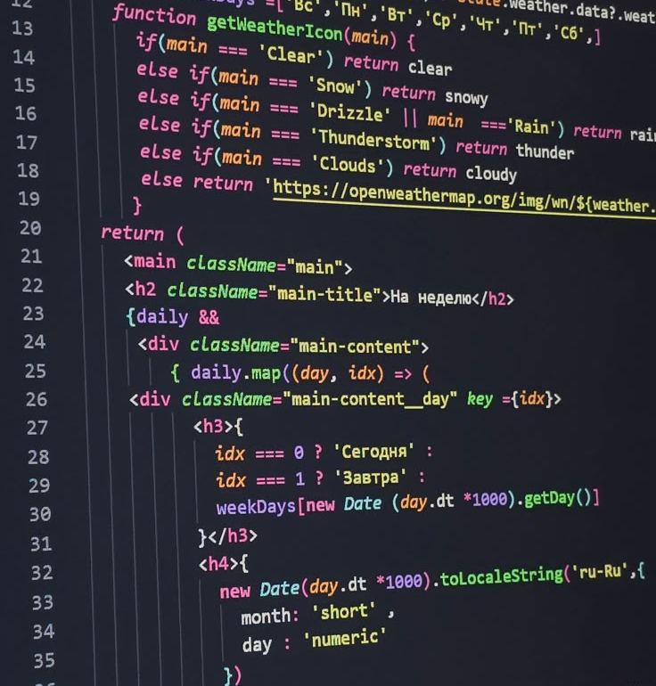
ARCHITECTURE OVERVIEW
Frontend (Html , CSS , JavaScript) Responsive multi-step UI, live preview, customization tools • Backend (Gemini API) Resume generation logic, JD matching engine, PDF/DOCX rendering • Deployment: GitHub

Slide 7
Api Integration
Goal :Seamlessly integrate OpenAI + internal ML to generate and refine resume content.
Content Generation Structures the content on the user imputes. Keyword Matching Jobs based on skills and on description.
ATS Checker It is ATS checker friendly and generates formal fonts, formatting, sections.

Slide 8
Conclusion
AI Resume Builder isn’t just a tool , it’s a career catalyst. • We combined the power of AI, UX, and software engineering to transform a traditionally painful process into a strategic advantage. • Designed with adaptability,and usability in mind. • Ready to scale, improve, and empower job seekers globally.

Slide 9
Demo Walk Through

Slide 10
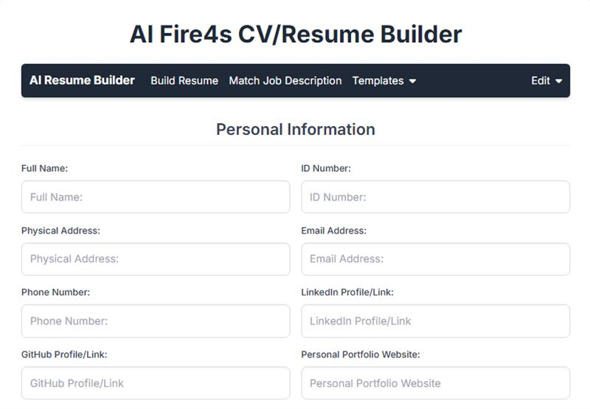

Slide 11
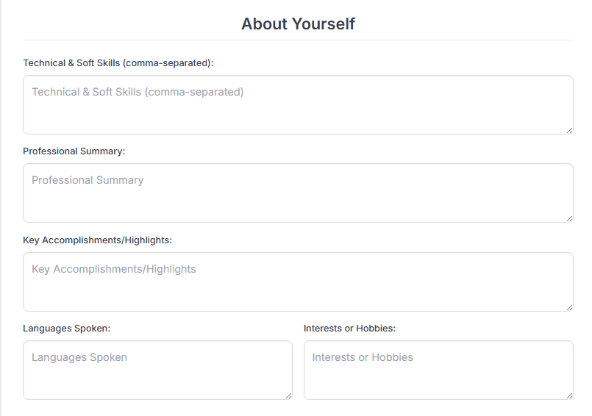

Slide 12
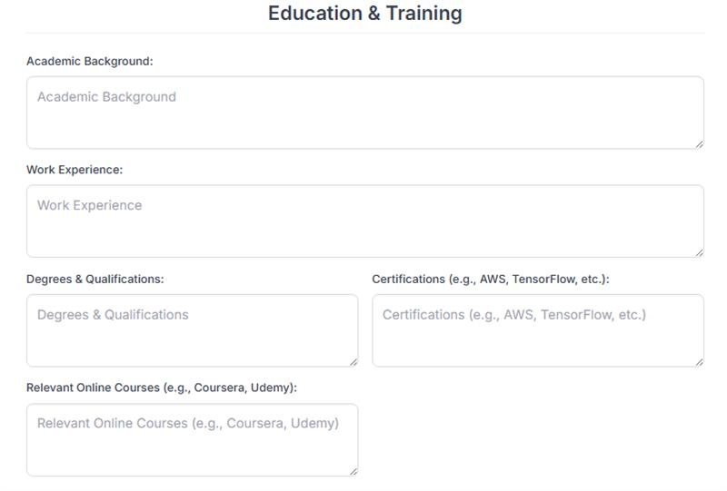

Slide 13
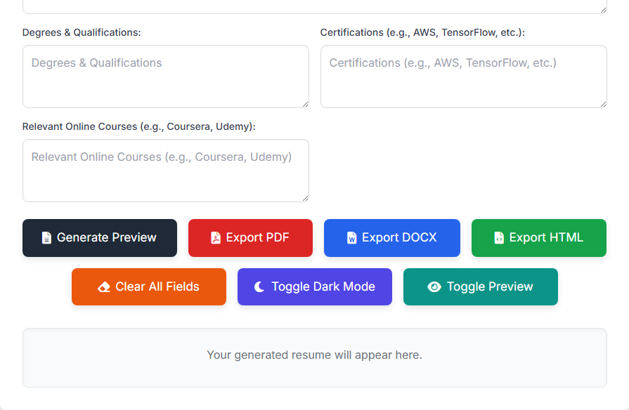

Slide 14
Thank You All
Created by Fire4s

