Slide 1

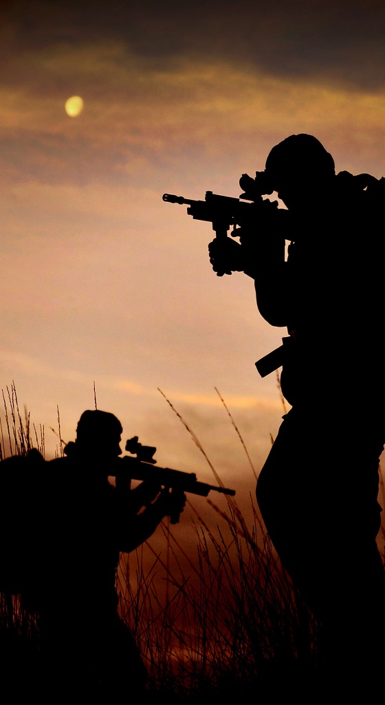
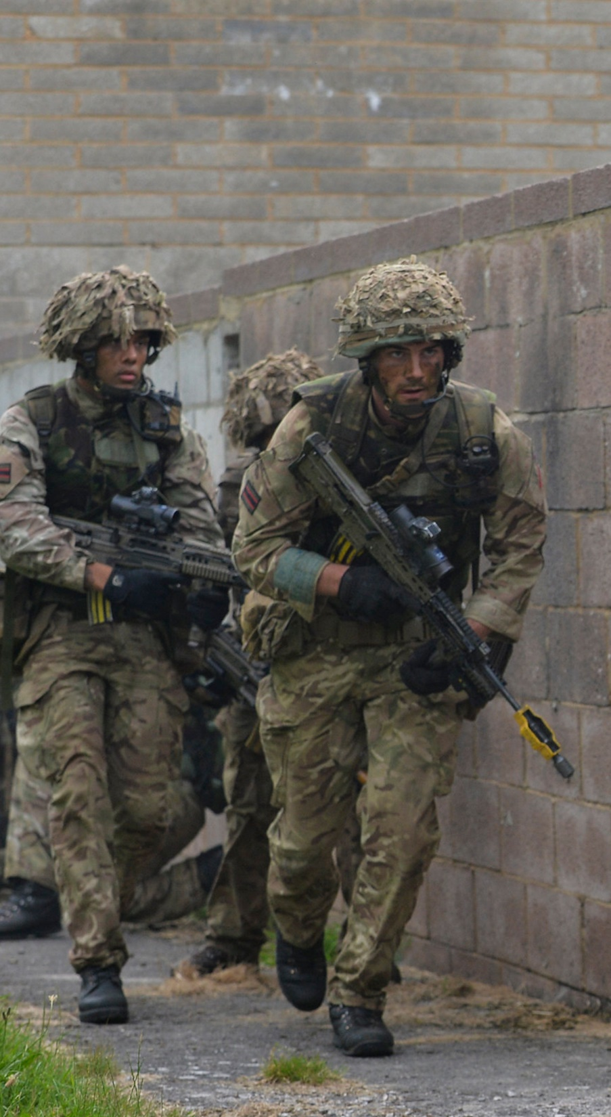
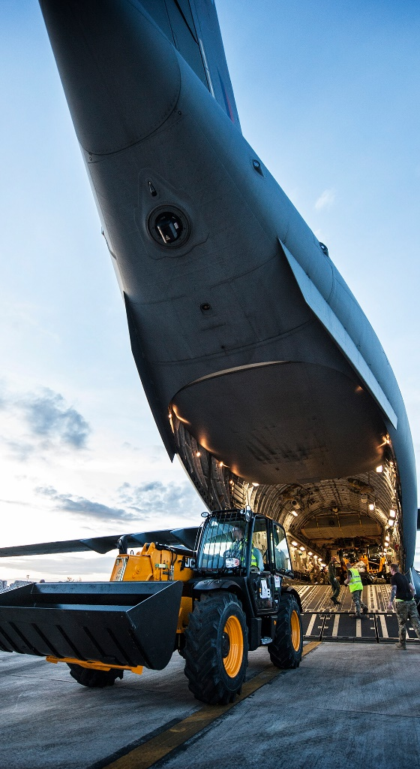
Armed Forces
Reserves Presentation
Notes:
Good morning/afternoon and thank you for the opportunity to speak to you today.
I am …….. (speaker intro, experience, operational and civilian.)
We would like to give you something today – a better understanding of what the Armed Forces Reserves – or the volunteer arms of the Army, Navy and Air Force – and in particular what membership of the Reserves could give to you personally.
Whilst we are here to inform you, and demonstrate the benefit of Reserve service, if at the end of the session it is not for you, that is not a problem: you will be better informed on what Reserve service does and we hope this will help you support Reservists and potential Reservists in your organisations.
There are 3 Reserve services Maritime Reserves (incorporating the Royal Naval Reserve and the Royal Marines Reserve), the Army Reserve and the Royal Air Force Reserves.
Each of these are currently recruiting spare-time personnel for a basic commitment of roughly 1 weekend a month and two weeks a year. This time is paid and on successful completion of annual training a tax free lump sum is paid on top of daily pay.
Today we will give a brief insight into what Reserve service entails, the benefits of Reserve service, and the options that are open to you.
(ONLY IF PRESENT) We have recruiter available from each service (CONFIRM WHO IS REPRESENTED) for you to speak to at the end of the presentation.
So who are we?
[CLICK] = NEXT SLIDE (The Reserves)

Slide 2

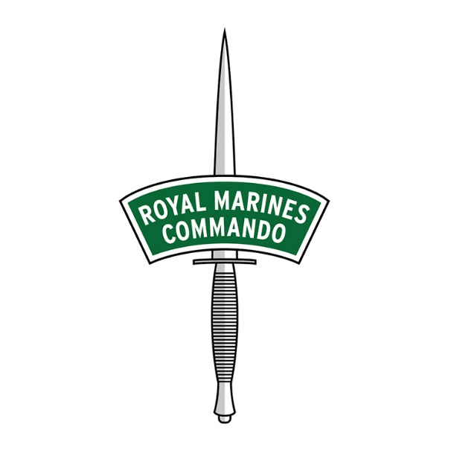


The Reserves
Notes:
Who are the Reserve Forces?
The Reserve Forces – known as Reservists – are ordinary men and women who give up their spare time to train and serve alongside the Regular forces.
Reserves make up a significant element of the nation’s total defence capacity and increasingly complement Regular Forces, and are called upon as individuals for specialist skills or as ready-formed units whenever required.
Reservists receive the same world-class training and develop the same skills as their Regular counterparts – which means they can carry out the same roles to exacting high standards.
NEXT SLIDE (Why we need Reserves)

Slide 3
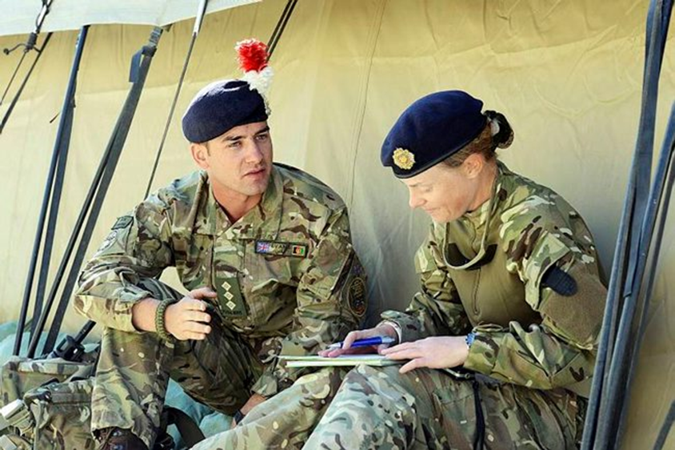
Why we need Reserves
Cost Effectiveness
  Maintaining regular force may not be best value for money.
  Certain specialist areas that are not practical or cost effective to maintain full time.
Specialist Capability
  Better access to skills and capabilities more readily available in the civilian sector.
Regeneration
  Strategic reserve for resilience and regeneration of our Armed Forces in case of national crisis.
Connecting with Society
Notes:
The requirement for the increase to the reserve force can be split into 4 main areas:
The maintenance of a pure Regular force may not be the most cost effective approach and could in fact reduce the overall capability of the force, owing to a reduced ability to react to emergent issues. Of particular note are specialist areas, such as cyber/media/medical, which may not be practical to maintain full time.
An appropriately skilled and diverse Reserve force enables access to skills and capabilities which may not be readily available in a Regular force.
A Reserve force also enables a strategic reserve for resilience and regeneration.
Finally, a Reserve force improves the links to society, through employers, individuals and their families.
[CLICK = NEXT SLIDE] (The Reserves Service Offer)

Slide 4
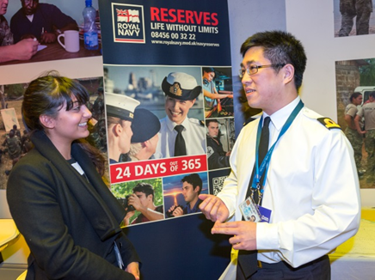
The Financial Offer
Paid to serve
(rates vary by rank)
Annual training bounty
Travel expenses
Access to learning credits
Access to pension
(from April 2015)
Paid leave
Notes:
CLICK x6:
Rates of pay vary according to rank and experience, details are available on the single Service websites.
Annual training bounty is a tax free sum paid on the completion of the financial years training commitment
Travel expenses - travel to and from training activity receives a financial contribution from the MOD
Access to learning credits
Access to pension (from April 2015)
Paid leave
[CLICK = NEXT SLIDE] (Commitment)

Slide 5

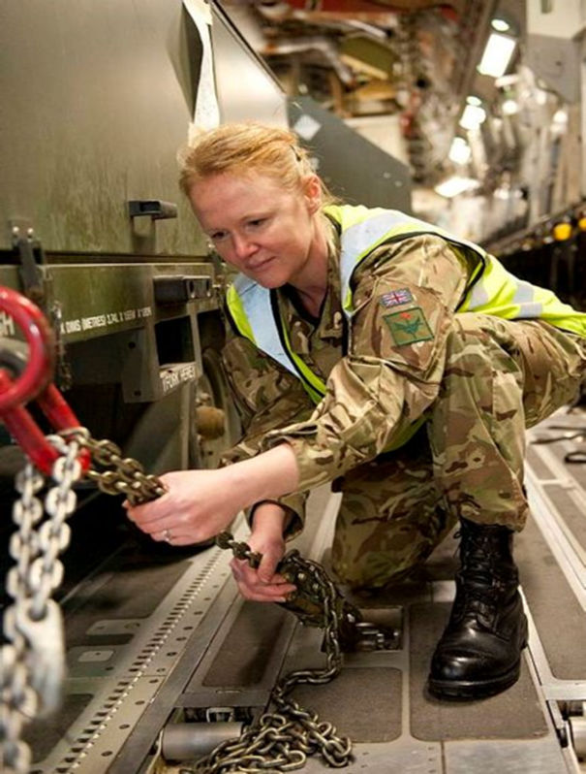
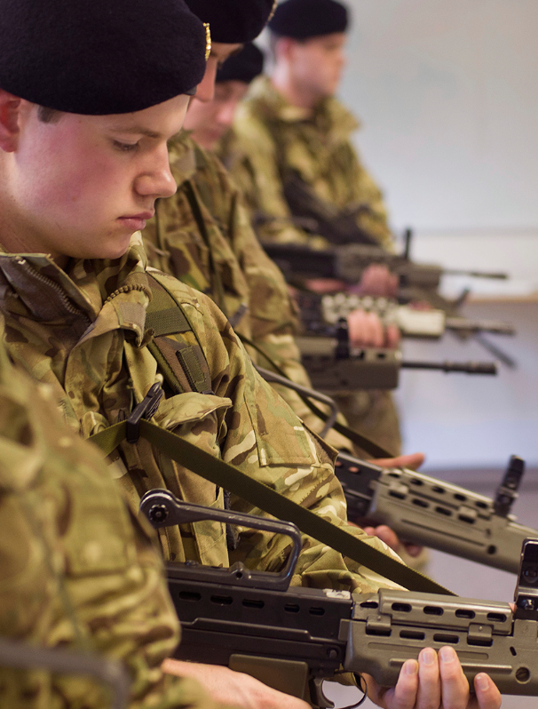

The Reserve Service Offer
Fitness, Sport & Adventurous Training
Develop new skills and gain qualifications
Train and work alongside regular forces
Get paid, with access to support & welfare services
Notes:
All members of the Reserve Forces undergo rigorous training which develops key skills that are transferable to, and of great value to the civilian workplace. Like leadership, teamwork and organisation. These skills form the foundations of not only a highly valuable Reservist, but also an invaluable member of your workforce.
Core skills - Teamwork, self-confidence, leadership qualities and experience of other cultures are highly-prized attributes that many Reservists develop. Undergoing training and serving on duty also develops resourcefulness, perseverance and the ability to cope with unfamiliar or difficult circumstances.
Personal skills - Training teaches individuals how to lead as well as how to work within a team, solve problems, communicate, present ideas and organise complex events or processes. This encourages reliability and integrity, developing confidence in abundance. Through the accreditation of military skills with their civil counterparts, you can pick up a range of qualifications of use to your career at no cost to you or your employer.
At the same time you make new friends, get fit and have a lot of fun!
[CLICK = NEXT SLIDE] (The Financial Offer)

Slide 6
The Commitment
Routine Commitment
Exceptional Circumstance
1 evening a week
1 weekend a month
2 weeks a year – training
Mobilisation
(up to 12 months including pre-training and post tour leave)
Routine commitment will usually be taken outside of work time (weekends and leave). Many employers grant additional paid or unpaid leave for Reserve service.
Mobilisation continues to be based on the need to meet operations.
Notes:
Reservists are incredibly committed and many train one evening a week with their units as well as attending training weekends throughout the year. They also take part in a two-week Annual Camp to consolidate their skills (or modular training courses of up to two weeks in total).
Opportunity exists to do more for those who wish to and have the spare time. Some Specialist units meet less often. Key is training is worked around your civilian life – it really does fit in with you.
[CLICK = NEXT SLIDE] (Recruitment Ages)

Slide 7

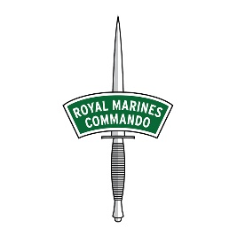


Recruitment Ages
Age – new entrants
16-40
16-32 (Marine)
17-49
18-50
Age – with previous military experience
16-56
16-51 (Marine)
17-51 (Officer)
18-57
18-56
Other Requirements: Must be a UK, Irish Republic or Commonwealth citizen, or Naturalised British Subject. Must have lived in the UK for the past 5 years and meet basic fitness and medical standards.
Notes:
So how old do I need to be?
This depends on whether you have or don’t have previous military experience from any of the Services. If you don’t, new entrants will have to be within the following age ranges:
16-40 for the Royal Navy Reserve
16-32 for the Royal Marines Reserve as a Marine. N.B. There is no direct entry to the RMR as an Officer.
17-49 for the Army Reserve – apply between ages 17yrs 9mths and 49yrs 9mths.
18-50 for the RAF Reserves
[CLICK] = If you do have military experience, in most cases you can be a bit older at point of entry than the new entrants:
Up to 56 for Royal Navy Reserve, and up to 51 in the Royal Marine Reserve
In the Army Reserve, you can join as old as 57 for previously commissioned officers. Otherwise, the upper age limit for Specialist Commissioning is 50
Up to 56 for ex-Regulars in the RAF Reserves
[CLICK] = There are other requirements too, in that you must be a UK, Irish Republic or Commonwealth citizen, or Naturalised British Subject. You must have lived in the UK for the past 5 years and as well meet the basic fitness and medical standards. See the website for the Service in question for the Fitness and Medical details.
[CLICK= NEXT SLIDE] (Reserves in the Civil Service)

Slide 8





Reserves in the Civil Service
Professional & Personal Development
Challenges, Adventures & Rewards
Leadership and Management Accreditation
Additional Paid Annual Leave
Yearly Tax-Free Bonus
Notes:
The Government values the benefits that Reservists bring to their workplace, including the development of transferable skills. Reserve service is challenging, rewarding and presents opportunities that you can’t find anywhere else.
So what can you gain from the Reserves and how does it benefit those of the Civil Service?
[CLICK] = Professional & Personal Development
Joining the Reservists will equip you with new, transferable skills and strengths to take into your civilian life.
[CLICK] = Challenges, Adventures & Rewards
A Reservist role is both challenging and rewarding. You could travel to new countries and enjoy adventure that you wouldn’t find anywhere else.
[CLICK] = Leadership and Management Accreditation
Through the Reserves you can attain leadership accreditation from CMI, City and Guilds and the Institute of Leadership and Management.
[CLICK] = Additional Paid Annual Leave
As a Civil Servant, the Government will grant up to an additional 15 days paid annual leave to accommodate you for your Reservist commitments.
[CLICK] = Yearly Tax-Free Bonus
By joining the Reserves you are eligible for a tax-free bonus that will increase annually over 5 years.
[CLICK NEXT SLIDE] (The Reserves)

Slide 9
The Reserves
Notes:
Each of the services has a number of trades that are very similar: medics, drivers, security protection, chefs, mechanics, physical training instructors etc. So its a personal choice which organisation you select. This could be closest to home or work, or perhaps a family connection to a particular Service (parents/grandparents service).
Much of the Service training is delivered in a tri-Service environment so the end product is very similar. And they are changing all the time. You may have heard of the Joint Cyber Reserves, made up of 100% Reservists? This new unit uses individuals specialist information technology expertise to deliver a military need using cutting edge skills and equipment.
Each Service will also have specialisations not found elsewhere in Defence. We would like to give you a quick rundown of what these include.
[CLICK = NEXT SLIDE] (Maritime Reserve)

Slide 10


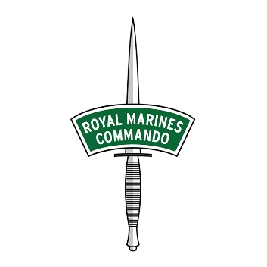
Maritime Reserve
Join the ‘trained strength’ of the Naval Service on completion of training
The primary roles of the Maritime Reserves are:
  Mobilise in support of operations
  Provide training exercise enablers
  Provide niche capabilities
  Connect with the nation (Royal Navy in the Public Eye)
The Maritime Reserve does not provide standing formed units. Personnel are employed in small teams or as individuals to support their regular counterparts.
Notes:
After you complete training, you can join the ‘trained strength’ of the Naval Service.
[CLICK] = The primary roles of the Maritime Reserves are:
Mobilise in support of operations.
Provide training exercise enablers.
Provide niche capabilities.
Connect with the nation (Royal Navy in the Public Eye).
[CLICK] = The Maritime Reserves do not provide standing formed units. Personnel are employed in small teams or as individuals to support their regular counterparts
16 RNR Units/Divisions and 17 RMR Units/Detachments nationally
Recruit locally – offering a variety of roles and specialisations
Units undertake initial training (jointly with lead RN/RM establishment/school)
Unit maintains through-life support of Reservist
Specialist training through lead Naval Service establishments
Transfer between Units allowed (in case of relocation of individual)
[CLICK = NEXT SLIDE] (Navy Specialisations)

Slide 11
Royal Navy Reserve Specialisations
General Entry:
Seaman
Logistics
Mine Warfare
Communications
Information Operations
Submarine Operations
Maritime Trade Operations
By Selection: Intelligence, Diver
With Prior Experience:
Amphibious Warfare
Chaplain
Cyber Operations
Engineering
Media Operations
Medical Officer
Nursing Officer
Nurse
Notes:
Starting with General Entry, these are the specialisations within the Royal Navy Reserve:
Seaman
Logistics
Mine Warfare
Communications
Information Operations
Submarine Operations
Maritime Trade Operations
CLICK = By Selection
Intelligence
Diver
CLICK = With Prior Experience
Amphibious Warfare
Chaplain
Cyber Operations
Engineering
Media Operations
Medical Officer
Nursing Officer
Nurse
CLICK = NEXT SLIDE (Royal Marines Specialisations)

Slide 12

Royal Marine Reserve Specialisations
Commando Rifleman
Fire Support (Machine guns)
Indirect Fire (Mortars)
Heavy Weapons
Landing Craft
Assault Engineers
Combat Intelligence
Military Stabilisation Support Group
Special Boat Service
Notes:
Specialisations in the Royal Marine Reserve Specialisations
[CLICK = NEXT SLIDE] (Army Reserve Specialisations)

Slide 13

Army Reserve Specialisations
Combat
Engineering
Driving, Logistics & Support
Intelligence, Cyber, IT & Communications
Human Resources & Finance
Medical
Policing
Music & Ceremonial
Notes:
The Army Reserve is the largest of the Reserve Forces and provides support to the Regular Army at home and overseas. It has two clearly defined roles. Firstly, it provides highly trained soldiers who can work alongside the Regulars in the UK and overseas. Secondly, it gives people who have specialist skills, like medics and engineers, a range of exciting opportunities to use them in new ways.
The primary roles of the Army Reserve are to provide:
Highly trained soldiers to work alongside regulars in the UK and overseas.
Individuals with specialist skills (e.g. medical and engineers) a range of opportunities to use the skills in new ways.
Over the coming years the role of the Army Reserve will expand and they will be employed even more closely with the rest of the Army. This will lead to greater opportunities for those that enjoy the challenges that come with being a Reservist.
CLICK = NEXT SLIDE (Army Reserve Recruitment)

Slide 14
Army Reserve Recruitment
Regionally recruited:
Recruit local to you
Variety of the roles
Minimum of 27 days training a year
Nationally recruited:
Recruit across the UK
Greater use of civilian skills in a military setting
Reduced time commitment (min 19 days)
Increased upper age limit for recruitment
Notes:
For Army Reserve your time commitment will vary, depending on the type of unit you join:
CLICK =
Most of these units recruit locally; they make up the majority of the Army Reserve and have centres in most areas, so finding one near to you shouldn’t be difficult. Army Reserve soldiers serving in Regional Units complete a minimum of 27 days training a year.
CLICK =
However there are also nationally recruited units where their members are recruited from a wide geographical area. They specialise in a very specific role or trade, such as logistics, IT, communications or medical services. Members of National Army Reserve units attend centrally-located training centres of the specialisation they join.
Because of the travel involved, members of these units have a lower level of commitment and complete 19 days training a year, divided between two to three weekends and an annual two-week camp. There are also some highly-specialised National Units, dealing with such areas as media relations, chaplaincy and civil/military liaison. They are structured and operate in the same way as other National Units, although their training commitment may be the same as for a Regional Unit
CLICK = NEXT SLIDE (RAF Reserves Specialisations)

Slide 15


RAF Reserves Specialisations
Air Operations Support
Communications & Intelligence
Force Protection & Policing
Logistics
Medical & Medical Support
Personnel Support
Technical & Engineering
Notes:
The primary roles of the Royal Air Force Reserves are to provide:
Trained personnel in support of operations.
Training exercise enablers.
Niche capabilities to support the Royal Air Force.
The RAF Reserves do not provide standing formed units. Personnel are employed in small teams or as individuals to support their regular counterparts.
Units are located throughout the UK and most offer a variety of roles and specialisations.
21 locations throughout the UK.
Each with a variety of trades and roles.
Flexibility to easily move between units if required.
Regularly used to support the RAF as part of the whole force approach.
[CLICK = NEXT SLIDE] (Length of Training)

Slide 16
Length of Training
3 weekends
1 week weapon training course
2 week confirmation course
5 weekends
2 week course
7 weekends
2 weeks Reserve Forces Commando Course
6 modules
4 weekends
2 week course
2 week trade course
4 weekends
2 week course
1 weekend
Notes:
Initial training for all of the elements takes place over a series of weekends and a two week course. This will count as your first annual training camp, this training will take place at your local unit and training establishments.
Travel expenses are paid for attendance.
[CLICK = NEXT SLIDE] (Officer Training)

Slide 17
Officer Training
Initial training with officer focus
4 weekends and 2 weeks Sea Time
Post Fleetboard - Initial Warfare & Leadership modules
Normal initial training for Royal Marines Reserve
Recommendation by Commanding Officer
Bespoke training by Unit and Commando Training Centre
4 modules over
several weekends
3 week course
Post Command modules
Basic Training
Followed by 4 weekends
2 week course
Notes:
Initial training for all of the elements takes place over a series of weekends and a two week course. This will count as your first annual training camp. this training will take place at your local unit and training establishments. Travel expenses are paid for attendance.
As you can see, officer training takes a bit longer. Initial Officer training for all of the elements takes place over a series of weekends and a slightly longer residential courses. These will count as your annual training camp. Travel expenses are paid for attendance.
CLICK = Next Slide (Find out more)

Slide 18

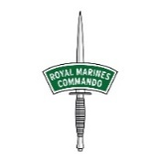



Find out more…
Questions?
www.royalnavy.mod.uk/rnr
www.royalnavy.mod.uk/careers/skills-and-specialisations/royal-marines-reserve
www.army.mod.uk/reserve/31781.aspx
#jointhereserves
www.raf.mod.uk/recruitment/lifestyle-benefits/life-as-a-reserve/
Or Search Online: ‘Reserves’
Notes:
So that concludes this presentation.
We’d like to open the floor to the questions, but do speak with the recruiters (IF PRESENT ) here after we finish so you can have your more specific questions answered.
All the Reserve forces have their own websites too, which can be found at these links. Alternatively, just search online for ‘Reserves’.

