Slide 1
Our approach to risk
Bryan Horne
Associate Director, Standards for Vocational
Qualifications and Apprenticeships

Slide 2
In this session
Regulating in line with the Hampton Principles
Our overall risk approach
Details of the approach
Supervisory Regime
How we use our risk understanding
‘A perfect storm’
Discussion

Slide 3
Regulating in line with the Hampton Principles
Regulators, and the regulatory system as a whole, should use comprehensive risk assessment to concentrate resources on the areas that need them most
No inspection should take place without a reason
Businesses should not have to give unnecessary information, nor give the same piece of information twice
The few businesses that persistently break regulations should be identified quickly, and face proportionate and meaningful sanctions

Slide 4
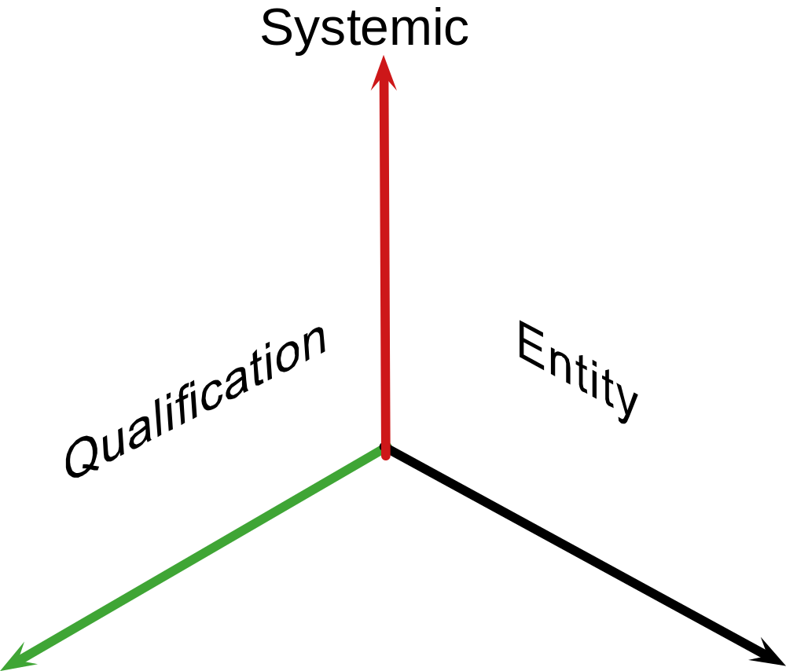
Risks that we consider
We consider 3 classifications:
Systemic
Risks that affect multiple organisations or qualifications
Entity
Risks posed by individual organisations
Qualification
Risks relating to specific qualifications or types of qualification

Slide 5
How entity risk works
Profiles are produced for all AOs based upon a variety of information The profiles contain two parts:
Impact
Reflecting the potential scale of regulatory issues we examine the qualifications each awarding organisation offers, the numbers of learners and other factors such as public funding.
Likelihood
Based on experience and available information we identified risk indicators that can help suggest whether issues may arise in an awarding organisation. We test each organisation against this selection of indicators.

Slide 6
Examples of ‘likelihood’ indicators
Inactive awarding organisations
Based on whether the number of certificates awarded is significantly different from previous periods.
Number of event notifications
Based on data modelling, the number of event notifications is significantly greater or lesser than the number expected.
Variation in the number of certificates awarded
Based on whether the number of certificates awarded is significantly different from previous periods.

Slide 7
What entity profiles are and are not
Entity profiles are | Entity profiles are not
Evolving | Comprehensive
A consistent starting point | A quality mark
One source of many | Determinative
Time limited | Everything that we are concerned about
A collation of key information | A tool for identifying non-compliance

Slide 8
Next steps for entity profiles
We will be issuing risk profiles to you in mid-2016 alongside further explanation of the approach we use.
We will continue to develop the profiles. For instance forthcoming work to align the qualification portfolio and risk assessment components.

Slide 9
Supervisory regime
Ofqual writes rules in furtherance of our objectives and in line with our duties
We enforce our rules by putting a supervisory regime in place
This regime allows us to:
  build intelligence
  understand and quantify risks
  gather evidence
  Investigate
  take enforcement action where appropriate and proportionate
By effectively using it, we can also consider the appropriateness of our rules and guidance
We can also seek to influence where appropriate

Slide 10
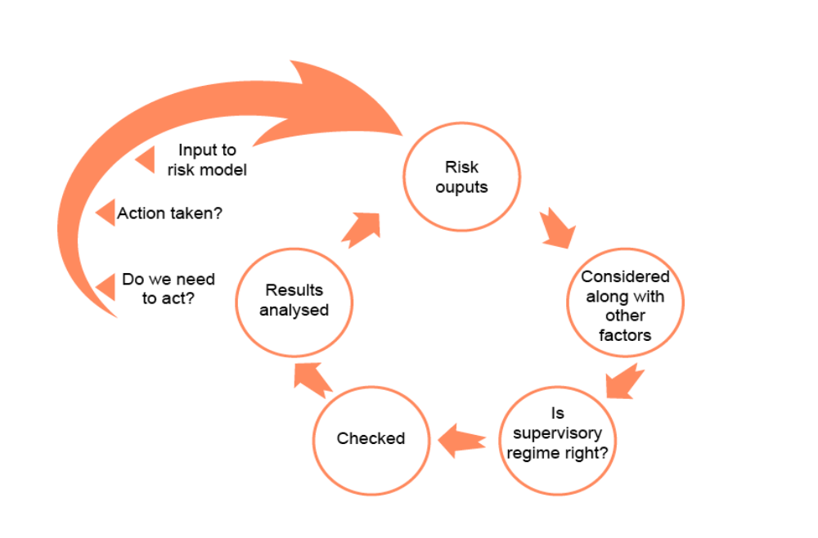
Targeting risks

Slide 11
A perfect storm
Centre agreement in place but ineffective and not routinely monitored
Short course and high volume – leading to qualification assessed on site, in a day
Usually delivered and assessed on an on-demand basis – hired venues
Learner funded – no public funding supporting delivery (no external audit scrutiny, inspection)
Direct claims status
Qualification leads to job – in essence a ‘licence to practice’
Peripatetic assessors

Slide 12
Discussion
What risks concern you?

