Slide 1




Achieving Progress for Suppliers: Building Fairness and Securing Change
Working Together, Making Progress
Annual Report
March 2015
#GCA2016

Slide 2
Statutory reporting requirements
The GCA Act 2013 sets out the information we must report:
Statutory report
Disputes referred to arbitration under the Groceries Supply Order | Two requests in reporting period adding to two initiated in previous years. Two concluded; two remain underway
Investigations carried out by the GCA | GCA concluded its first investigation, into Tesco plc, on 26 January 2016
Cases in which the GCA has used enforcement measures | GCA issued five recommendations to Tesco plc
Recommendations made to the CMA for changes to the Code | None
But we have achieved so much more ...

Slide 3

Promoting the work of the GCA

Slide 4
Providing advice and guidance
Policy:
  Interpretative guidance, best practice statements and retailer voluntary commitments
  Revised GCA arbitration policy and statutory guidance
Best practice statements on:
  Forecasting
  Consumer Complaints

Slide 5
Acting on supplier issues: working with CCOs
Quarterly meetings with each CCO and 3 meetings with all CCOs together
  CCOs update GCA on progress on Top 5 issues
  Extra meeting for all CCOs together post Tesco investigation report

Slide 6
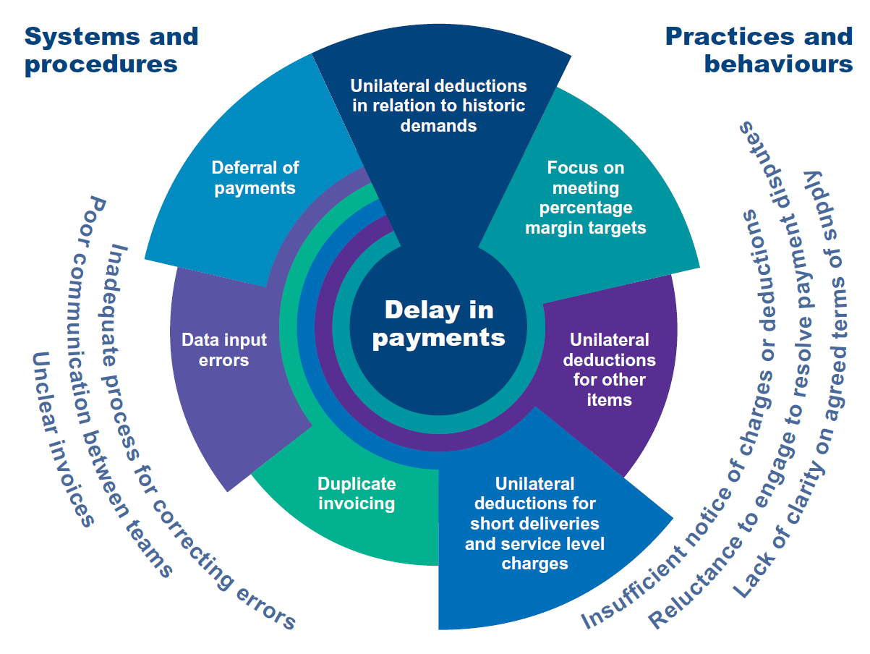
Acting on supplier issues: Tesco investigation

Slide 7
Tesco investigation: my recommendations
Money owed to suppliers must be paid in accordance with the terms agreed
Tesco must not make unilateral deductions – 30 days for suppliers to challenge proposed deduction
Data input errors identified by suppliers must be resolved promptly – within 7 days
Tesco must provide transparency and clarity in its dealings with suppliers
Tesco finance teams and buyers must be trained in the investigation findings

Slide 8
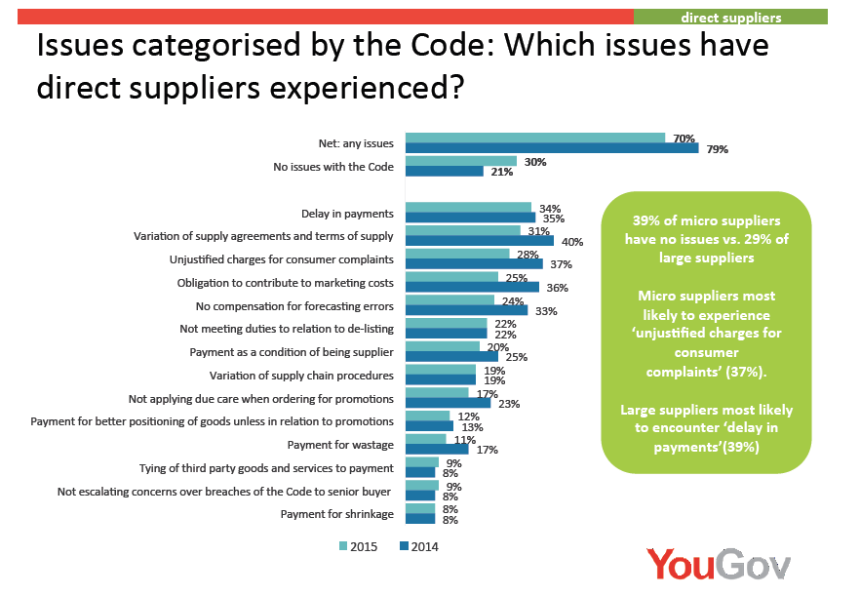
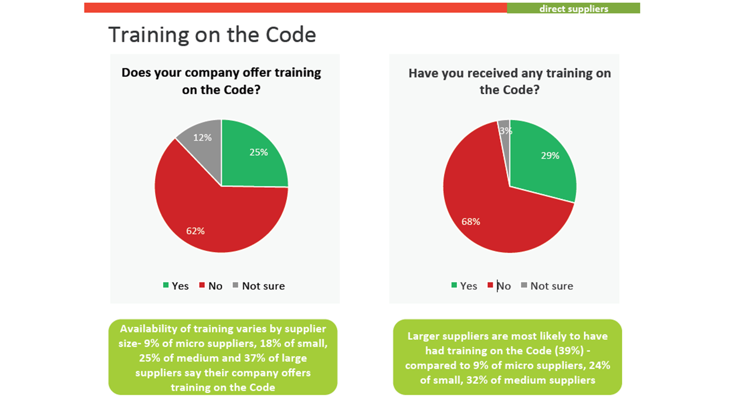
Acting on supplier issues: 2nd survey

Slide 9
Improving the culture of compliance
Visited retailer head offices to meet with CEOs, buyers and others and to review training
Held Audit Committee chairs meeting to discuss thematic issues arising from Annual Compliance Reports
Reinforced that I expect GCA and Code issues to be discussed at Board level
Focused on culture in Tesco investigation

Slide 10
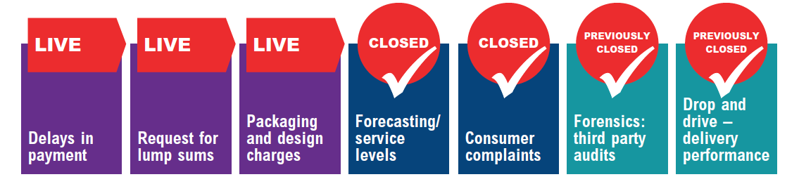
Building Fairness and Securing Change
Top five issues
Working Together, Making Progress
Annual Report
March 2015

Slide 11
Forecasting & service levels – now closed
Why an issue?
  Inaccuracies in retailer forecasting; suppliers claim they bear all the risk from poor forecasts
How is this Code related?
Paragraph 10: Compensation for forecasting errors
What has the GCA done?
  Published best practice statement: closer collaboration, work to improve forecasts, review accuracy and check before applying penalties, fairly share risk with supplier.
  Continues to monitor.

Slide 12
Consumer complaints – now closed
Why an issue?
  Concerns that retailers may be overcharging for dealing with complaints
How is this Code related?
Paragraph 15: No unjustified payment for consumer complaints
What has the GCA done?
  Published best practice statement: ensure suppliers know basis of charges, inform suppliers of issues within 5 days and resolve more complaints in-store to keep costs down.
  Continues to monitor.

Slide 13
Packaging and design charges
Why an issue?
  Claims of unreasonable charges; multiple changes in packaging design; rising charges for photography
How is this Code related?
Paragraph 6: No obligation to contribute to marketing costs
Paragraph 11: No tying of 3rd party goods and services for payment
What has the GCA done?
  Supplier workshop revealed concerns mainly with artwork and design charges and few on packaging.
  Reviewed retailer information on charging policies
Notes:
I

Slide 14
Requests for lump sums
Why an issue?
  Requests for lump sums linked to margin maintenance; payments for better positioning; pay to stay arrangements
How is this Code related?
Paragraph 3: Variation of Supply Agreements and terms of supply
Paragraph 9: Limited circumstances for payments as a condition of being a Supplier
What has the GCA done?
  Decided to consult on payments for better positioning.
  Continues to clarify with CCOs.
  Needs to learn more from suppliers.

Slide 15
Delay in payments
Why an issue?
Deduction from money due to suppliers for delivery performance, duplicate invoices, current and historic promotions without supplier agreement; delay in paying entire invoice when only part is disputed
How is this Code related?
Paragraph 5: No delay in payments
What has the GCA done?
Reviewed undisputed payments and established 94% on time,
99% within 7 days of being due.
Report of Tesco investigation sets out how GCA will interpret a
range of practices which lead to delay in payments.

Slide 16
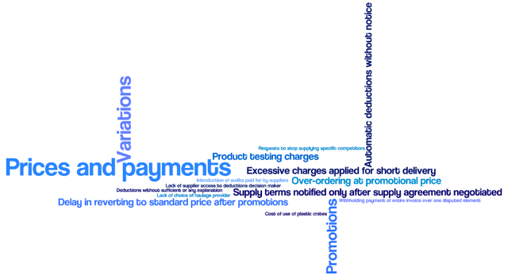
Many issues still being experienced

Slide 17
www.gov.uk/gca
Working Together, Making Progress
Annual Report
March 2015
#GCA2016

