Slide 1



Driving effective compliance
risk management
Christine Tacon
24 June 2019
@UKGCA
#GCA2019

Slide 2
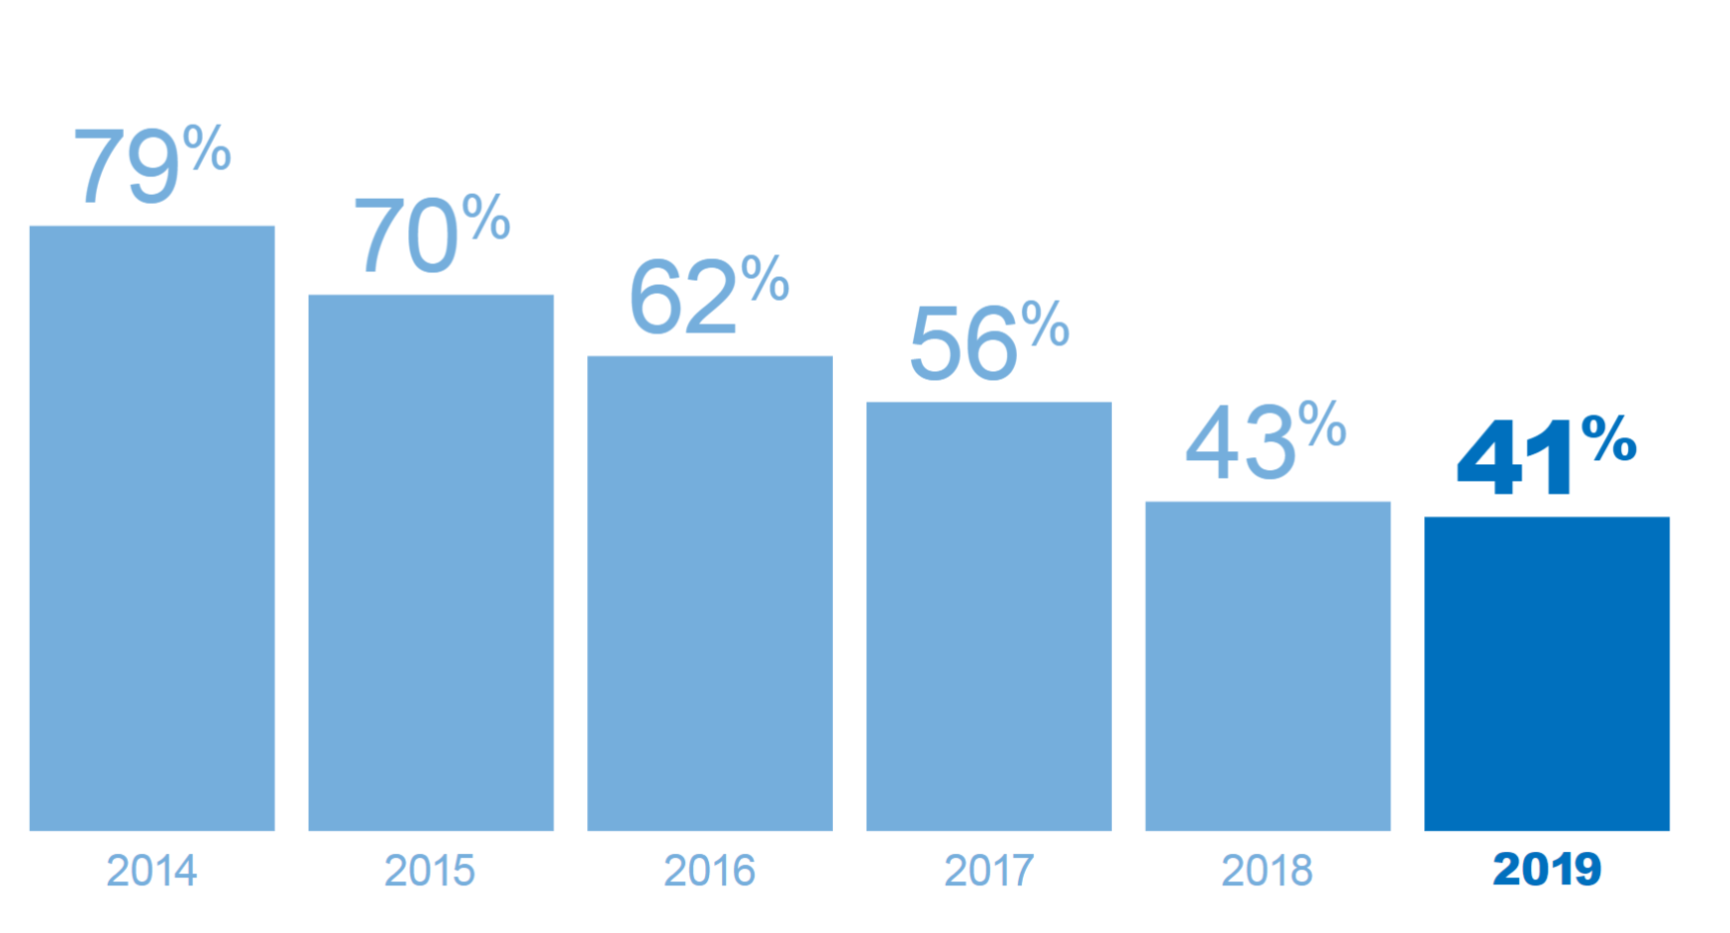
Suppliers experiencing Code-related issues

Slide 3
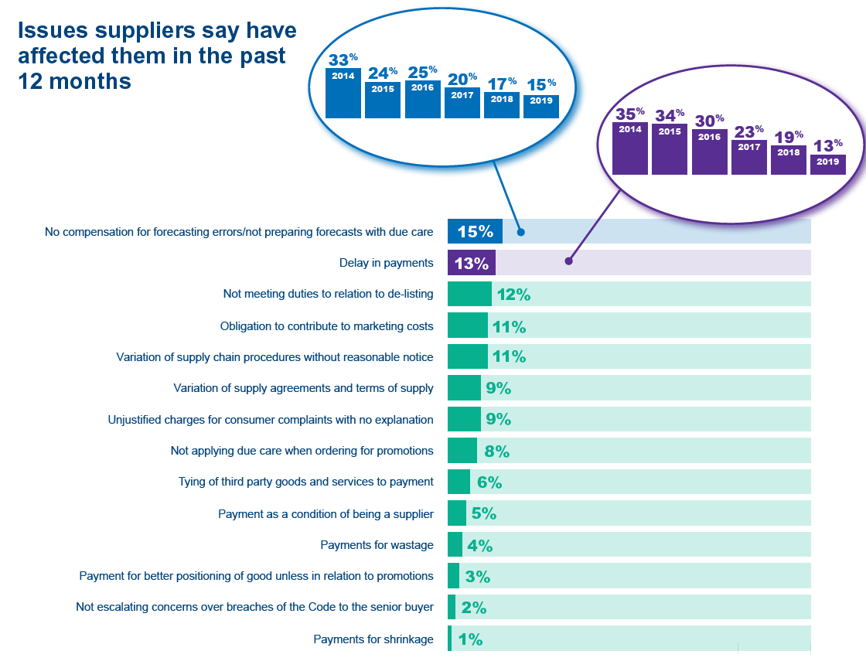
Issues suppliers experienced in the past 12 months

Slide 4
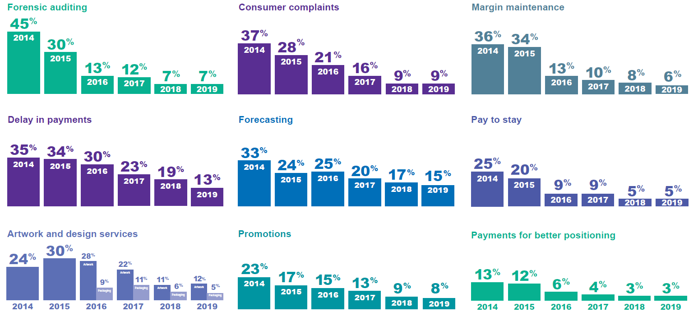
Progress on Top Issues since 2014

Slide 5
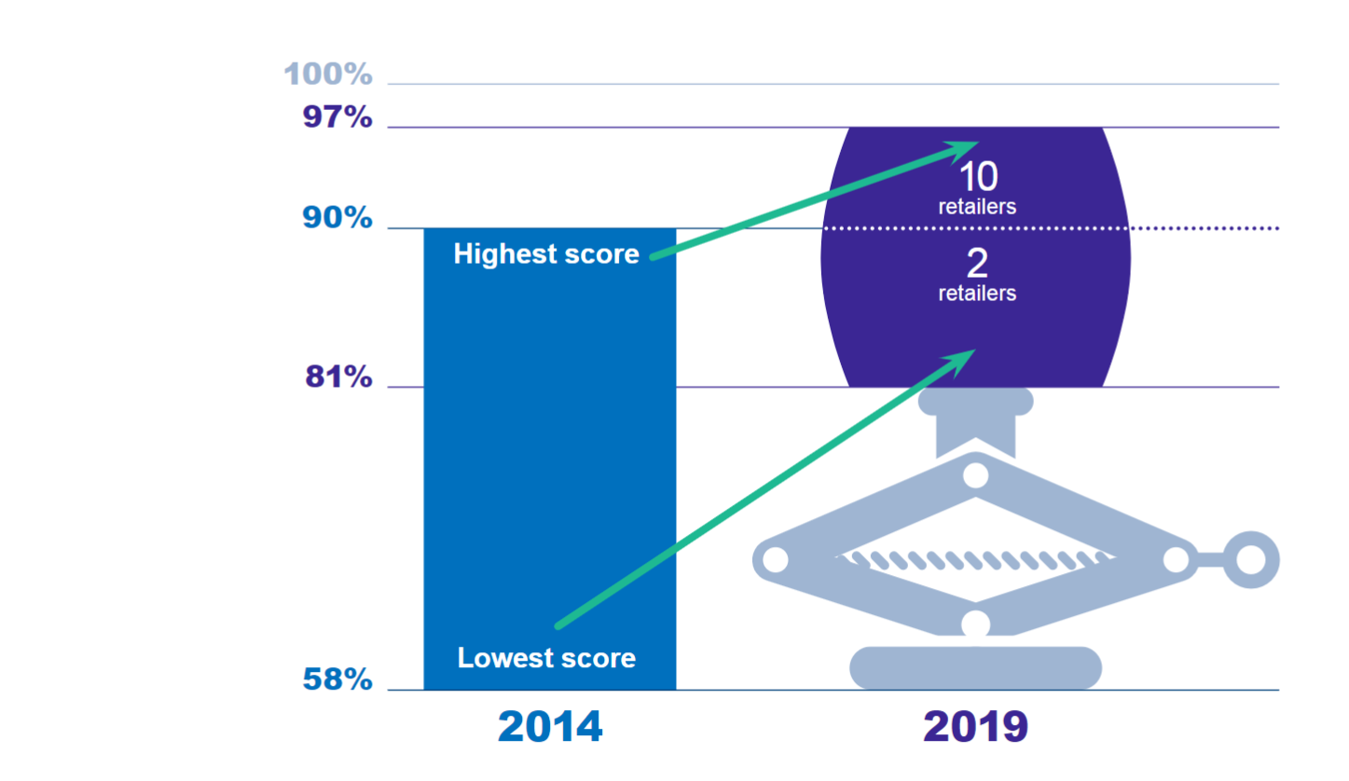
Overall assessment of retailers’ compliance with the Code

Slide 6
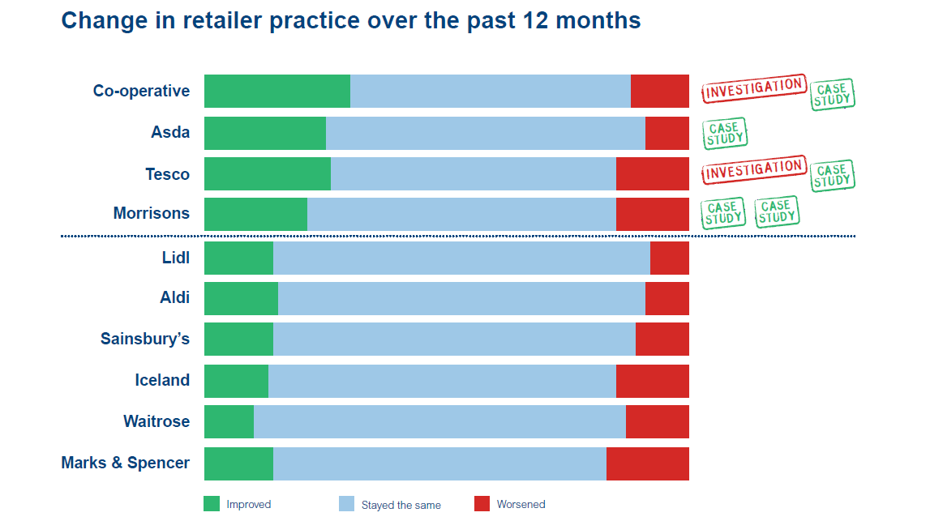
Change in retailer practice over the past 12 months

Slide 7
Retailer focus for the year ahead
 | Retailer 1 | Retailer 2 | Retailer 3 | Retailer 4 | Retailer 5 | Retailer 6 | Retailer 7 | Retailer 8 | Retailer 9 | Retailer 10 | Retailer 11 | Retailer 12
Incurring significant costs when cause is inaccurate forecasting by the retailer
Inadequate processes and procedures in place to enable invoice discrepancies to be resolved promptly
De-listing, including significant reduction in volume without giving reasonable notice
Not allowing time (30 days) to challenge proposed invoice deductions, or deducting even if challenged
Requirement to predominantly fund the cost of a promotion
Data input errors (e.g. pricing) not resolved promptly (7 days)
Drop and drive: delays in, or not receiving, payment when there are disagreements over deliveries
Undisputed invoices not paid according to agreed terms
Unfair, unreasonable or unexpected charges for artwork and design
Retrospective changes to supply agreements
Variation of supply chain procedures without reasonable notice
Unilateral changes to supply agreements/terms of supply by retailers without reasonable notice
Unjustified charges for consumer complaints with no explanation

Slide 8
Monitoring Top Issues
7
Retailers
1 Retailer
2
Retailers
3 Retailers

Slide 9
Next steps on Top Issues
Continue working with two of the original 10 retailers on delay in payments
Work with additional designated retailers on all areas
  prioritising delay in payments, forecasting and areas from survey results
Ocado and Waitrose have agreed to make the voluntary commitment to time limit forensic audits

Slide 10
The route to culture change
Tough, honest conversations
Tough, honest conversations
Prompt remedial action
Getting to the heart of issues and their root causes
Long-term change for the better within retailers
Long-term change for the better within retailers
Prompt remedial action
Getting to heart of issues and their root causes

Slide 11
Development of regulatory approach
Go / No Go areas -
practice-based

Slide 12
Development of regulatory approach
Systemic issues and practices
Go / No Go areas -
practice-based

Slide 13
Development of regulatory approach
Embedded Code compliance
Systemic issues and practices
Go / No Go areas -
practice-based

Slide 14
A self-regulating system of Code compliance?

Slide 15

A self-regulating system of Code compliance?

Slide 16
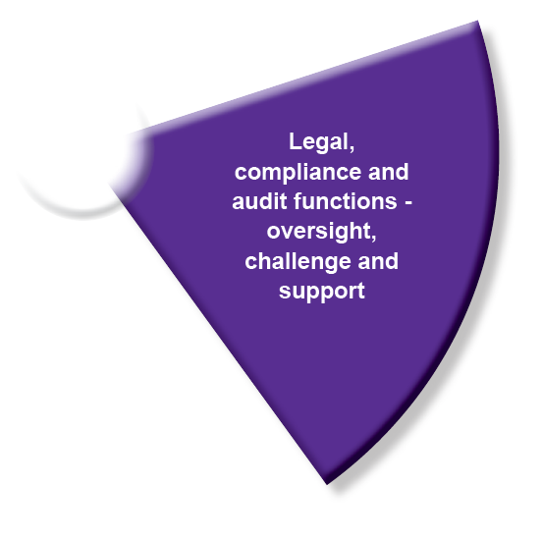
A self-regulating system of Code compliance?

Slide 17
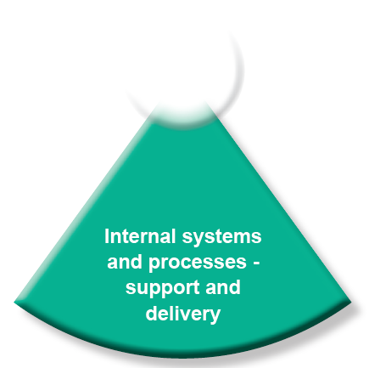
A self-regulating system of Code compliance?

Slide 18

A self-regulating system of Code compliance?

Slide 19
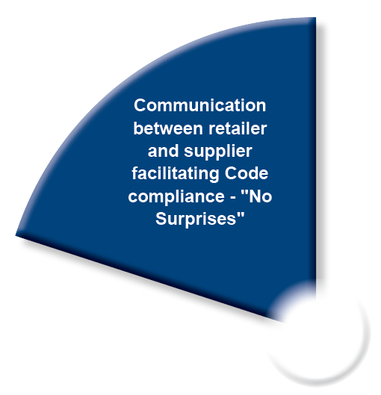
A self-regulating system of Code compliance?

Slide 20
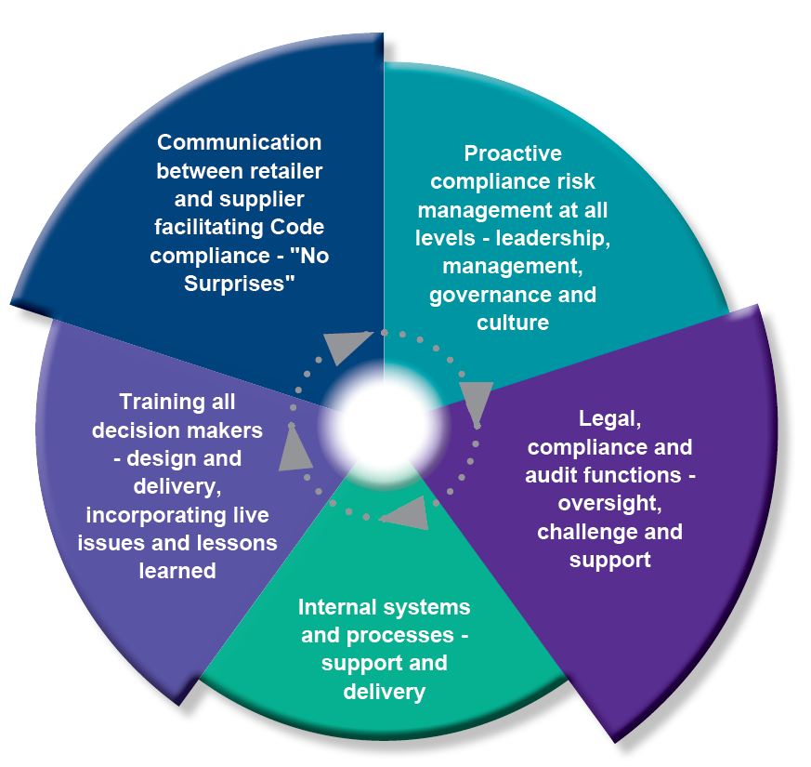
A self-regulating system of Code compliance?

Slide 21
Forward look

Slide 22
Buying alliances, joint ventures and merged entities
Code applies for direct supply of groceries to a regulated retailer for UK resale
Consider:
  Co-op and the independent societies ordering through it
  Retailers’ use of intermediaries
  Tesco / Booker – combining wholesale and retail
  Tesco / Carrefour – combining UK and non-UK groceries resale
  Franchises

Slide 23

Designated retailers
Annual review
Additional designated retailers?

Slide 24


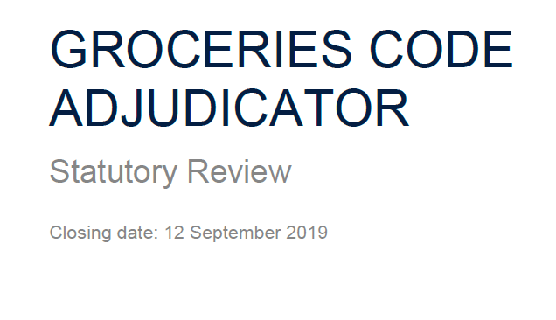
Moving office
Second statutory review
of the GCA

Slide 25


