Slide 1




Achieving Progress for Suppliers: Building Fairness and Securing Change
Working Together, Making Progress
Annual Report
March 2015
The Year Ahead
#GCA2016

Slide 2
Forward look
Acting on YouGov survey
Progressing the new Top 5 issues
Conducting better positioning consultation
Introducing a new-style levy
Co-operating with BIS review
Ready to conduct further investigations if merited

Slide 3
Delivered on 2015 survey
Increased understanding of GCA’s role and responsibilities ✓
Rise in perception among suppliers of retailers complying with the Code ✓
Improvements in retailer practice ✓
More suppliers trained in the Code ✓

Slide 4
Acting on 2016 Survey
Overcome the fear factor
Continuing concern – no change in suppliers willing to raise issues with me
Investigation showed how I can keep confidentiality while making significant findings
2016/17 campaign with message that suppliers must lose the fear or lose the chance of progress
Reach out overseas
Rise in number of overseas suppliers taking part in survey (8% - 16%)
Large proportion unaware of Code
Big push to provide more information working with trade associations, retailers and UK Government bodies
Continue to press home the message on Code training for direct suppliers, working with trainers and trade associations

Slide 5
Building Fairness and Securing Change
New Top 5 Issues
Working Together, Making Progress
Annual Report
March 2015
#GCA2016

Slide 6
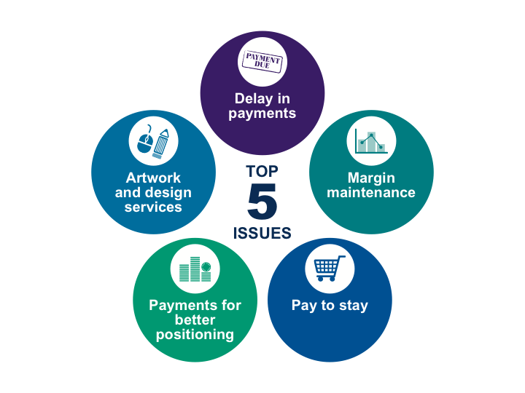

Slide 7

Artwork and design services
Following supplier workshop this is focused on artwork and design only
GCA passing rate card analysis back to CCOs:
  Concern over simplicity, transparency and predictability
  Feeding back on comparative charges (anonymised)
No obligation to contribute to marketing costs and no tying of 3rd party goods and services for payment

Slide 8
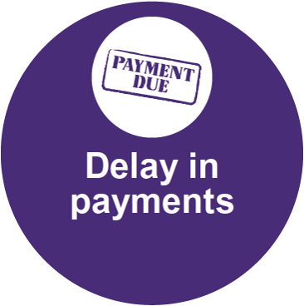
Delay in payments
In my report into the Tesco investigation I set out clearly what I interpret as delay in payments
Tesco is responding to the recommendations which are directed only to them and I will monitor how other retailers act on my interpretation of the Code
The issue remains live while I ensure there is Code compliance by all retailers
A retailer must pay a supplier for groceries delivered ….. in accordance with the relevant Supply Agreement

Slide 9
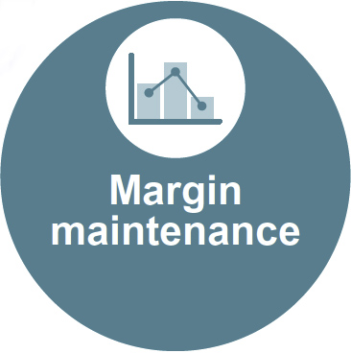
Margin maintenance
Following my investigation into Tesco I set out clearly that requests for margin maintenance need to be unambiguously supported by the Supply Agreement
A retailer must not vary any Supply Agreement retrospectively unless the Supply Agreement sets out clearly [the] circumstances…and rules calculating the adjustment

Slide 10

Pay to stay arrangements
An emerging issue in which it appears that suppliers may be indirectly required to pay lump sums to keep their business with a retailer, not part of normal commercial negotiations
A retailer must not require a supplier to make any payment as a condition of stocking that supplier’s groceries unless in relation to a promotion or products which have not been stocked during the preceding 365 days

Slide 11

Payments for better positioning
My investigation into Tesco identified a range of practices relating to payments for better positioning or increased share of shelf space that gave me concern
These practices may amount to indirect requirements for payments for more space or better positioning and merit further scrutiny
A retailer must not directly or indirectly require a supplier to make any payment in order to secure better positioning or an increase in allocation of shelf space….

Slide 12

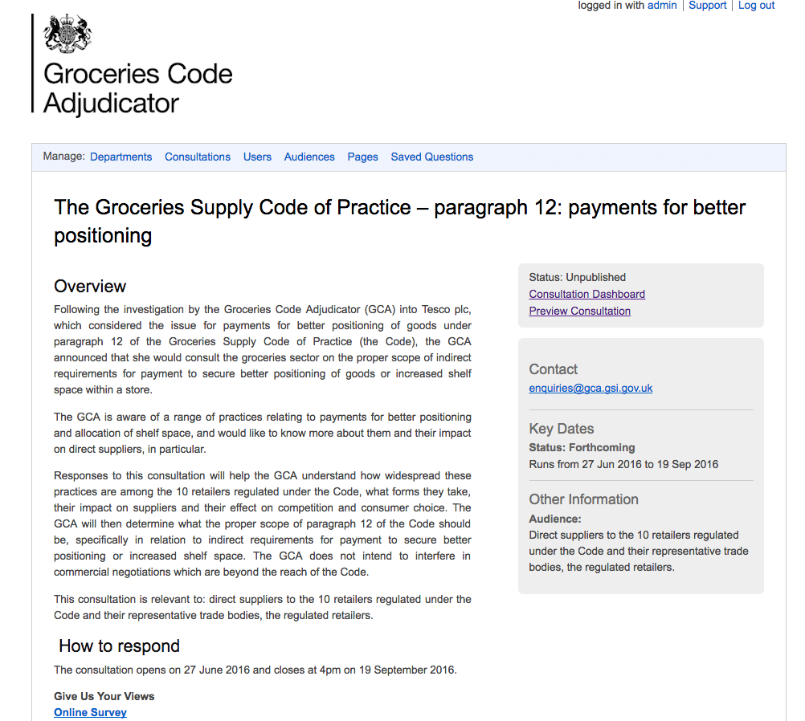
Consultation

Slide 13

Future resourcing – variable levy
Total levy £2 million
(including £1 million to ensure sufficient funds for any future investigation)
Levy contributions range from 7.7% to 17% of the total amount (largest net payment £302k)
Notes:
.

Slide 14
BIS review
GCA welcomes the statutory review of its effectiveness in performing its statutory functions and ensuring that the role is still required
Still a way to go to get suppliers to tell me of their issues.

Slide 15
Make sure you tell me what is going on
Give me the information and I will act swiftly
Give me the information and I will fix problems
Give me the information and you will benefit

Slide 16
Make sure you know what is going on
www.gov.uk/GCA

