Slide 1







UKHSA Presents
Vector-borne Disease
Thursday 5 September 2024
#UKHSAPresents

Slide 2
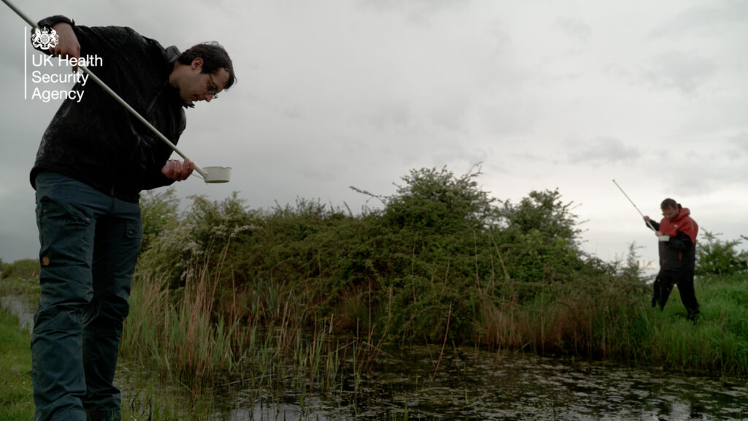
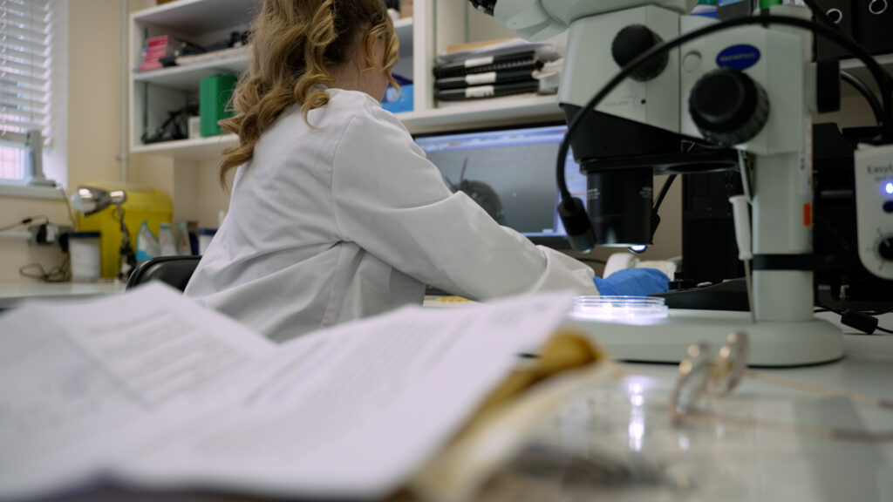
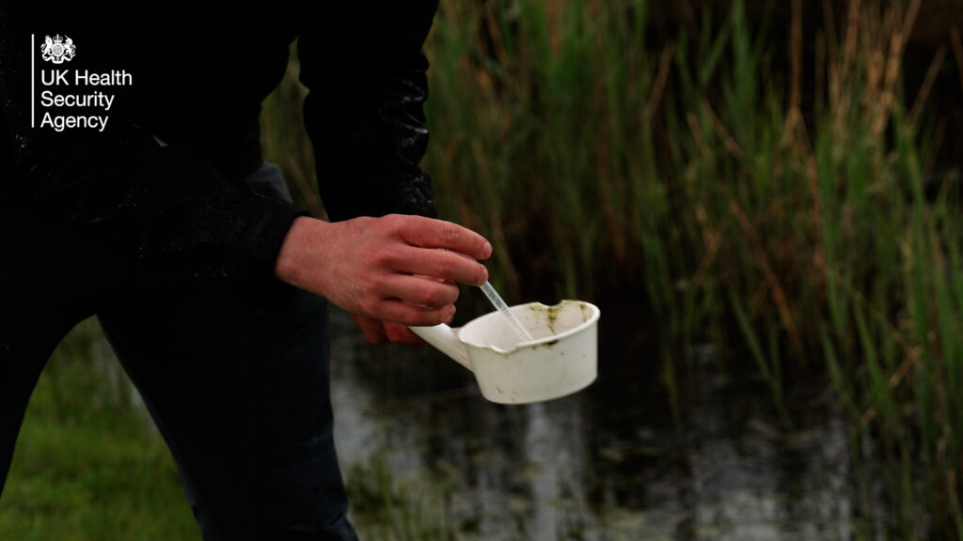
Medical Entomology group in UKHSA ​
Dr Jolyon Medlock, Head of Medical Entomology, UKHSA

Slide 3
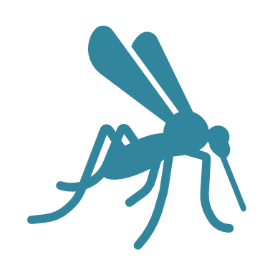
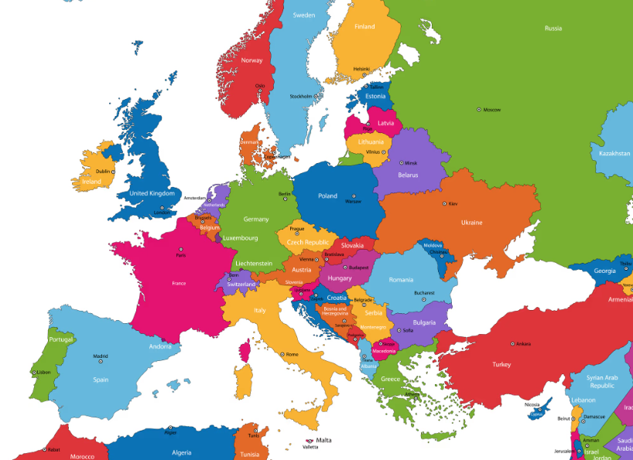


What is vector-borne disease?
First decade
Ljungan
Sindbis
Second decade
TBE
Third decade
Usutu
Human Babesiosis
WNV
Schmallenberg
Dengue
Usutu
WNV
WNV
WNV
Exotic Mosquitoes
Dengue
CCHF
Dengue
Malaria
Leishmania
CCHF
Dengue
WNV
Aedes aegypti
Dengue
RVF
Notes:
Vector-borne diseases are illnesses that can be transmitted to humans by arthropods.
Arthropod vectors include: mosquitoes, ticks, sand-flies, fleas, midges.
VBDs include Lyme disease, Tick-borne encephalitis virus, West Nile virus, malaria, dengue and yellow fever.​
In the UK the threat from vector-borne diseases is on the rise, due to factors like growing global travel and trade (movement of infected people and invasive vectors), changes in land use (increase human exposure to vectors) and climate change (warmer temperatures for disease transmission and vector survival).

Slide 4
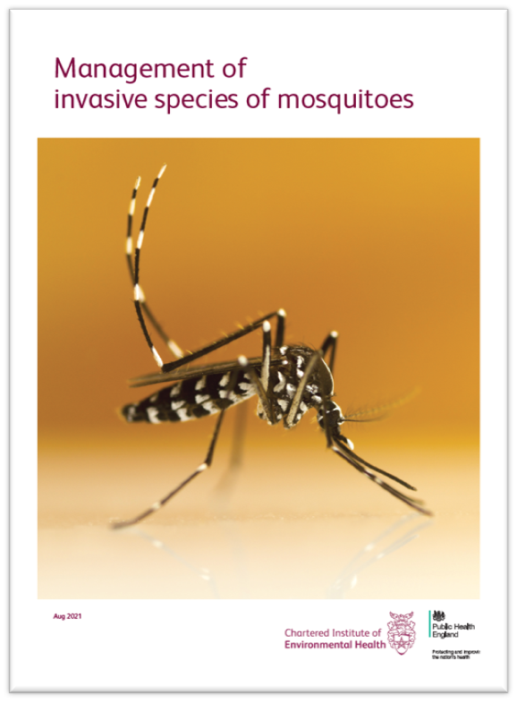


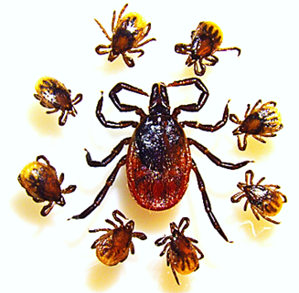

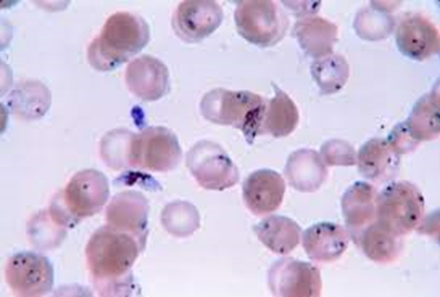

Vector-borne disease in numbers
17% of infectious disease globally
> 700,000 global deaths each year
Imported UK Malaria cases >2000 since 2004
Spread of invasive mosquitoes to >30 European countries
Rise of mosquito Dengue and over 100 locally transmitted cases in Europe in each of last 2 years
UK ticks: > 20 species, >65000 Lyme cases annually in Europe
Notes:
Vector-borne disease accounts for more than 17% of all infectious disease and cause more than 700,000 deaths globally each year.
Imported malaria cases to England, Wales and Northern Ireland in 2023 have exceeded 2000 cases for the first time in 20 years (2004 cases in 2023 compared to 1369 in 2022).
Invasive mosquito vectors of dengue have been reported in >30 European countries since 1990.
In the last two years there have been ~100 locally transmitted dengue cases in Europe, with recent notable outbreaks also of chikungunya virus
The UK has over 20 recorded tick species.
There are >85,000 Lyme disease cases confirmed each year in Europe.

Slide 5
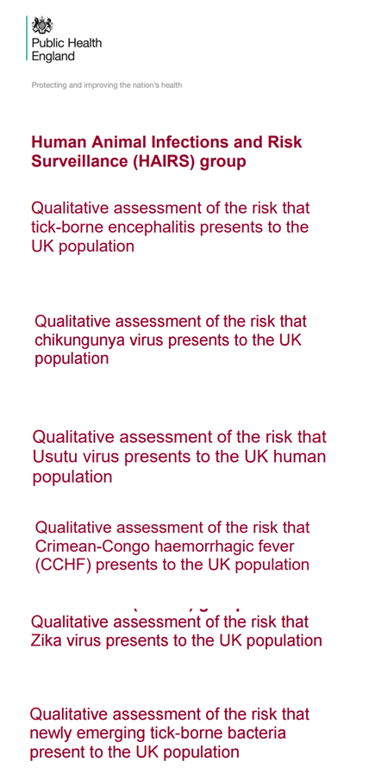
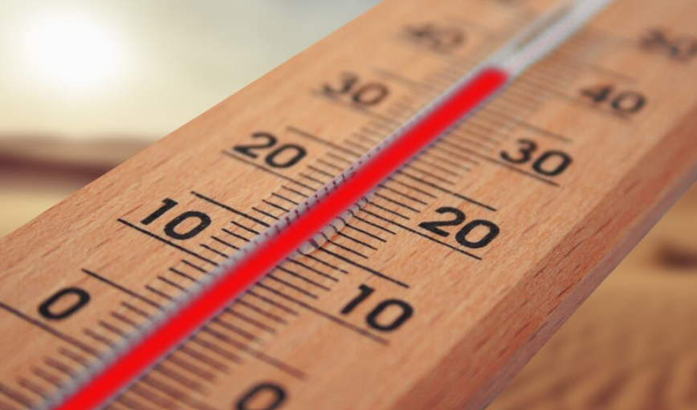
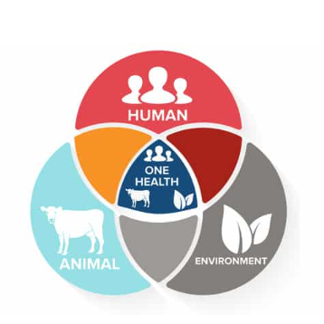
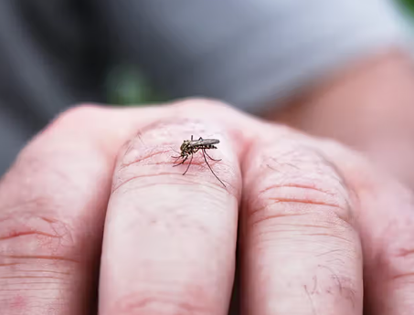
What is UKHSA doing?
Established Centre for Climate Health Security 2022
Established Centre for Climate and Health Security in 2022
Working with HAIRS since 2004
MEZE Team works with local authorities and stakeholders
Collaboration across government, crown dependencies and overseas territories
Notes:
Established a Centre for Climate and Health Security
UKHSA, and its predecessor organisation Public Health England, has been working on emerging vector-borne diseases in Europe​ supporting One Health Human Animal Infections Risk Surveillance Group (HAIRS)​ since 2004​.
Our Medical Entomology and Zoonoses Ecology (MEZE) team assess the emerging risk posed by ticks, mosquitoes and other arthropods that can carry and transmit bacteria, viruses and parasites.
Our entomologists work with local authorities and local stakeholders to monitor and manage risks, and to put in place strategies to minimise the opportunity for invasive species to become established in our towns and countryside.
We work collaboratively across government to support Department of Health and Social Care, Defra, Food Standards Agency, Animal and Plant Health Agency, the devolved administrations, crown dependencies and Overseas territories.

Slide 6
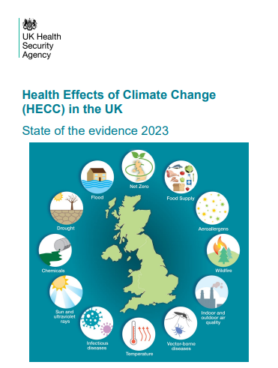
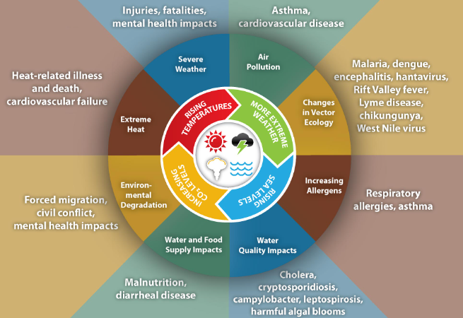
Impact of climate change on vector-borne disease
Credit: CDC
Notes:
UKHSA’s Health Effects of Climate Change report demonstrates substantial and growing evidence of the effects of climate change on health in the UK.
The impact that climate change could have on vector-borne diseases and our society, if we do not take decisive action, could have major impacts on physical and mental health.
Considering and monitoring the impact of climate and other environmental change in relation to vector-borne diseases through our surveillance systems is vital to our countries ability to safeguard future generations from the increasing threat from diseases such as recently emerged VBD in the UK such as tick-borne encephalitis, and those emerging in Europe, such as dengue from invasive mosquitoes.

Slide 7
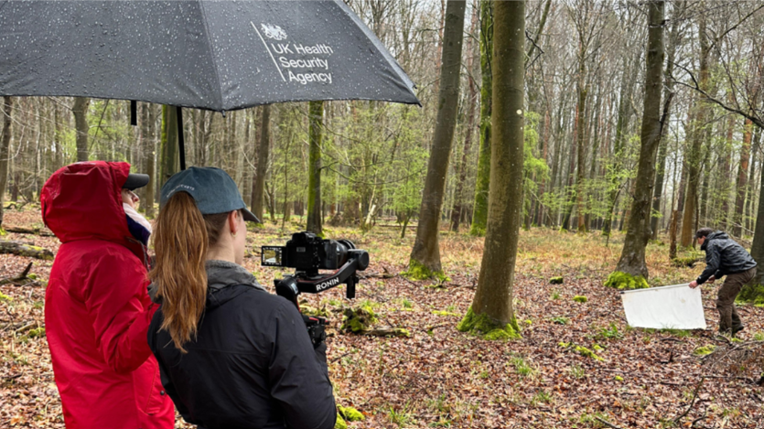
Ticks
Ticks
Ticks in England carry Lyme disease
And more rarely Tick-borne encephalitis
Increasing issue in green spaces
1500 lab confirmed cases of Lyme
1000-2000 more diagnosed clinically
Notes:
Ticks in England can carry infections, including Lyme disease and — very rarely — tick-borne encephalitis (TBE).
Not all ticks carry bacteria and not all bites from an infected tick will result in human infection.
Disease can be acquired when someone is bitten by an infected tick, usually outdoors in green spaces where ticks might be present.
There are around 1,500 laboratory-confirmed cases of Lyme disease in England and Wales each year, although an estimated 1,000 to 2,000 more people are diagnosed each year based on clinical assessment rather than laboratory tests

Slide 8
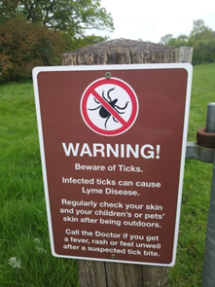
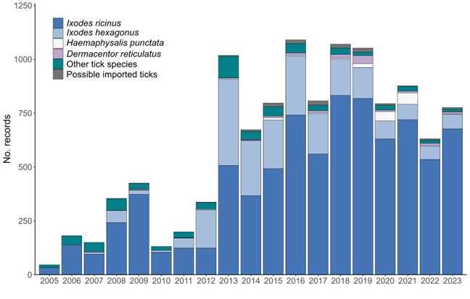
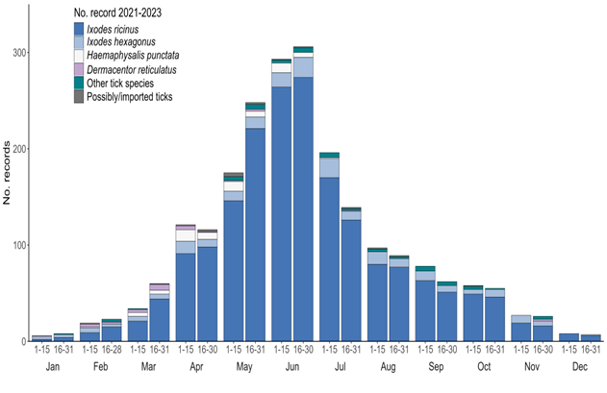
Our tick surveillance programme
The Tick Surveillance Scheme was set up in 2005 and is the only scheme that records tick distributions on a national scale.
The main aims of the scheme are to:
      promote the surveillance of ticks in the UK
    monitor tick distribution and seasonality on a nationwide scale
    determine the diversity of ticks infesting humans and animals
    detect non-native (imported) or rare UK tick species
    Tick@ukhsa.gov.uk

Slide 9
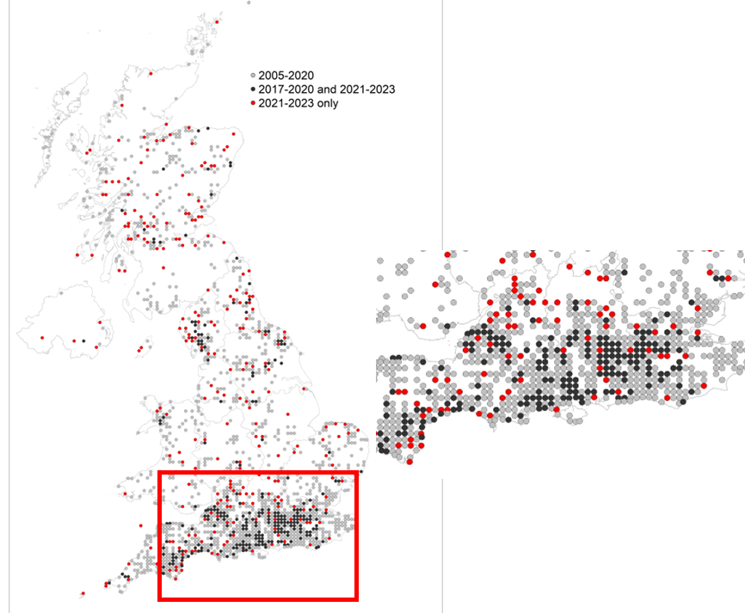
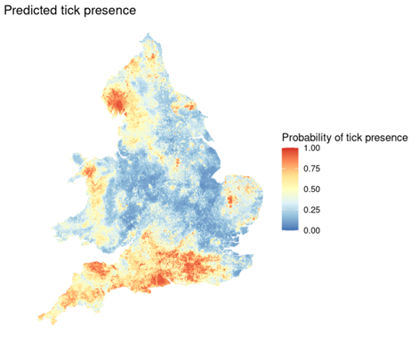

Monitoring change in tick distribution
Detection of change in distribution of Lyme disease vector
​
​
Lower risk in Midlands
Expansion in distribution of 3% each year
Large increase in distribution in southern counties of England, and part of North-west​
    Lower risk in Midlands
​

Slide 10
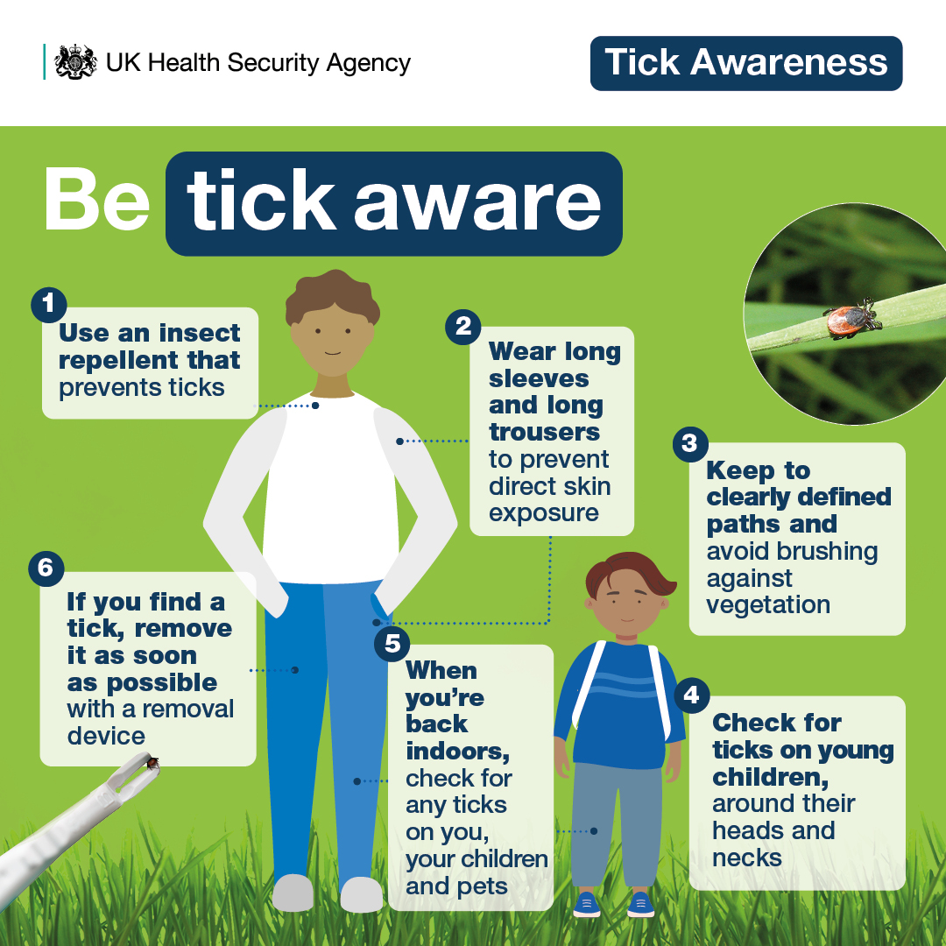
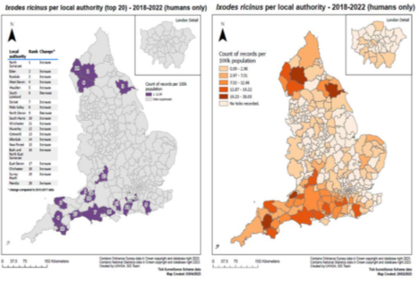
Translating tick surveillance into local action in England
Developing indicators of tick risk and ​Lyme and increasing public awareness
Developing and updating the Tick Awareness Toolkit
increasing public awareness
eloping and updating to encourage the public to ‘Be Tick Aware
Communications and campaigns activity to increase public awareness

Slide 11
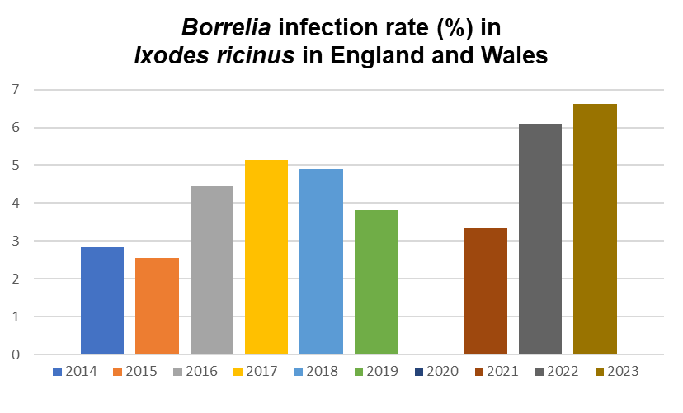
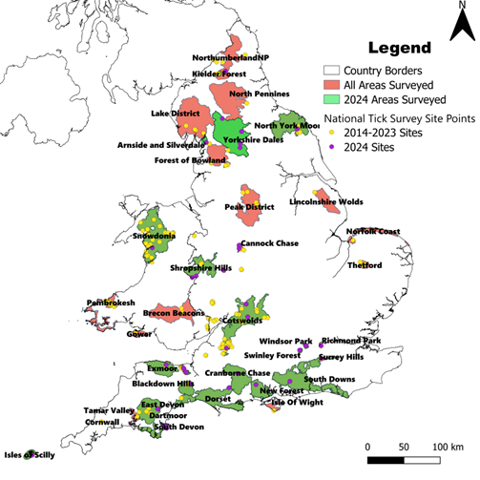
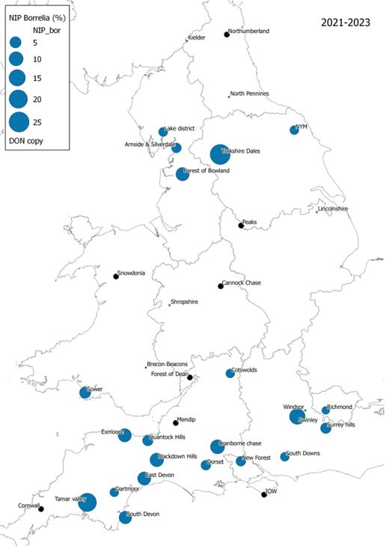
Monitoring change in tick-borne disease infection rates in vectors (e.g. Lyme disease Borrelia)

Slide 12
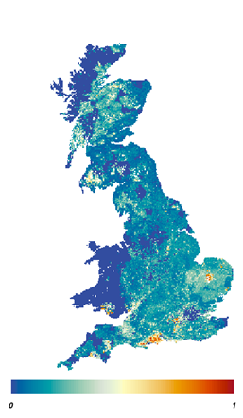


Tick-borne encephalitis virus research: first detection in the UK
Working with virologists, academia and wildlife experts
Sero survey of wild deer for tick-borne flavivirus​
Identification of hot-spots of seropositivity​
Subsequent tick testing from deer and the environment​
Sequencing TBEV and phylogenetic analysis​
Four probable or confirmed cases (RIPL)
Work to understand TBEV endemic areas and other potential hot spots: risk factors are spring warming​, deer occupancy​, woodland connectivity​, temperature

Slide 13
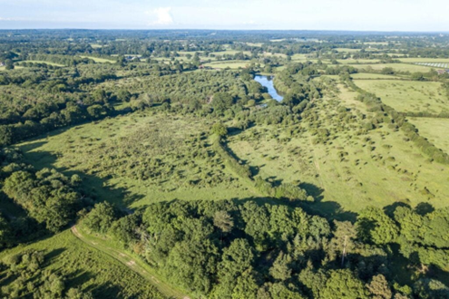
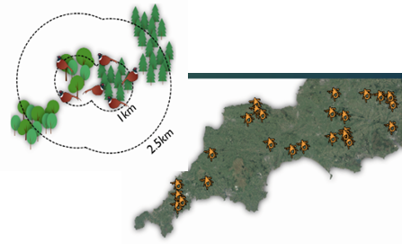
Surveillance and research on drivers for change in Tick-borne disease risk
Impact of rewilding on Lyme disease
Working with academia and wildlife experts through UKRI funded research
Role of deer and gamebirds in sustaining ticks and Borrelia infection
Impact of woodland management, connectivity and planting on ticks
Impact of imported ticks on pets

Slide 14
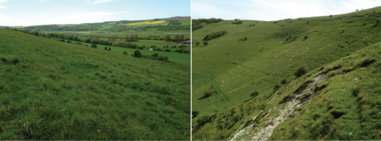

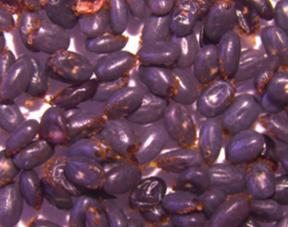

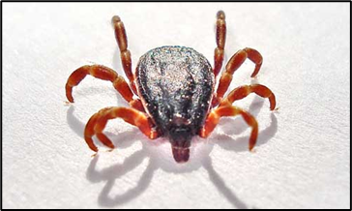
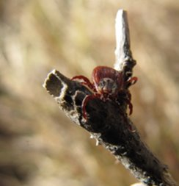

One Health Case studies on detections of new tick-borne disease incidents
Dermacentor reticulatus ticks as novel ​vectors of Canine babesiosis in Essex and as a potential vector of Rickettsia
Red sheep ticks Haemaphysalis punctata in Sussex – challenge for conservation grazing, and as a cause of tick pyaemia in sheep and vector of veterinary pathogens: Babesia/Theileria
Hyalomma ticks on migratory birds and their potential as a vector of Crimean Congo Haemorrhagic Fever virus (CCHFV)

Slide 15


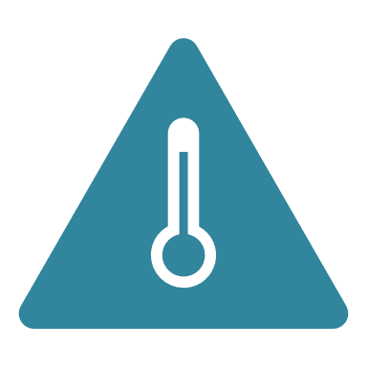


Future risks: Dengue, Chikungunya & Zika viruses
Epidemic dengue risk in London as early as 2060, currently cases in Paris
Chikungunya transmission in the UK a risk for the latter half of the century
Chikungunya transmission in the UK begin the latter half of the century
Establishment of Ae. albopictus in the UK is one of the most significant vector-borne disease risks from climate change
We monitor the situation in the UK and European countries as it continues to evolve
8 separate detections of Aedes albopictus or Aedes aegypti mosquitoes since 2016, including recent detections
Notes:
London could become suitable for endemic dengue transmission as early as the 2060s under a high-warming scenario.
High-warming scenarios indicate the potential suitability for chikungunya transmission in the UK beginning in the latter half of the century, with spread linked to rate of warming.
This evidence indicates that the establishment of Ae. albopictus in the UK is one of the most significant vector-borne disease risks for public health posed by climate change.
We monitor the situation in the UK and European countries for increasing reports of autochthonous cases or changes in pathogenicity for human infections. This remains an evolving situation.
8 separate detections of Aedes albopictus or Aedes aegypti mosquitoes since 2016, including recent detections

Slide 16
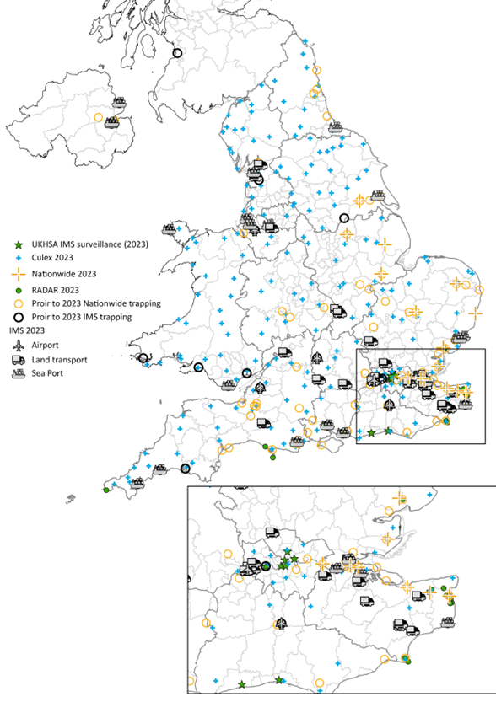





Surveillance for Invasive mosquitoes in the UK
Work with local authorities and port health to monitor
Focus on points of entry and Urban centres
with accommodating climates
Work on the ground to prevent incursions though implementation of plans
Advice and information to the public
Support overseas territories in prevention
Notes:
Work with local authorities and port health to monitor for invasive mosquitoes ​
Focus at sea and airports, vehicular transport hubs and other points of entry
In local authorities where climate could currently support detections
Local incident management with UKHSA Health Protection Teams and Local Authorities to manage incursions
Provide technical advice and information to the public
Also support UK Overseas Territories to support dengue prevention work in Gibraltar and Caribbean territories

Slide 17
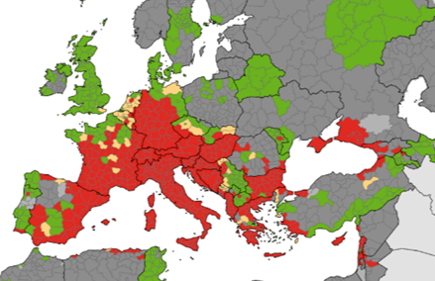
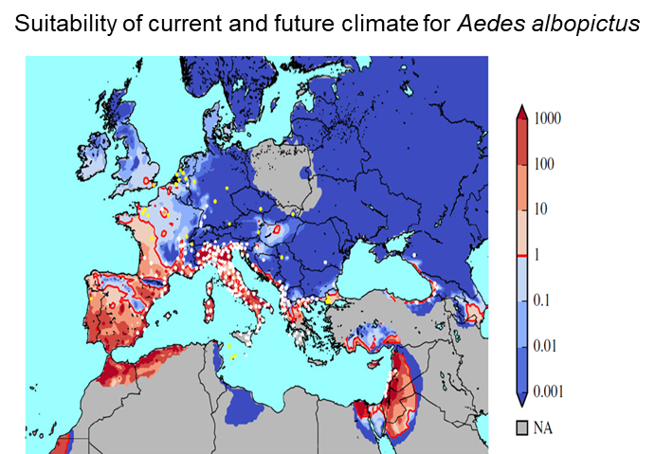
Surveillance for Invasive mosquitoes in the UK
Notes:
Work with local authorities and port health to monitor for invasive mosquitoes ​
Focus at sea and airports, vehicular transport hubs and other points of entry
In local authorities where climate could currently support detections
Local incident management with UKHSA Health Protection Teams and Local Authorities to manage incursions
Provide technical advice and information to the public
Also support UK Overseas Territories to support dengue prevention work in Gibraltar and Caribbean territories

Slide 18
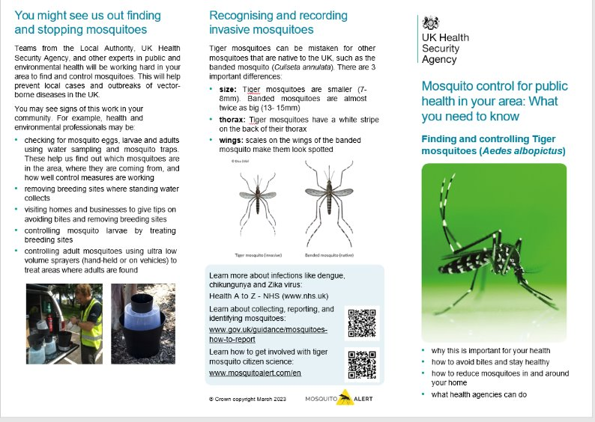
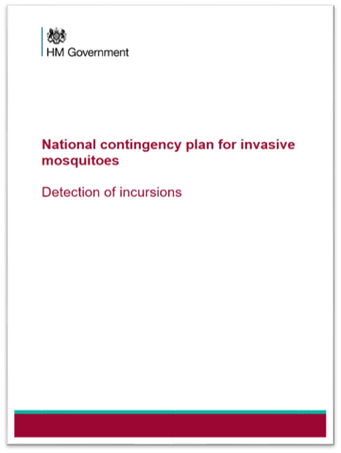
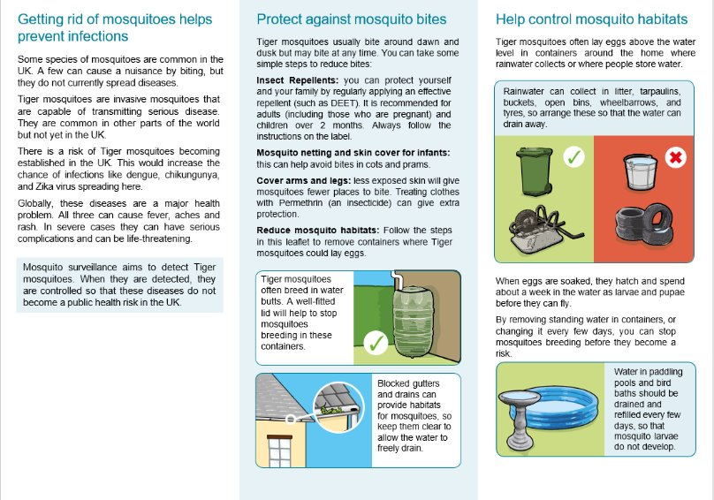
Developing contingency plans & guidance

Slide 19
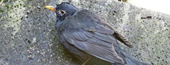



One Health outbreaks – Usutu virus & other arboviruses
Usutu virus in dead birds and mosquitoes
UKHSA conduct extensive mosquito surveillance to understand key vectors, seasonality, habitat risks
APHA conduct virus testing of mosquitoes to implicate key vectors
Zoological Soc London conduct garden bird health studies
APHA testing dead birds for virus
British Trust for Ornithology collate data on bird abundance and die-offs, facilitate bird ringing and sample testing
UKHSA conduct human seroprevalence studies
Notes:
Emergence of Usutu virus in dead birds and mosquitoes – joint one health response with APHA/ZSL​
UKHSA conduct extensive mosquito surveillance to understand key vectors, seasonality, habitat risks
APHA conduct virus testing of mosquitoes to implicate key vectors
Zoological Soc London conduct garden bird health studies and pathological testing of birds
APHA testing dead birds for virus
British Trust for Ornithology collate data on bird abundance and die-offs, facilitate bird ringing and sample testing
UKHSA conduct human seroprevalence studies

Slide 20
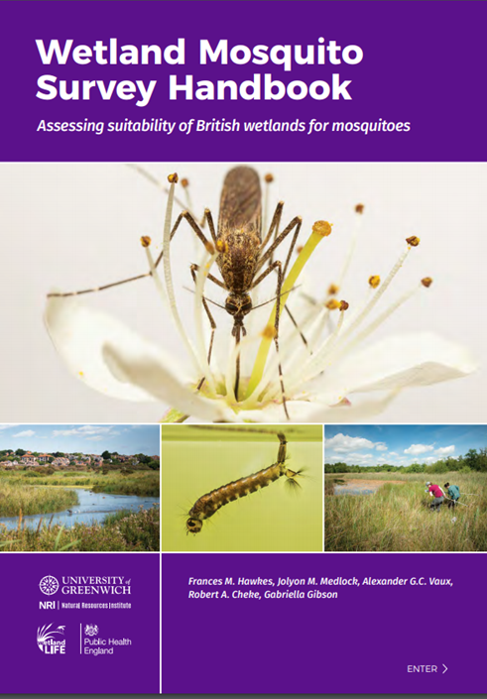
Building resilient communities and habitats
Developing guidance for wetland managers on minimising risk of mosquito-borne disease in wetlands, flood alleviation schemes, newly constructed wetlands
Developing research on impacts of urban greenspace management on tick-borne disease
Providing guidance to local authorities on managing urban Lyme issues

Slide 21
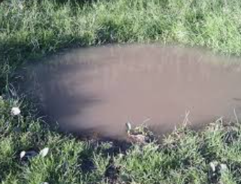
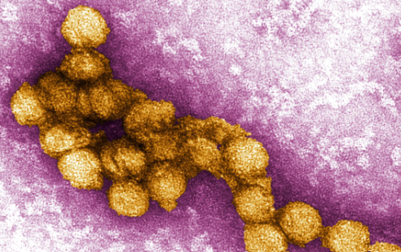

Incident response to climate related threats
Supporting One Health government response to emergence of Vector-borne disease e.g. Usutu virus
Supporting local authorities on managing nuisance mosquito issues and invasive species
Supporting devolved administrations, crown dependencies and overseas territories on emergence of VBD e.g Tick-borne encephalitis virus, Lyme disease, dengue outbreaks, hurricane response
Readiness to respond to emergence of newly detected VBDs: e.g. surveillance for West Nile virus
Providing entomological support to Cryptic malaria cases – airport, suitcase, transfusion transmitted – assessing potential for local transmission​
Notes:
Supporting One Health government response to emergence of Vector-borne disease e.g. Usutu virus
Supporting local authorities on managing nuisance mosquito issues and invasive species
Supporting devolved administrations, crown dependencies and overseas territories on emergence of VBD e.g Tick-borne encephalitis virus, Lyme disease, dengue outbreaks
Readiness to respond to emergence of newly detected VBDs: e.g. surveillance for West Nile virus
Providing entomological support to Cryptic malaria cases – airport, suitcase, transfusion transmitted – assessing potential for local transmission​

Slide 22

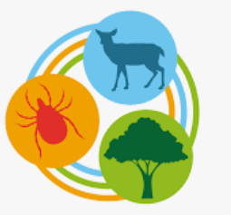
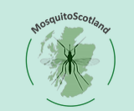
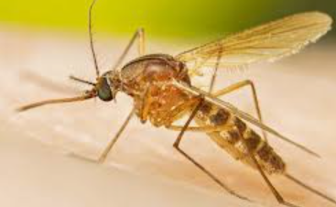


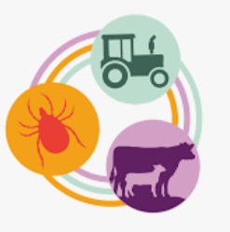
UKRI funding on vector-borne disease
TICKSOLVE
TICKSOLVE
Mosquito Scotland
CULEX
Vector-borne RADAR
VB Genes
OpTick
Notes:
TICKSOLVE: Environmental solutions to tick-borne disease transmission​ (With Liverpool, Glasgow Universities and UK CEH​)
CULEX: Culex distribution, vector competence and threat of transmission of arboviruses to humans and animals in the UK - focus on West Nile virus entomology​ (With Liverpool, LSTM & Lancaster Universities)​
VB Genes: Genomic epidemiology tools for the surveillance of vector-borne diseases network: applied to tick species, reservoirs and pathogens​ (With London School of Hygiene and Tropical Medicine , UKHSA genomics)
Mosquito Scotland: Assessing the risk of mosquito vector-borne diseases in Scotland and their response to environmental change​ (With University of Glasgow) ​
Vector-borne RADAR (real-time arbovirus detection and response) – focus on Usutu, West Nile bird hosts & mosquitoes​ (With APHA, ZSL & BTO​)
OpTick: One health surveillance and management of tick-borne disease threats in a changing environment​ (With UK Centre for Ecology and Hydrology , University of Liverpool, APHA, UKHSA V&P​)

Slide 23
UKHSA Presents
Vector-borne Disease
Thursday 5 September 2024
#UKHSAPresents

