Slide 1
Enquiries about results and appeals
Julie Swan
March 2016

Slide 2
The scale of awarding in England in 2015 – by four exam boards
4,835,712 GCSEs awarded
782,325 A levels awarded
1,286,125 AS awarded
(Total UK undergraduate and postgraduate students in 2014/15 2,266,075 (HESA))

Slide 3
Additional pressures
Exams taken second half of May – end June
All AS and A levels results announced on the same date – and given to HEIs in advance (results will be sent to schools/colleges 17 August 2016)
All GCSE results announced on the same date

Slide 4
Enquiries about results – 2015 – England, Wales and Northern Ireland
572,350 requests for a review of marking (across the qualifications) in respect of 506,750 qualifications (reviews are of individual assessments)
90,650 grades were changed (1.1% of all grades issued)
Reviews of marking turned around in an average of 9 days for GCSE
A level reviews (priority reviews) turned around on average in 5 days (the average was 7 days in 2014), although there was a 42% increase in the number of requests for priority reviews in 2015 over 2014

Slide 5
Grade changes – A levels
39,900 requests for priority review – an increase of 42% on 2014
Relating to 28,400 qualifications
5,000 grade changes – 18% of those requesting a review
99% of the grade changes were upwards

Slide 6
Most requests for review by subject, by percentage of entries, varies but typically includes for A levels
Music
Philosophy
History
English literature

Slide 7
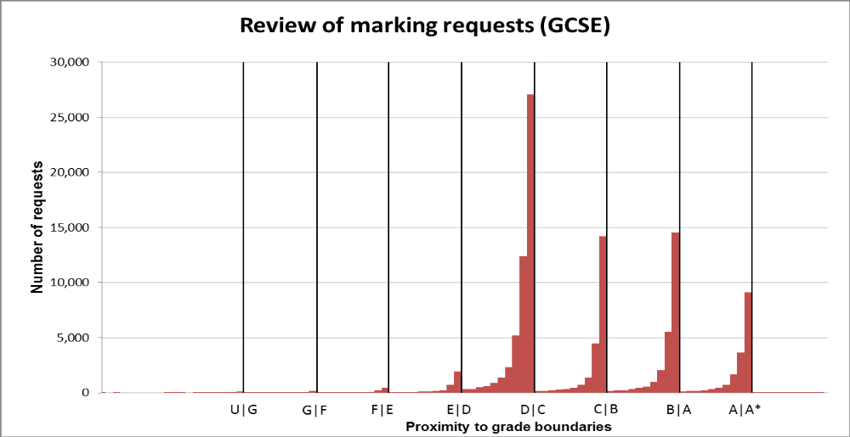
Requests for reviews are more likely to be made when a mark is just below a key grade boundary

Slide 8
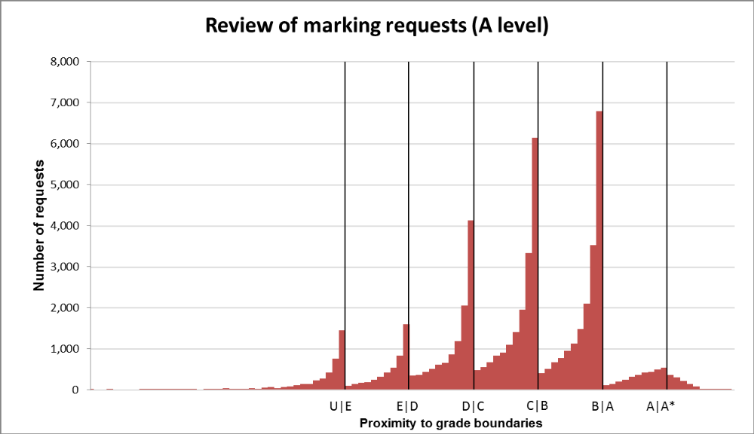
Requests for reviews are more likely to be made when a mark is just below a key grade boundary

Slide 9
So…….
A very small change in mark, where the original mark was just below a grade boundary, is likely to lead to a grade change

Slide 10
Ofqual consultation – closes 11 March
We acknowledge some marking errors are inevitable in such a large scale system
We raise concerns – informed by research – that legitimate marks are being revised on review, introducing the potential for unfairness
We propose:
  reviewers should only be permitted to change marks that could not reasonably have been given - legitimate marks must stand
  reviewers should be specifically trained for and monitored while reviewing initial marking
  grounds for an appeal – that can only be undertaken once a marking review is complete – are extended to include unreasonable application of the mark scheme
  schools/colleges should have access to marked scripts before deciding whether to request a review

Slide 11
Questions
Will you be responding to our consultation -closes 11 March?
Do your admission arrangements allow for the small number of A level students whose grade is increased after a review or marking?

