Slide 1
Innovation in Qualifications
Professor Ken Young, MTC
Clare Rowntree, Senior Economist, Strategic Policy & Risk

Slide 2


Slide 3
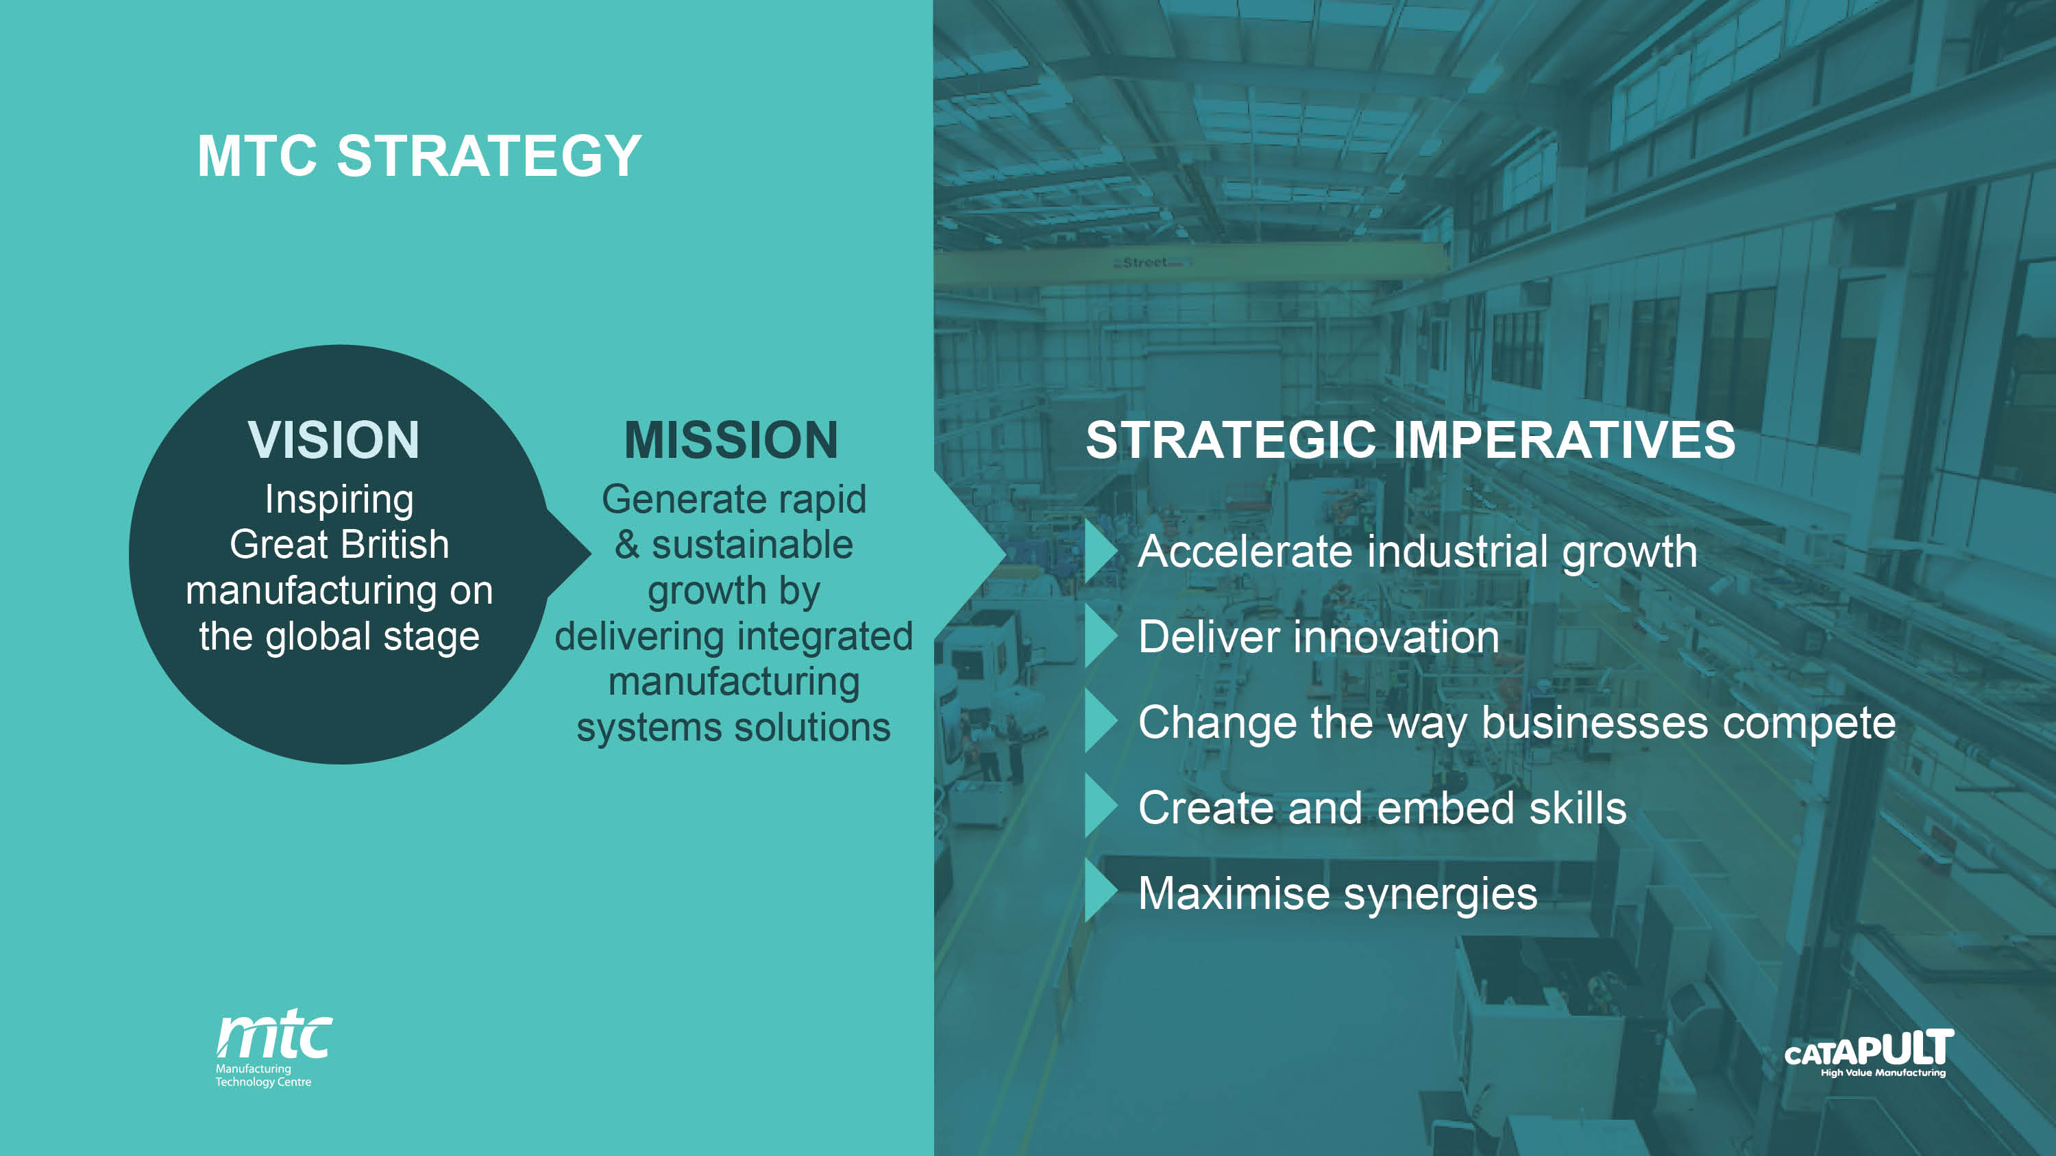

Slide 4
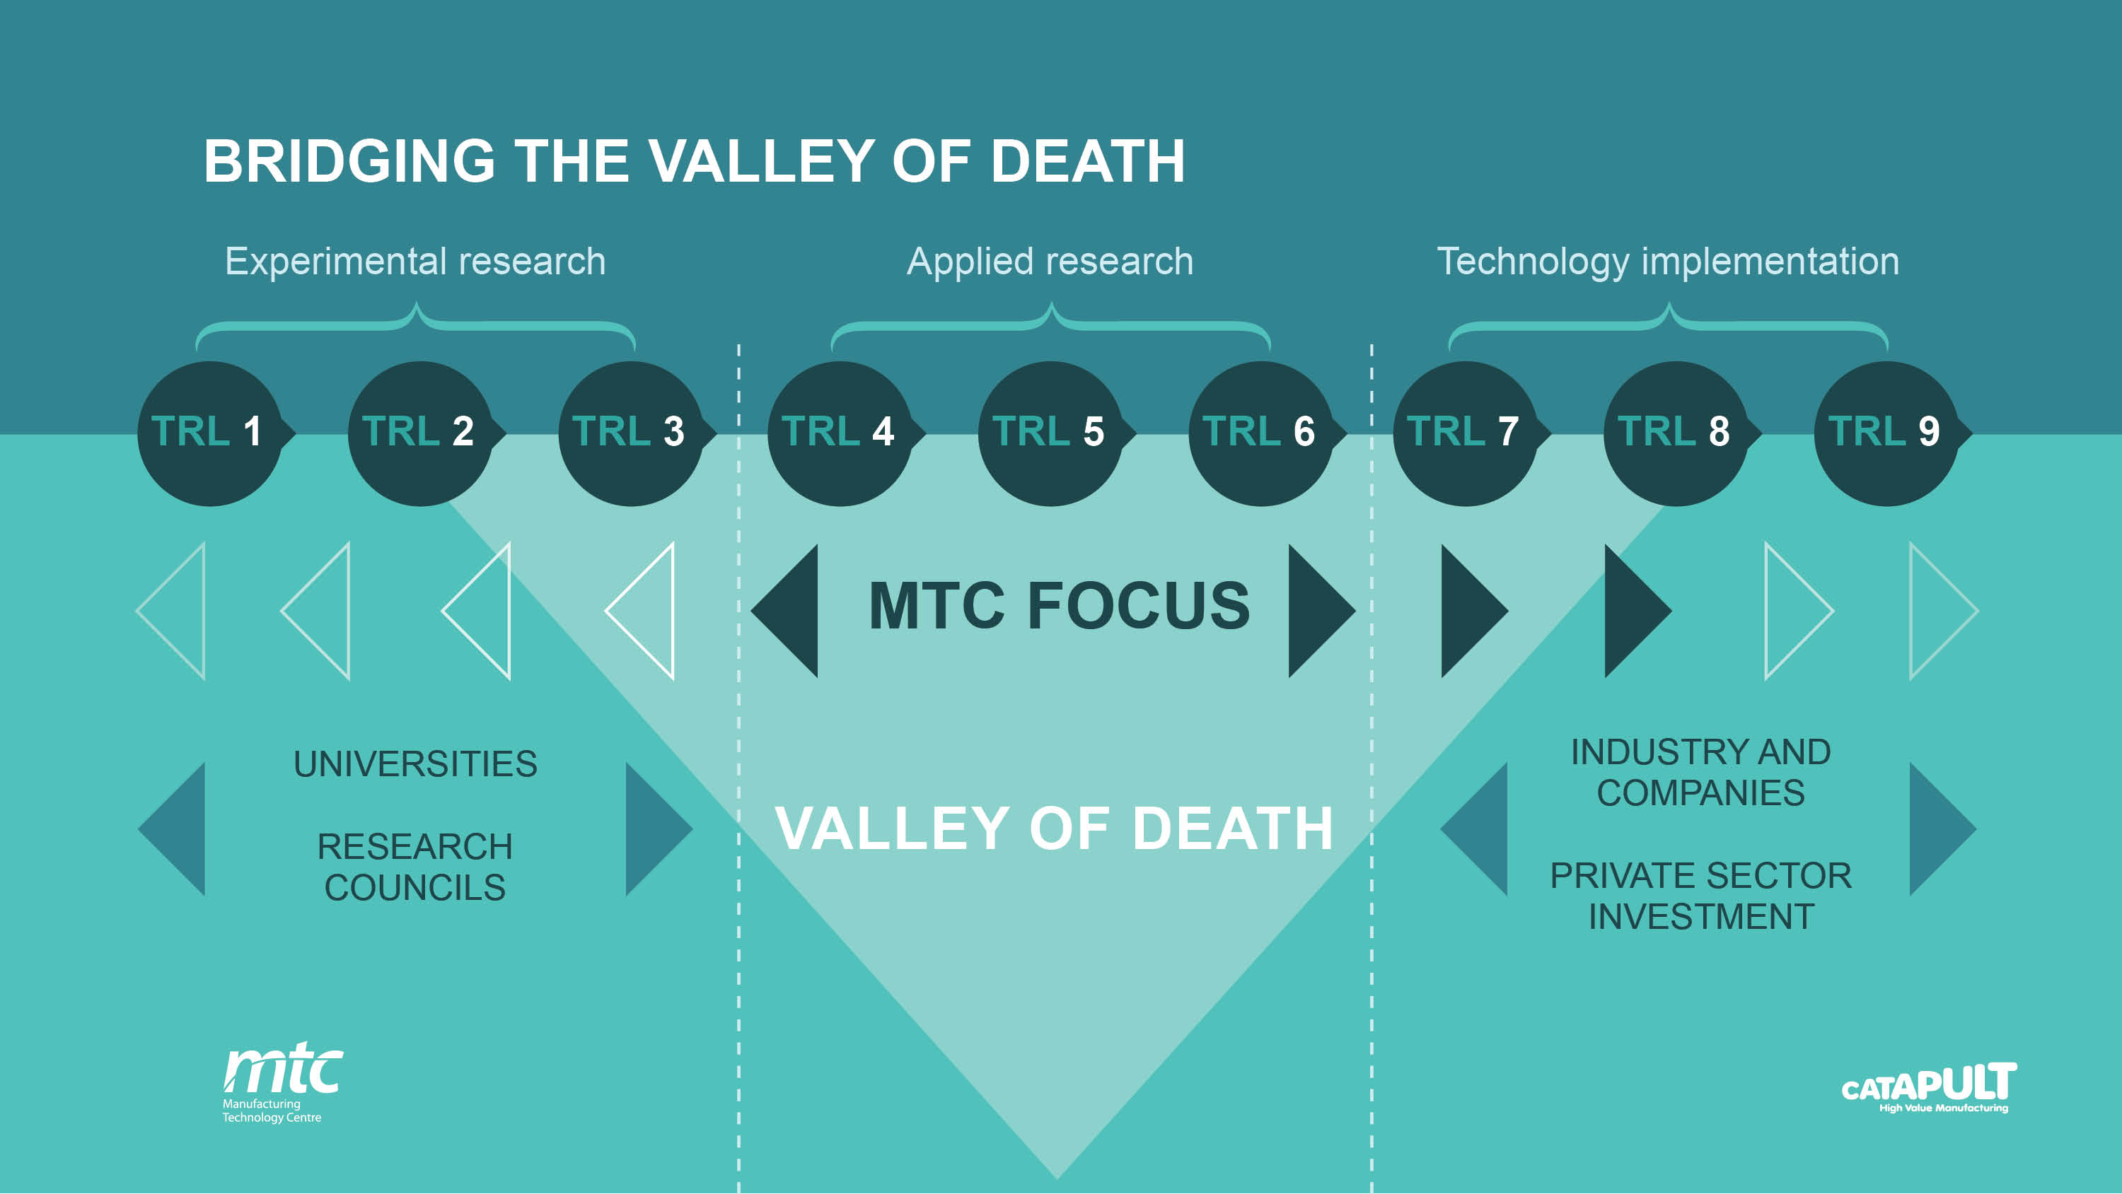

Slide 5
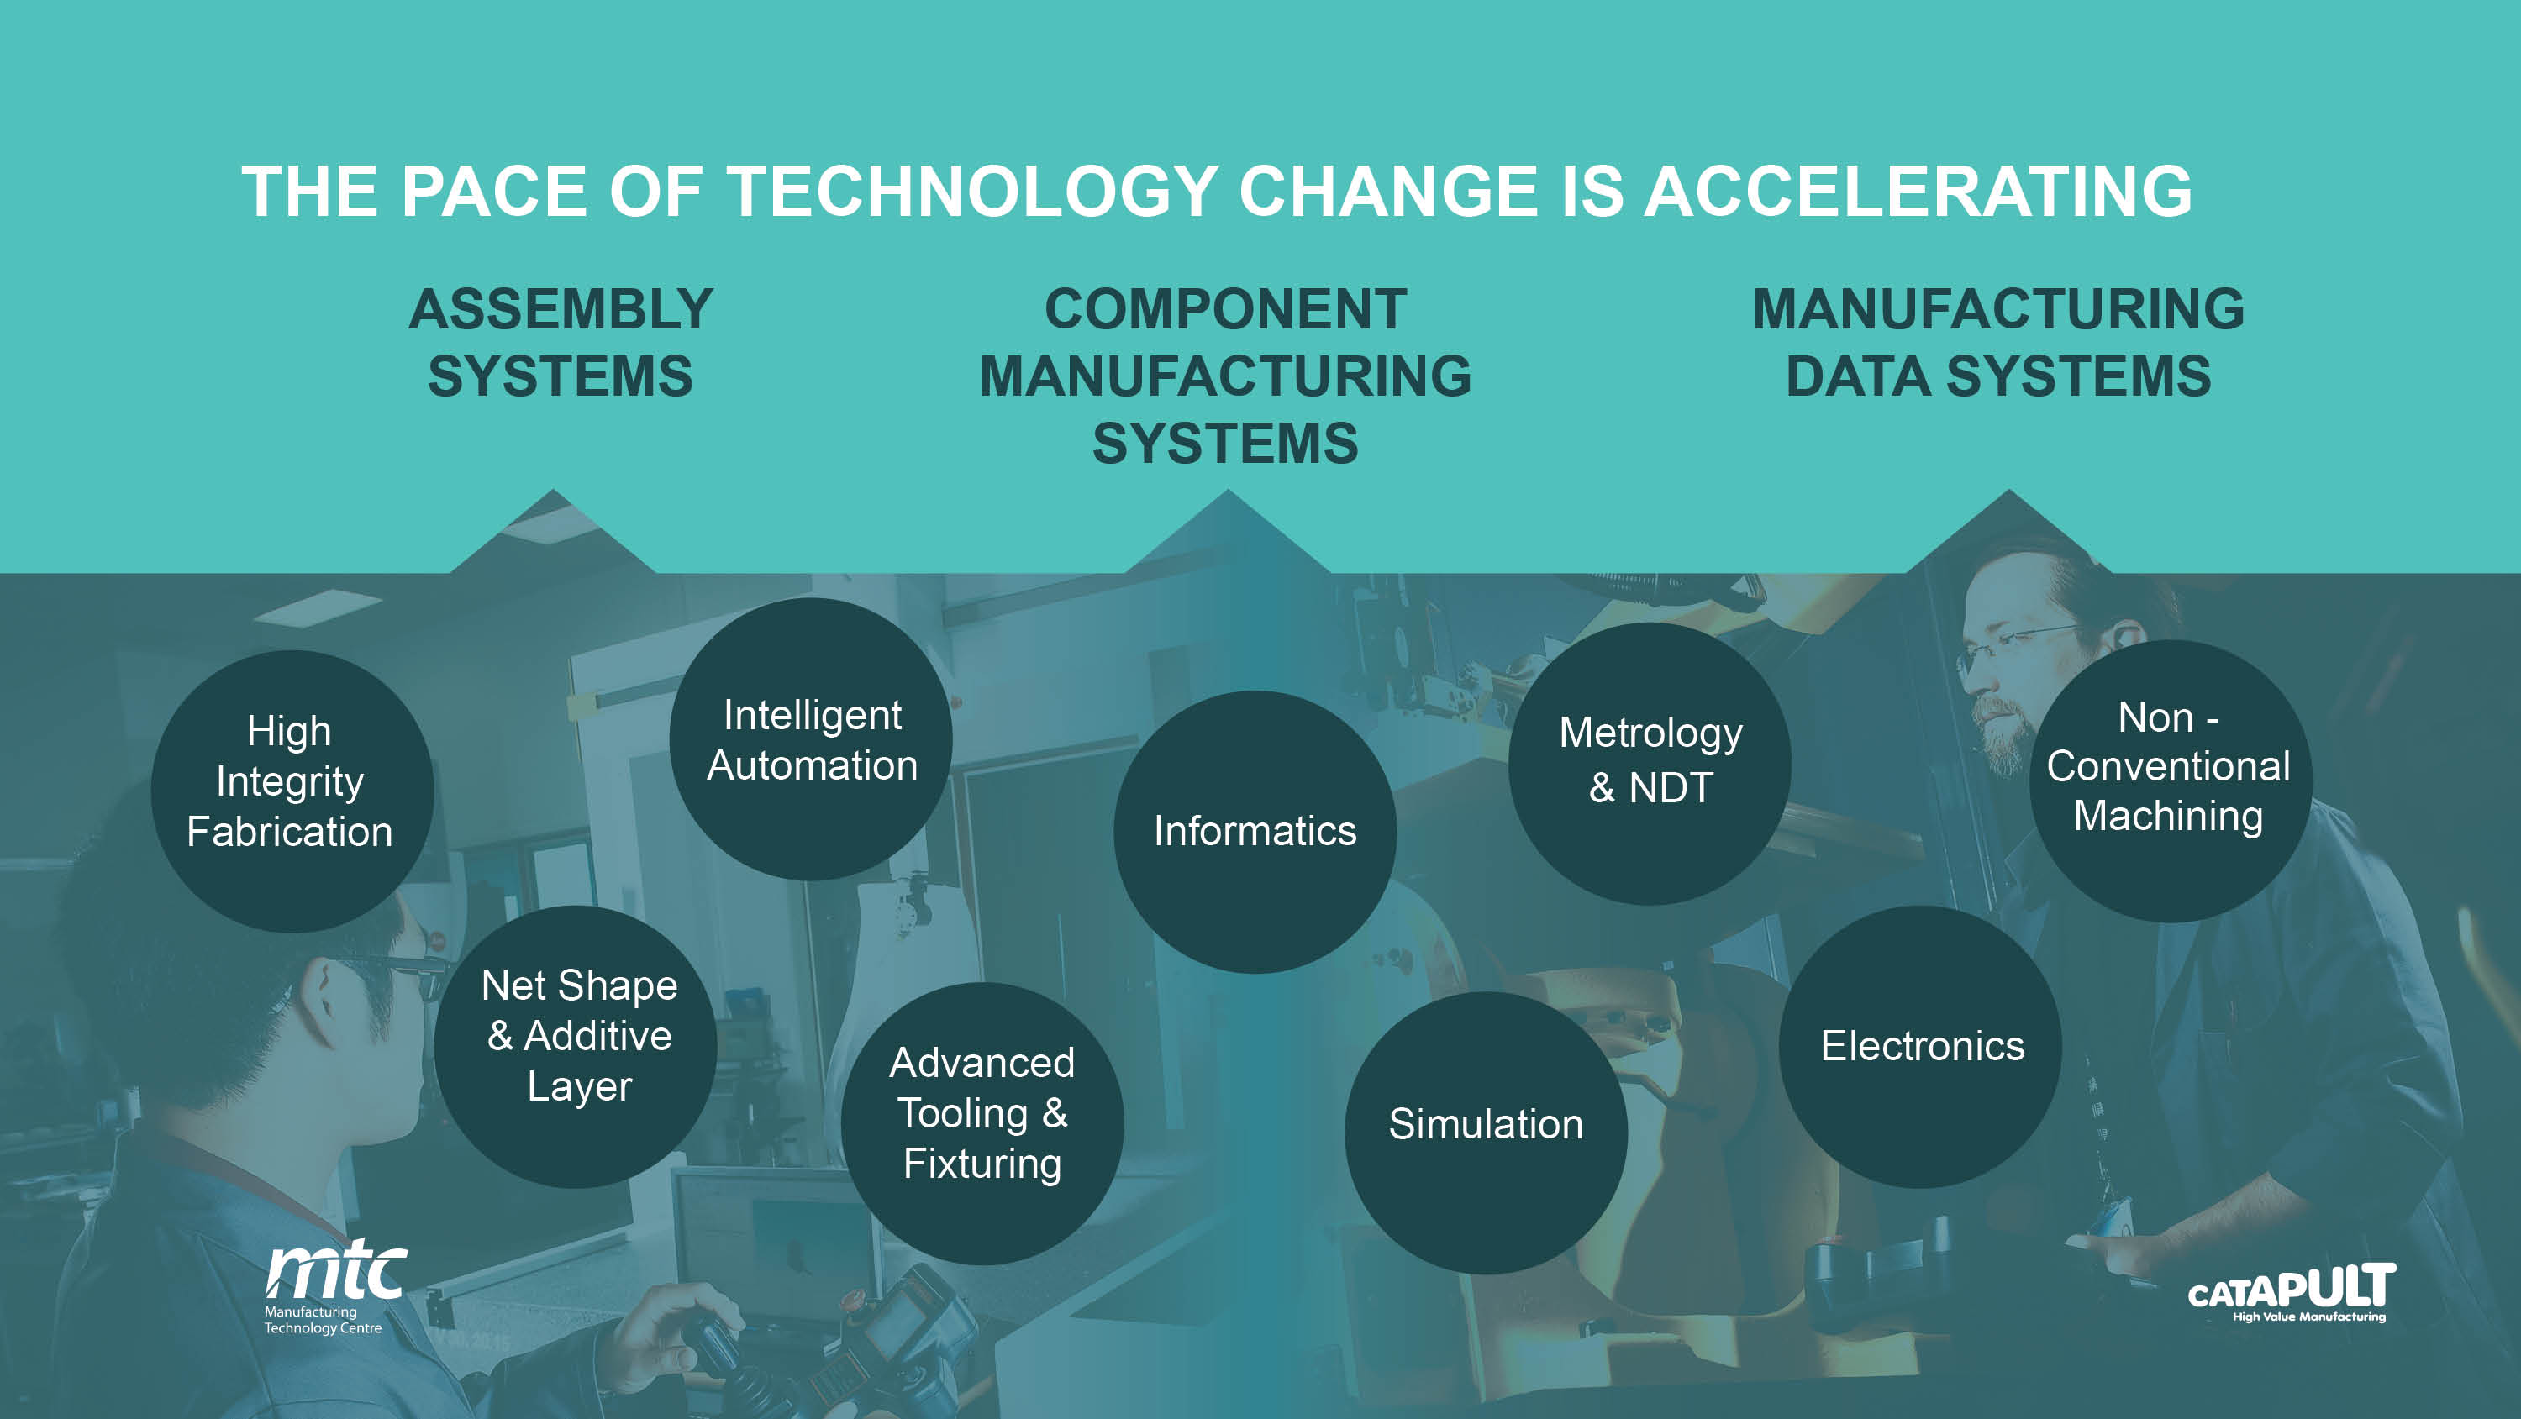

Slide 6
Process
Impact
Engineers and Technicians
Capable Engineers and Technicians
Training
Equipment
Capability
Mature
Capability
Customer
Target Application

Slide 7
What does capable mean?
Technical ability
Practical ability
Confident
Trustworthy
Soft skills
  Communication
  Project management
  Financial management
  Health and safety
  Company culture

Slide 8
Issues
New capabilities
  No trainers
  No courses defined
  No mechanism for assessing
Multi-skilled
Fast changing technology
  Annual refresh needed
  Needs to be targeted at market
Not just theoretical
  Students need to be dangerous
Expensive to do properly

Slide 9
How do we achieve it
Project based learning
Expensive equipment
Long contact hours
Industrial steering groups
Assessment by true industry experts
Not everybody makes it to the end
Professional registration
  Work based learning

Slide 10
Questions for discussion
Where do you see innovation happening now?
How is this responding to what users want?
How can technology help achieve this?
Are there ways we could regulate better to enable you to innovate more easily?
          Are there specific examples of where we have unnecessary rules that are hindering innovation?
          Could we improve the ways we use technology in our regulation?
Where do you see innovation happening in the future?

