Slide 1
GCA – Annual Survey 2019
Gavin Ellison,
Research Director, Public Sector & NfP
gavin.ellison@yougov.com

Slide 2

The 2019 survey

Slide 3
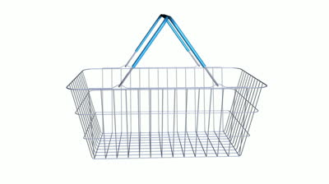
Survey details
  Live mid Feb to end of April 2019.
  A large increase in direct supplier participation (55%).
  The addition of Ocado and B&M is the most significant change since the survey started.
1,417 Direct suppliers
114 Indirect
suppliers
25 Trade Associations

Slide 4
Who took part?
Direct suppliers
Personally based…
Direct supplier size
(No. of employees)
Micro
Small
Medium
Large
75% supply branded products
64% supply own label products
Q19b. And where are you personally based? Base: all direct suppliers (1130) / all direct suppliers based outside the UK (122) Q2. What products do you supply across branded and own label types? Base: direct suppliers (1148)
Q18. How many employees do you have? Base: direct suppliers (1131)

Slide 5
Which retailers supplied?
Direct suppliers

Slide 6

Awareness of the Code and GCA

Slide 7
Direct suppliers
Awareness & understanding of the GCA’s role and responsibilities
2019
Understanding of the GCA’s role & responsibilities
GCA awareness
2018
2018
Notes:
Larger suppliers are more likely to be aware of the GCA’s role than smaller suppliers. Only 9% of large suppliers were unaware compared to 22% of small suppliers and 30% of micro suppliers. Supplier size also affected understanding of the GCA: 81% of large suppliers rated their understanding as ‘good’ or ‘fair’ compared to 67% of small suppliers and 54% of micro suppliers.
Perhaps unsurprisingly, awareness was also higher among direct suppliers based in the UK (89%) than those based abroad (55%)

Slide 8
Direct suppliers
Why suppliers wouldn’t/ aren’t sure whether they would consider raising issues with the GCA
Among this 53%...
Notes:
Unlike in previous years, micro suppliers are now the most likely to say they would raise an issue with the GCA (52%); just under half (48%) of large suppliers said the same.
Those who have had training on the code are more likely to raise an issue (54%) than those who have not (41%).

Slide 9

Training on the Code

Slide 10
Direct suppliers
Have you received any training on the Code?
By supplier size
Yes

Slide 11

Experience of issues

Slide 12
Issues experienced in the past 12 months? (in Code language)
Direct suppliers
Among those who only had one type of issue (20%) – it was delay in payments (25%) ahead of compensation for forecasting (18%) and de-listing duties (16%).
Notes:
Notable decrease in the share of issues around delay in payments.
Compensation for forecasting errors becomes number one issue.

Slide 13
Issues experienced in the past 12 months? (in supplier language)
Direct suppliers
63% had experienced least one of the issues.
51% only experienced one of the issues listed.
Notes:
Issues over 5% only

Slide 14
Raising issues with a retailer in the last year
Direct suppliers
9% of micro, 7% of small, 8% of medium, 10% of large direct suppliers
2018

Slide 15
Code-related issues direct suppliers have experienced – by retailer
Direct suppliers
 | Retailer 1 | Retailer 2 | Retailer 3 | Retailer 4 | Retailer 5 | Retailer 6 | Retailer 7 | Retailer 8 | Retailer 9 | Retailer 10 | Retailer 11 | Retailer 12
Incurring significant costs when cause is inaccurate forecasting by the retailer | 7% | 7% | 7% | 10% | 4% | 0% | 7% | 3% | 10% | 7% | 5% | 8%
Inadequate processes and procedures in place to enable invoice discrepancies to be resolved promptly | 6% | 3% | 14% | 8% | 4% | 0% | 5% | 7% | 8% | 4% | 7% | 5%
De-listing, including significant reduction in volume without giving reasonable notice | 7% | 4% | 5% | 7% | 4% | 2% | 6% | 3% | 6% | 6% | 2% | 4%
Not allowing time (e.g. 30 days) to challenge proposed invoice deductions, or deducting even if challenged | 4% | 1% | 4% | 4% | 2% | 1% | 4% | 4% | 4% | 3% | 5% | 4%
Requirement to predominantly fund the cost of a promotion | 6% | 1% | 2% | 7% | 7% | 0% | 7% | 9% | 7% | 3% | 1% | 5%
Data input errors (e.g. pricing) not resolved promptly (e.g. 7 days) | 4% | 1% | 7% | 3% | 1% | 0% | 2% | 2% | 4% | 1% | 4% | 3%
Drop and drive: delays in, or not receiving, payment when there are disagreements over deliveries | 2% | 2% | 5% | 4% | 1% | 0% | 3% | 6% | 4% | 1% | 4% | 1%
Undisputed invoices not paid according to agreed terms | 2% | 2% | 4% | 2% | 1% | 0% | 2% | 4% | 3% | 3% | 5% | 2%
Unfair, unreasonable or unexpected charges for artwork and design | 2% | 9% | 6% | 3% | 1% | 1% | 2% | 0% | 2% | 1% | 3% | 2%
Retrospective changes to supply agreements | 2% | 3% | 3% | 3% | 1% | 1% | 1% | 1% | 4% | 3% | 2% | 4%
Variation of supply chain procedures without reasonable notice | 2% | 2% | 2% | 2% | 1% | 1% | 2% | 2% | 2% | 2% | 2% | 2%
Unilateral changes to supply agreements/terms of supply by retailers without reasonable notice | 1% | 3% | 2% | 2% | 1% | 2% | 2% | 2% | 2% | 3% | 3% | 2%
Unjustified charges for consumer complaints with no explanation | 1% | 1% | 3% | 4% | 3% | 0% | 6% | 2% | 1% | 0% | 1% | 2%
N.B. Retailers have been shuffled and are NOT shown in alphabetical order
Example of how to read this table: for each issue:
All issues that are 3% or lower are coloured green
All issues that are between 4% and 6% are coloured amber
All issues that are 7% or more are coloured red
Q6d. And with which retailers have you experienced these issues in the last 12 months? For each issue please tick all retailers you have experienced this with or 'none of these' if none.

Slide 16
Have a written supply agreement with these retailers?
Direct suppliers
Average across retailers
2019: 47%*
2018: 48%
2017: 47%
Notes:
2019 average excluding Ocado and B&M is 50%

Slide 17
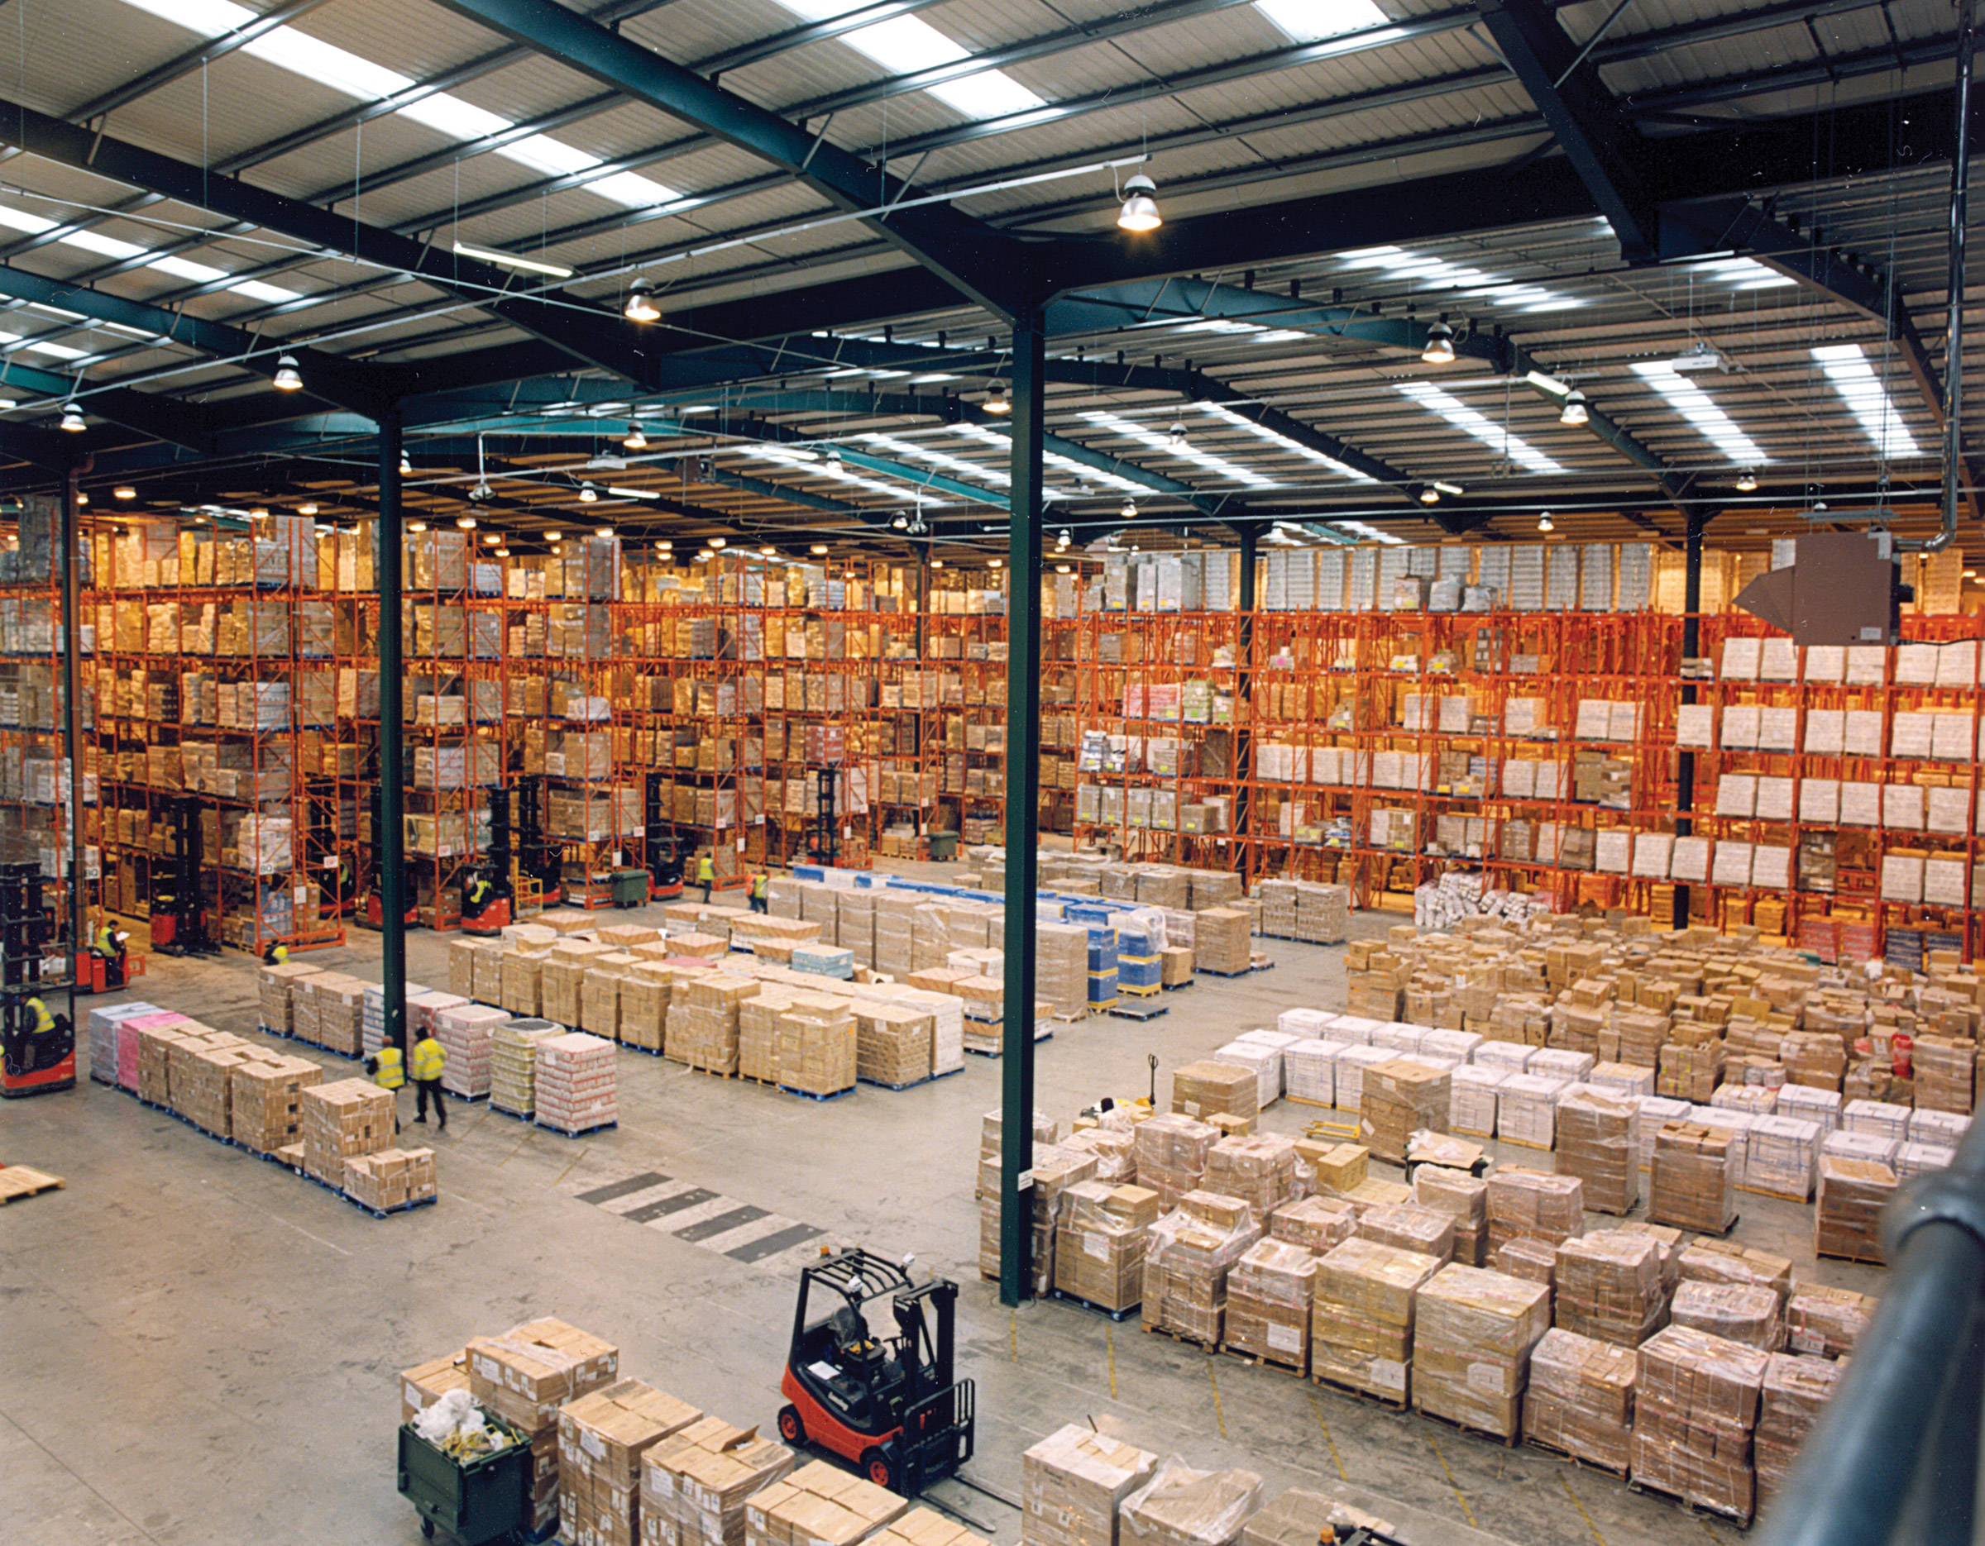
Overall assessment

Slide 18
Change in retailer practice over the past 12 months
Direct suppliers commenting on the retailers they have supplied in the past 12 months
18
16
10
7
6
5
Net improvement
score (2019)
(improved% minus worsened%)
3
-2
-2
-3
Improved
Stayed the same
Worsened
N.B. Retailers have been ranked by net improvement score to 2 dp.
Notes:
In 2018 there was strong perceived improvement from Tesco and Morrisons with Cooperative in 4th.

Slide 19
Trading relationships with suppliers conducted fairly, in good faith & without duress?
Direct suppliers commenting on the retailers they have supplied in the past 12 months
N.B. Retailers have been ranked by net ‘strongly agree’ and ‘tend to agree’ to 2 dp.
Notes:
THIS HAS SHIFTED QUITE CONSIDERABLY – WITH ASDA AND SAINSBURYS RISING AND COOPERATIVE FALLING RELATIVE TO OTHERS.
OCADO ENTERS IN MID RANKING, B&M CLOSE TO THE BOTTOM.

Slide 20
Overall assessment of compliance with the Code
Direct suppliers commenting on the retailers they have supplied in the past 12 months
Aldi
Sainsbury’s
Waitrose
Tesco
Asda
Morrison's
Lidl
M&S
Ocado
Co-operative
Iceland
B&M
Retailers ranked by net ‘consistently well’ and ‘mostly’ (to 2 dp)

Slide 21
Other comments
“Whilst many buyers and retailers have had GSCOP training, they do not appear to be too worried about the code. There are too many grey areas within the code for them to bend the ‘rules’ and treat suppliers un-ethically as well as unfairly.”
“Whilst I applaud the work done to date by the GCA, I would like it to be made easier to report retailer violations and/or to get impartial guidance on suspected transgressions”
  Comments made at the end of the survey covered many issues, including…
    Many report a positive experience of the GCA leading to a more balanced relationship with retailers
    Concern over future mergers; several were unhappy about how the merger of Booker and Tesco led to confusion of how the Code should be applied
    A desire for further GCA regulation of retailers (in numbers: Amazon (12), Boots (10), Superdrug, Wilkinsons, Home & Bargains, Booths, Brakes, Bidfoods (all 3).
    Some smaller suppliers feeling that they are not offered sufficient protection in their dealings with retailers
    Several comments point to areas the Code doesn’t cover, for example food service sector.
“Lack of clarity between what is hard (but acceptable) negotiation versus behaviour incompliant with the Code”
“GSCOP and role of GCA have been transformative in terms of retailer behaviour and the impact is to be applauded.”
“I believe areas of the retailers are improving, such as communication to us about 'reasonable notice' but worsened in areas such as lump sums being asked for and requiring promotions to be predominantly funded or not being open about the amount it costs to fund the promotion so you are not aware if you are predominantly funding.”
“Continue to feel that retailers ‘talk’ the Code but try every means possible to get around it in what they actually do.”

Slide 22

Trends over time

Slide 23
Direct suppliers
Selected key trends 2014 to 2019

