Slide 1
Microcontroller

Slide 2
Agenda
Introduction
Hardware Components
Coding

Slide 3
Arduino / ESP32
Arduino / ESP32 is the go-to gear hobbyists
With Arduino / ESP32, you can control almost everything around you, be it simple LED or giant robots
Basically Arduino / ESP32 are microcontroller boards
Microcontroller is microprocessor with memory, RAM and some other peripheral connected with it.

Slide 4
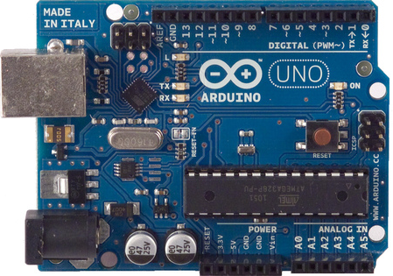
Example: Arduino Uno
What does it have?
Microcontroller ATmega328 with 20 MHz, 32 kB flash memory and 2 kB of RAM
14 Digital In/Out pins (6 can be used as PWM)
6 Analog Inputs
A USB Connection
A Power Jack
Reset Button
On-board LED
SCL/SDA pins (Serial Clock/ Serial Data pins)
ATmega328

Slide 5
Example: Arduino Uno
What does it have?
Microcontroller ATmega328 with 20 MHz, 32 kB flash memory and 2 kB of RAM
14 Digital In/Out pins (6 can be used as PWM)
6 Analog Inputs
A USB Connection
A Power Jack
Reset Button
On-board LED
SCL/SDA pins (Serial Clock/ Serial Data pins)
→ ESP32 boards are more powerful, often with 240 MHz dualcore, more memory, WiFi and Bluetooth
ATmega328

Slide 6
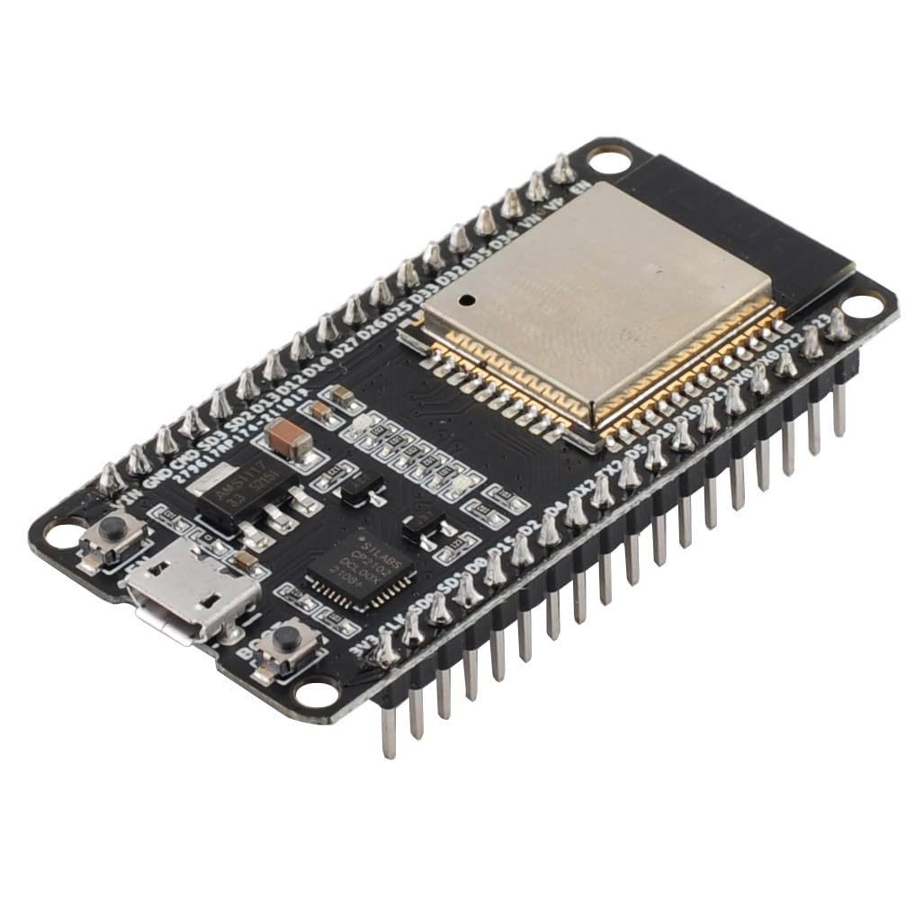
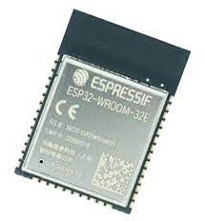
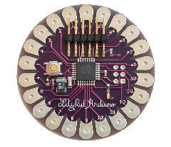
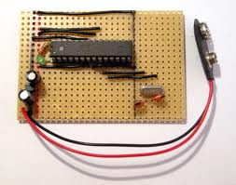
Different Types of Arduino / ESP32
Arduino Uno
ESP32 WROOM 32
ESP32 WROOM 32E N8
Arduino LilyPad
DIY Arduino

Slide 7
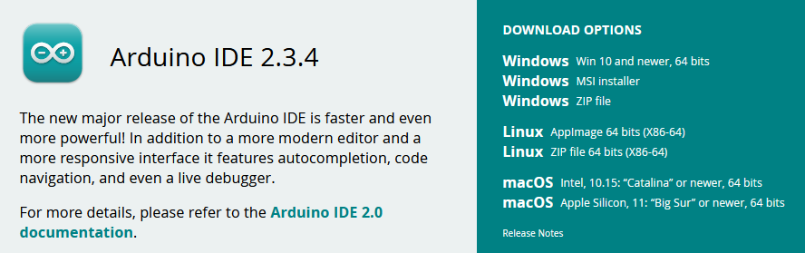
How to Code with Arduino / ESP32
You need to download Arduino IDE (Integrated Development Environment)
Arduino IDE is available for all Mac, Windows and Linux

Slide 8
How to Code with Arduino / ESP32
You need to download Arduino IDE (Integrated Development Environment)
Arduino IDE is available for all Mac, Windows and Linux
For more complex projects, other IDEs are available, like a VS Code plugin (platform.io)

Slide 9
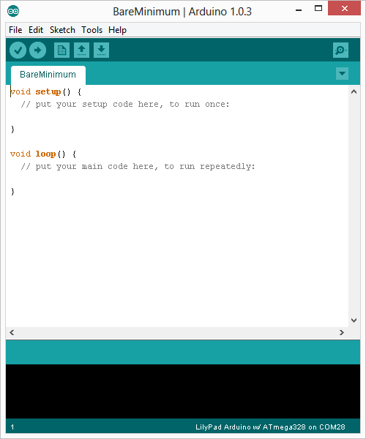
Run the Arduino IDE
Once you have downloaded and installed/extracted the folder, you can directly run Arduino.exe, which will take you to its IDE
The IDE will look like the shown screenshot

Slide 10
Run the Arduino IDE
Once you have downloaded and installed/extracted the folder, you can directly run Arduino.exe, which will take you to its IDE.
The IDE will look like the shown screenshot.
Coding language is C++

Slide 11
Run the Arduino IDE
Once you have downloaded and installed/extracted the folder, you can directly run Arduino.exe, which will take you to its IDE.
The IDE will look like the shown screenshot.
Coding language is C++
Setup: Code will run once the Arduino / ESP 32 is started
Loop: After setup was called, the loop will run indefinitely

Slide 12
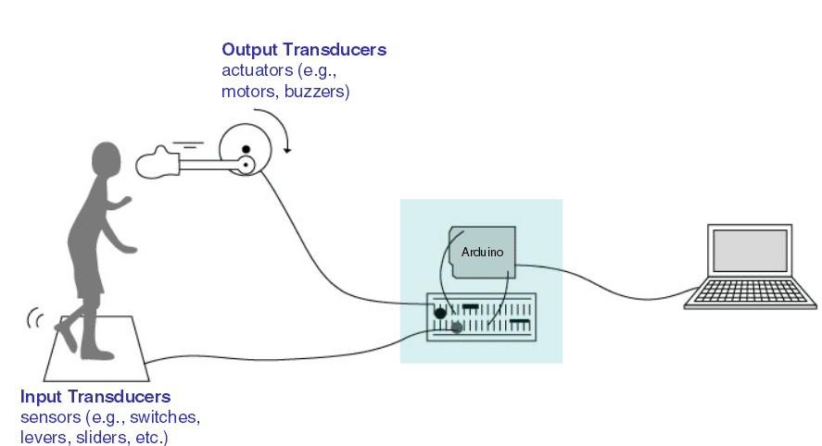
Inputs vs. Outputs

Slide 13
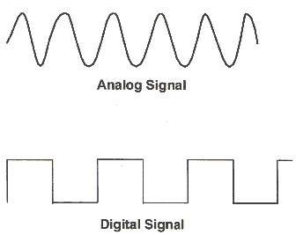
Reading (Input) and Writing (Output) Data
The pins can be used to read or write data
digitalWrite()
analogWrite()
digitalRead()
analogRead()
5 V
5 V
0 V
0 V

Slide 14
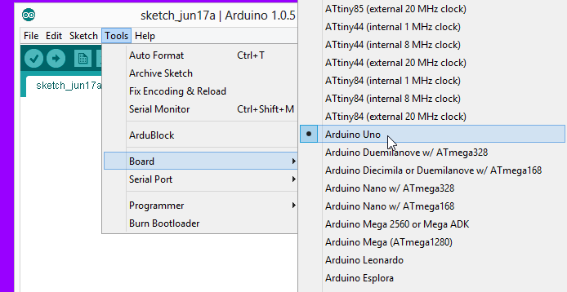
Upload Code: Board Selection
Before uploading your code to the Arduino / ESP32, double check that correct board is selected under Tools → Board

Slide 15
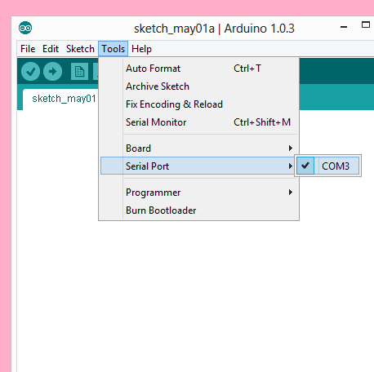
Upload Code: Serial Port Selection
Before uploading the serial port has to be selected (defines which USB port the Arduino / ESP32 is connected to)

Slide 16
Upload Code: Upload
Upload code to the Arduino / ESP32
Once uploaded, whenever powered the microcontroller will start executing the code (setup first, then loop)

Slide 17
Agenda
Introduction
Hardware Components
Coding

Slide 18
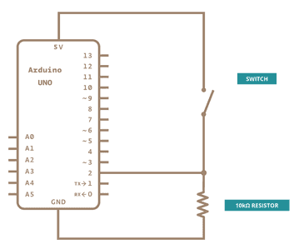
Push Button
When button not pressed, 5 Volts are read on pin 2
When button is pressed, 0 Volt are read on pin 2

Slide 19
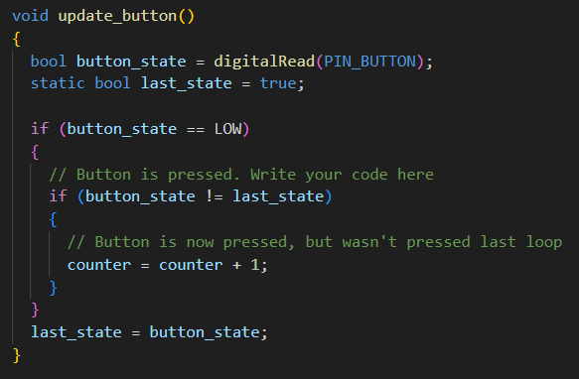
Push Button

Slide 20
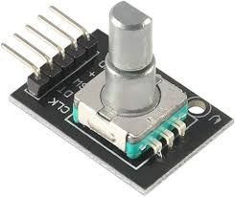
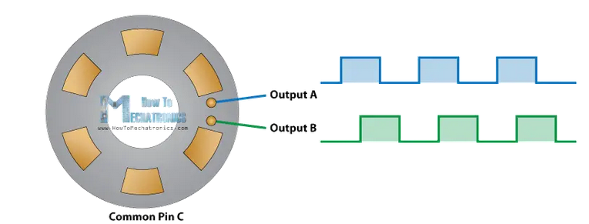
Rotary Encoder
Measure clockwise or counterclockwise rotations
Pin C can be connected to pin A and pin B via sliding contacts

Slide 21
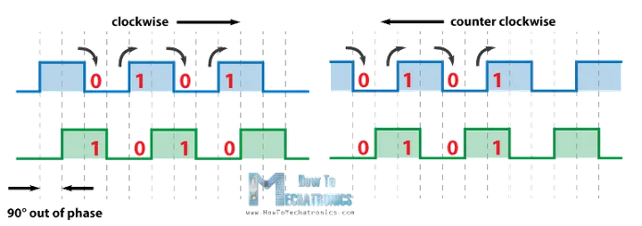
Rotary Encoder
Measure clockwise or counterclockwise rotations
Pin C can be connected to pin A and pin B via sliding contacts
Pin C: Ground
Pin A and B are measured
Pin A
Pin B

Slide 22
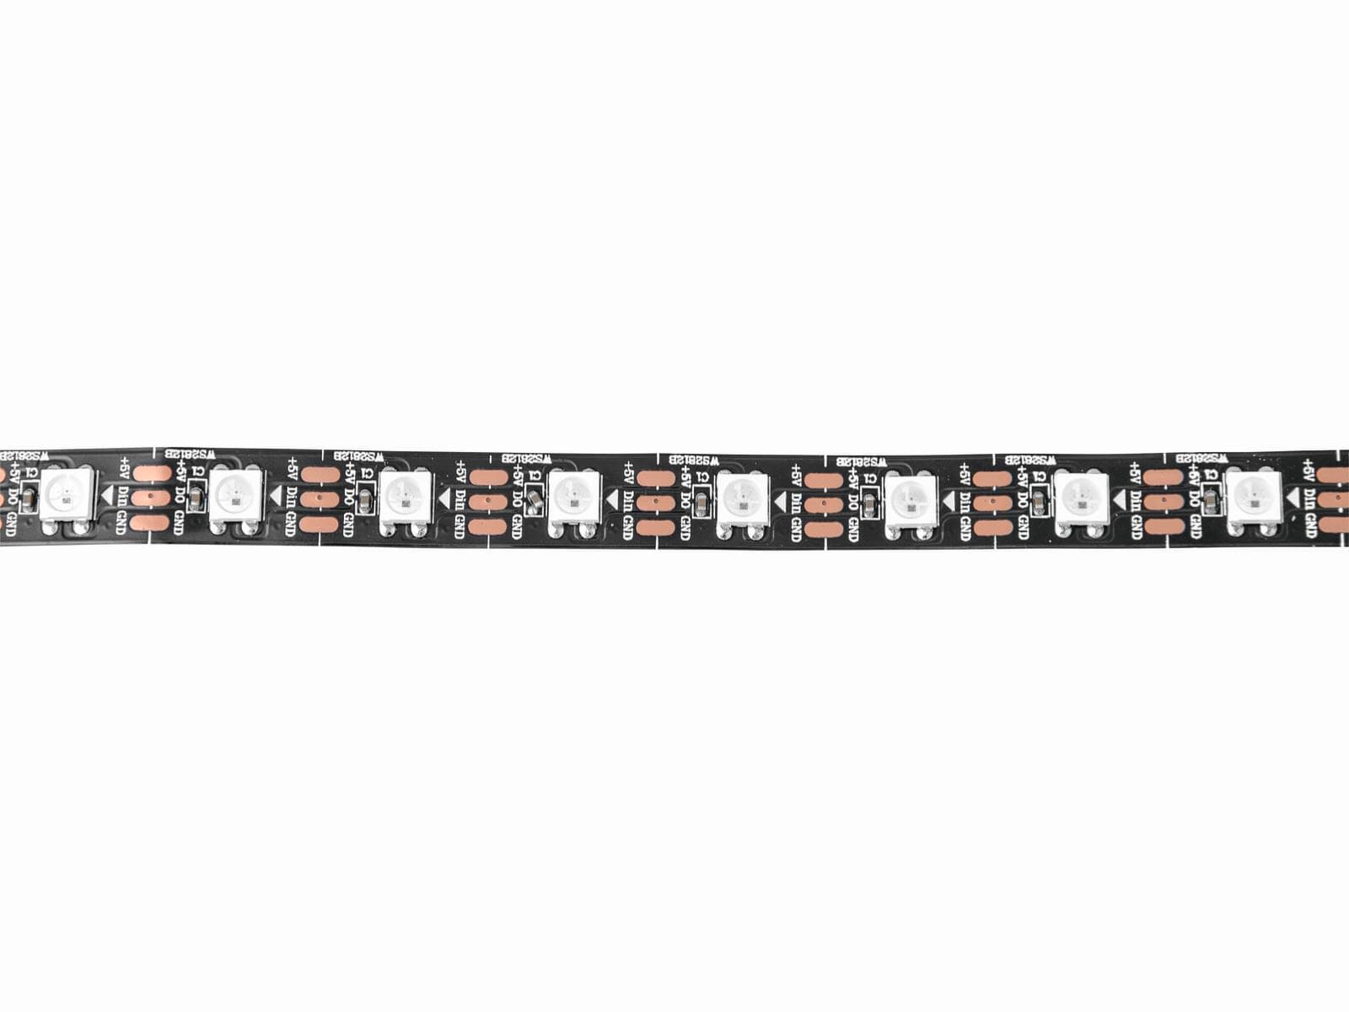
LEDs
LED type WS2812b
Each Red, Green, Blue (RGB) has a value from 0 – 255 (8 bit)
Ground
Data
5 Volts
 | LED 1 | LED 2 | LED 3 | …
Red | 100 | 0 | 255 | …
Green | 0 | 0 | 255 | …
Blue | 0 | 0 | 255 | …

Slide 23
LEDs
LED type WS2812b
Each LED can be addressed individually, even with only one data connection
when data is transmitted to a an LED, which already has old data, the old data is send to the next LED
Ground
Data
5 Volts

Slide 24
LEDs
LED type WS2812b
Each LED can be addressed individually, even with only one data connection
Ground
Data
5 Volts
LED 1
LED 2
LED 3
Data

Slide 25
LEDs
LED type WS2812b
Each LED can be addressed individually, even with only one data connection
Ground
Data
5 Volts
R: 255
G: 255
B: 255
LED 1
LED 2
LED 3

Slide 26
LEDs
LED type WS2812b
Each LED can be addressed individually, even with only one data connection
Ground
Data
5 Volts
LED 1
LED 2
LED 3
R: 255
G: 255
B: 255

Slide 27
LEDs
LED type WS2812b
Each LED can be addressed individually, even with only one data connection
Ground
Data
5 Volts
R: 0
G: 0
B: 0
LED 1
LED 2
LED 3
R: 255
G: 255
B: 255

Slide 28
LEDs
LED type WS2812b
Each LED can be addressed individually, even with only one data connection
Ground
Data
5 Volts
LED 1
LED 2
LED 3
R: 0
G: 0
B: 0
R: 255
G: 255
B: 255

Slide 29
LEDs
LED type WS2812b
Each LED can be addressed individually, even with only one data connection
Ground
Data
5 Volts
R: 100
G: 0
B: 0
LED 1
LED 2
LED 3
R: 0
G: 0
B: 0
R: 255
G: 255
B: 255

Slide 30
LEDs
LED type WS2812b
Each LED can be addressed individually, even with only one data connection
Ground
Data
5 Volts
LED 1
LED 2
LED 3
R: 100
G: 0
B: 0
R: 0
G: 0
B: 0
R: 255
G: 255
B: 255

Slide 31
LEDs
LED type WS2812b
Each LED can be addressed individually, even with only one data connection
Ground
Data
5 Volts
LED 1
LED 2
LED 3
→ When no new signal is sent for a certain while, all LEDs change colors
R: 100
G: 0
B: 0
R: 0
G: 0
B: 0
R: 255
G: 255
B: 255

Slide 32
Agenda
Introduction
Hardware Components
Coding

Slide 33

LEDs: Code Setup 1/2
Library to control the LEDs → FastLED
Define the number of LEDs on our LED strip

Slide 34

LEDs: Code Setup 1/2
Library to control the LEDs → FastLED
Define the number of LEDs on our LED strip
Define an array that contains our RGB value
CRGB is a data structure from FastLED
e.g. pixel_buffer[2].r is the red value of the third LED
Constant values of many different colors are available, e.g. CRGB::YELLOW

Slide 35
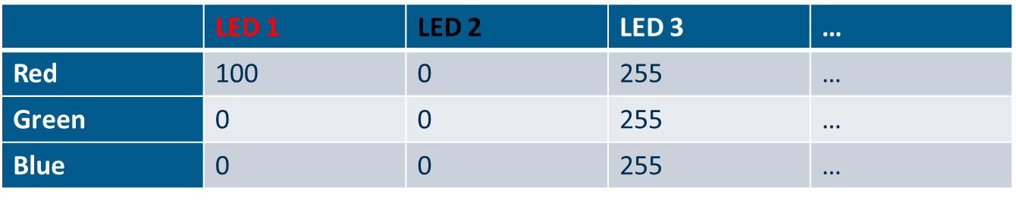
LEDs: Code Setup 1/2
Library to control the LEDs → FastLED
Define the number of LEDs on our LED strip
Define an array that contains our RGB value
CRGB is a data structure from FastLED
e.g. pixel_buffer[2].r is the red value of the third LED
Constant values of many different colors are available, e.g. CRGB::YELLOW

Slide 36
LEDs: Code Setup 2/2
Tell FastLED what LEDs are used, what pin the LED strip is on and what array to use for LED data

Slide 37

LEDs: Code Setup 2/2
Tell FastLED what LEDs are used, what pin the LED strip is on and what array to use for LED data
Send the pixel_buffer data to the LED strip

Slide 38
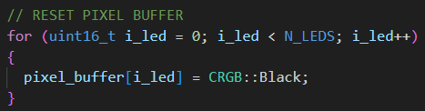
LEDs: Code Setup 2/2
Tell FastLED what LEDs are used, what pin the LED strip is on and what array to use for LED data
Send the pixel_buffer data to the LED strip
Reset the pixel_buffer by setting all values to black

Slide 39
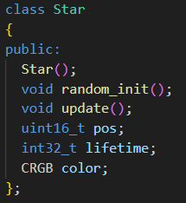
Star Animation 1/5
Idea: have random single LEDs light up in rainbow colors for a short period of time
Define the number of stars we want
Create an array with possible colors for the star
Using object oriented programming to create a Star class
functions
properties

Slide 40
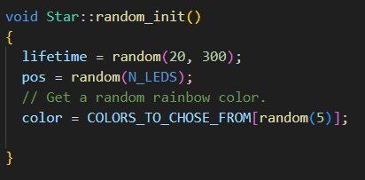
Star Animation 2/5
Function 1: random_init

Slide 41
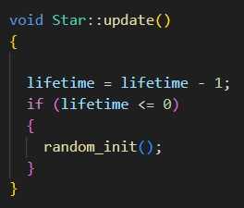
Star Animation 3/5
Function 2: update

Slide 42

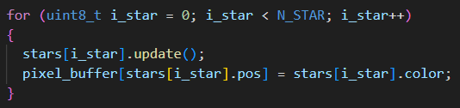
Star Animation 4/5
Initialization of arrays of Star objects
Setup: initialize each star once
Loop: Update each star and write star color to pixel_buffer

Slide 43
Star Animation 5/5
More code is added to make the star animation prettier
Brightness is fading in and out
Have breaks between a star ends and a new star beginns
Choosing any of the rainbow colors (wheel function)

Slide 44
Drop Animation
A colorful raindrop running down the LED strip
Similar structure to Star
Functions random_init and update
Parameters for color, position
Instead of a lifetime, the drop runs through the strip and ends after running out of the strip

