Slide 1
AngioGame
CS: 480 Final Presentation
Prepared By:
Jacob Culley and Russell Short
Mentor: Dr. Vanscoy

Slide 2
What is AngioGame
A fully interactive Cardiovascular System exploration simulator game.
Provides a medically accurate representation of the human Cardiovascular System that one would see from the inside.

Slide 3
Why AngioGame?
There is a strong need for educational software that engages the user along with teaching them about the material.
Provide an enjoyable gaming experience with the capacity to teach the player about what is actually going in within the human body.

Slide 4
Objective Tree

Slide 5
What will players be doing?
You get to create your player character which will be the ships captain.
You get to select and/or build your crew.
Accept and complete missions.

Slide 6
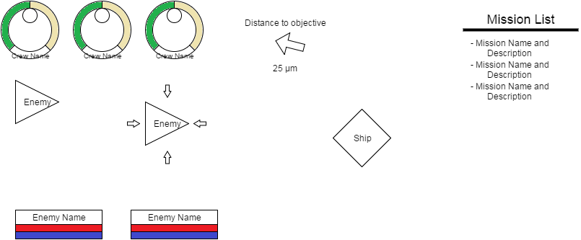
What will it look like?

Slide 7
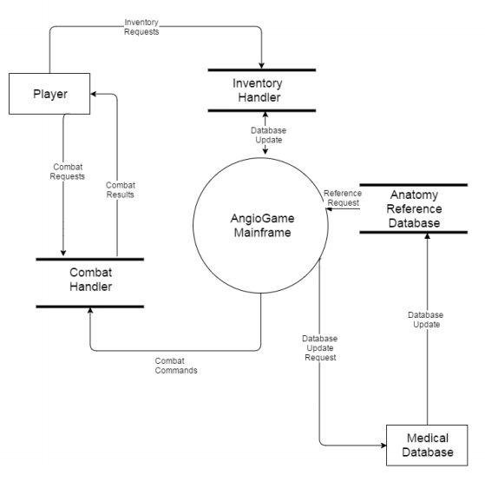
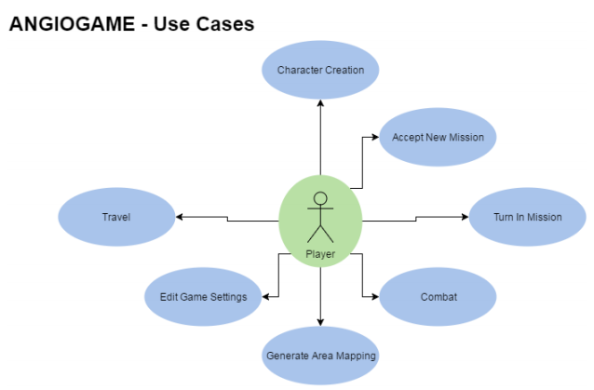
Overall Architecture

Slide 8
Major Technologies
Android OS devices and software
IOS devices and software
Rendering software
Unity type technologies

Slide 9
Innovative and Creative Aspects
Attempt to expand the users understanding of difficult and complex material through the use of interactive software.
Use a procedurally generated vessel and artery rendering technique to reduce storage requirements.

Slide 10
Challenges and Uncertainties
Attaining AMA certification for medical accuracy.
Hardware and software compatibility.
Accurate rendering of vessels and arteries.

Slide 11
Expected Outcomes
Have a fully functional prototype that can perform the basic functions of the game.
Would like to have IOS and Android OS compatible software for greater marketability.

Slide 12
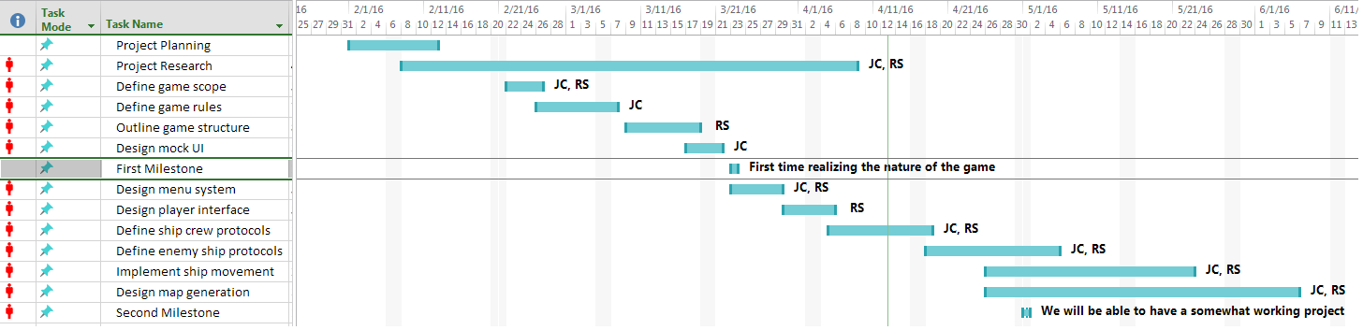
Project Plan

Slide 13
Component Procurement Plan
To ensure medical accuracy we have access to licensed medical doctors in pertinent fields.

Slide 14
Conclusion
Questions?

