Slide 1
Online Chatbot based ticketing system
CSE7101- Capstone Project
Review-2
Batch Number:CSE_130
Roll Number | Student Name
20221CSE0359 20221CSE0256 20221CSE0274 | Spandana KG Misba Ain M Priyanka
Under the Supervision of,
Mr.Afroj Alam
Assistant Professor
School of Computer Science and Engineering
Presidency University
Name of the Program: B.Tech CSE
Name of the HoD: Dr. Asif Mohammed
Name of the Program Project Coordinator: Dr. Jayavadivel Ravi
Name of the School Project Coordinators: Dr. Sampath A K , Dr. Geetha A

Slide 2
Problem Statement Number:
Organization: Travel & Tourism
Category (Hardware / Software / Both) : Software
Problem Description:
The implementation of a chatbot for ticket booking in a museum addresses several critical needs, enhancing the overall visitor experience and streamlining museum operations. Here are the key reasons for adopting a chatbot ticket booking system:
1. Improved Customer Service
2. Efficient Handling of High Volumes
3. Cost-Effective Solution
4. Data Collection and Analysis
5. Accessibility
6. Reduced Human Error
7. Multilingual Support
8. Enhanced Marketing and Promotion

Slide 3
Content
Abstract
Literature Survey
Objectives
Existing methods and drawbacks
Proposed method and Feasibility study
Architecture Diagram
Modules
Hardware and Software Details
Timeline(Gantt Chart)
References

Slide 4
Abstract
The Online Chatbot-Based Ticketing System is designed to automate and simplify customer support and service request handling. Traditional ticketing systems often require manual intervention, leading to delayed responses, customer dissatisfaction, and high operational costs. Customers frequently struggle with long wait times or complex navigation before their issues are addressed.
This project addresses these challenges by integrating an AI-powered chatbot into the ticketing process. The chatbot acts as the first point of contact, instantly interacting with users to collect queries, categorize issues, and generate support tickets in real time. By automating initial interactions, the system reduces workload on support staff, improves response times, and ensures that tickets are properly classified and routed to the right department.
The key objectives of this project are to enhance customer experience through instant query resolution, streamline ticket management, and minimize human effort in repetitive tasks. The approach combines natural language processing (NLP) for understanding user inputs, an intelligent backend for ticket tracking, and a user-friendly interface for monitoring ticket status.
Overall, the chatbot-based ticketing system provides a faster, smarter, and more efficient way to handle customer issues, ensuring scalability, improved service quality, and higher customer satisfaction.

Slide 5
Literature Survey
Zangari, A., Ticket automation: an insight into current research, Expert Systems with Applications, 2023.
Bonechi, S., Leveraging AI for Efficient Ticket Classification, Procedia Computer Science, 2024.
Gandla, P.K.K., et al., Ticket Classification Using Machine Learning, Springer Proceedings, 2024.
Marcuzzo, M., et al., A multi-level approach for hierarchical Ticket Classification, ACL W-NUT, 2022.
Bird, J.J., et al., Customer service chatbot enhancement with attention-based transfer learning, Knowledge-Based Systems, 2024.
Liu, Z., et al., Labeling Incident Management Tickets with Language Models (Ticket-BERT), 2022.
Ferreira, L., SNOOKER: a dataset generator for helpdesk services, Journal of Intelligent Information Systems (Springer), 2024.
Zangari, A., Combining deep ensemble learning and explanation for ticket classification, Expert Systems with Applications, 2022.
Al-Khawaldeh (example domain), Efficient intent classification & NER for a multilingual service chatbot, Elsevier journal, 2023.
Zhai, X., Intent detection for task-oriented conversational agents: RNN vs. Transformers, Wiley – Expert Systems, 2024.

Slide 6
Objectives
The primary objectives of this project are:
•To design and develop an intelligent, conversational AI chatbot for booking tickets in a natural, user-friendly manner.
•To implement a secure and reliable payment gateway (e.g., Stripe, Razorpay) for seamless online transactions.
•To build a multilingual system that can cater to a diverse, international audience.
•To create a back-end admin dashboard for staff to monitor bookings, view analytics, and manage event listings.
•To enhance the visitor experience by reducing wait times, eliminating booking errors, and providing 24/7 support for inquiries.

Slide 7
Existing Methods and Drawbacks
Existing Methods
On-site manual ticket counters.
Basic web-based forms.
Generic e-commerce chatbots used for general customer support
Drawbacks of Existing Methods
Inefficiency and Time Consumption: Manual systems lead to long queues, particularly during peak times, creating a poor visitor experience.
Proneness to Errors: Manual processes are susceptible to mistakes like incorrect ticket issuance, double bookings, or lost records.
Lack of Accessibility: These systems often do not have multilingual support and are not easily accessible for users who need immediate information.
High Pre-Visit Friction: Traditional methods are not interactive, which contributes to visitor frustration before they even arrive.
Operational Overhead: Manual ticketing can negatively affect a museum's reputation and operational efficiency.
Generic Nature: Standard e-commerce chatbots are not specifically designed for the unique needs of museum ticketing, which involves specific dates, time slots, and various ticket types.

Slide 8
Proposed Methods and Feasibility Study
Proposed Method:
The project proposes the development and implementation of a specialized, intelligent, conversational AI chatbot for booking museum tickets.
This system is designed to replace traditional manual and basic online booking methods with a more efficient, user-friendly, and accessible solution.
The core of the proposed system includes:
A conversational AI chatbot for natural, user-friendly ticket booking³.
Secure payment gateway integration (e.g., Stripe, Razorpay) for seamless online transactions.
Multilingual support to cater to a diverse, international audience.
A back-end admin dashboard for staff to monitor bookings, view analytics, and manage event listings.

Slide 9
Proposed Methods and Feasibility Study(contd...)
Feasibility Study
The project outlines a modern and robust technology stack, which supports the feasibility of the proposed system:
Frontend: The use of Next.js and Tailwind CSS allows for the creation of a fast, responsive, and user-friendly chat interface.
Backend: Firebase provides a real-time database, authentication, and hosting, while Node.js offers a scalable server-side environment
Generative AI: The integration of Genkit will power the chatbot's conversational capabilities.
Deployment: Google Cloud will be used for hosting, ensuring scalability and reliable infrastructure management.
The specified hardware and software requirements, such as an Intel Core i3 processor, 8 GB of RAM, and standard development tools like Visual Studio Code and Git, are readily available and do not pose significant barriers.

Slide 10
Proposed Methods and Feasibility Study(contd...)
  Addressing Existing Problems​
  The proposed chatbot system directly addresses the key drawbacks of current methods:​
    It aims to eliminate long queues and reduce booking errors by providing a 24/7 automated booking platform.​
    The inclusion of multilingual support makes it accessible to a global audience, overcoming a major limitation of traditional systems.​
    The system is designed to handle high volumes of booking requests efficiently, which manual systems struggle with.​
    Innovative Contributions​
    The project's feasibility is further strengthened by its innovative aspects:​
      Domain-Specific Intelligence: Unlike generic chatbots, this system will be specifically trained for the museum context, handling queries about exhibits and events.​
      Actionable Analytics: The admin dashboard will provide valuable data on visitor patterns, allowing the museum to optimize operations and make data-driven decisions.​
      Based on the clearly defined objectives, a well-chosen technology stack, and the direct solutions it provides for existing problems, the proposed chatbot-based ticketing system is a highly feasible project.​

Slide 11
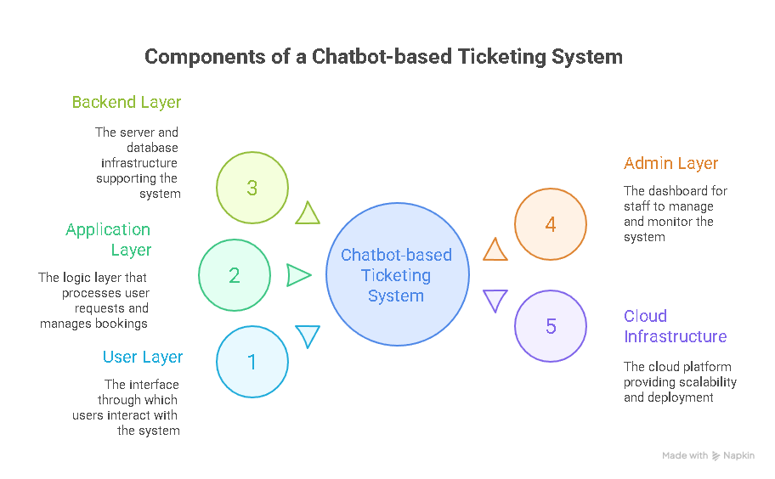
Architecture Diagram

Slide 12
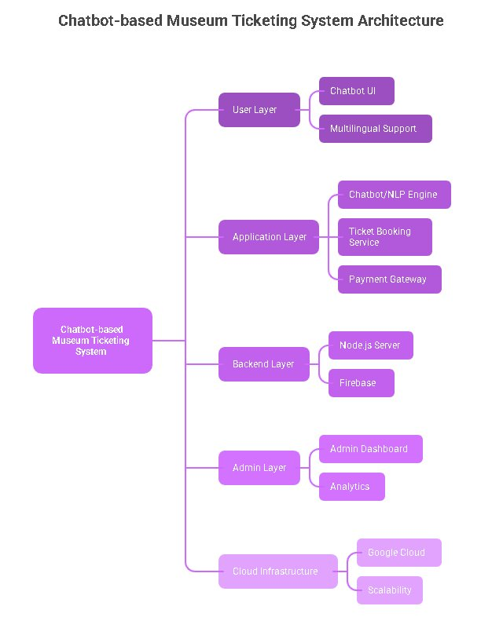

Slide 13
​Modules
1. User Interaction Module
Chatbot interface (Next.js + Tailwind)
Multilingual support
Real-time user interaction
2. Booking Module
Seat/slot validation
Ticket booking confirmation
3. Payment Module
Secure online payments (Stripe/Razorpay)
Payment receipts

Slide 14
​Modules
4. Admin Module
Event & exhibit management
Booking analytics and monitoring
5. Database Module
Firebase authentication
User & booking data storage
6. AI Module
Natural Language Processing (NLP)
Intent classification and response generation

Slide 15
Hardware and Software Details
Hardware
Processor: Intel i3 or higher
RAM: 8GB minimum
Storage: 256 GB SSD
Internet connection
Software
Frontend: Next.js, Tailwind CSS
Backend: Node.js, Express
Database: Firebase
AI Tools: Genkit (for chatbot), NLP models
Deployment: Google Cloud
Dev Tools: Git, VS Code, Postman

Slide 16
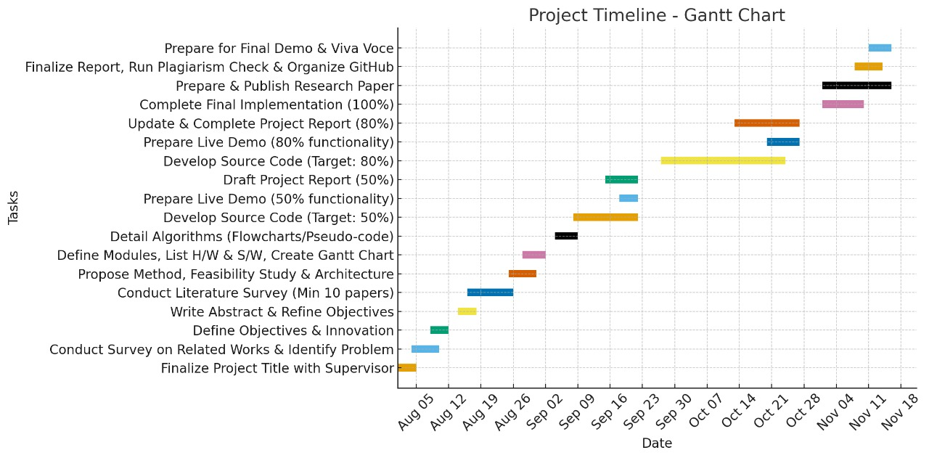
Timeline of the Project (Gantt Chart)

Slide 17
References (IEEE Paper format)
  [1]. A. Kumar, B. R. Patel, and C. Zhang, “Plant disease identification using convolutional neural networks,” IEEE Access, vol. 9, pp. 34567–34578, Mar. 2021.
  [2]. J. Smith, “Deep learning in agricultural systems,” IEEE Transactions on Neural Networks and Learning Systems, vol. 32, no. 7, pp. 1234–1245, Jul. 2021.

Slide 18


