Slide 1
SMART CLASSROOM AND TIMETABLE SCHEDULAR
Review-2
Batch Number:
Under the Supervision of,
Dr. Akshatha Y
Assistant Professor
School of Computer Science and Engineering
Presidency University
Roll Number | Student Name
20221CSE0359 | Spandana K G
20221CSE0256 | Misba Ain
20221CSE0274 | M Priyanka
Name of the Program: School of Computer Science and Engineering
Name of the HoD: Dr. Asif Mohammed
Name of the Program Project Coordinator: Dr. Jayavadivel Ravi
Name of the School Project Coordinators: Dr. Sampath A K , Dr. Geetha A

Slide 2
Problem Statement Number: 25028
Organization: Smart Education
Category : Software
Problem Description:
Background
Higher Education institutions often face challenges in efficient class scheduling due to limited infrastructure, faculty constraints, elective courses, and overlapping departmental requirements. Manual timetable preparation leads to frequent clashes in classes, underutilized classrooms, uneven workload distribution, and dissatisfied students and faculty members. With the increasing adoption of multidisciplinary curricula and flexible learning under NEP 2020, the class scheduling process has Become more complex and dynamic, requiring intelligent and adaptive solutions.
Description
The current scheduling mechanism in most higher education institutes/colleges relies on manual input via spreadsheets or basic tools. These fail to account for real-time availability of faculty, room capacity, teaching load norms, subject combinations, and student preferences. A solution is required that will accommodate the various parameters required for scheduling classes for UG and PG students and return an optimized timetable ensuring:

Slide 3
Problem Statement Number: 25028
*Maximized utilization of classrooms and laboratories
*Minimized workload on faculty members and students
* Achievement of required learning outcomes
Key Parameters
The following parameters can be taken into account as variables for creating optimized timetables:
Number of classrooms available
Number of batches of students
Number of subjects to be taught in a particular semester
Names of subjects
Maximum number of classes per day
Number of classes to be conducted for a subject per week / per day
Number of faculties available for different subjects
Average number of leaves a faculty member takes in a month
Special classes that have fixed slots in timetable

Slide 4
Content
Problem Statement
Objectives
Analysis of Problem Statement
Proposed method and feasibility study
Architecture Diagram
Git-hub Link
Timeline of the Project
References

Slide 5
Objectives
The primary goal of this project is to automate the academic scheduling process through a full-stack application that ensures conflict-free and optimized timetables. Key objectives include:
Conflict Prevention: Enforcing "Hard Constraints" such as preventing faculty and room overlaps, ensuring room capacity meets batch size, and respecting faculty daily limits.
Optimization: Implementing "Soft Constraints" to balance faculty workloads, minimize student idle time (gaps between classes), and maximize classroom utilization.
User Empowerment: Providing a multi-role system (Admin, Scheduler, Viewer) to manage data, generate alternatives, and approve finalized schedules.
Accessibility: Offering export capabilities in PDF and Excel formats for easy distribution.

Slide 6
Analysis of Problem Statement
1. Full Technology Stack
Frontend (Client-Side)
Core Framework: React v18.2 (Component-based UI architecture)
Language: TypeScript v5.3 (Static typing for reliability)
Build Tool: Vite v5.0 (Next-generation frontend tooling, faster than Webpack)
Styling: Tailwind CSS v3.4 (Utility-first CSS framework for responsive design)
Routing: React Router DOM v6.21 (Client-side routing)
HTTP Client: Axios v1.6 (Promise-based HTTP client for API requests)
Linting: ESLint + TypeScript-ESLint (Code quality and consistency)

Slide 7
Analysis of Problem Statement (contd...)
Backend (Server-Side)
Runtime Environment: Node.js (JavaScript runtime)
Web Framework: Express.js v4.18 (RESTful API development)
Language: TypeScript v5.3
ORM (Object-Relational Mapping): Prisma v5.8 (Type-safe database queries)
Validation: Express-validator v7.0 (Incoming request validation)
File Export Engines:
pdfkit v0.14 (PDF generation)
exceljs v4.4 (Excel spreadsheet generation)
Database & Security
Database: PostgreSQL (Relational Database System)
Authentication: JSON Web Tokens (JWT) v9.0 (Stateless authentication)
Encryption: Bcrypt v5.1 (Password hashing)
Environment Management: Dotenv v16.3 (Configuration management)

Slide 8
Analysis of Problem Statement (contd...)
Software:
OS: Cross-platform (Windows/Linux/macOS) due to Node.js environment.
Database: PostgreSQL instance.
Client: Modern Web Browser (Chrome/Edge) with JavaScript enabled.
Hardware (Server):
RAM: Minimum 4GB (to handle in-memory timetable generation arrays).
CPU: Multi-core processor recommended for concurrent generation requests.

Slide 9
Analysis of Problem Statement (contd...)
Algorithm Approach: Randomized Heuristic Search (Greedy approach with multiple attempts).
Workflow:
Initialization: The system defines working days (Mon-Fri) and standard time slots (09:00 - 17:15).
Constraint Checking:
Capacity Check: classroom.capacity < requiredCapacity
Faculty Availability: Verifies maxClassesPerDay limits.
Conflict Detection: Uses a Hash Map (Map<string, Set<string>>)
to track occupied slots for Batches, Faculties, and Rooms in $O(1)$ time.
Scoring Function:
Score= 100 - (Violations * 10) - (Variance*2) + (Utilization*10)
Note: The formula above is derived from the logic in calculateScore method.

Slide 10
Proposed method and feasibility study
Proposed Method: Constraint-Based Heuristic Algorithm
The system utilizes an iterative, greedy approach with randomization:
Initialization: Creates a 5-day × 7-slot grid.
Fixed-Slot Priority: Schedules pre-assigned classes first to ensure mandatory slots are honored.
Iterative Placement: Uses a "Shuffled Batch" order to attempt class placements, validating against hard constraints (faculty/room availability) at every step.
Overlapping Logic: For practical sessions, the system blocks the primary slot and all overlapping 1-hour slots to ensure total room/faculty exclusivity.
Feasibility Study
Technical Feasibility: The project uses a modern PERN stack (PostgreSQL, Express, React, Node) and TypeScript, which provides the type safety and performance required for complex calculations.
Operational Feasibility: With a setup time of under 10 minutes and pre-configured seed data, the system is easily deployable for educational institutions.
Algorithm Efficiency: The time complexity is O(n × m × s), making it efficient enough to generate multiple options in real-time for small-to-medium-sized departments.

Slide 11
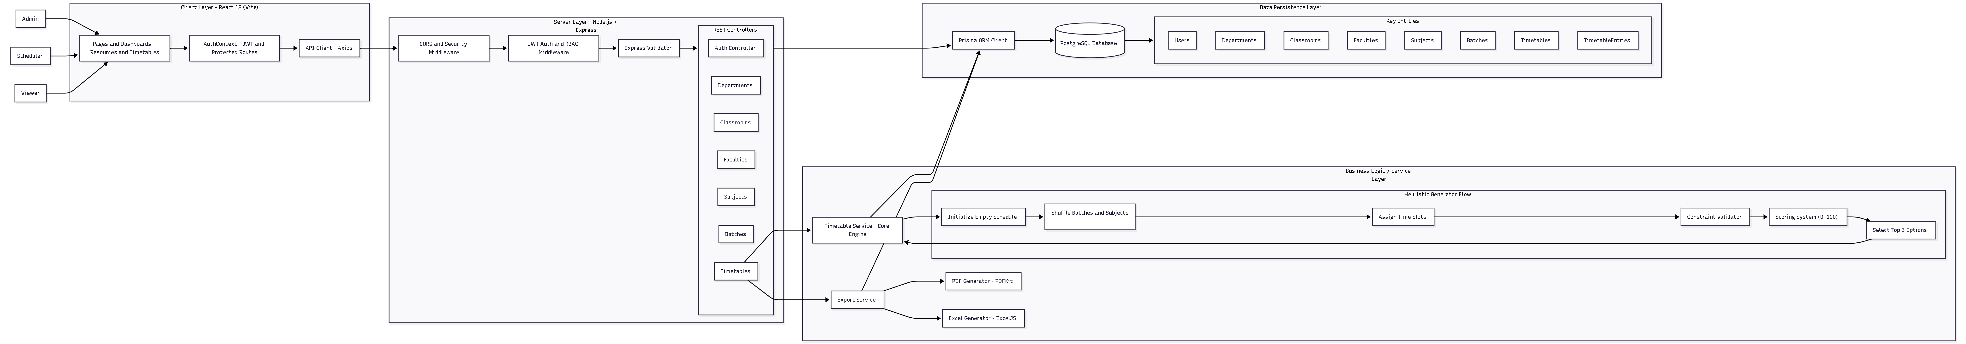
Architecture Diagram

Slide 12
Github Link
Github Link
https://github.com/Span-09/Smart-Classroom-and-Timetable-Scheduler-
Visibility : Public

Slide 13
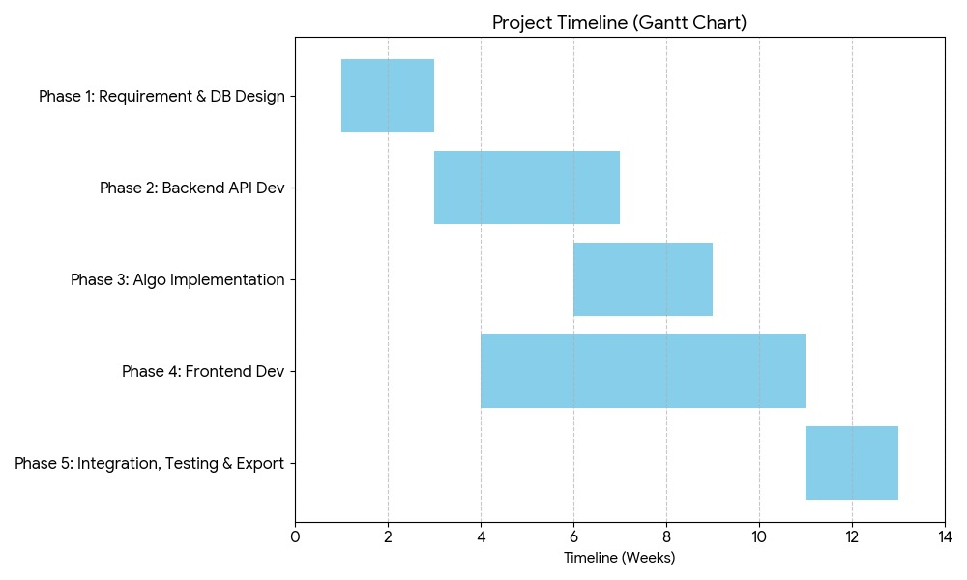
Timeline of the Project (Gantt Chart)

Slide 14
References (IEEE Paper format)
[1] S. A. K. Al-Hajri, "Automating Timetable Generation with Conflict Resolution Algorithms in Web-Based Systems for Educational Institutions," 2023 Intelligent Computing and Control for Engineering and Business Systems (ICCEBS), Bangalore, India, 2023, pp. 1-6.
[2] Z. L. Tan et al., "A Survey of University Course Timetabling Problem: Perspectives, Trends and Opportunities," IEEE Access, vol. 9, pp. 12111-12125, 2021.
[3] M. A. Al-Betar et al., "Automated Timetabling System for University Course," 2021 International Conference on Emerging Smart Computing and Informatics (ESCI), Pune, India, 2021, pp. 45-50.

Slide 15


