Slide 1
TIMEFORGE: SMART TIMETABLE SCHEDULAR
Review-3
Batch Number: 95
Under the Supervision of,
Mr. Syed Mohsin Abbasi
Assistant Professor
School of Computer Science and Engineering
Presidency University
Roll Number | Student Name
20221CSE0359 | Spandana K G
20221CSE0256 | Misba Ain
Name of the Program: School of Computer Science and Engineering
Name of the HoD: Dr. Asif Mohammed
Name of the Program Project Coordinator: Dr. Jayavadivel Ravi
Name of the School Project Coordinators: Dr. Sampath A K , Dr. Geetha A

Slide 2
Problem Statement Number: 25028
Organization: Smart Education
Category : Software
Problem Description:
Background
Higher Education institutions often face challenges in efficient class scheduling due to limited infrastructure, faculty constraints, elective courses, and overlapping departmental requirements. Manual timetable preparation leads to frequent clashes in classes, underutilized classrooms, uneven workload distribution, and dissatisfied students and faculty members. With the increasing adoption of multidisciplinary curricula and flexible learning under NEP 2020, the class scheduling process has Become more complex and dynamic, requiring intelligent and adaptive solutions.
Description
The current scheduling mechanism in most higher education institutes/colleges relies on manual input via spreadsheets or basic tools. These fail to account for real-time availability of faculty, room capacity, teaching load norms, subject combinations, and student preferences. A solution is required that will accommodate the various parameters required for scheduling classes for UG and PG students and return an optimized timetable ensuring:

Slide 3
Problem Statement Number: 25028
*Maximized utilization of classrooms and laboratories
*Minimized workload on faculty members and students
* Achievement of required learning outcomes
Key Parameters
The following parameters can be taken into account as variables for creating optimized timetables:
Number of classrooms available
Number of batches of students
Number of subjects to be taught in a particular semester
Names of subjects
Maximum number of classes per day
Number of classes to be conducted for a subject per week / per day
Number of faculties available for different subjects
Average number of leaves a faculty member takes in a month
Special classes that have fixed slots in timetable

Slide 4
Content
Problem Statement
Objectives
Analysis of Problem Statement
Proposed method and feasibility study
Literature review
Architecture Diagram
Git-hub Link
Timeline of the Project
References

Slide 5
Objectives
The primary goal of this project is to automate the academic scheduling process through a full-stack application that ensures conflict-free and optimized timetables. Key objectives include:
Conflict Prevention: Enforcing "Hard Constraints" such as preventing faculty and room overlaps, ensuring room capacity meets batch size, and respecting faculty daily limits.
Optimization: Implementing "Soft Constraints" to balance faculty workloads, minimize student idle time (gaps between classes), and maximize classroom utilization.
User Empowerment: Providing a multi-role system (Admin, Scheduler, Viewer) to manage data, generate alternatives, and approve finalized schedules.
Accessibility: Offering export capabilities in PDF and Excel formats for easy distribution.

Slide 6
Analysis of Problem Statement
1. Full Technology Stack
Frontend (Client-Side)
Core Framework: React v18.2 (Component-based UI architecture)
Language: TypeScript v5.3 (Static typing for reliability)
Build Tool: Vite v5.0 (Next-generation frontend tooling, faster than Webpack)
Styling: Tailwind CSS v3.4 (Utility-first CSS framework for responsive design)
Routing: React Router DOM v6.21 (Client-side routing)
HTTP Client: Axios v1.6 (Promise-based HTTP client for API requests)
Linting: ESLint + TypeScript-ESLint (Code quality and consistency)

Slide 7
Analysis of Problem Statement (contd...)
Backend (Server-Side)
Runtime Environment: Node.js (JavaScript runtime)
Web Framework: Express.js v4.18 (RESTful API development)
Language: TypeScript v5.3
ORM (Object-Relational Mapping): Prisma v5.8 (Type-safe database queries)
Validation: Express-validator v7.0 (Incoming request validation)
File Export Engines:
pdfkit v0.14 (PDF generation)
exceljs v4.4 (Excel spreadsheet generation)
Database & Security
Database: PostgreSQL (Relational Database System)
Authentication: JSON Web Tokens (JWT) v9.0 (Stateless authentication)
Encryption: Bcrypt v5.1 (Password hashing)
Environment Management: Dotenv v16.3 (Configuration management)

Slide 8
Analysis of Problem Statement (contd...)
Software:
OS: Cross-platform (Windows/Linux/macOS) due to Node.js environment.
Database: PostgreSQL instance.
Client: Modern Web Browser (Chrome/Edge) with JavaScript enabled.
Hardware (Server):
RAM: Minimum 4GB (to handle in-memory timetable generation arrays).
CPU: Multi-core processor recommended for concurrent generation requests.

Slide 9
Analysis of Problem Statement (contd...)
Algorithm Approach: Randomized Heuristic Search (Greedy approach with multiple attempts).
Workflow:
Initialization: The system defines working days (Mon-Fri) and standard time slots (09:00 - 17:15).
Constraint Checking:
Capacity Check: classroom.capacity < requiredCapacity
Faculty Availability: Verifies maxClassesPerDay limits.
Conflict Detection: Uses a Hash Map (Map<string, Set<string>>)
to track occupied slots for Batches, Faculties, and Rooms in $O(1)$ time.
Scoring Function:
Score= 100 - (Violations * 10) - (Variance*2) + (Utilization*10)
Note: The formula above is derived from the logic in calculateScore method.

Slide 10
Proposed method and feasibility study
Proposed Method: Constraint-Based Heuristic Algorithm
The system utilizes an iterative, greedy approach with randomization:
Initialization: Creates a 5-day × 7-slot grid.
Fixed-Slot Priority: Schedules pre-assigned classes first to ensure mandatory slots are honored.
Iterative Placement: Uses a "Shuffled Batch" order to attempt class placements, validating against hard constraints (faculty/room availability) at every step.
Overlapping Logic: For practical sessions, the system blocks the primary slot and all overlapping 1-hour slots to ensure total room/faculty exclusivity.
Feasibility Study
Technical Feasibility: The project uses a modern PERN stack (PostgreSQL, Express, React, Node) and TypeScript, which provides the type safety and performance required for complex calculations.
Operational Feasibility: With a setup time of under 10 minutes and pre-configured seed data, the system is easily deployable for educational institutions.
Algorithm Efficiency: The time complexity is O(n × m × s), making it efficient enough to generate multiple options in real-time for small-to-medium-sized departments.

Slide 11
Literature Review
No | Paper Title | Authors | What the Paper Has Done | What Is Missing / Research Gap | Technology / Method Used
1 | A Memetic Algorithm for University Exam Timetabling | E. K. Burke, J. P. Newall, R. F. Weare | Proposed memetic algorithm combining GA and local search for exam timetabling | Not extended to course/class timetables, no web system | Memetic Algorithm
2 | Recent Research Directions in Automated Timetabling | E. K. Burke | Surveyed automated timetabling techniques and challenges | No implementation or system architecture | Survey
3 | A Comprehensive Course Timetabling and Student Scheduling System | M. W. Carter | Developed real-world university scheduling system | Lacks modern UI and dynamic updates | Optimization models
4 | A Survey of University Course Timetabling Problem: Perspectives, Trends and Opportunities | S. L. Goh, N. R. Sabar, G. Kendall et al. | Comprehensive survey of UCTP methods | No practical deployment | Literature survey
5 | Automated Timetable Generation with Conflict Resolution Algorithms | S. A. K. Al-Hajri | Web-based automated timetable with conflict handling | No faculty workload balancing | Rule-based algorithm
6 | Automated Timetabling System for University Course | M. A. Al-Betar et al. | Automated university course scheduling | Static constraints | Genetic Algorithm
7 | International Timetabling Competition 2019: Overview | H. Rudová, T. Müller et al. | Provided real-world benchmark problems | Not institution-specific | Benchmark-based optimization
8 | UniCorT: MaxSAT-Based Approach for Course Timetabling | A. Lemos, P. Monteiro, I. Lynce | Solved ITC2019 using MaxSAT | No UI / user interaction | MaxSAT + Local Search
9 | Curriculum-Based Course Timetabling | P. Kostuch | Formalized curriculum-based timetabling | Faculty availability ignored | Constraint modeling
10 | Particle Swarm Optimization for University Timetabling | R. M. Chen et al. | Applied PSO to UCTP | Hard to tune parameters | PSO
11 | Hybrid PSO for University Course Timetabling | S. Deris et al. | Improved PSO using hybrid strategies | Scalability issues | Hybrid PSO
12 | Fuzzy Methodologies for Automated Timetabling | S. Petrovic | Used fuzzy logic for soft constraints | Low accuracy for large data | Fuzzy Logic
13 | Multi-Objective Optimization for Timetabling | K. Deb et al. | Balanced multiple constraints | Complex implementation | NSGA-II
14 | University Course Timetabling Using Genetic Algorithms | D. Goldberg | Applied GA to scheduling | Slow convergence | Genetic Algorithm
15 | Hybrid Evolutionary Approach for Timetabling | E. K. Burke et al. | Combined GA and heuristics | No real-time scheduling | Hybrid Metaheuristics
16 | Timetabling Using Neural Networks | Y. LeCun et al. | Used neural networks for scheduling | Hard to interpret results | Neural Networks
17 | Optimization of Classroom Allocation | L. Wang, Y. Chen | Optimized classroom usage | Faculty workload ignored | Linear Programming
18 | Constraint Satisfaction Approach for Timetabling | P. Van Hentenryck | Modeled scheduling as CSP | High computational cost | CSP
19 | Automated College Timetable Generator | R. Sharma | Desktop-based timetable system | No optimization | Java Swing
20 | Cloud-Based Timetable Management System | S. Patel | Cloud-based timetable storage | No scheduling intelligence | Cloud Computing
21 | Smart Campus Management System | M. Al-Fuqaha et al. | Integrated smart campus modules | Weak scheduling logic | Web + IoT
22 | Academic Scheduling Using Data Mining | S. Han, J. Pei | Used historical data trends | Not real-time adaptable | Data Mining
23 | Automated Examination Timetabling System | C. Qu et al. | Automated exam scheduling | Not suitable for class scheduling | GA
24 | University Timetabling: Bridging the Gap... | B. McCollum | Investigated the disconnect between theoretical scheduling algorithms and real-world university constraints. | Focuses on problem analysis rather than providing a deployable software tool. | Survey / Gap Analysis
25 | Hybrid Heuristic Timetable Scheduling System | S. Abdullah | Combined greedy and heuristic methods | No modern web deployment | Hybrid Heuristic

Slide 12
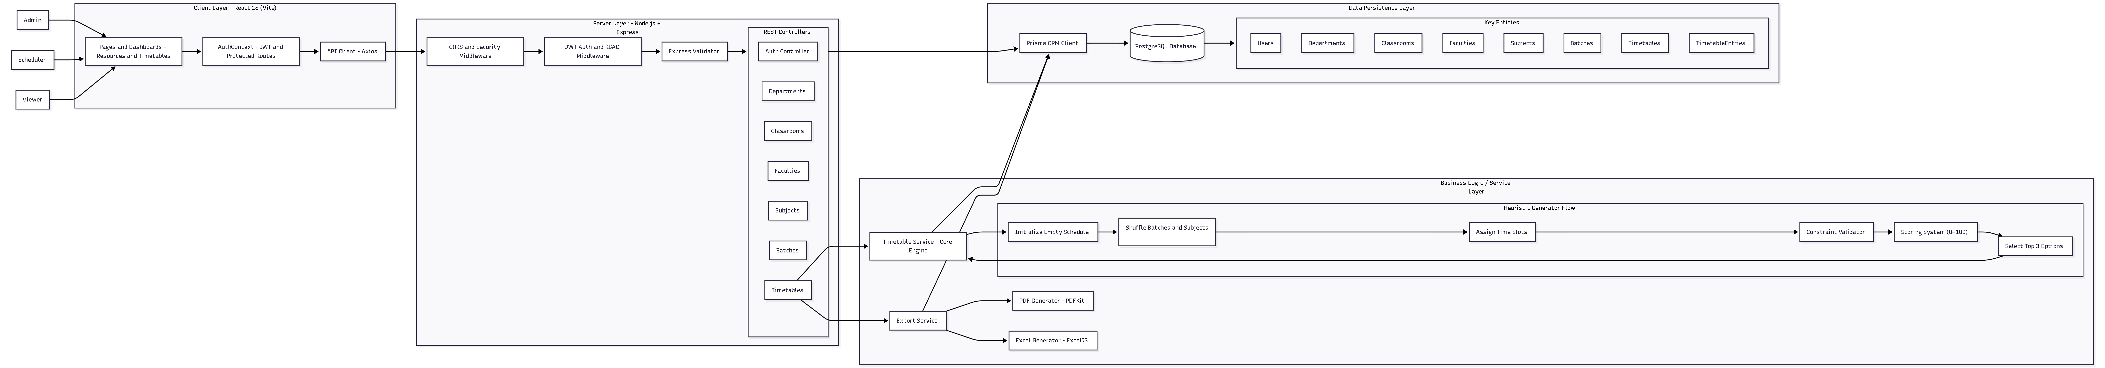
Architecture Diagram

Slide 13
Algorithm Details
It uses a "greedy" approach combined with randomization to solve the scheduling problem.
1. Hard Constraints
No Faculty Overlap: A single faculty member cannot be assigned to two different classes at the same time.
No Room Overlap: A classroom can only be occupied by one batch during any given time slot.
Room Capacity: The system ensures the assigned classroom can accommodate the number of students in the batch.
Fixed Slots: Any classes pre-assigned to specific times are placed first and locked.
Faculty Daily Limits: The algorithm respects the "max classes per day" setting for each teacher.
2. Soft Constraints (Optimization Targets)
The algorithm attempts to optimize these to improve the quality of the timetable.
Balanced Workload: Distributes teaching hours evenly across the work week for faculty.
Minimize Idle Time: Aims to reduce "gaps" or free periods for student batches between classes.
Classroom Utilization: Maximizes the efficient use of available room space.
3. Execution Logic
Initialization: Creates an empty 5-day × 7-slot grid.
Iterative Placement: For each batch and subject, it attempts to place classes in random slots, checking all hard constraints for every attempt.
Scoring System: Once a valid schedule is created, the system calculates an optimization score based on workload variance and student idle time.
Multi-Option Output: The system generates 3 different versions and ranks them by their scores so the Admin can choose the best one.

Slide 14
Source Code
The project is built using a modern TypeScript full-stack architecture.
Backend (Node.js & Express)
ORM: Prisma is used to manage 13 database models and ensure type safety between the code and PostgreSQL.
MVC Pattern: Organized into Controllers (Request handling), Routes (API endpoints), and Services.
Security: Uses Bcrypt for password hashing and JWT (JSON Web Tokens) for role-based authorization.
Frontend (React & Vite)
State Management: React Context API is used for global authentication and user session management.
Styling: Built with Tailwind CSS for a responsive, mobile-friendly design.
API Interaction: Uses Axios with interceptors to automatically include security tokens in every request.
Database Schema Highlights
The database is fully normalized with key relationships:
Departments link to Faculties, Subjects, and Batches.
Faculty ↔ Subjects and Batch ↔ Subjects use many-to-many junction tables.
Timetable Entries store the final generated data, including the specific Day, Slot, Room, and Faculty assigned.

Slide 15
Github Link
Github Link
https://github.com/Span-09/Smart-Classroom-and-Timetable-Scheduler-
Visibility : Public

Slide 16
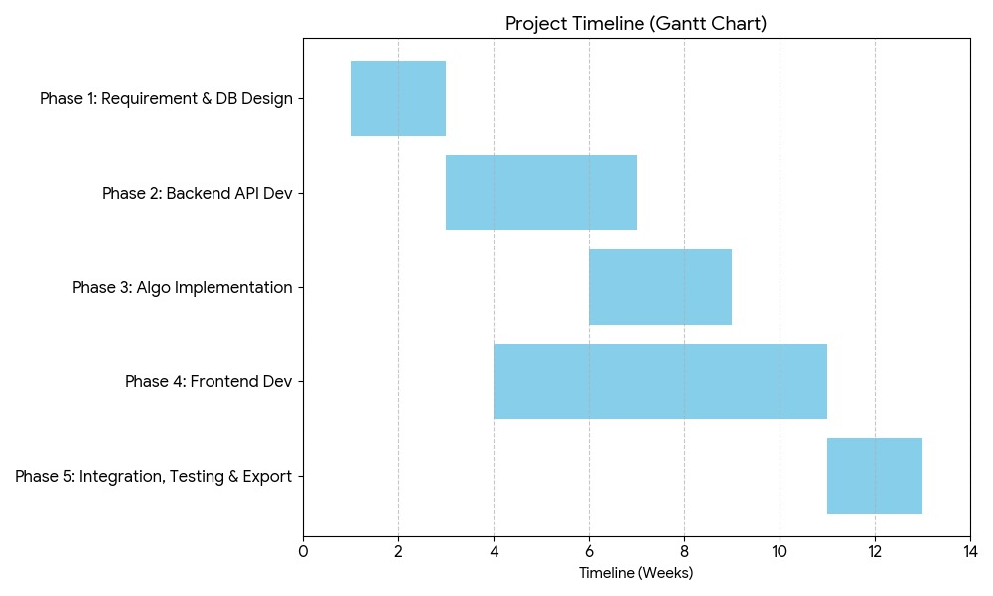
Timeline of the Project (Gantt Chart)

Slide 17
References (IEEE Paper format)
[1] S. A. K. Al-Hajri, "Automating Timetable Generation with Conflict Resolution Algorithms in Web-Based Systems for Educational Institutions," 2023 Intelligent Computing and Control for Engineering and Business Systems (ICCEBS), Bangalore, India, 2023, pp. 1-6.
[2] Z. L. Tan et al., "A Survey of University Course Timetabling Problem: Perspectives, Trends and Opportunities," IEEE Access, vol. 9, pp. 12111-12125, 2021.
[3] M. A. Al-Betar et al., "Automated Timetabling System for University Course," 2021 International Conference on Emerging Smart Computing and Informatics (ESCI), Pune, India, 2021, pp. 45-50.

Slide 18


