Slide 1
Youtube Ranking
Spandana Surapaneni 16186540
Bhuvana Atluri 16186197
Bhargavi Vepuri 16183984
Venkata Nagaraju Voonna 16188998

Slide 2
Login Page
In this we have username and password
We don’t accept wrong username
We don’t accept wrong password
We can recover the password if we forgot the password
We maintained the session in this, once you are logged in the session is maintained.

Slide 3
Search Page
In this we can search the required query in the text field provided using the given API and Jframes

Slide 4
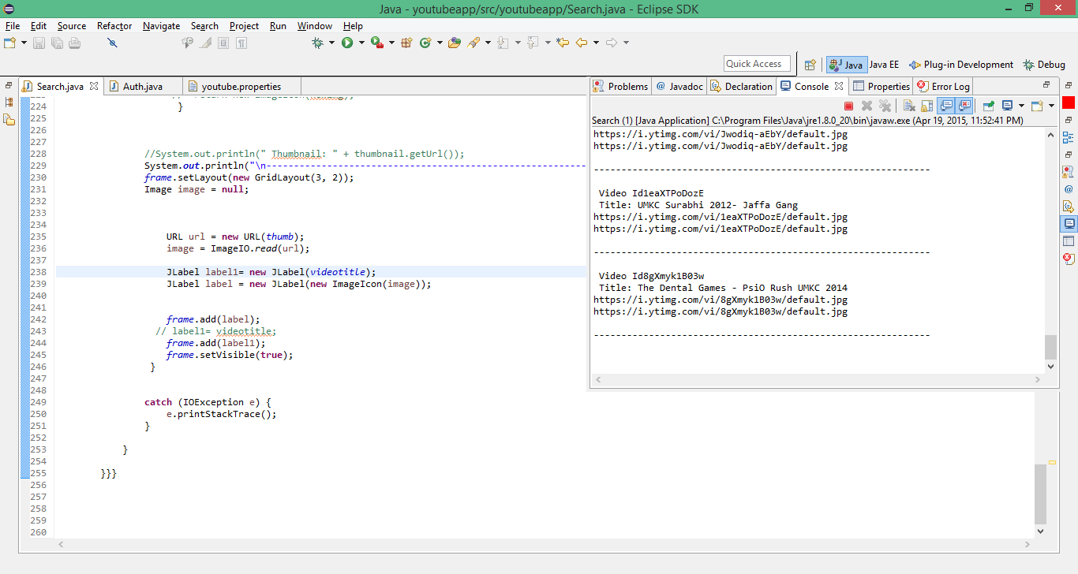

Slide 5
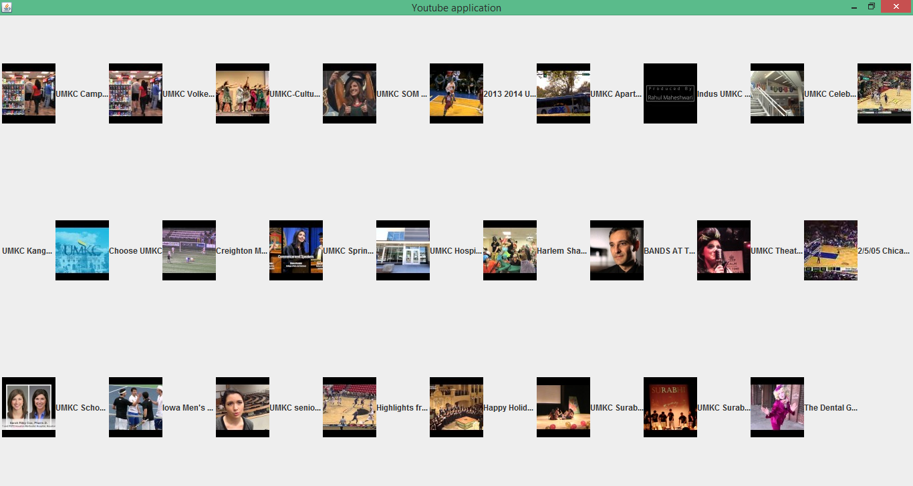

Slide 6
Priority
After searching the required query we started giving priority to the obtained search results
We gave the highest priority to the query that we searched recently

Slide 7
Logout Page
In this we maintained the session time so that once we are logged out, the session is not maintained

